Slide 1
Lesson Learnt
CADM number : 3D_JF_HER_019
Meghana and amrutha

Slide 2
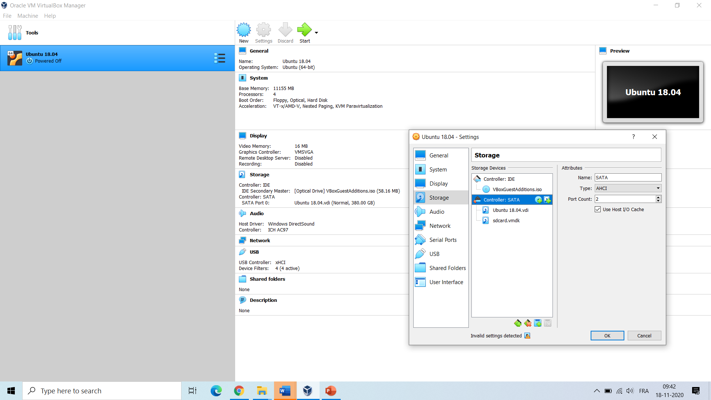
Error 1
Accessing SD Card from Linux VirtualBox Guest on Windows host
Solution:
Check Device ID for SD Card,
$wmic diskdrive list brief
Create Virtual Machine Disk file (VMDK) for SD Card,
$.\VBoxManage.exe internalcommands createrawvmdk -filename C:\sdcard.vmdk -rawdisk \\.\PHYSICALDRIVE1
Attach SD card VMDK to VM
Verify on ubuntu terminal,
$ sudo fdisk -l /dev/sdb
Link:
https://scribles.net/accessing-sd-card-from-linux-virtualbox-guest-on-windows-host/
SecureHospitals.eu
2
Notes:
By,
Amrutha NR
<number>

Slide 3
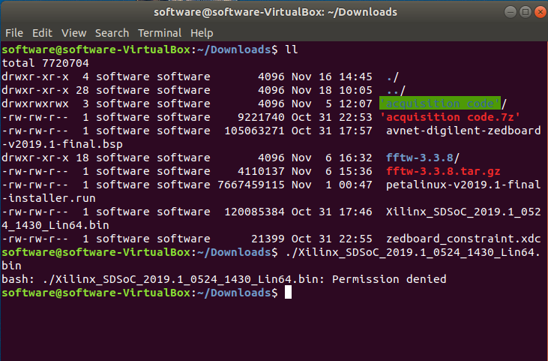
Error 2
Ubuntu says “bash: ./program Permission denied”
Solution:
During installation of SDSoC and petalinux ,
$sudo chmod u+x program_name
$./program_name
SecureHospitals.eu
<number>
Notes:
By,
Amrutha NR
<number>

Slide 4
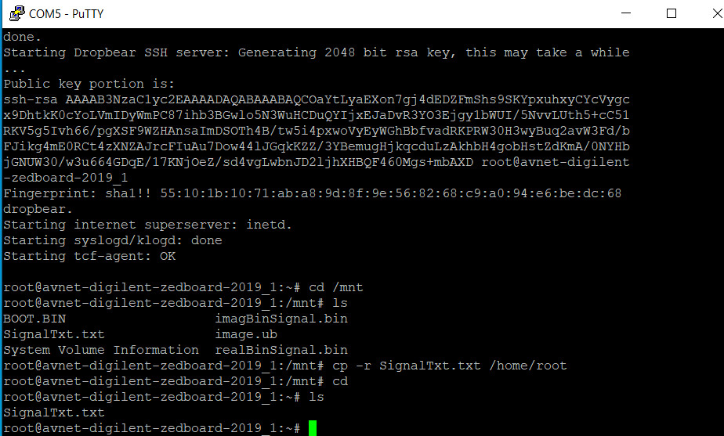
Error 3
Read a file in Xilinx SDSoC platform
Solution:
Copy the files from sd card to Petalinux root directory and read those file from petalinux root directory structure into C code running on SDSoC platform.
$cp –r SignalTxt.txt /home/root
SecureHospitals.eu
<number>
Notes:
By,
Amrutha NR
<number>

Slide 5
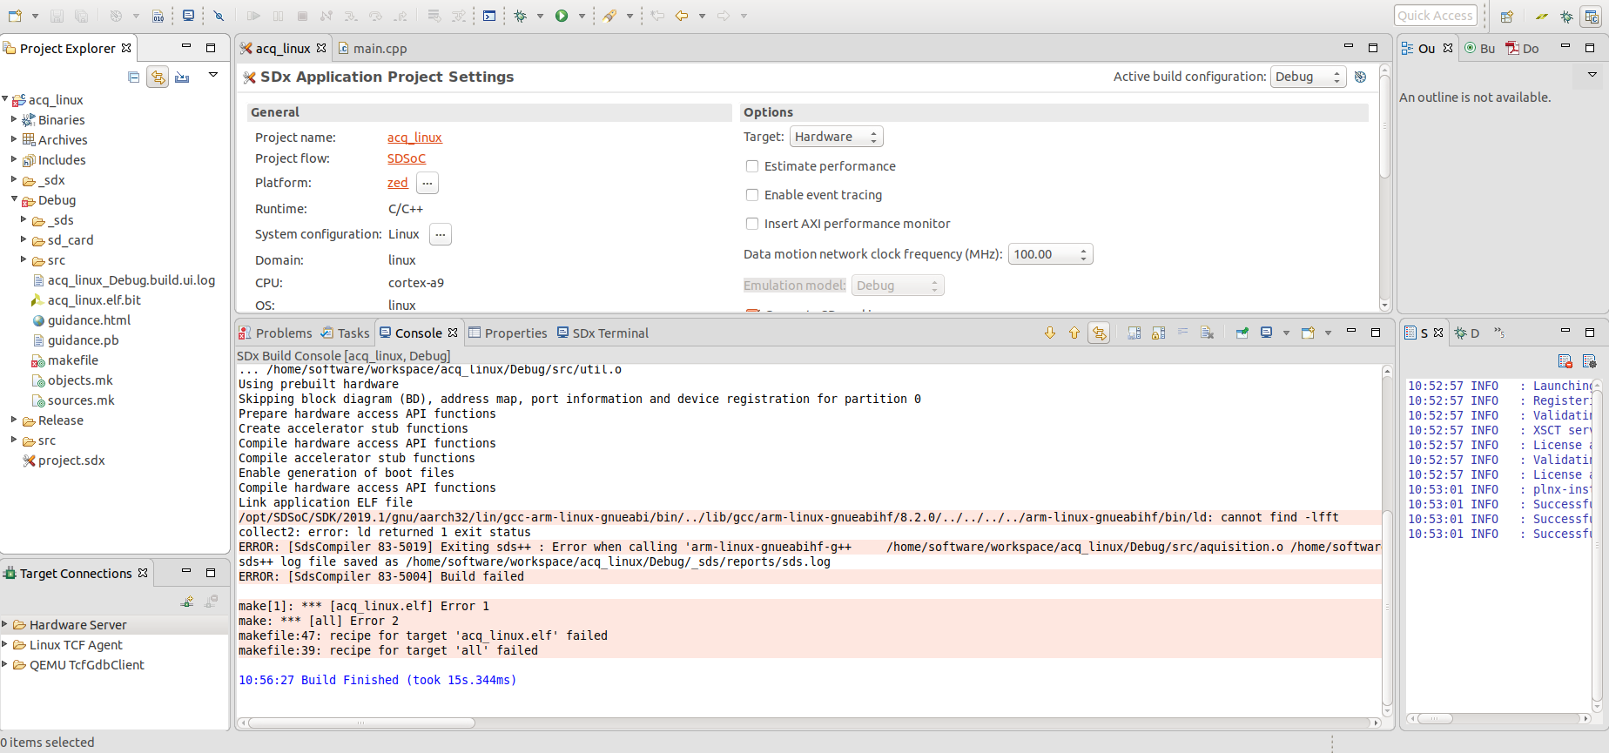
Error 4
FFT Cross Compilation error from 64 bit host machine to 32 bit execution file
Solution:
When library is not found/ Error adding symbols / file format not recognized, configure fftw3 library to the path of the compiler during fftw3 installation,
$.configure CC=:opt/SDSoC/SDK:2019.1/gnu/aarch32/lin/gcc-arm-linux-gnueabi/bin/arm-linux-gnueabihf-gcc --host arm --disable-fortan --config-cache
$make install
$sudo install
SecureHospitals.eu
<number>
Notes:
By,
Amrutha NR
<number>

Slide 6
Error 5
Cable drivers – software
Error Message :
xsct% WARNING: [Hsi 61-9] Current Software design may not be compatible with "memory_tests" app. Tool is ignoring the MSS file specified in the app directory attempting to launch hw_server
****** Xilinx hw_server v2018.2 **** Build date : Jun 14 2018-20:18:37 ** Copyright 1986-2018 Xilinx, Inc. All Rights Reserved.
INFO: hw_server application started INFO: Use Ctrl-C to exit hw_server application
INFO: To connect to this hw_server instance use url: TCP:127.0.0.1:3121
Solution:
cable drivers must be installed manually in the Ubuntu
https://www.xilinx.com/support/documentation/sw_manuals/xilinx2019_2/ug973-vivado-release-notes-install-license.pdf
SecureHospitals.eu
<number>

Slide 7

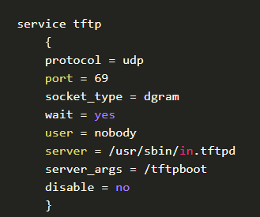
Error 6
Petallinux Installation
NOTE:
PetaLinux also needs a TFTP server setup and service running so that it can support TFTP booting on the target system if you choose so in any of your designs. In the /etc/xinetd.d/ directory create the following file by opening your text editor of choice:
Solution:
Then add the following
SecureHospitals.eu
<number>

Slide 8


Error 7
NOTE:
Create the directory for the TFTP service to pull files from such as the boot image file (BOOT.bin), kernel, device tree file, etc. to copy to the target during its boot up. Give the directory the appropriate permissions and give ownership to the same user specified in the TFTP service.
Solution:
Stop and restart the host machine's extended internet services for these changes to take effect.
SecureHospitals.eu
<number>

Slide 9
Error 8
Problem when downloading the IDE
./petalinux-v2019.1-finalinstaller.run: line 52: /proj/ petalinux/petalinuxv2019.1_daily_latest/ petalinux_installation_log: Permission denied
Solution:
Problem Description: This error message indicates that PetaLinux install directory does not have writable permissions.
Solution: Give 755 permissions to the install directory.
https://www.hackster.io/news/vivado-vitis-2019-2-install-on-ubuntu-18-04-lts-93242be6c9eb
https://www.hackster.io/news/vivado-vitis-2019-2-install-on-ubuntu-18-04-lts-93242be6c9eb
SecureHospitals.eu
<number>

Slide 10
Error 9
https://stackoverflow.com/questions/21951556/changing-the-owner-of-folder-in-linux#:~:text=1%20Answer&text=Use%20chown%20to%20change%20ownership,inside%20of%20a%20directory%20too.
https://www.youtube.com/watch?v=4U7PxdAwvM8
SecureHospitals.eu
10

Slide 11
Error 10
Error in SDx- while xreating opencv application
unrecognized command line option ‘-wstrict-align
https://forums.xilinx.com/t5/Vitis-Acceleration-SDAccel-SDSoC/unrecognized-command-line-option-mstrict-align/td-p/928402?_ga=2.170596898.327743438.1605606962-207701440.1588249171
Solution : wstrict-align is a machine dependent option (e.g. not supported/needed on all platforms/compilers)
In the settings of sds++ compliler, “Miscellaneous” – remove these lines from other flags “-Wno-overloaded-virtual -Wno-unused-label -Wno-strict-overflow -Wno-uninitialized -Wno-unused-function -Wno-unused-variable -Wno-unknown-attributes -Wno-unused-local-typedefs -Wno-sign-compare -mstrict-align -hls-target 1” and add “-hls-target 1” in Inferred options- software platforms.
SecureHospitals.eu
11

Slide 12
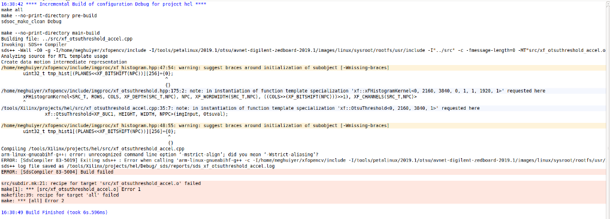
Error 10
SecureHospitals.eu
<number>

Slide 13
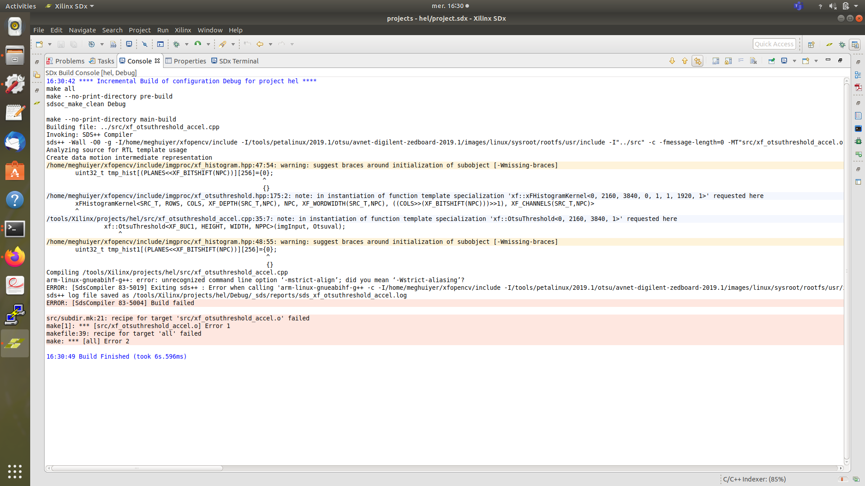
Error 11
Fatal error:
SecureHospitals.eu
<number>

Slide 14
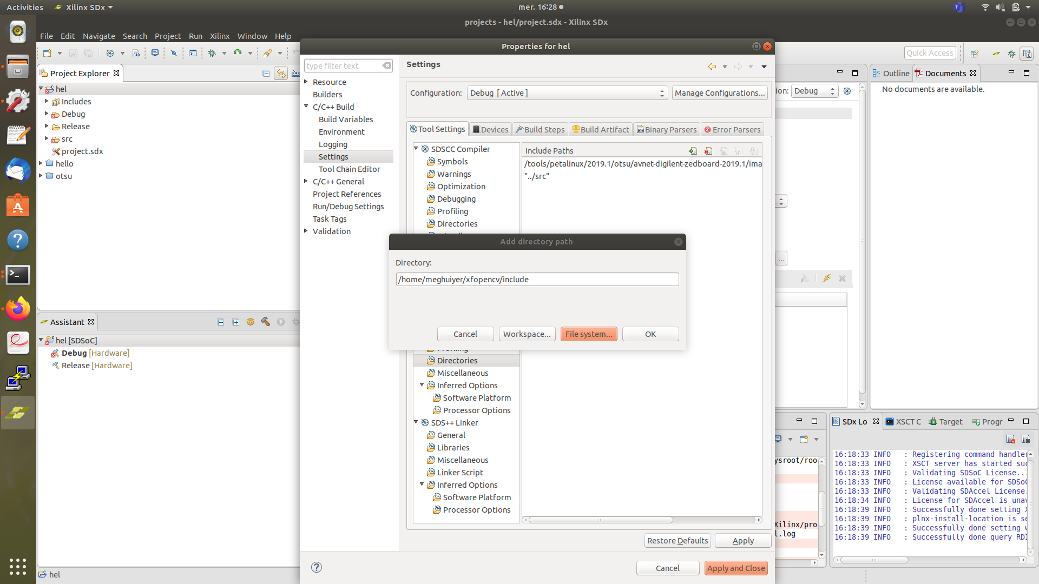
Error 11
Solution add the path as shown in the fogure
SecureHospitals.eu
14

Slide 15
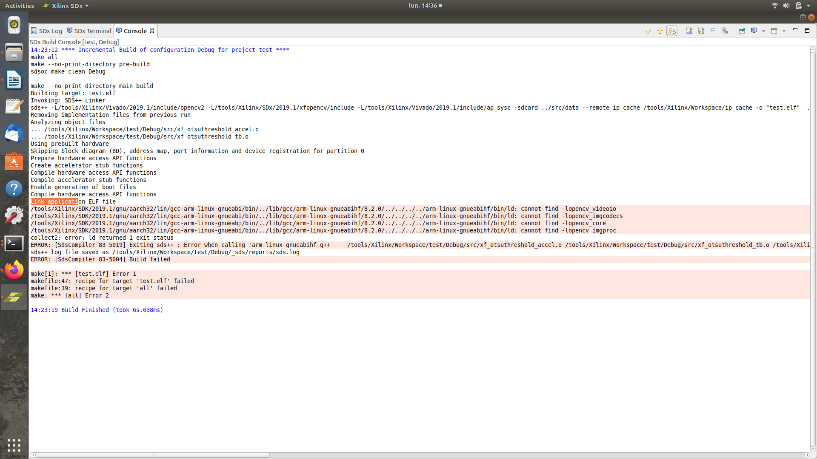
Error 12
Error in adding sysroot
When there is error in your petalinux project, the sysroot would be really a big pain! So make sure, unzip rootfs.tar.gz in a folder name sysroot and give the path. This would save up the cross complier issue or also can use to generate the sysroot folder.
Petalinux-build –sysroot
Petalinux-package –sdk
SecureHospitals.eu
15

Slide 16
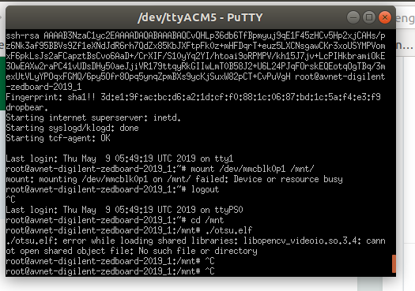
Error 13
Error on sd card while excuting the iso image
Solution: once we build the project, we should actually create a boot.bin and image.ub file with the bit stream generated in the sdx application usibg the follwing command
Petalinux-package --boot --format BIN --fsbl ../images/linux/zynq_fsbl.elf --fpga <path to project>/release/_sds/p0/vivado/vpl/output/system.bit –u-boot ../images/linux/ u-boot.elf
Petalinux-package --boot --fsbl zynq_fsbl.elf --fpga<path to the project> fpga <path to project>/release/_sds/p0/vivado/vpl/output/system.bit --u-boot --force
SecureHospitals.eu
<number>

Slide 17
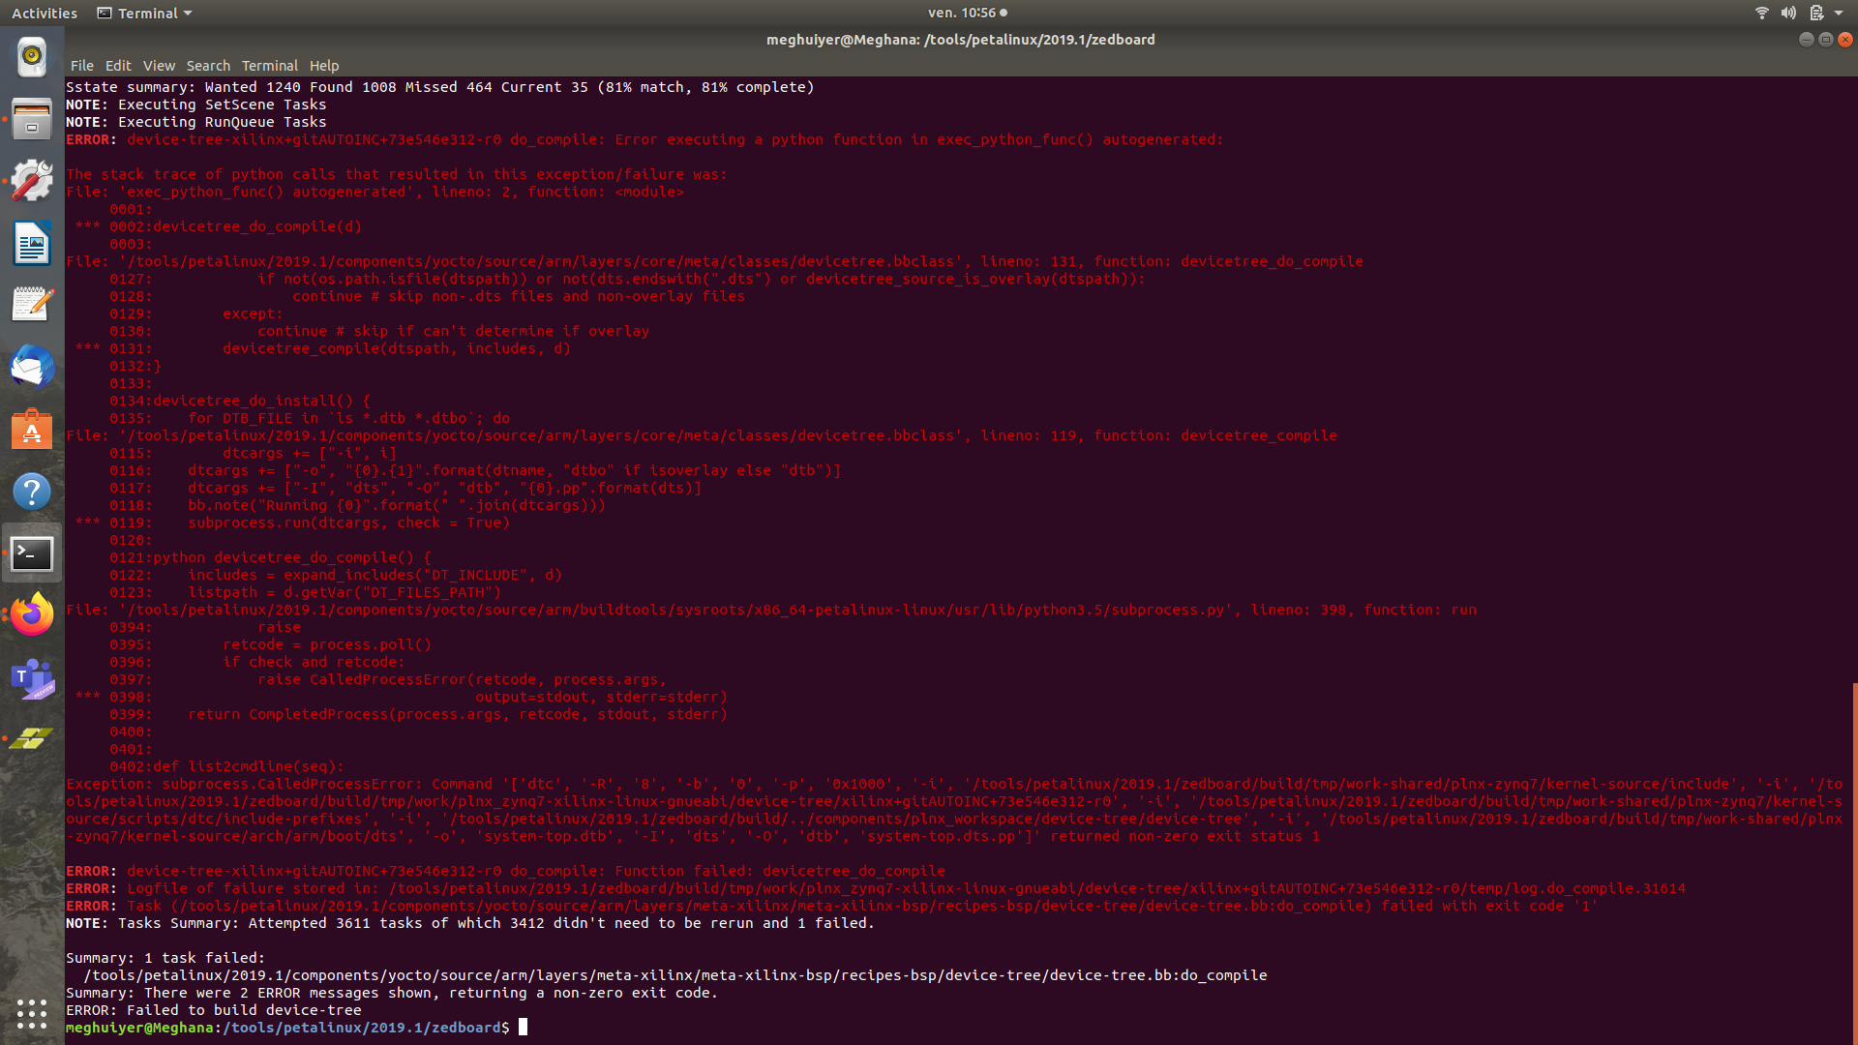
Error 14
Petalinux project building error
Solution: delete the petalinux project, create new one and make sure you have enough space almost 100gb. This generally is because of not properly generated hardware description file from DSA file (step2 of petalinux project)
SecureHospitals.eu
17

Slide 18
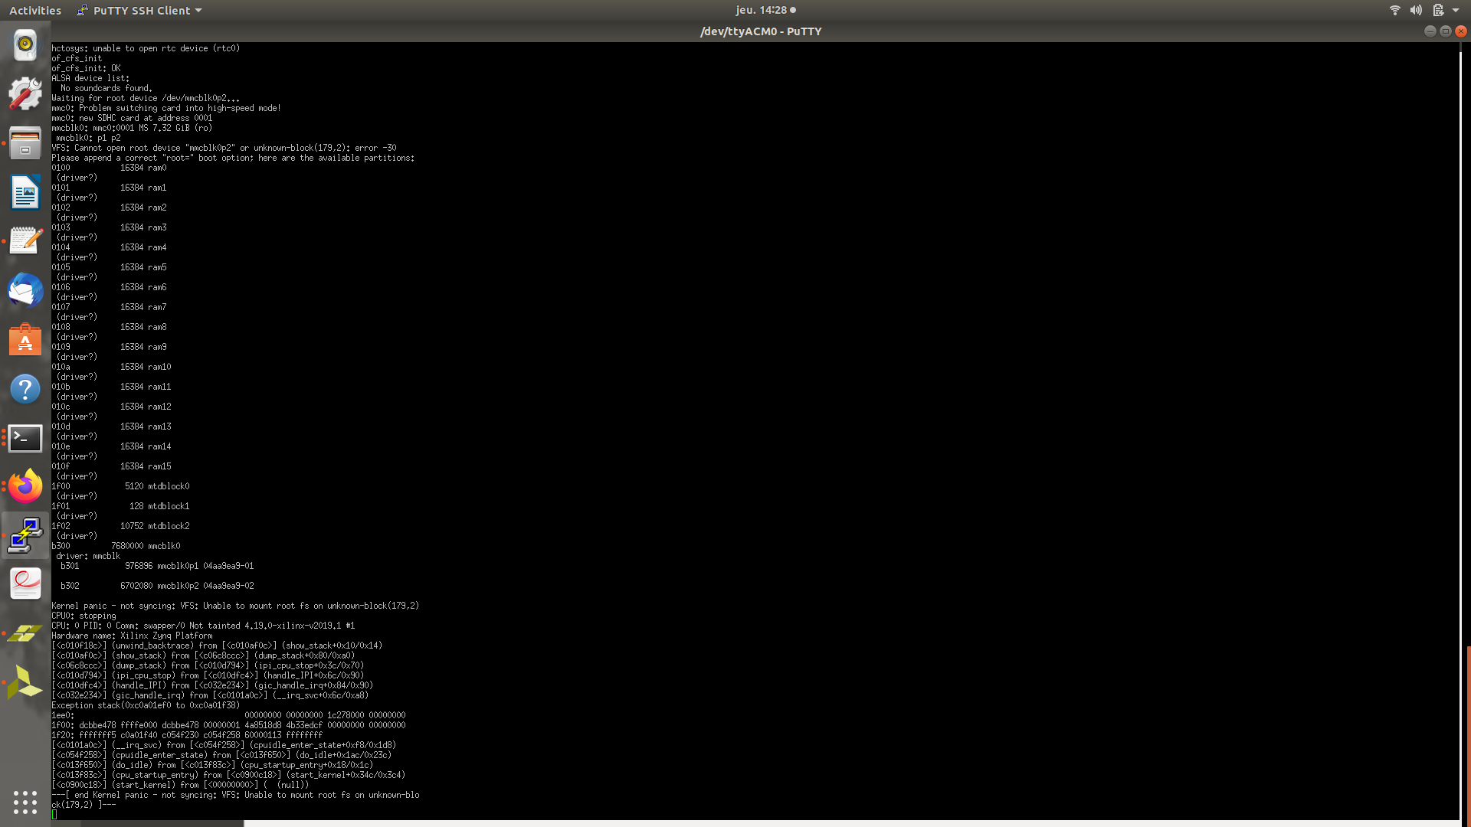
Error 15
SD card: kernel panic
Solution: format both partition FAT32 and EXT4, re-do the file transferand
Umount /dev/sdc1, umount /dev/sdc2 and eject to not have kernel panic
SecureHospitals.eu
<number>

Slide 19
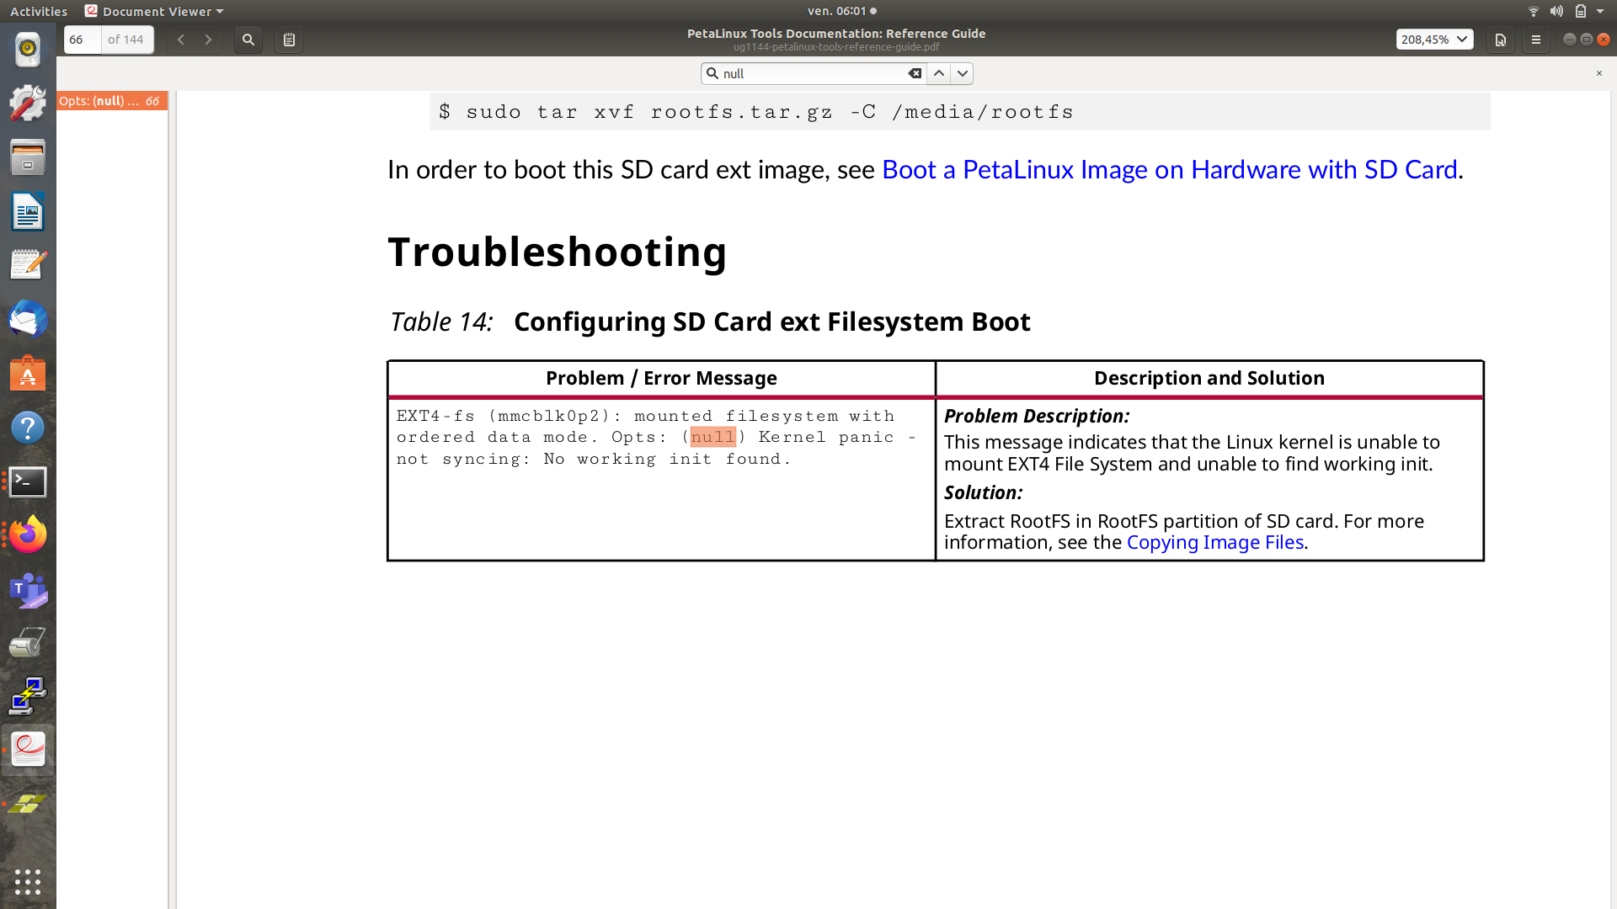
Error 16
SD card: another type of kernel panic
SecureHospitals.eu
19

Slide 20
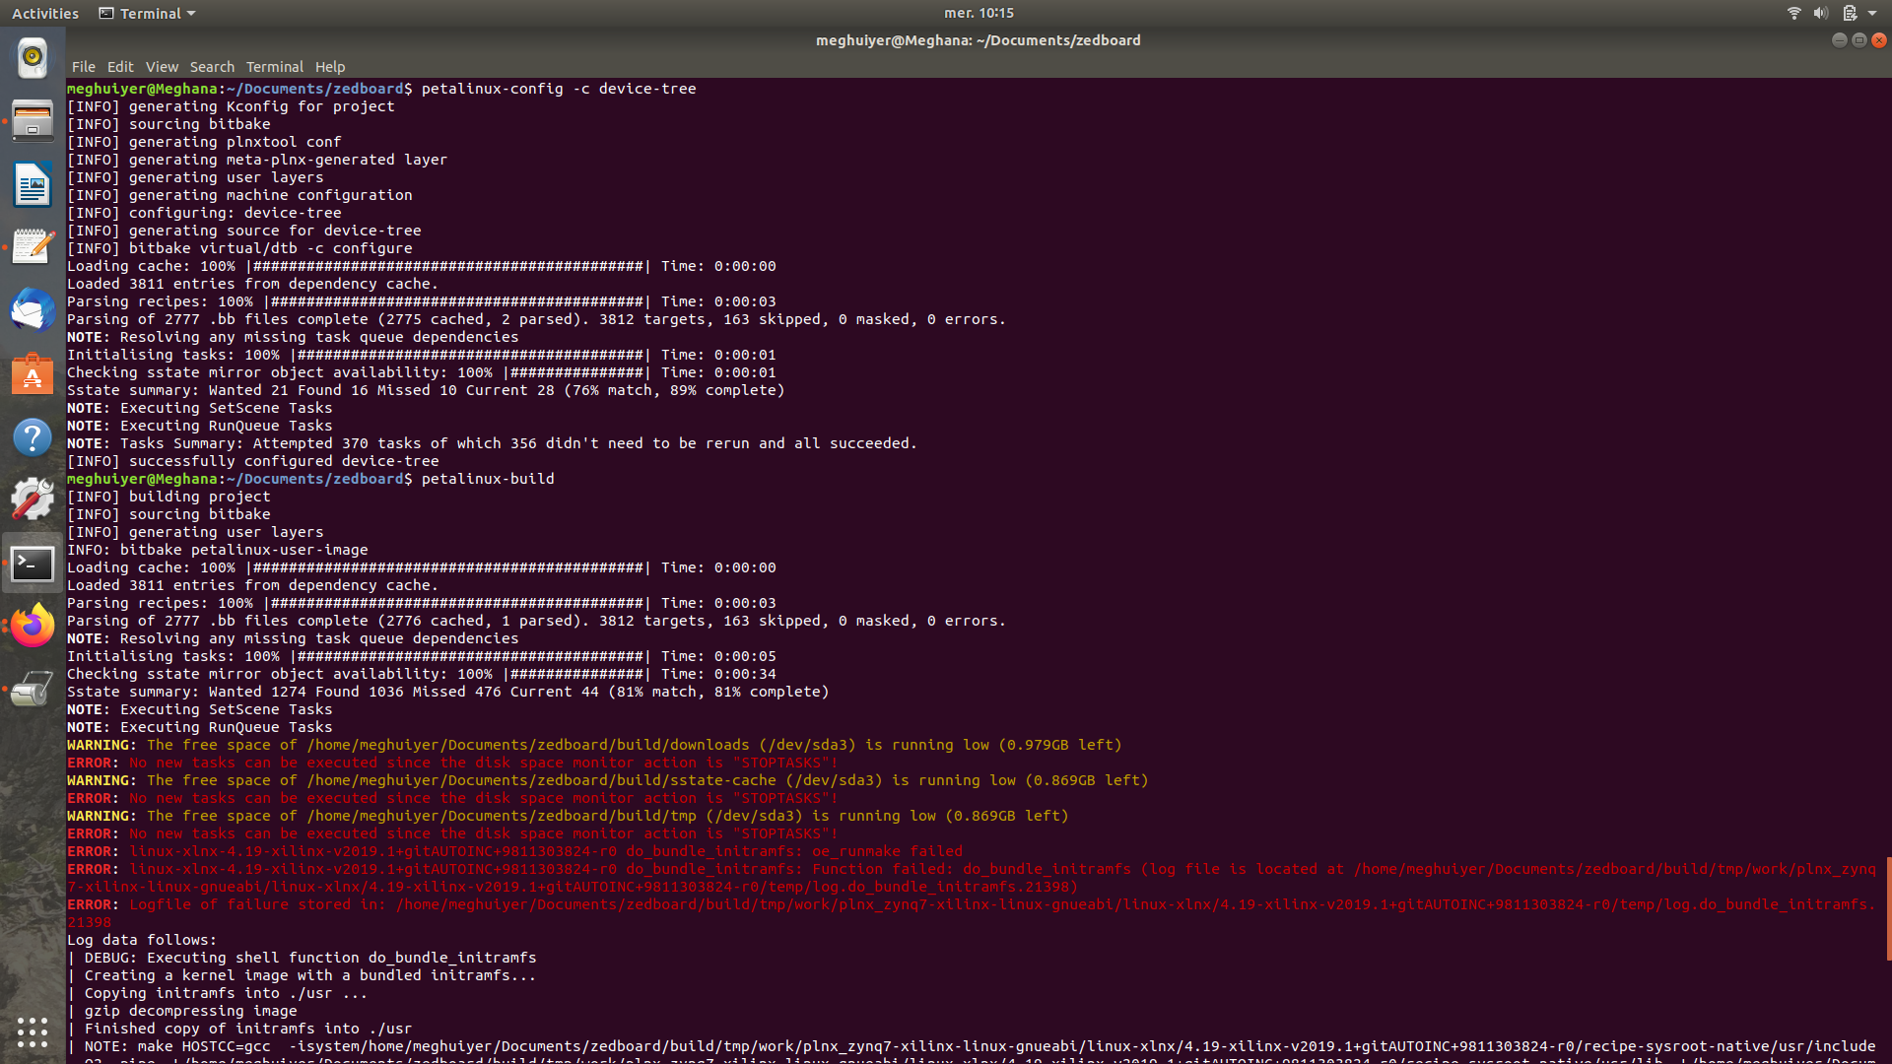
Error 17
Another version of petalinux-build error
<number>

Slide 21
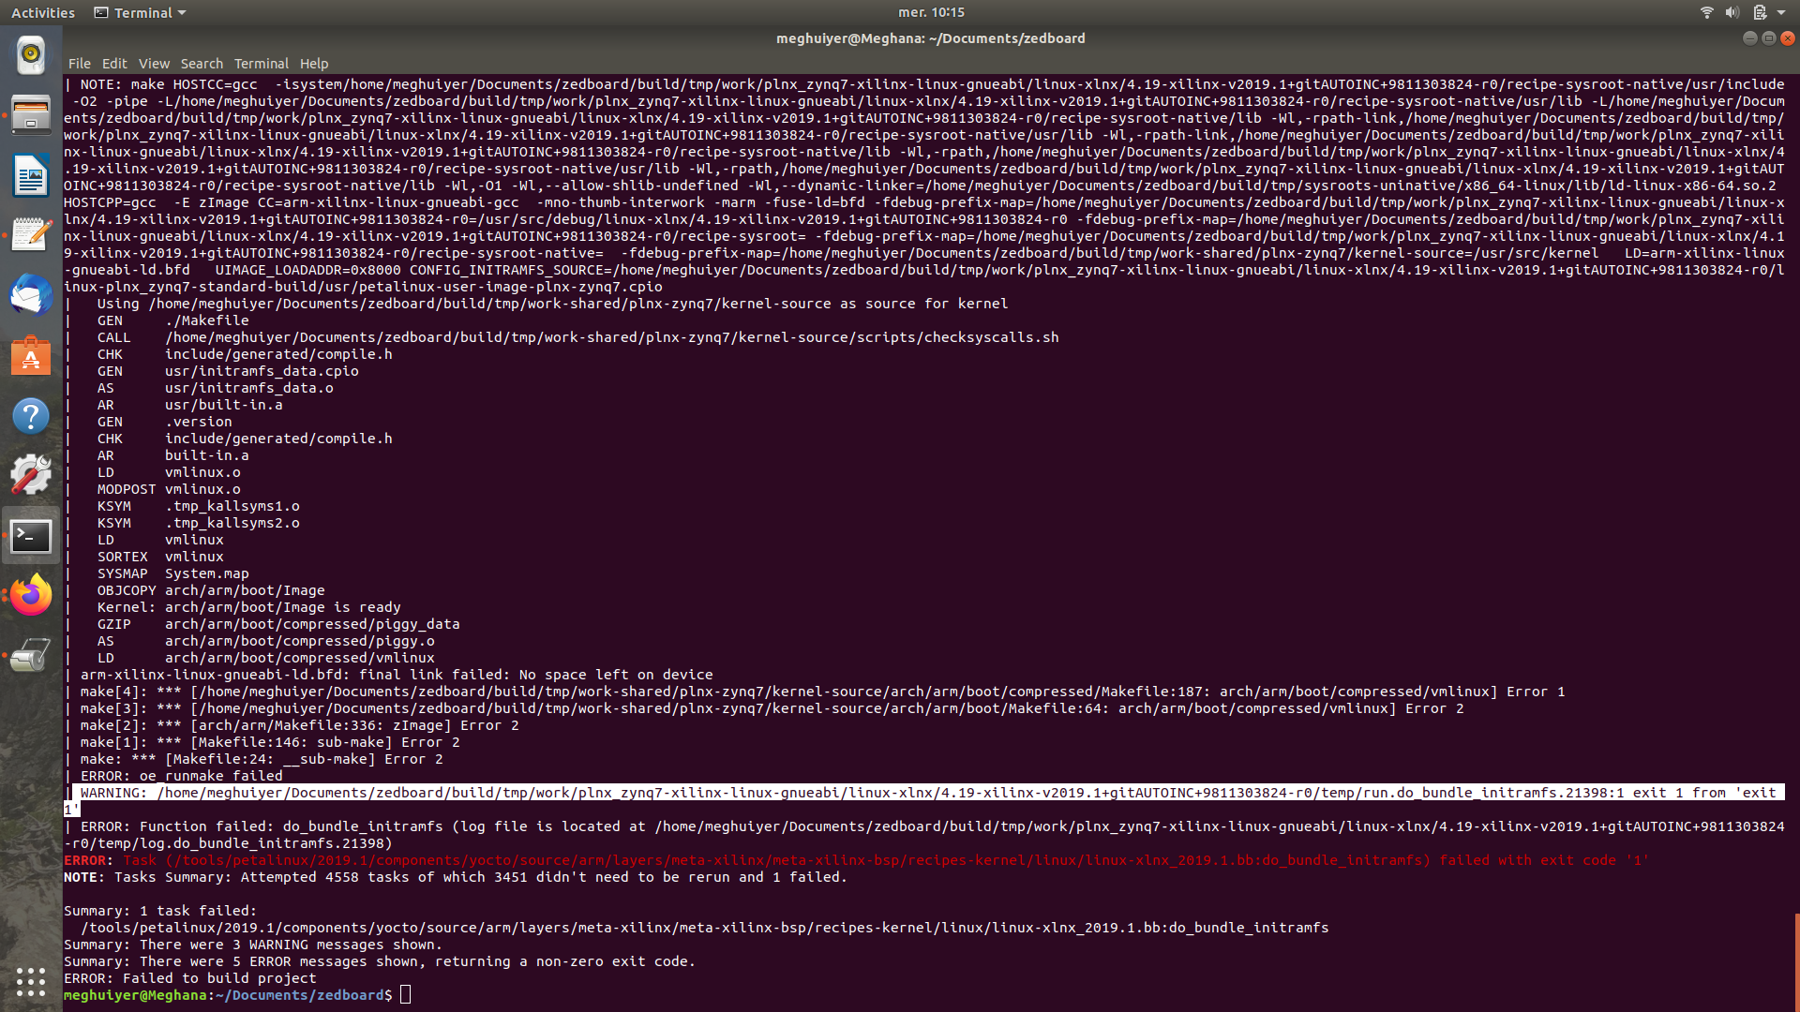
Error 17
Another version of petalinux-build error
21

Slide 22
Error 18
JTAG
SecureHospitals.eu
22

Slide 23
Error 19
Cable drivers
SecureHospitals.eu
23

Slide 24
Error 20
SecureHospitals.eu
24

Slide 25
Error 21
SecureHospitals.eu
25

Slide 26
Error 22
SecureHospitals.eu
26

Slide 27
Error 23
SecureHospitals.eu
27

Slide 28
Error 24
SecureHospitals.eu
28

Slide 29
Error 25
SecureHospitals.eu
29

Slide 30
Error 26
SecureHospitals.eu
30

Slide 31
Error 27
SecureHospitals.eu
31

Slide 32
Error 28
SecureHospitals.eu
32

Slide 33
Error 29
SecureHospitals.eu
33

Slide 34
Error 30
Machine Learning: Using the SORT tracker
Modification of the SORT parameters:
The module I was using did not provide me with a lot of flexibility in terms of modification of the core parameters of the Sort tracker. My guess is that the parameters were referenced somewhere else in the module as well, so whenever I tried to change it, the code broke.
I overcame this problem by rewriting the implementation part from scratch, so that I can have more granular control of the SORT parameters. This step, combined with a little tuning of these parameters, was able to bring down the number of misaligned tracks by a significant amount.
Problem
Tracker was switching IDs very often
Miscounting of objects
Could not provide the class IDs to the JSON
Details
I was previously using the tracker provided as a Python module, as a result I was not being able to modify the parameters of the Sort instance to my liking without breaking the code.
Fix
There are two available fixes for this problem:
Modify the SORT parameters
Use a better tracker
Fixed the problem of assigning the class IDs by modifying the underlying source code of the SORT algorithm. Initially it used to return a numpy array of [x1, y1, x2, y2, track_id]. I added an extra field in the numpy array such that now it returns the class id as well.
Using a better tracker to handle occlusions:
The SORT tracker, while being an impressive tracker, still has its limitations. This comes into view when the objects are close together, and the tracked objects get occluded. The DeepSORT tracker uses a Deep Neural Network to improve the association metrics of the SORT algorithm. I am still looking into the implementation of the training part required for this tracker to be able to be implemented.
Initial
[ x, y, w, h, conf]
update()
[ x1, y1, x2, y2, track_id]
Final
[ x, y, w, h, conf, class_id]
update()
[ x1, y1, x2, y2, track_id, class_id]
SecureHospitals.eu
34

Slide 35

SecureHospitals.eu
<number>

