Slide 1
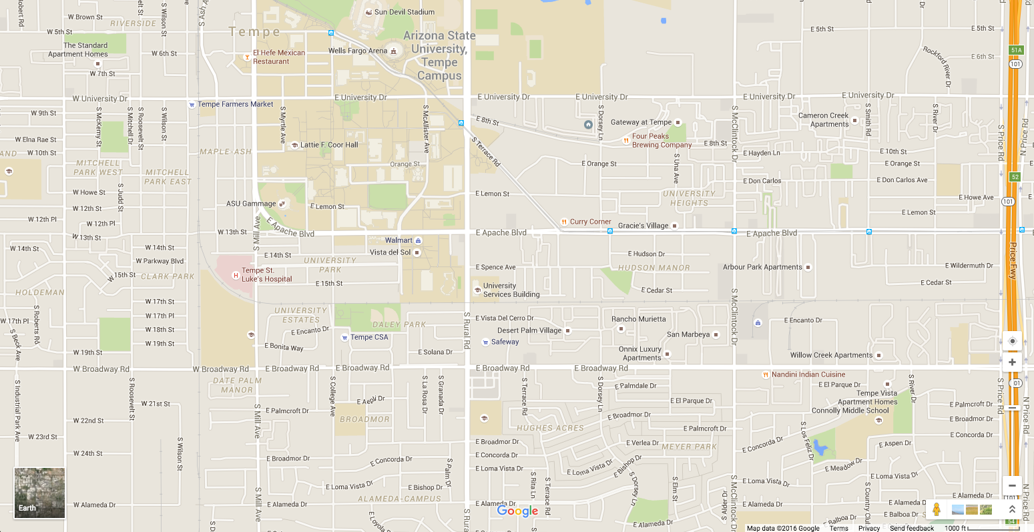
Prof
Yuhan
Azmat
Anique
Nitin
Jia
G
H
F
D
K
I
C
R
J
A
E
B

Slide 2
C
0.6
0.7
A
I
0.4
0.8
B
0.5
0.2
D
0.9
H
0.65
G
1
F
E
1 |  |  |  |  |  |  | 8
 |  |  |  |  |  |  | 16
1
2
3
4
5
6
7
9
10
11
12
13
14
15
Notes:
Change 15, 16
Rows should be of same color

Slide 3
0.7
I
C
G
0.6
0.4
A
F
0.8
0.65
B
0.2
0.5
H
0.9
D
1
F
E
1 | 2 | 3 | 4 | 5 | 6 | 7 | 15
8 | 9 | 10 | 11 | 12 | 13 | 14 | 16
Notes:
Change 15, 16
Rows should be of same color

Slide 4
1 | 2 | 3 | 4 | 5 | 6 | 7 | 8
9 | 10 | 11 | 12 | 13 | 14 | 15 | 16
17 1,2,9,10 | 18 3,4,11,12 | 19 5,6,13,14 | 20 7,8,15,16
21 17, 18,19,20

Slide 5
0.7
I
C
G
0.6
0.4
A
F
0.8
u
B
0.65
0.2
0.5
H
0.9
v
D
1
F
x
E
1 | 2 | 3 | 4 | 5 | 6 | 7 | 8
9 | 10 | 11 | 12 | 13 | 14 | 15 | 16
R

Slide 6
C
0.7
0.6
A
F
I
0.4
0.8
B
0.5
0.2
0.9
H
u
D
G
1
0.65
F
x
v
E
1 | 2 | 3 | 4 | 5 | 6 | 7 | 8
9 | 10 | 11 | 12 | 13 | 14 | 15 | 16
X
Notes:
Change 15, 16
Rows should be of same color

Slide 7
C
0.6
0.7
A
I
0.4
0.8
B
0.5
0.2
D
0.9
H
0.65
G
1
u
F
E
x
v
1 | 2 | 3 | 4 | 5 | 6 | 7 | 8
9 | 10 | 11 | 12 | 13 | 14 | 15 | 16
X
Notes:
Change 15, 16
Rows should be of same color

