Slide 1



PhishingGuard 2024 - 2025
Anti-Phishing protection
GenAI-2024-2025-B1-0040
GenAI-2024-2025-B1 | v1.0.2

Slide 2






PhishingGuard
GenAI-2024-2025-B1-0040
Team Information
Yogeshwar.P
Yogeshwaran.G
Nitha Vinod.T
Ratheesh.R
Student Team
IV CST
Frontend and integration with backend
IV CSE (IoT)
Backend development & Database management
IV CST
Wireframes & helping in development process
IV EEE
UI\UX design & and frontend work
Nivetha.A
Kavipriya.V
Faculty
Project Guide
Technology Mentor

Slide 3
PhishingGuard
GenAI-2024-2025-B1-0040
Project Overview
Requirement / Problem statement
Enhancing phishing detection with machine learning solutions.
Description
Enhancing online security and reducing phishing attacks through advanced machine learning solutions to ensure secure and reliable web interactions and protect users from malicious websites.
Scope
GenAI | AI
The Phishing URL Detection System is a real-time web platform using machine learning to analyze and assess phishing risks, offering secure, user-friendly protection for individuals and businesses. Key benefits include enhanced security and adaptability to emerging threats.
The Phishing URL Detection System uses the Gemini API and AI for real-time phishing risk analysis.
Key factors & features
Target Audience
Domain
The Phishing URL Detection System enhances online security with real-time detection, accuracy, scalability, and risk reporting.
The system targets users, businesses, and cybersecurity professionals seeking protection from phishing threats.
The system applies to cybersecurity, AI, web development,

Slide 4
PhishingGuard
GenAI-2024-2025-B1-0040
Project Features
Project Features / Journeys
Project Features:
Real-time URL analysis
Phishing risk assessment
Risk reporting and alerts
User-friendly interface
Epics:
URL Analysis Engine
Risk Reporting System
User Interface
Scalability and Integration
User Stories:
User receives real-time risk reports for URLs.
Cybersecurity professionals monitor multiple URLs.
Businesses receive alerts for high-risk URLs.
Journeys:
User submits URL → Risk report generated.
Admin configures thresholds → Real-time alerts received.
Use Cases:
User checks URL for phishing. Business secures network from phishing.

Slide 5
PhishingGuard
GenAI-2024-2025-B1-0040
Technology Stack
Presentation Layer
Methodology
Thgcgcgfccgcg
Provide methodologies used in the project
Application Layer
Products, Tools & Utilities
Provide list of technologies used in Application layer
Provide list of tools and utilities used in your project
Data Layer
Infrastructure
Provide list of technologies used in Data layer
Provide details of infrastructure used in your project including cloud as required and as applicable.
Source Code
API
Project code repository is available at Link
Provide details of APIs used with source URL
Note: Artefacts locations are provided as clickable hyperlink available as “Link”

Slide 6
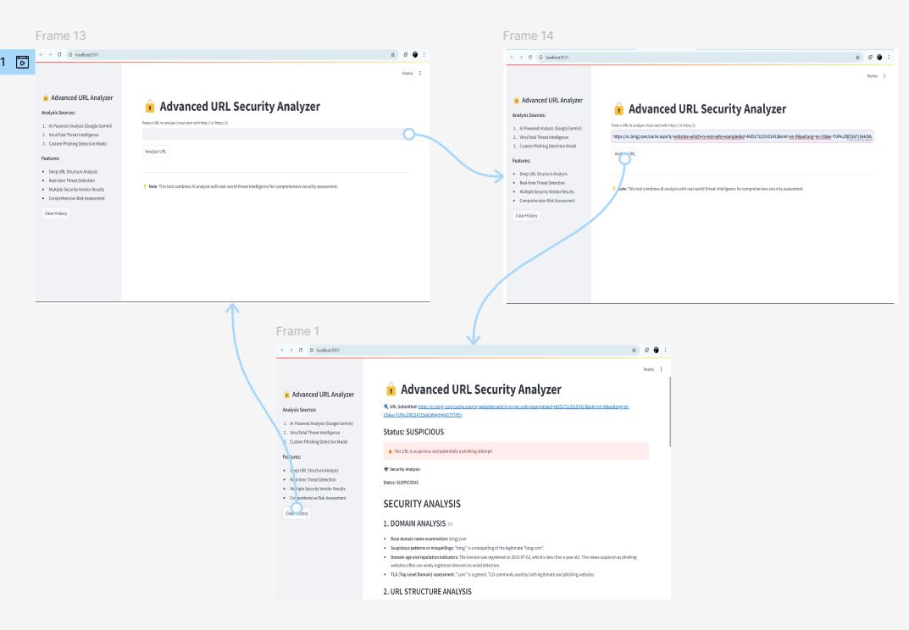
PhishingGuard
GenAI-2024-2025-B1-0040
Wireframe | UI
Wireframe | UI

Slide 7
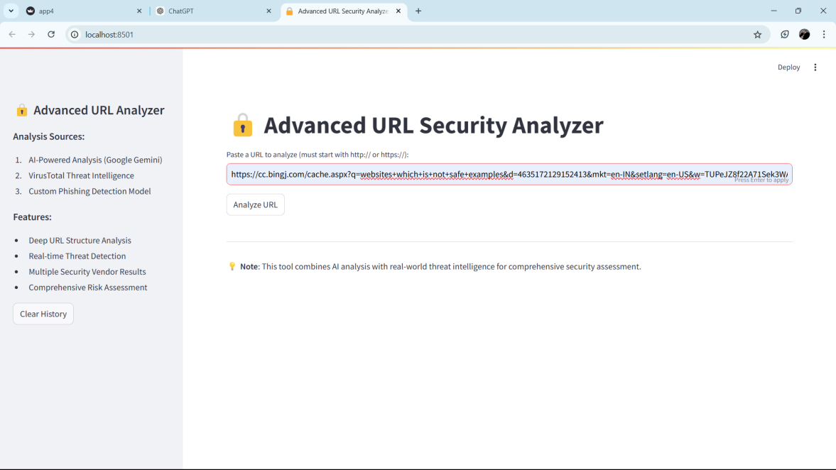
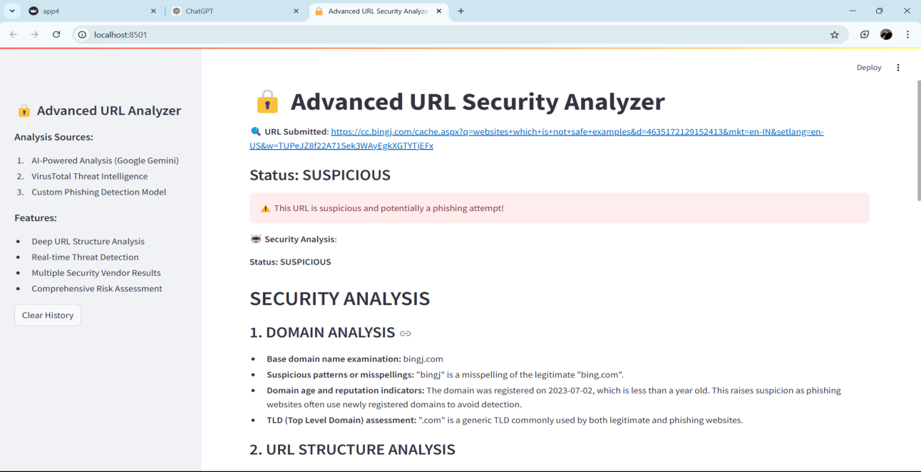
PhishingGuard
GenAI-2024-2025-B1-0040
Application Screenshots
Application Screenshots

Slide 8
PhishingGuard
GenAI-2024-2025-B1-0040
Project / Product Roadmap
Project / Product Roadmap | Milestones | Features
Short Term | Mid Term | Long Term
Develop core functionality with URL analysis and risk assessment, and implement a basic Streamlit interface for real-time reporting. Conduct internal testing and fine-tune the detection model. | Integrate machine learning for advanced phishing detection and implement real-time alerts. Enhance scalability and gather user feedback to improve detection accuracy and interface usability. | Enhance system adaptability with continuous learning from evolving phishing threats and expand API access for business integration. Focus on improving cross-platform scalability and expand the system to serve a wider range of industries.

Slide 9
PhishingGuard
GenAI-2024-2025-B1-0040
Artefacts
Project Portal
Wireframe | UI
Project Portal / website is available at Link
Project wireframe / UI designs are available at Link
Presentation
Application
Project presentation (this document) is available at Link
Application is available at Link
Requirement Document / Specification
DT Playbook
Project requirement document / specification is available at Link
Project DT Playbook is available at Link
Technical Document / Specification
Overview Video
Project technical document / specification are available at Link
Project overview video is available at Link
Video provides project overview, presentations, journey wise Wireframe, UI, application demo as required and as applicable.
Source Code
Project code repository is available at Link
Note: All links are provided as clickable hyperlink available as “Link”

Slide 10
PhishingGuard
GenAI-2024-2025-B1-0040
Thanks
Thanks

