Slide 1
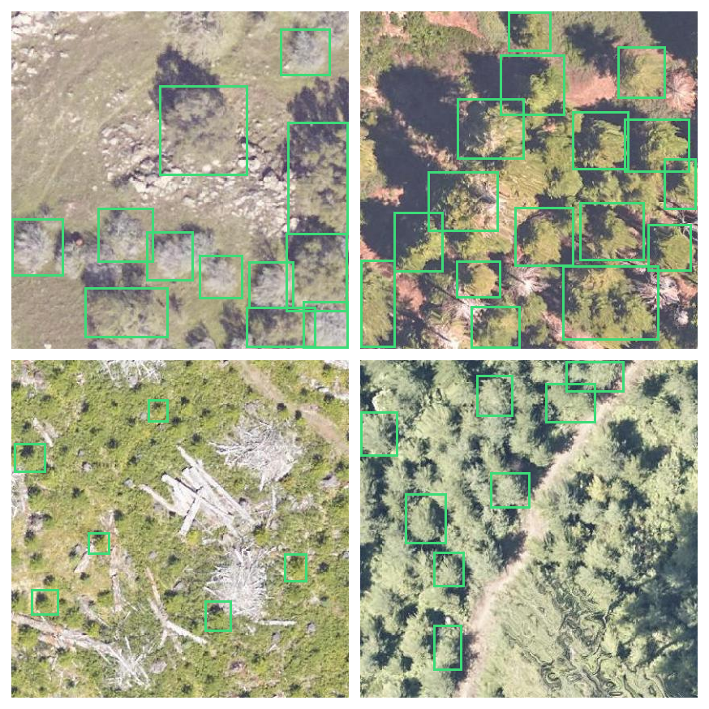
MINI PROJECT · PROJECT REVIEW
Tree Counting
Using Drone Images
Automatic detection and counting of tree canopies
from aerial imagery using YOLOv11
Nitheesh · Nishu Kumari · Astley
Guided by our project mentor

Slide 2
THE PROBLEM
Counting trees by hand does not scale
Slow. A field survey of a single plantation block can take days of manual walking and tallying.
WHO NEEDS THIS
Expensive. Forestry and agriculture teams spend most of the survey budget on labour, not analysis.
Forestry and plantation management
Agriculture and orchard yield planning
Inconsistent. Two surveyors counting the same plot rarely agree, and nobody can audit the result later.
Environmental and carbon monitoring
Urban green cover surveys
Not repeatable. Yearly monitoring means paying the full cost again, every single year.
Drones already fly over these sites. The images exist. What is missing is a system that reads them.
Tree Counting Using Drone Images
2

Slide 3
OBJECTIVES
What we set out to build
01
Detect
Locate every individual tree canopy in a top-view drone image with a bounding box.
02
Count
Turn those detections into a reliable total count per image and per surveyed area.
03
Train
Train and tune a YOLOv11 detector on a real annotated aerial dataset.
04
Evaluate
Measure quality with standard detection metrics plus a counting accuracy metric.
05
Ship
Leave behind a reproducible pipeline that a non-author can clone and rerun.
Tree Counting Using Drone Images
3

Slide 4
OUR APPROACH
Detection first, counting second
We treat tree counting as an object detection problem, not a regression problem.
Density regression
Object detection (our choice)
Predicts a count directly from the image.
Predicts a box per tree, then counts the boxes.
Gives you a number and nothing else. You cannot see which trees it found, so you cannot debug it or trust it.
The count is explainable. Every tree is visible on the image, mistakes are visible too, and the same output feeds mapping and health analysis later.
WHY YOLOv11
Single stage
Small objects
Mature tooling
Deployable
One forward pass per image, fast enough for large image batches
Anchor-free head handles the dense, small canopies in our data
Ultralytics gives training, validation and export out of the box
Nano and small variants can run on modest hardware in the field
Tree Counting Using Drone Images
4

Slide 5
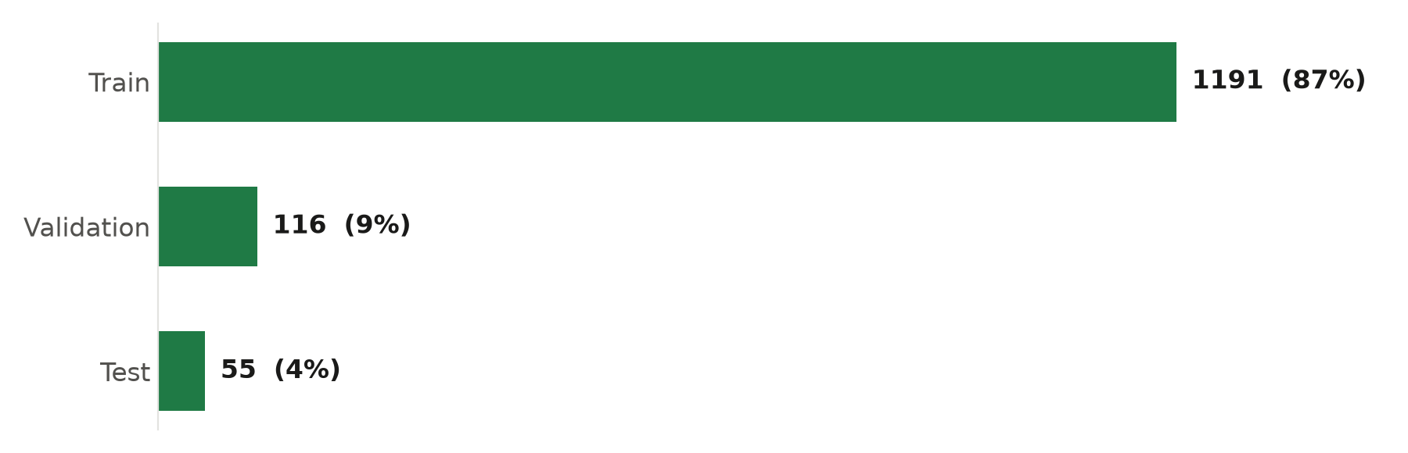
DATASET
Tree-Top-View, an annotated aerial dataset
1,362
11,377
8.4
1
annotated aerial images
labelled tree canopies
trees per image on average
class: tree-top
SPLIT USED FOR TRAINING
AT A GLANCE
Source
Roboflow Universe
Format
YOLOv11
Resolution
416 x 416 px
Licence
CC BY 4.0
Scenes
Forest, plantation, mixed terrain
Tree Counting Using Drone Images
5

Slide 6
DATASET SAMPLES
What the model has to learn
Four validation images with their ground truth boxes
Canopies overlap and touch, so boxes overlap too
Tree colour is close to grass and shrub colour
Shadows and bare ground look like canopies
Scale varies widely inside a single image
Some scenes are dense forest, others are sparse
This is why a naive colour or blob threshold fails, and why a trained detector is worth the effort.
Tree Counting Using Drone Images
6

Slide 7
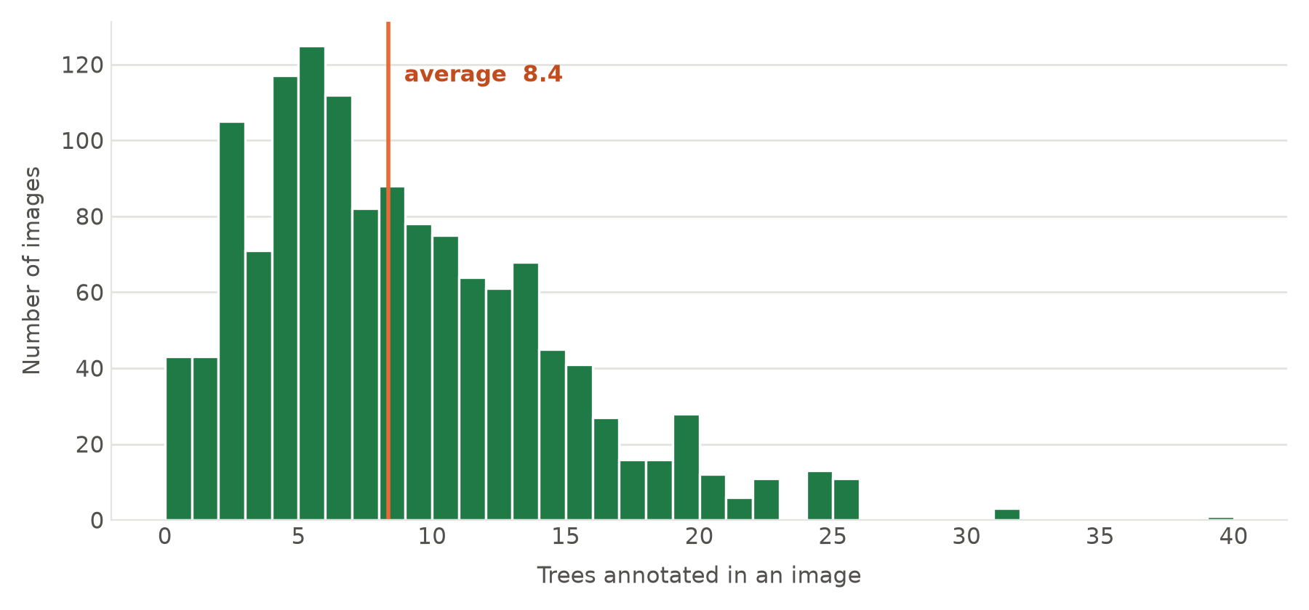
DATA ANALYSIS
How many trees are in a typical image
DISTRIBUTION OF ANNOTATIONS PER IMAGE
WHAT WE READ FROM IT
Most images hold 3 to 15 trees
The tail runs to 40 in one image
43 images have no trees at all, useful as negative examples
Counting error will scale with density, so we report it by band
Tree Counting Using Drone Images
7

Slide 8
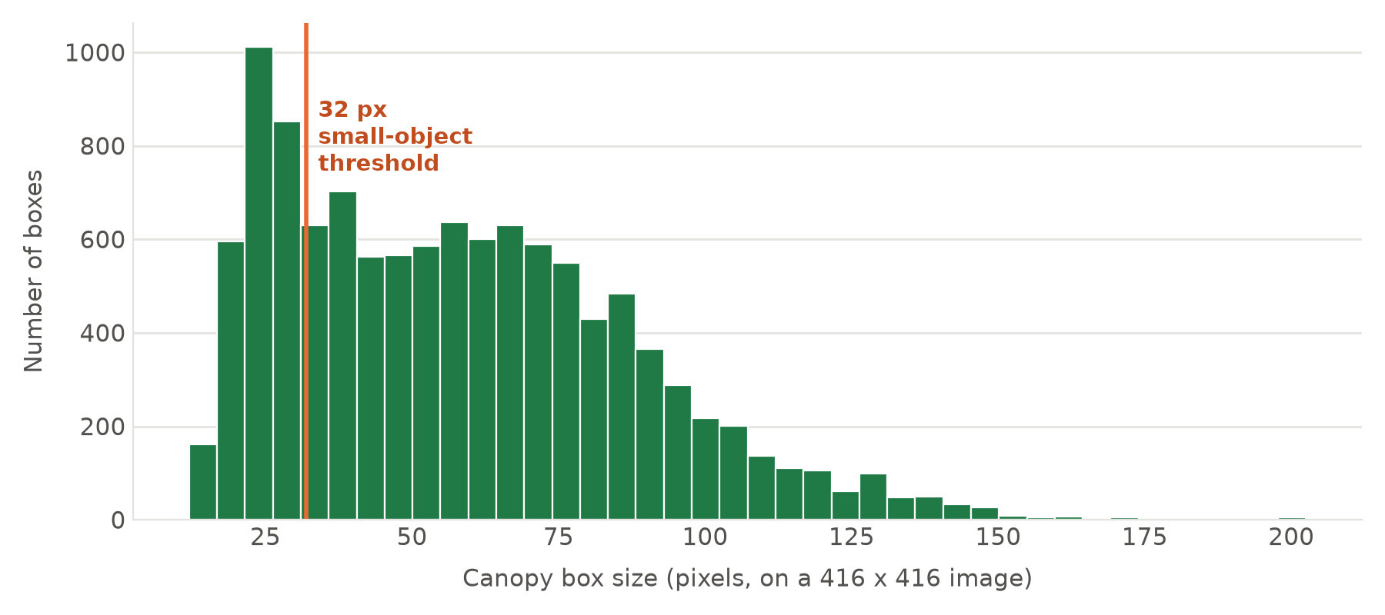
DATA ANALYSIS
The hard part is that trees are small
CANOPY BOX SIZE DISTRIBUTION
55 px
median canopy width on a 416 px image
24%
of all boxes fall under the 32 px small-object threshold
A quarter of our targets are small objects. That directly shapes our training plan: higher input resolution and small-object augmentation.
Tree Counting Using Drone Images
8

Slide 9
DATA ANALYSIS
One finding we want to flag early
The 1,191 training images are not 1,191 distinct scenes.
Roboflow applied offline augmentation before export. Counting unique base filenames shows the real picture:
1,191
375
~3x
training image files
unique source scenes
augmented copies per scene
WHY IT MATTERS
WHAT WE WILL DO
Random splitting would leak augmented twins of a training scene into validation and inflate our scores.
Verify that the provided splits are scene-disjoint, and report metrics on the untouched test set only.
Tree Counting Using Drone Images
9

Slide 10
METHOD
End to end pipeline
Drone imagery
Dataset prep
Training
Inference
Counting
Evaluation
Top-view aerial capture
YOLO format, split, verified
YOLOv11 on the tree-top class
Boxes with confidence scores
Post-process, NMS, tally
Detection and count metrics
TRAINING CONFIGURATION WE START FROM
yolo detect train \
model=yolo11n.pt \
data=datasets/Tree-Top-View/data.yaml \
epochs=100 imgsz=640
Baseline first. yolo11n gives us a fast reference run.
Then scale. yolo11s and yolo11m if accuracy demands it.
imgsz 640. Upscaled from 416 to help the small canopies.
Tree Counting Using Drone Images
10

Slide 11
EVALUATION PLAN
How we will judge the result
Detection quality and counting quality are different questions, so we measure both.
DETECTION METRICS
COUNTING AND PRACTICAL METRICS
Precision
Count MAE
Of the trees we detected, how many were real
Average absolute difference between predicted and true count
Recall
Count error %
Of the real trees, how many we found
Relative counting error, reported per density band
mAP@0.5
Inference speed
Detection quality at a standard overlap threshold
Milliseconds per image, for field feasibility
mAP@0.5:0.95
Failure review
Detection quality averaged over strict thresholds
Manual look at the worst images, not just the averages
Tree Counting Using Drone Images
11

Slide 12
ENGINEERING SETUP
The repository is already structured for this
Version controlled. Every change tracked on GitHub from day one.
TreeCountingUsingDroneImages/
├── datasets/ Tree-Top-View: train, valid, test, data.yaml
├── src/ train, predict, evaluate, visualize, utils
├── models/ checkpoints and trained weights
├── outputs/ metrics, predictions, visualizations
├── notebooks/ exploration and analysis
├── scripts/ reproducible run scripts
├── docs/ report and presentation
└── requirements.txt
Separated concerns. Data, code, weights and outputs never mix.
Reproducible. Clone, install requirements, run one command.
Documented. README carries setup, dataset and workflow.
Stack: Python 3 · PyTorch · Ultralytics YOLOv11 · OpenCV · NumPy · Pandas · Matplotlib · Git
Tree Counting Using Drone Images
12

Slide 13
PROGRESS
Where we are today
Repository setup
Done
Model training
Next
Dataset collection
Done
Hyperparameter tuning
Planned
Dataset analysis
Done
Evaluation
Planned
Literature survey
In progress
Final documentation
Planned
Data work is complete and understood. The next milestone is a trained baseline with real numbers to show.
Tree Counting Using Drone Images
13

Slide 14
RISKS
What could go wrong, and our plan for it
Small canopies are missed
24% of boxes are under 32 px, the classic weak spot for detectors.
Train at 640 or 960 input size, add scale and mosaic augmentation, tune the confidence threshold for recall.
Overlapping canopies get merged
Dense forest means boxes sit on top of each other and NMS may delete true positives.
Tune the NMS IoU threshold explicitly and validate the count, not just the mAP.
Limited unique scenes
375 distinct source scenes is a modest amount of real variety.
Rely on augmentation, keep the test split untouched, and report honestly rather than overclaiming.
Domain shift on new drone data
A different camera, altitude or season may not look like our training set.
Document the operating conditions the model was trained for, and flag it as future work.
Tree Counting Using Drone Images
14

Slide 15
NEXT STEPS
What happens next
Now
Verify split integrity
Confirm no augmented twin of a training scene appears in valid or test.
Week 1
Baseline training run
Train yolo11n for 100 epochs and record the first full metric set.
Week 2
Tune and compare
Sweep image size, augmentation and model size, then pick a winner.
Week 3
Counting layer
Build the count post-processing and measure counting error directly.
Week 4
Report and demo
Annotated prediction gallery, final metrics, written report.
Ask for the mentor: is our evaluation plan complete, and should we prioritise accuracy or field-deployable speed?
Tree Counting Using Drone Images
15

Slide 16
THE TEAM
Thank you
Nitheesh
Project lead, model development, repository, documentation
Nishu Kumari
Literature survey, dataset analysis, documentation
Astley
Data collection, research, model evaluation, testing
Dataset: Tree-Top-View, Roboflow Universe, CC BY 4.0 · Built with Ultralytics YOLOv11 and PyTorch

