Slide 1
RACS: Retrieval-Augmented Coverless Steganography
Introduction
My Contribution
Retrieval-Augmented Coverless Semantic Steganography. A secret photo is turned into an ordinary-looking stego image, sent over a noisy wireless channel, and only someone with the 8-digit token gets it back. We build on AgentSemSteCom (IEEE TCCN, 2026) and change how the reference image is obtained.
Baseline rebuild: 16 phases using the paper's own models (BLIP, Qwen2.5, EDICT, SwinJSCC)
C1 RACS retrieval: CLIP + FAISS search over 1,000 photos, structural rerank, token picks the reference
C2 exact-recovery layer: a locked copy of the secret is hidden inside the stego image, so the right key gets it back exactly
Phone app: send and receive a secret photo
receiving takes 1 to 2 s
Evaluation: 66 images, 4 SNR levels, security and steganalysis tests
Objectives
Get the reference image by lookup, not by diffusion
Recover the secret exactly and reject wrong keys
Stay hard to detect (XuNet, chi-square)
Notes:
This project hides a secret photo inside a normal-looking image and sends it over a noisy channel. We first rebuilt the AgentSemSteCom paper on a laptop GPU, then made two changes: C1 finds the reference image by retrieval instead of generating it, and C2 adds a layer that brings the secret back exactly.

Slide 2
Background and Existing Work
1
Embedding (LSB)
2
DiffStega
3
AgentSemSteCom (baseline)
Changes the lowest bits of a cover photo to carry the secret.
Diffusion generates the stego image from a password-keyed prompt; no cover is modified.
LLM + diffusion make a reference, EDICT hides the secret, sent over a semantic channel.
Problem: Easy to detect with chi-square and SPA.
Problem: Secret comes back only approximately; no semantic channel.
Problem: New diffusion reference per message (3.9 s, 2.6 GB GPU); secret only approximate.
Approach | Coverless | Semantic channel | Reference image | Exact secret
LSB / adaptive embedding | No | No | - | Yes
DiffStega | Yes | No | Generated | No
AgentSemSteCom (baseline) | Yes | Yes | Generated | No
RACS (this project) | Yes | Yes | Retrieved | Yes
Why this project is needed: no earlier method is coverless, works over a semantic channel and still returns the secret exactly. RACS does all three, by retrieving the reference instead of generating it and adding an exact-recovery layer.
Notes:
Three earlier approaches. Embedding methods such as LSB are exact but easy to detect. DiffStega generates the stego image with diffusion, so nothing is modified, but the secret is only approximate and there is no semantic channel. AgentSemSteCom, our baseline, adds the semantic channel but generates a new diffusion reference for every message and is still approximate. The table is from the report: RACS is the only row with yes everywhere.

Slide 3
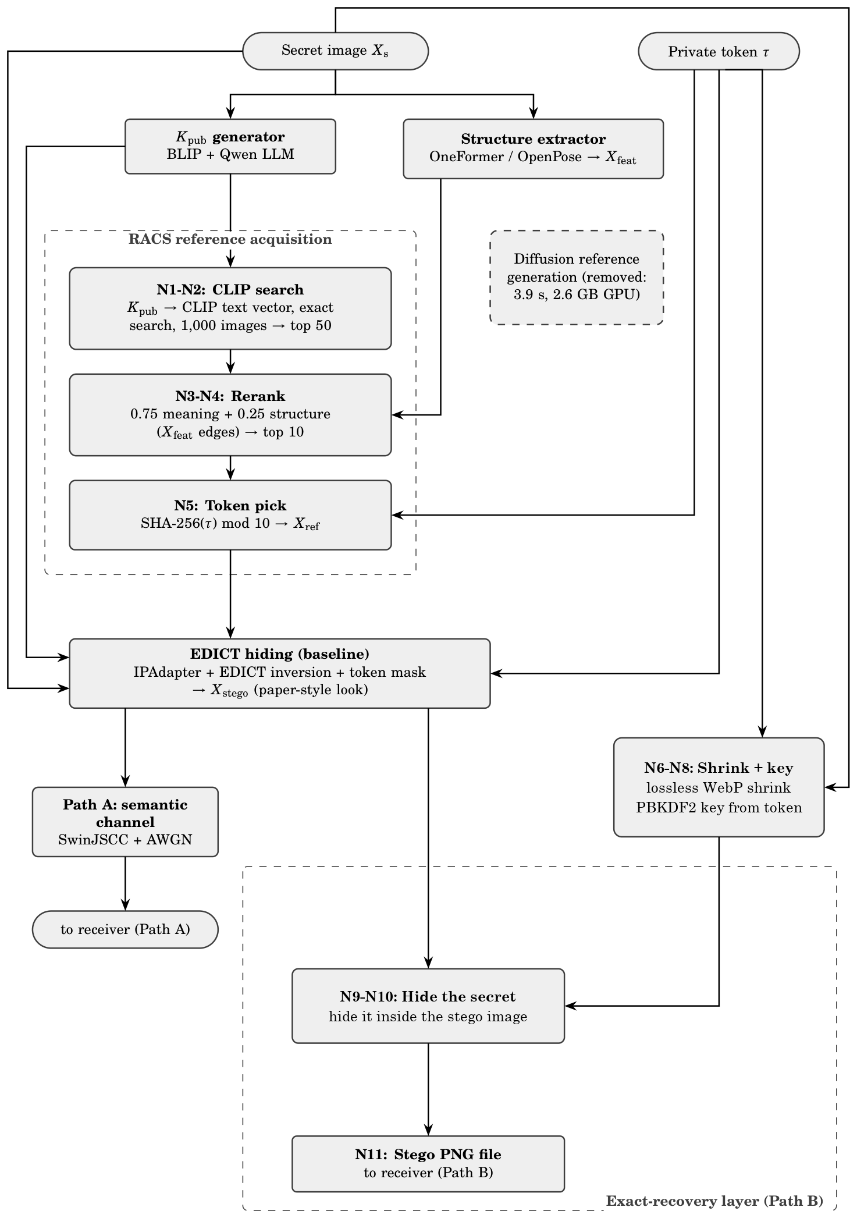
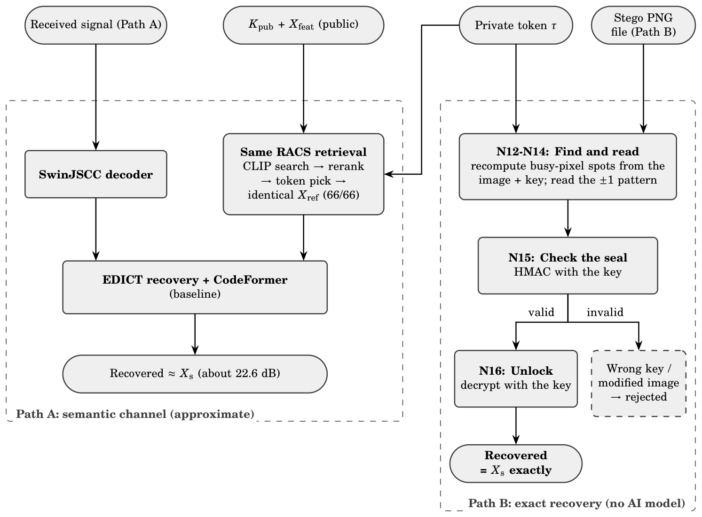
Proposed System and Architecture
Receiver (recovery)
Sender (hiding)
Notes:
Sender: the secret gives public hints (a text key and a structure map). C1, RACS, uses them to retrieve a reference photo from a fixed collection, and the token picks which of the top ten is used. EDICT, the baseline's hiding step, turns the secret into the stego image. Path A sends it over the semantic channel. C2 shrinks the original with lossless WebP, makes a key from the token with PBKDF2, and hides that copy inside the stego image. Receiver: Path A decodes, retrieves the same reference and reverses EDICT, giving an approximate secret. Path B reads the hidden copy, checks the seal and decrypts it, giving the exact secret, or rejects a wrong key.

Slide 4
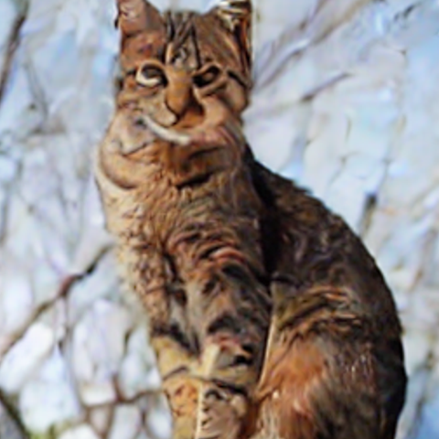
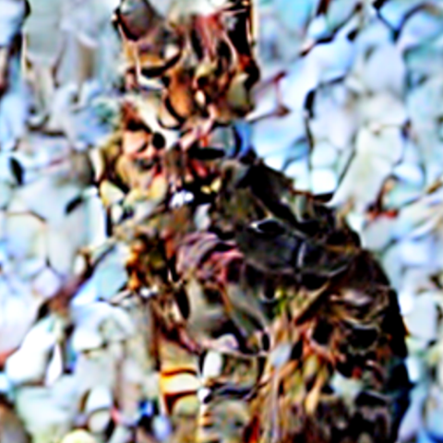
Result and Analysis
0.048 s
22.62 dB
66/66
100 %
reference time (was 3.92 s)
recovery PSNR (was 22.37)
pixel-identical (C2)
wrong keys rejected
C1: baseline vs RACS
C2: earlier methods vs ours
Right vs wrong token
Metric | Baseline | RACS
Reference time | 3.92 s | 0.048 s
Recovery PSNR | 22.37 dB | 22.62 dB
SSIM | 0.616 | 0.627
LPIPS | 0.238 | 0.227
Same Xref at both ends | - | 66 / 66
Question | Baseline | Simple LSB | Ours (C2)
Secret back exactly? | No (~22 dB) | Yes | Yes, 66/66
Wrong key? | blurry image | - | rejected
Caught by chi-square? | - | 1.00 | 0.50
Visible change | - | 44 dB | 57 dB less
Right
Wrong
Path A output. With the exact layer a wrong key returns nothing at all.
Quality on 6 images × 4 SNRs, same code path; the same-reference check on all 66.
Detector score: 0.5 = just guessing, 1.0 = always caught. Tested on all 66 images.
Phone app: hide ~21 s, receive 1-2 s, no AI model on the receiver.
Notes:
Top row: the reference is 82 times faster, while recovery quality is slightly better. The table compares baseline and RACS on the same code path, so the difference comes only from the reference stage. The middle table compares C2 with the baseline and with simple LSB hiding: only ours returns the secret exactly, rejects a wrong key, fools chi-square (0.50) and weakens SPA (0.83), with a smaller visible change. The cat on the right shows what a wrong token gets through the semantic channel.

Slide 5
Conclusion and Future Scope
1
Summary of work
2
Key findings
3
Future scope
Rebuilt AgentSemSteCom end to end on a 6 GB laptop GPU
C1: reference found by retrieval, not diffusion
C2: encrypted, sealed copy for exact recovery
Phone app for sending and receiving
Evaluated on 66 images at 4 SNR levels
Faces recovered at 22.6 to 25.1 dB, in the paper's range
Retrieval is 82× faster with no loss in quality
All 66 secrets came back identical
How the cover is made matters as much as how bits are hidden
SPA weakened, not defeated (AUC 0.83)
RACS-Hybrid: fall back to diffusion when no photo is close enough
Run C1 on all 66 images, 50 EDICT steps
Grow the collection to 50k-100k photos
Test against trained detectors like SRNet
Error-correcting codes to survive recompression
Thank you | Questions are welcome
Notes:
To sum up: we rebuilt the baseline, replaced its reference generator with retrieval, and added an exact-recovery layer. Retrieval is 82 times faster with no loss, every secret came back identical, and the cover's realism turned out to matter for detectability. Next steps are RACS-Hybrid, bigger evaluations, stronger detectors and making the exact layer survive recompression.

