Slide 1


Slide 2
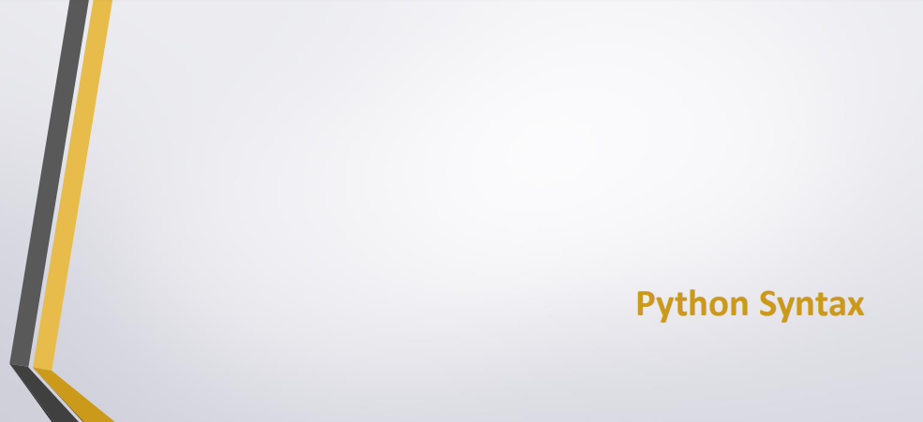

Slide 3
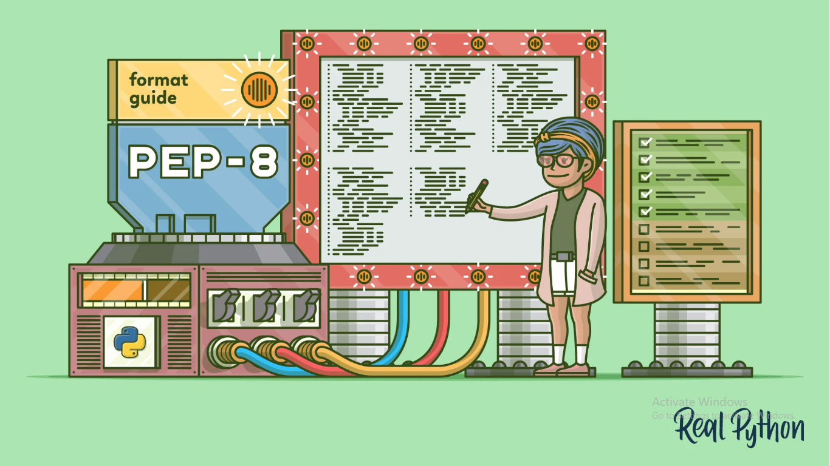
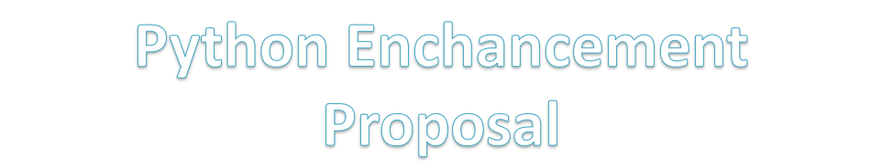

Slide 4
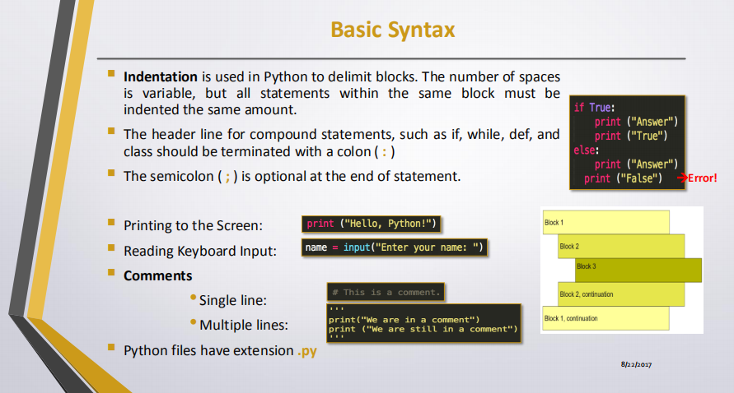

Slide 5
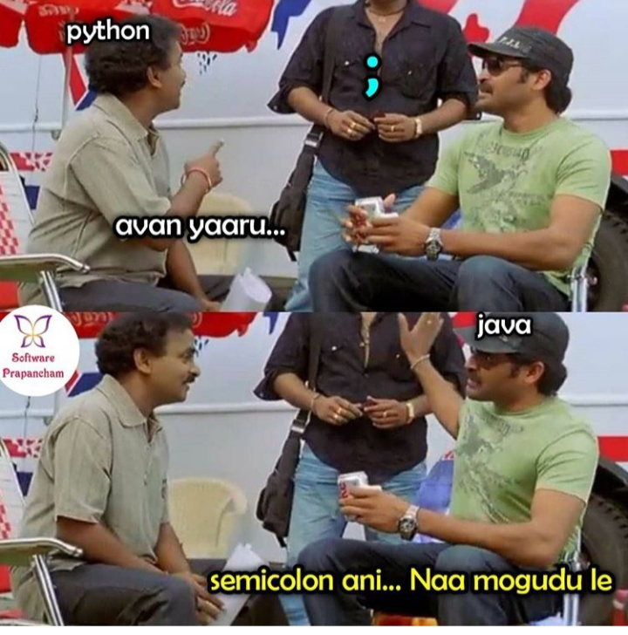

Slide 6
Variables
Variables are names for values
Created by use – no declaration necessary
>>>planet = ‘Pluto’
>>>print planet
Pluto
>>>moon = ‘Charon’
>>>
variable
value
planet
‘Pluto’
moon
‘Charon’

Slide 7

Declaration Of Variables :

Slide 8
Variables
Variables can be assigned to other variables
>>>p = planet
>>>
variable
value
planet
‘Pluto’
moon
‘Charon’
p

Slide 9
Variables
Variables can be assigned to other variables
>>>p = planet
>>>print p
Pluto
>>>
variable
value
planet
‘Pluto’
moon
‘Charon’
p

Slide 10
Variables
In Python, variables are just names
Variables do not have data types
>>>planet = ‘Pluto’
>>>
string
variable
value
planet
‘Pluto’

Slide 11
Variables
In Python, variables are just names
Variables do not have data types
>>>planet = ‘Pluto’
>>>planet = 9
>>>
variable
value
planet
‘Pluto’
9
integer

Slide 12
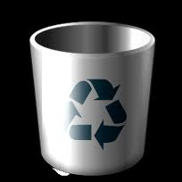
Variables
In Python, variables are just names
Variables do not have data types
>>>planet = ‘Pluto’
>>>planet = 9
>>>
variable
value
planet
‘Pluto’
9
Python collects the garbage and recycles the memory (e.g., ‘Pluto’)
integer

Slide 13
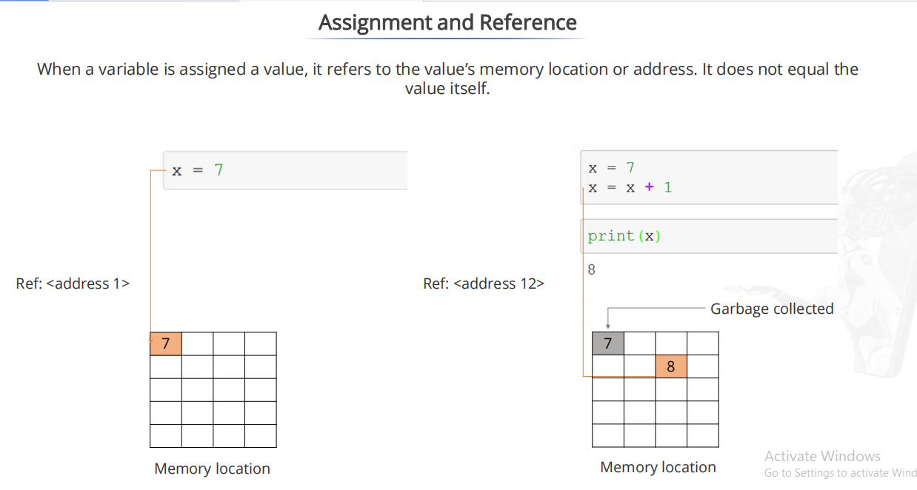

Slide 14
Variables
You must assign a value to a variable before using it
>>>planet = ‘Sedna’
>>>

Slide 15
Variables
You must assign a value to a variable before using it
>>>planet = ‘Sedna’
>>>print plant #Note the deliberate misspelling

Slide 16
Values Do Have Types
>>>string = ‘two’
>>>number = 3
>>>print string * number

Slide 17
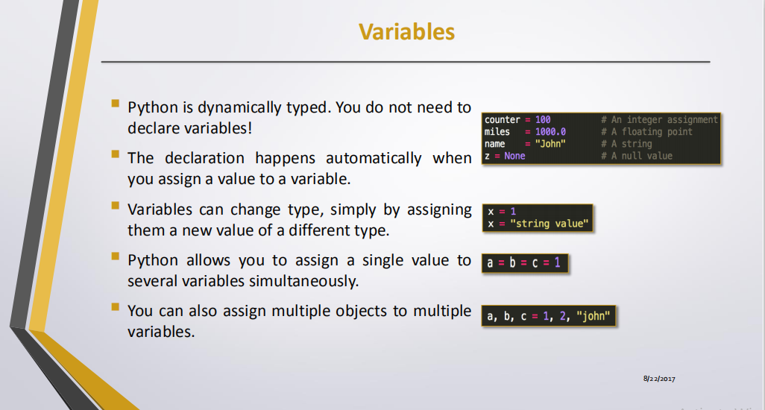

Slide 18


