Slide 1
PROJECT TITLE : SMART CLASSROOM TEAM NO : 09
 | SRI KRISHNA INSTITUTIONS (AN AUTONOMOUS INSTITUTION) (APPROVED BY AICTE AND AFFILIATED TO ANNA UNIVERSITY CHENNAI) ACCREDITED BY NAAC WITH “A” GRADE
TEAM MEMBERS
PECHI MUTHU J
PREETHI S
NITHEESH S
RANGANAYAGI P

Slide 2
ABSTRACT:
Smart Classroom is a virtual classroom which connects
learners and instructors.
Timed attendance is developed to get the accurate attendance from the students
to maintain them to stay alert all the time.
Group chat allows the learners and the instructors to communicate
with each other.
Exam proctoring is made easy using this application.

Slide 3
PROBLEM IDENTIFIED :
In the existing system, there is no attendance system users have
to use an external application (manual attendance or Google forms)
There is no exam portal so that the users have to use
an external application .(Examly )
There is no quiz portal so that the users have to
use an external application. (Quizizz )
There is no group chat options so that the users have to
use an external application.(Whatsapp)

Slide 4
NOVELTY PROPOSED:
In the proposed system there is an attendance management
system developed and incorporated within the application.
An exam portal with web cam monitoring is developed within
the application.
A group chat facility is developed in this application.
Timetable is created which connects g-meet and the classrooms.

Slide 5
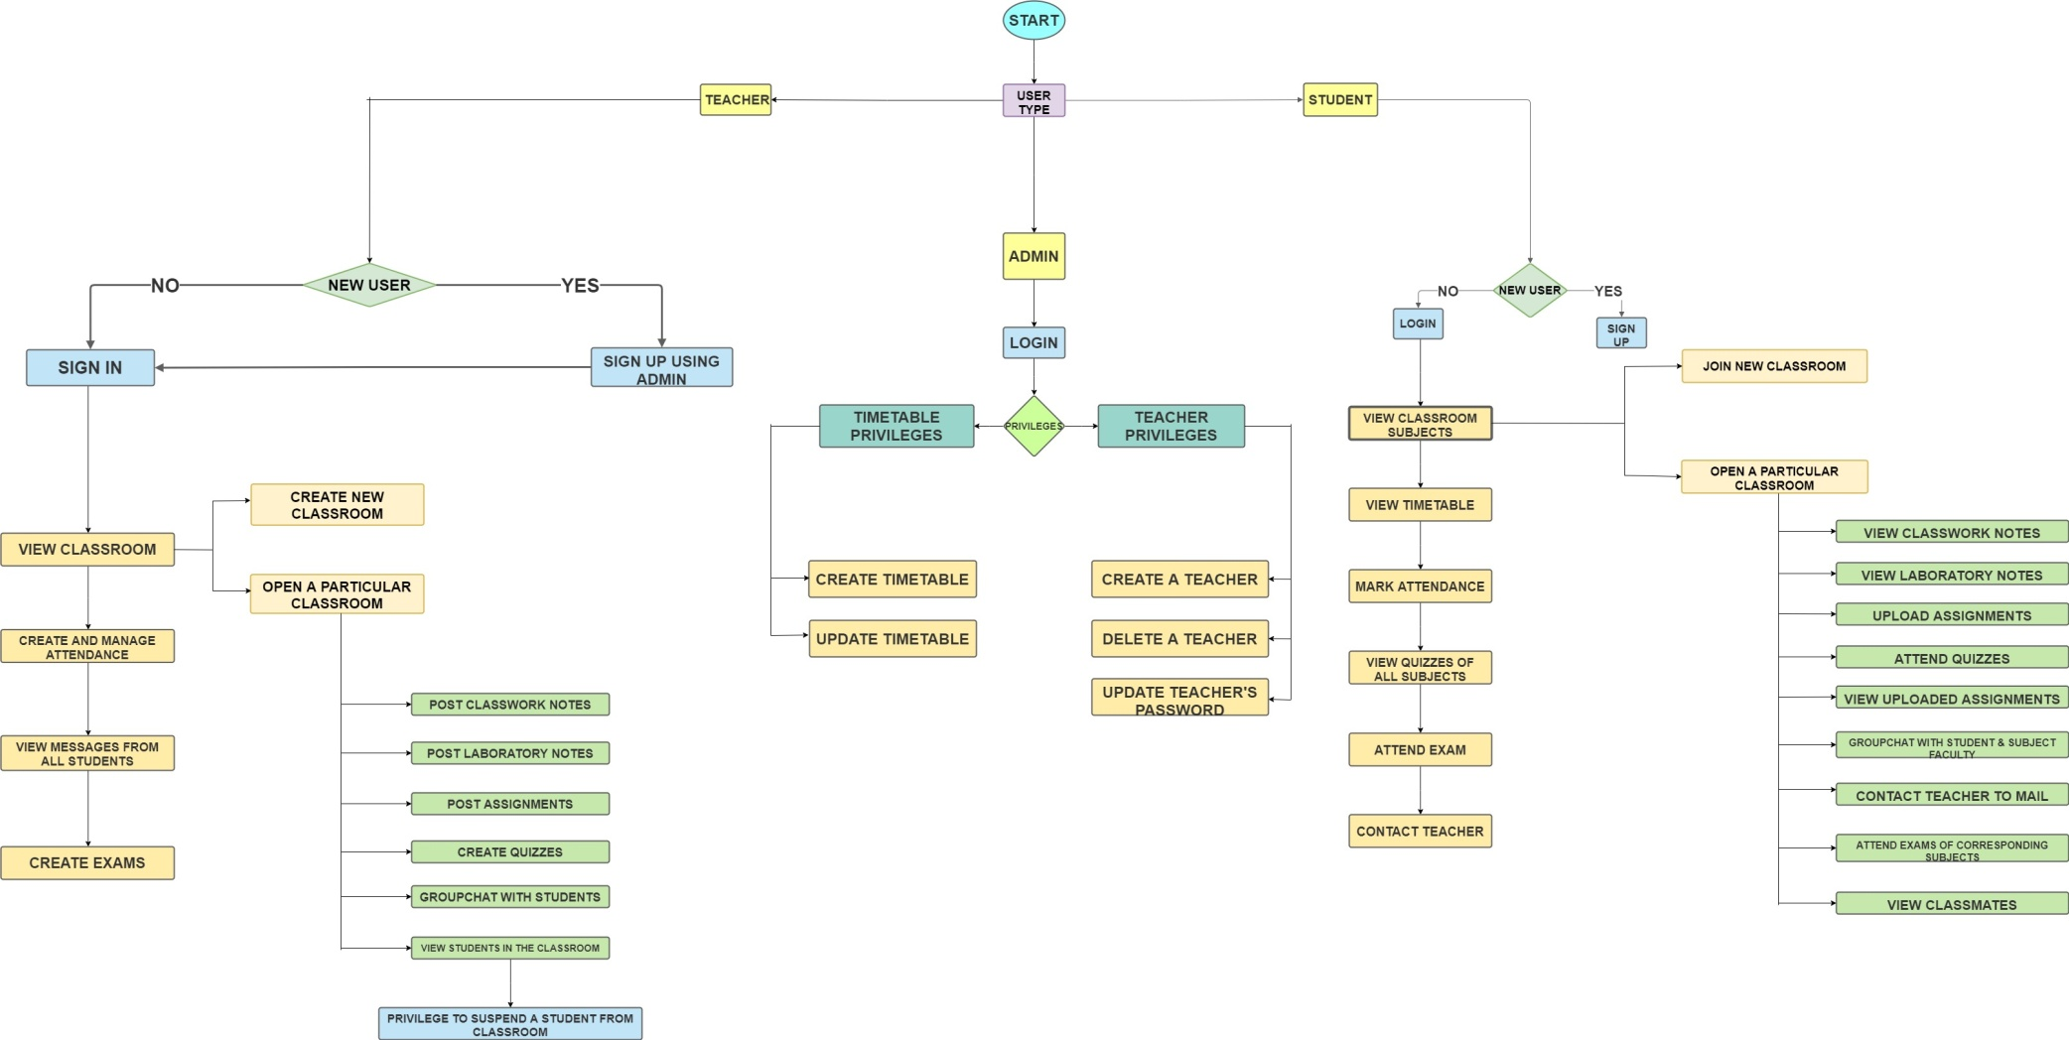
DATA FLOW DIAGRAM:

Slide 6
SELF EVALUATION:
S.NO | FILED | MAXIMUM | CLAIM | GRANTED
1 | NOVELTY | 30 | 27
2 | PRESENTATION | 20 | 17
3 | DOCUMENTATION | 20 | 18
4 | EXECUTION | 15 | 14
5 | VIVA VOCE | 15 | 13
6 | TOTAL | 100 | 89

