Slide 1

LOSSLESS DATA COMPRESSION ANALYSIS OF ALGORITHMS FINAL PROJECT SUBMITTED TO: Prof. Russel Pears
Submitted by: Pragnya Gannapureddy
Nitheesh EDLA

Slide 2
Loss less data compression which follows greedy approach technique, can be used to encode and decrease the size the given file.
Usually when we transfer a file in a network, it is transferred by using ASCII code and the ASCII code are changed to binary and saved.
For example: IF ABC is being transferred over a network it takes 24bits(8 bits for character) if we use ASCII codes, but it can be transferred by using only 4 bits by changing the binary codes .
These kind of techniques are used in various industry applications like WinRAR, 7-Zip etc..,

Slide 3
Algorithm:
buildLosslessCompressionTree{
Counts the frequencies of each character, stores them in a map and those are used to store in a priority queue (highest frequency has the highest priority) on the basis of frequencies.
Using the min heap, we are going to construct a tree.
}
encode_string{
Traverse the tree and encode each and every character and write the encoded codes into the file
}

Slide 4
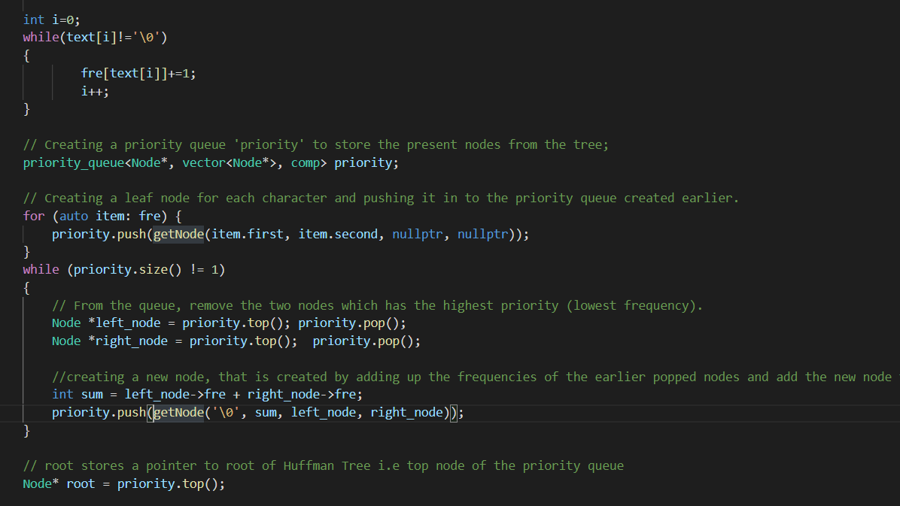
Snapshot of lossless method

Slide 5
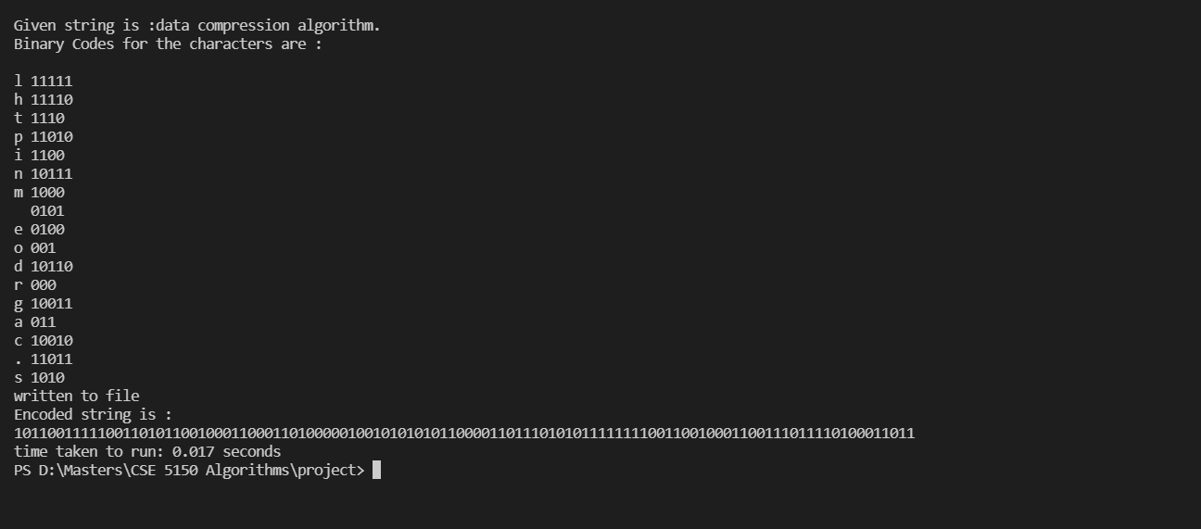
Sample output:

Slide 6
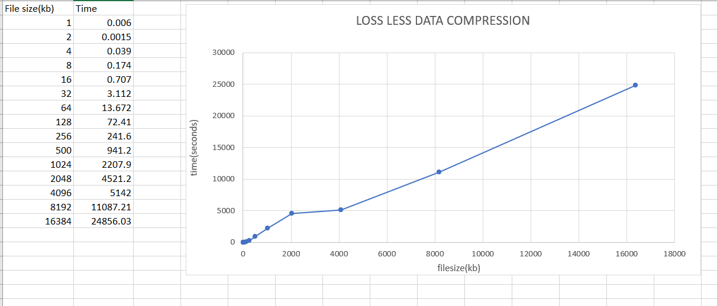
Experimental results:

Slide 7


