Slide 1
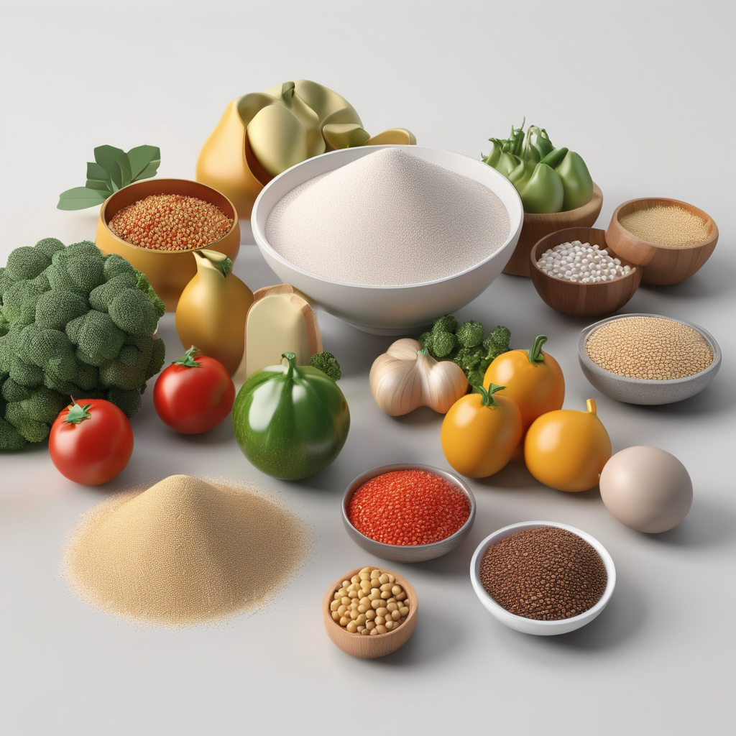
FOOD WAY
MENTOR : Ms.S.Sujitha
STUDENT : NITHEESH KUMAR M
REG : 99220040322

Slide 2
TABLE OF CONENTS
1)INTRODUCTION 2)ABSTRACT 3)OBJECTIVE
4)BENEFITS 5)OUTPUT 6)CONCLUSION

Slide 3
INRODUCTION
Foodway is an online food ordering and delivery platform that connects you to a vast selection of restaurants in your area. Whether you're craving pizza, pasta, sushi, or something more exotic, Foodway has something to tantalize every taste bud.
Our user-friendly website and mobile app make ordering your favorite food effortless. In just a few clicks, you can browse menus, customize your order exactly how you like it, and schedule delivery or pickup.
Explore our extensive menu selection, discover your perfect meal, and sit back, relax, and savor the flavor.

Slide 4
ABSTRACT Foodway is an online food ordering website designed to streamline the food ordering process for both customers and restaurants. Customers can browse menus from a variety of restaurants, customize their orders, and enjoy the convenience of home delivery or pickup. Restaurants benefit from an expanded customer base, efficient order management, and the potential for increased revenue.

Slide 5
OBJECTIVE
Website for selling Foods by a server using HTML,CSS and JavaScript.
It aims to connect sellers withbuyers through easy-to-use features like Add to card,Discount coupon,Combo Offer, weekend Offers and Direct contact forms , all within a responsive design for accessibility on any device.

Slide 6
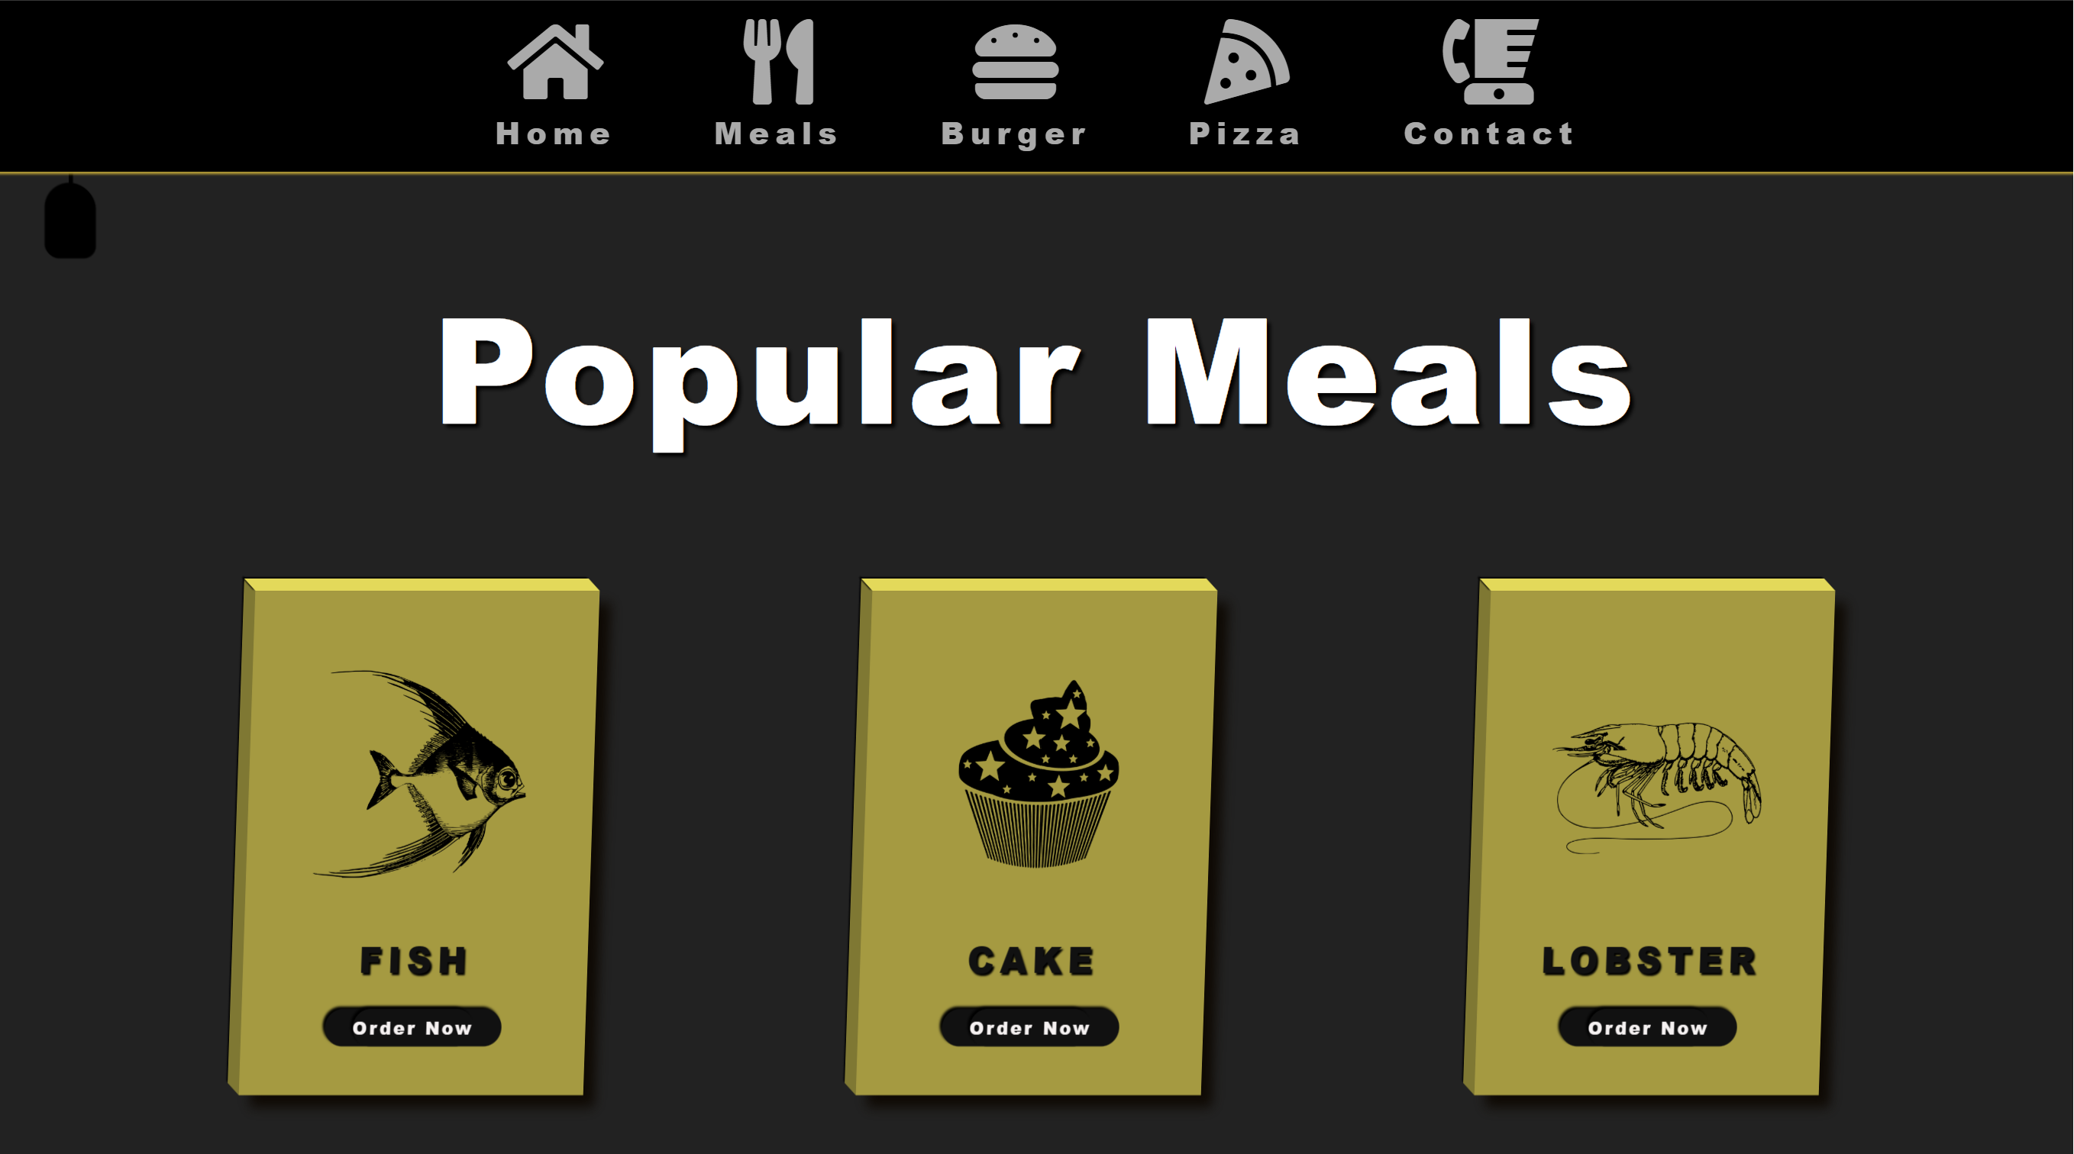
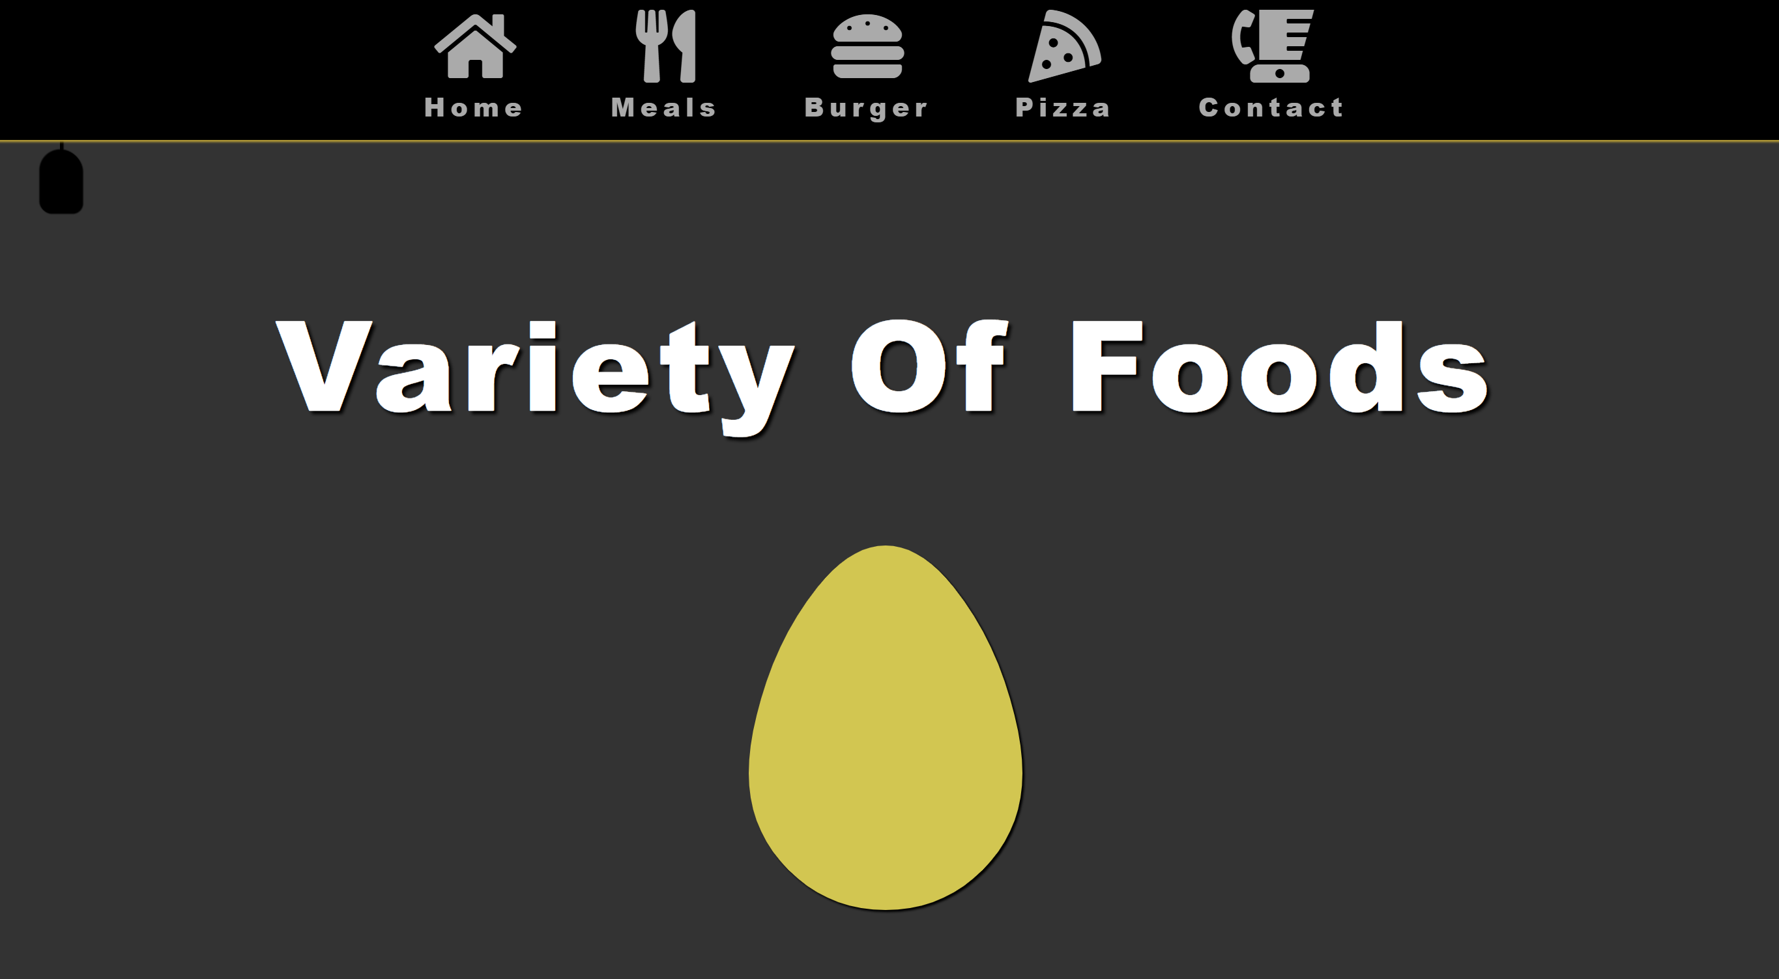
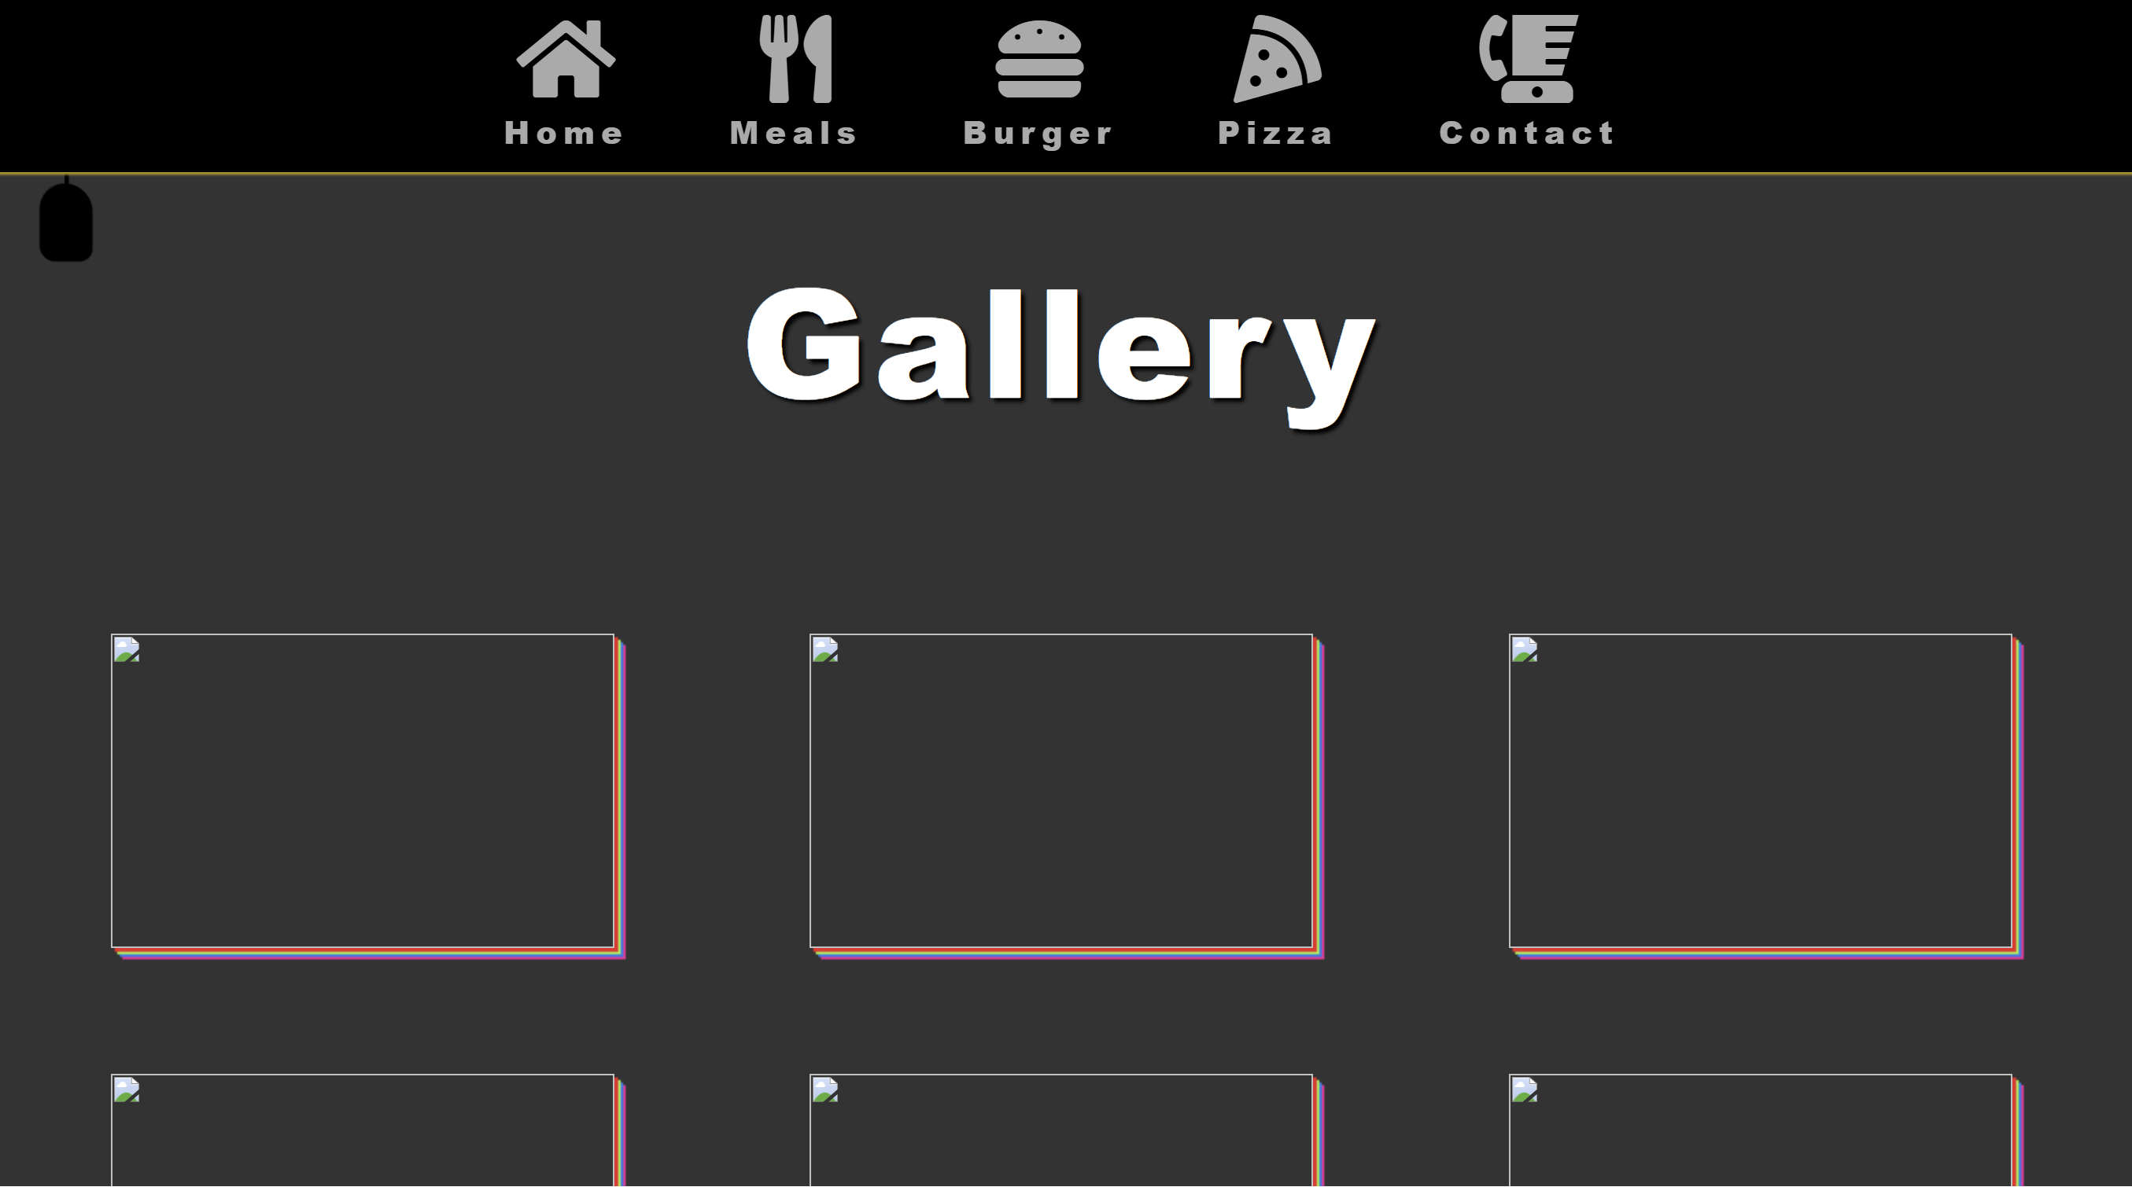
OUTPUT

Slide 7
BENEFITS
Vast Restaurant Selection
Effortless Ordering
Fast and Reliable Delivery
Convenience at Your Fingertips
Great Value

Slide 8
Conclusion
Foodway is here to make your life easier and tastier. We believe everyone deserves a delicious meal without the hassle. So, come join our growing community, explore our ever-expanding selection, and let Foodway be your trusted partner in good food and great experiences.

