Slide 1

Heart Disease Analysis and Prediction System
RNS INSTITUTE OF TECHNOLOGY
BENGALURU - 98
DEPARTMENT OF COMPUTER SCIENCE & ENGINEERING
Presentation on Internship

Slide 2
AGENDA
Abstract
About the Company
Introduction
Literature Survey
Requirements
System Design
Detailed Design
Results
Conclusion and Future Enhancements
References
Q & A

Slide 3
ABSTRACT
Heart Disease is one of the most significant problem that is arising in the world today .The diagnosis of heart disease in most cases depends on a complex combination of clinical and pathological data. Because of this complexity, there exists a significant amount of interest among clinical professionals and researchers regarding the efficient and accurate prediction of heart disease. In this project, we develop a heart disease analysis and prediction system that can assist medical professionals in predicting heart disease status based on the clinical data of patients. We select 12 important clinical features, i.e., age, sex, chest pain type, trestbps, cholesterol, fasting blood sugar, resting ecg, max heart rate, exercise induced angina, old peak, slope and after passing the data through Decision Tree Classifier, KNearest Neibours classifier, Logistic Reasoning Algorithm, Random Forest Classifier , SVM classifier we predict whether a person has heart disease or not.

Slide 4
ABOUT THE COMPANY
NASTECH – New Age Solutions & Technologies
NASTECH is formed with the purpose of bridging the gap between Academia and Industry.
Nastech is one of the leading Global Certification and Training service providers for technical and management programs for educational institutions.
They collaborate with educational institutes to understand their requirements and form a strategy in consultation with all stakeholders to fulfill those by skilling , reskilling and upskilling the students and faculties on new age skills and technologies.
Industry and project oriented student training programs.
Certification programs mapped to Global Certification Exams from Microsoft/EC- Council/Google/AWS/ Adobe.

Slide 5
INTRODUCTION
Heart disease describes a range of conditions that affect your heart. Today, cardiovascular diseases are the leading cause of death worldwide with 17.9 million deaths annually, as per the World Health Organization reports.
Nowadays it is well known that machine learning and artificial intelligence are playing a huge role in the medical industry. We can use different machine learning and deep learning models to diagnose the disease and classify or predict the results.
Anticipating patients future behavior on the given history is one of the important applications of machine learning techniques that can be used in healthcare management.
Healthcare data is massive It includes patient data, resource management data, and transformed data. Healthcare organizations must have the ability to analyze data.
Treatment records of millions of patients can be stored, and computerized into machine learning algorithms may help in answering several important and critical questions related to health care.

Slide 6
LITERATURE SURVEY
[1] Bo Jin, Chao Che. (2018) proposed a “Predicting the Risk of Heart Failure With EHR Sequential Data Modeling” model designed by applying neural network. This paper used the electronic health record (EHR) data from real-world datasets related to congestive heart disease to perform the experiment and predict the heart disease before itself.
[2] Aakash Chauhan. (2018) presented “Heart Disease Prediction using Evolutionary Rule Learning”. This study eliminates the manual task that additionally helps in extracting the information (data) directly from the electronic records. To generate strong association rules, we have applied frequent pattern growth association mining on patient’s dataset. This will facilitate (help) in decreasing the amount of services and shown that overwhelming majority of the rules helps within the best prediction of coronary sickness.
[3] Ashir Javeed, Shijie Zhou. (2017) designed “An Intelligent Learning System based on Random Search Algorithm and Optimized Random Forest Model for Improved Heart Disease Detection”. This paper uses random search algorithm (RSA) for factor selection and random forest model for diagnosing the cardiovascular disease. This model is principally optimized for using grid search algorithmic program. Two forms of experiments are used for cardiovascular disease prediction. In the first form, only random forest model is developed and within the second experiment the proposed Random Search Algorithm based random forest model is developed. This methodology is efficient and less complex than conventional random forest model. Comparing to conventional random forest it produces 3.3% higher accuracy. The proposed learning system can help the physicians to improve the quality of heart failure detection.

Slide 7
LITERATURE SURVEY
[4] “Effective Heart Disease Prediction Using Hybrid Machine Learning Techniques” proposed by Senthilkumar Mohan, Chandrasegar Thirumalai. (2019) was efficient technique using hybrid machine learning methodology. The hybrid approach is combination of random forest and linear method. The dataset and subsets of attributes were collected for prediction. The subset of some attributes were chosen from the pre-processed knowledge(data) set of cardiovascular disease .After prep-processing , the hybrid techniques were applied and disgnosis the cardiovascular disease.
[5] K.Prasanna Lakshmi, Dr. C.R.K.Reddy (2015) designed “Fast Rule-Based Heart Disease Prediction using Associative Classification Mining”. In the proposed Stream Associative Classification Heart Disease Prediction (SACHDP), we used associative classification mining over landmark window of data streams. This paper contains two phases: one is generating rules from associative classification mining and next one is pruning the rules using chi-square testing and arranging the rules in an order to form a classifier. Using these phase to predict the heart disease easily.

Slide 8
REQUIREMENTS
HARDWARE REQUIREMENTS
Processor : Any Processor above 500 MHz
RAM : 512Mb
Hard Disk : 4 GB
Input device : Standard Keyboard and Mouse
Output device : VGA and High Resolution Monitor
SOFTWARE REQUIREMENTS
Operating system : Windows 10, MacOS, Linux.
IDE : Google Collaboratory, Visual Studio Code, Jupyter Notebook.
Tools/Technologies : Python, numpy, pandas, matplotlib, seaborn, sklearn, streamlit libraries.

Slide 9
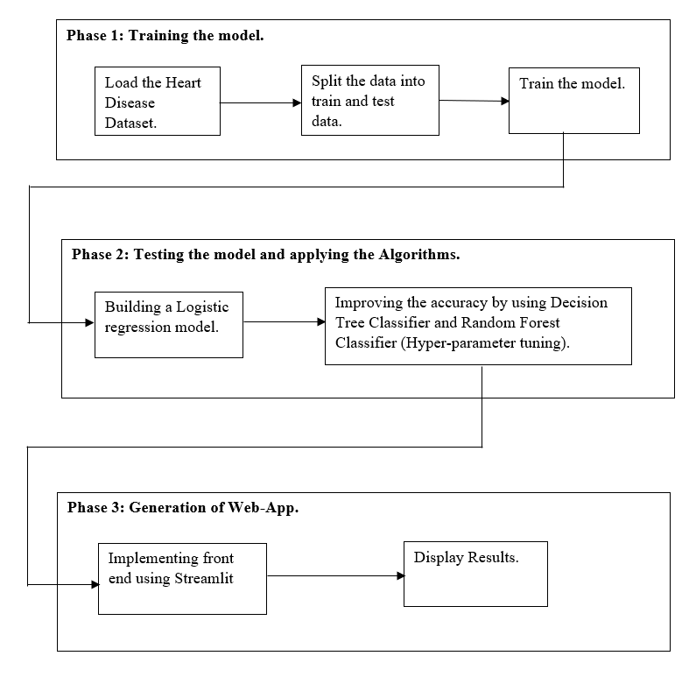
SYSTEM DESIGN
As depicted in the figure, the project is divided in three phases.
Phase 1 deals with loading, preprocessing and training the data set. In this phase, the model that performs training on the data set the best, in other words, the model that provides highest accuracy, is saved onto the disk.
Phase 2 In this phase, the model that performs training on the data set the best, in other words, the model that provides highest accuracy is recorded.
Phase 3 We make use of Streamlit to generate Web-App where predictions are done. Based on the predictions output is displayed.

Slide 10
DETAILED DESIGN
FUNCTIONAL MODULES
The entire project is divided into 3 modules:
Loading the dataset.
Training the dataset to generate the required models.
Testing the dataset to generate the required results and Based on the results the accuracy is generated.
Generating the Model:
In the first phase we split the dataset into train and test data. 67.77% of the data is utilized for training purpose and the rest 33.33% is utilized for testing purpose.
We built a Decision Tree model for the above dataset.
Then we used KNearest neighbour classifier , Logistic Regression ,SVM and Random Forest Classifier .
Finally we compare the accuracies of all the models and Decision tree gave highest accuracy among all the other models.
2. Front end part of the Model:
We have made use of Streamlit which is an app frame work used to create web apps for data science and machine learning models.
It is compatible with major python libraries such as numpy, pandas, matplotlib etc.

Slide 11
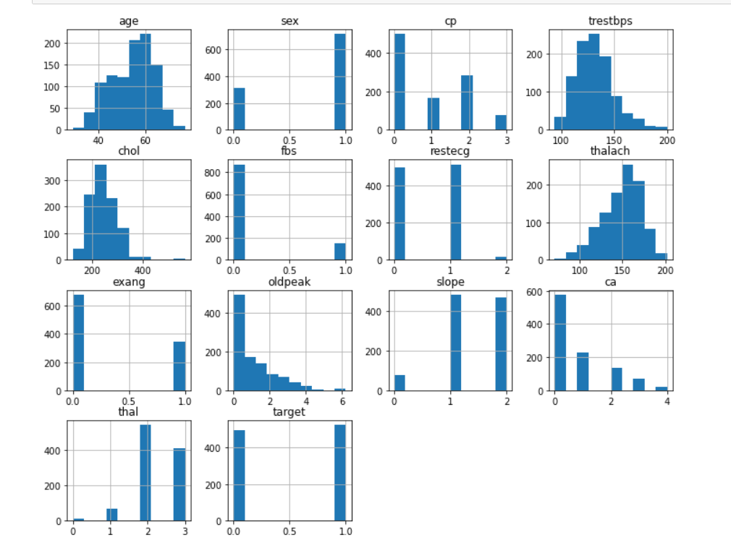
DATA VISUALIZATION

Slide 12
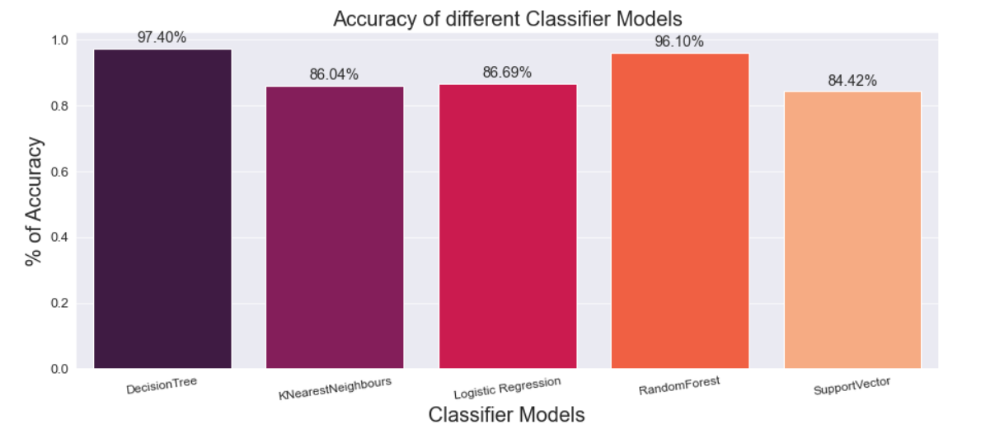
RESULTS
By using Decision Tree Classifier we obtained an accuracy of 97.40%.
By using KNearest Neighbours Classifier we obtained an accuracy of 86.04%.
By using Logistic Regression Classifier we obtained an accuracy of 86.69%
By using Random Forest Classifier we obtained an accuracy of 96.10%.
By using Support Vector Classifier we obtained an accuracy of 84.42%

Slide 13
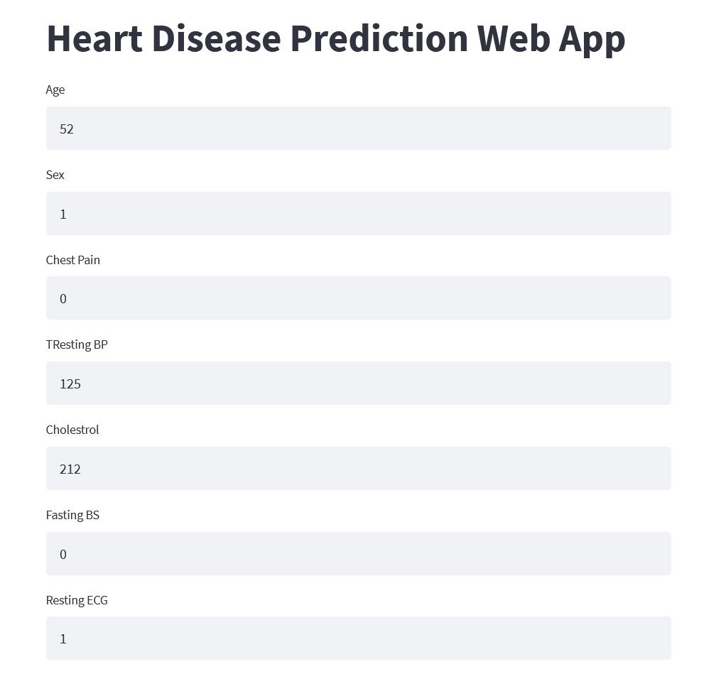
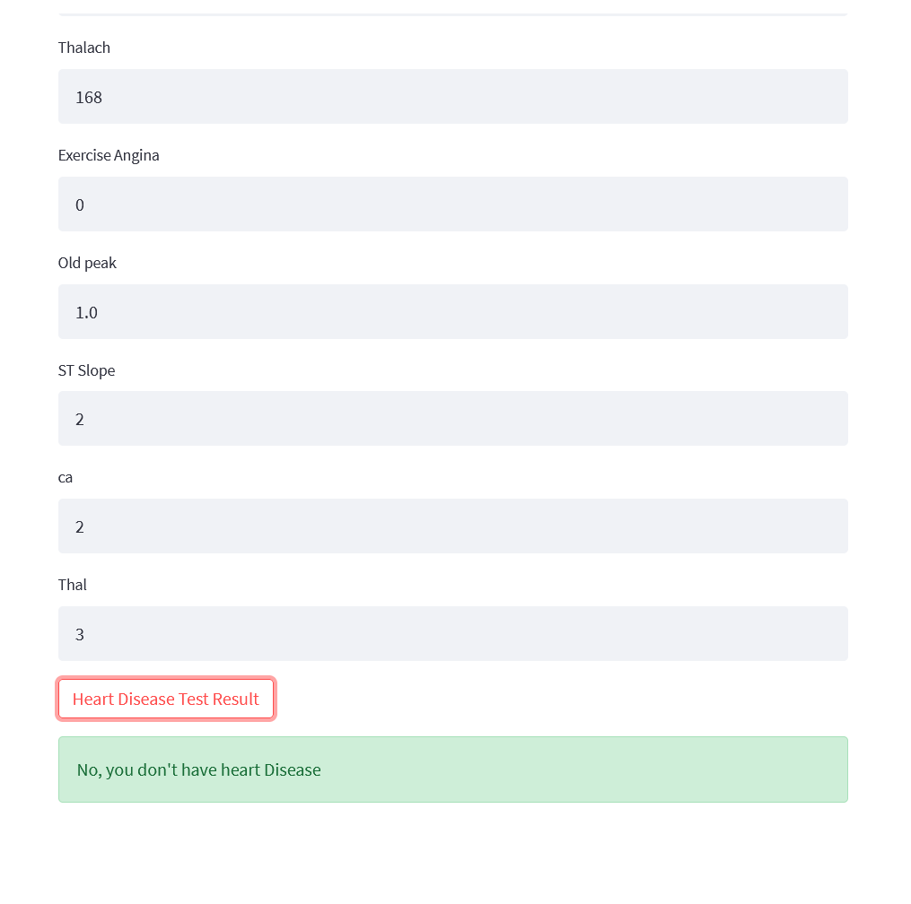
RESULTS

Slide 14
CONCLUSIONS
In this project, we used Five methods in which comparative analysis was done i.e. Decision Tree, KNearest neighbour Classifier, Logistic Regression, Random Forest algorithm and SVM Classifier, as a result of which Promising results were achieved. The conclusion which we found is that machine learning algorithms performed better in this analysis.
Handles roughest(enormous) amount of data using random forest algorithm and feature selection.
The computational time was also reduced which is helpful when deploying a model.
Our machine learning algorithm can now tell if a patient might have heart disease or not.
By diagnosing detecting these features early, we may prevent worse symptoms from arising later.

Slide 15
LIMITATIONS
Prediction of cardiovascular disease results is not accurate
Each narrow application needs to be specially trained.
Cannot handle enormous datasets for patient records.
Learning must generally be supervised, Training data must be tagged.

Slide 16
FUTURE ENHANCEMENTS
As an extension to this work, and some sort of limitation to the work performed here, different types of classifiers can be included in the analysis and more in depth sensitivity analysis can be performed on these classifiers.
An extension can be made by applying same analysis to other bioinformatics diseases datasets, and see the performance of these classifiers to classify and predict these diseases.
As future work, considering the more attributes as input data can expand this study. Furthermore, the work could be done on early detection of heart disease by processing family’s historical data.
There are many possible improvements that could be explored to improve the scalability and accuracy of this prediction system.

Slide 17
REFERENCES
[1] https://www.javatpoint.com/
[2] https://www.geeksforgeeks.org/
[3] A. S. Abdullah and R. R. Rajalaxmi, ‘‘A data mining model for predicting the coronary heart disease using random forest classifier,’’ in Proc.
[4] A. S. Abdullah and R. R. Rajalaxmi, ‘‘A data mining model for predicting the coronary heart disease using random forest classifier,’’ in Proc. Int. Conf. Recent Trends Comput. Methods, Commun. Controls

Slide 18
THANK YOU

