Slide 1

Medicine Plant Classification using Machine Learning

Slide 2
OBJECTIVE
Medicinal Plants plays a very active role in healthcare traditions. Ayurveda is one of the oldest systems of medicinal science that is used even today.
This project propose a fully automated method for the recognition of medicinal plants using computer vision and machine learning techniques has been presented.

Slide 3
Abstract
In this project we have been implemented a technique for medicinal plant identification using random forest algorithm, an ensemble supervise machine learning algorithm based on color, texture and geometrical features
Then reduced features vectors are inputted into the Classification model. Convolutional Neural Network(CNN) is used for classification and identifying the animal class.

Slide 4
INTRODUCTION
The world bears thousands of plant species, many of which have medicinal values , others are close to extinction , and still others that are harmful to man.
Not only are plants an essential resource for human beigns , but they form the base of all food chains.
To use and product plant species, it is crutial to study and classify plants correctly.

Slide 5
Proposed System
The image processing techniques have been established to optimize the footprints. Input image is converted into greyscale , Edge detection on the image.
All the images in the dataset are read , processed , and feature extracted, raw data is loaded for classification of input images.

Slide 6
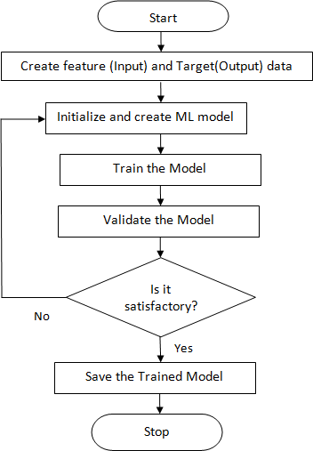
Training Model Flowchart

Slide 7
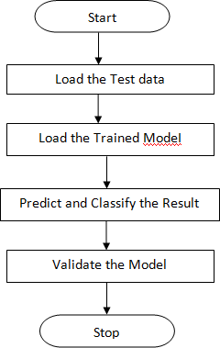
Testing Model Flowchart

Slide 8
Conclusion
In this work, we addressed the problem of identifying the medicinal plant species by the analysis of leaf images obtained directly from their habitat and irrespective of lighting conditions.
Machine learning algorithms were then used to classify the leaves from 60 different plant species into the appropriate category.
Computer vision techniques have been used to extract several shape-based features from the leaves of medicinal plants.

Slide 9


