Slide 1
BankMarketing
Data Analysis by:
S.Nitheshkumar

Slide 2
Description about the data provided
With the data provided using machine learning to help the client to predict their customers subscription.
The data is related with direct marketing campaigns of a Portuguese banking institution. The marketing campaigns were based on phone calls.
Often, more than one contact to the same client was required, in order to access if the product (bank term deposit) would be ('yes') or not ('no') subscribed.
There are other data which given customers personal details, economic condition, contact made to customers, and others.

Slide 3
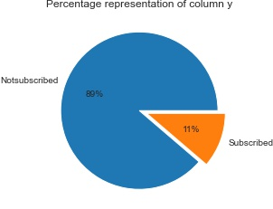
Proceeding with the Exploratory Analysis
Graphical representation and percentage of total number of customers who have subscribed to the term deposit.
This percentage representation gives us a clear image of term deposit subscriptions and the customers preference towards it.

Slide 4
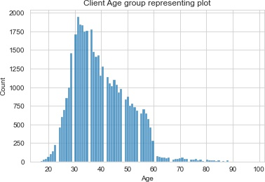
Which range of age group clients will show an interest to subscribe a term deposit?
Age group between 28 to 45 are the most number of cline show interest in the term deposit even for subscription or not interested in term deposit subscription.
This range of age group show good interest in term deposit since they have planned as a retirement scheme or in terms of personal saving.
Above age 60, these people will be coming under retired people so they are not will to make a term deposite.

Slide 5
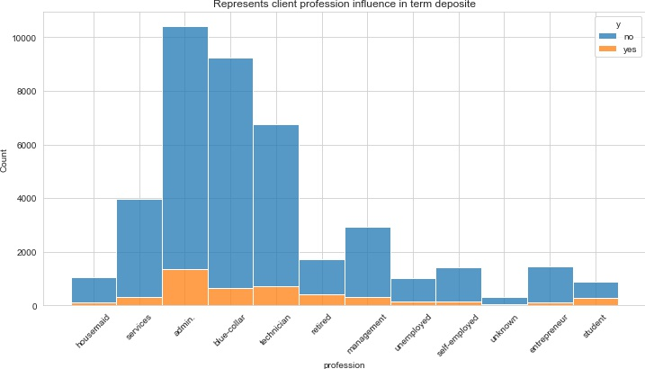
What profession client are subscribing more on a term deposit?
From the analysis the Admins, blue-collar and technician job clients are the once highly reached for term deposit subscription.
Seems like these people have good pay based on their profession.
There can be more subscription if the price is affordable by low paying profession.

Slide 6
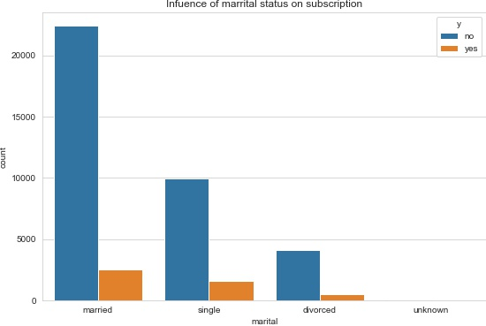
How is marital status affects the subscription?
The customers with marital status as married has showed more interest in term deposit.
This must be for the sake of their family.

Slide 7
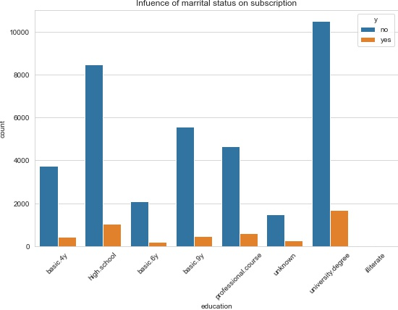
How is education affects the subscription?
The preference of subscription in term deposit is high for customers having education status as ‘University degree’ and ‘high school’.
This must be the plan of saving for their future.
They might have knowledge about the use of term deposit.

Slide 8
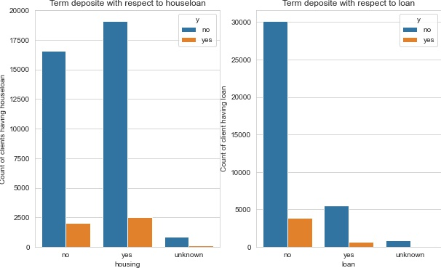
How is housing loan and loan affects the subscription?
The clients subscribing for term deposit are high who is having a housing loan.
Where as the client who is not having a loan are preferring subscription than the client having loan.

Slide 9
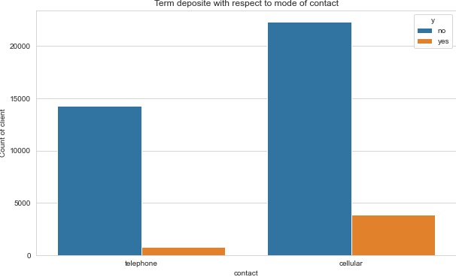
Which contact has the high rate of impact on term deposit subscription?
There is a high reach among the clients through the mode of cellular contact.
We are able to reach a large number of clients through this mode and the acceptance of the client for term deposite is also high.

Slide 10
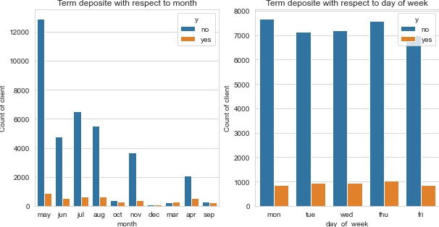
Which month or day of week has highest rate of term deposit subscription?
The month of may is having the highest number of term deposit subscription at the week days.
All the weeks are have an even amount of subscripting, Hence week days have no particular impact.

Slide 11
Conclusion
We are able to predict the number of client who will subscribe and who will not subscribe through the provided data using Logistic Regression which is giving an accuracy score of 91%.
Various factors plays a vital role in the term deposit subscription. Their age and job place a major role, for different job their salary would vary based on that client mind set towards term deposit subscription varies.
We can see that few changes in scheme can increase the number subscription towards term deposit.

Slide 12
Suggestion
Flexible pricing of term deposit could increase the number of subscription. Since the lower salaried people can also afford.
Providing offers to people of age above 50 can increase the subscription and also providing gift and vouchers to the client would help increase the subscription.
Providing fancy gift for clients who suggests to others and bring clients to add in term deposit.
At the period of Quartile or the month 'may' where all get salary increment new offers and scheme would help in the improvement of the subscription.
Contacting and specifying the offers and scheme to more clients who have not previously contacted and already contacted can make more people aware of the plan and scheme of term deposit which help to improve subscription.
Using Cellular contact have a high reach among clients, it can also reach a large number of clients and spread information about scheme over a large group.

