Slide 1
TNM112 – Deep Learning for Media Technology
Nithesh Chandher Karthikeyan

Slide 2
Agenda
Today we will discuss about
Basic components of CNN
CNN Exercise
Calculate the shape of the output activations at each layer
Calculate the number of parameters at each layer
Implement the above CNN in Keras

Slide 3
Basic Components of CNN

Slide 4
Convolution
5
4
10
9
3
7
2
6
1
0
*
=
6
12
1
8
0
1
14
1
0
11
Kernel (or) Filter
Input Matrix

Slide 5
Convolution
5
4
10
9
12
3
7
2
6
1
0
*
=
6
12
1
8
0
1
14
1
0
11
Kernel
Input Matrix

Slide 6
Convolution
5
4
10
9
12
6
3
7
2
6
1
0
*
=
6
12
1
8
0
1
14
1
0
11
Kernel
Input Matrix

Slide 7
Convolution
5
4
10
9
12
6
16
3
7
2
6
1
0
*
=
6
12
1
8
0
1
14
1
0
11
Kernel
Input Matrix

Slide 8
Convolution
5
4
10
9
12
6
16
3
7
2
6
1
0
=
15
6
12
1
8
*
0
1
14
1
0
11
Kernel
Input Matrix

Slide 9
Convolution
5
4
10
9
12
6
16
3
7
2
6
1
0
=
15
8
6
12
1
8
*
0
1
14
1
0
11
Kernel
Input Matrix

Slide 10
Convolution
5
4
10
9
12
6
16
3
7
2
6
1
0
=
15
8
10
6
12
1
8
*
0
1
14
1
0
11
Kernel
Input Matrix

Slide 11
Convolution
5
4
10
9
12
6
16
3
7
2
6
1
0
=
15
8
10
6
12
1
8
*
0
1
7
14
1
0
11
Kernel
Input Matrix

Slide 12
Convolution
5
4
10
9
12
6
16
3
7
2
6
1
0
=
15
8
10
6
12
1
8
*
0
1
7
12
14
1
0
11
Kernel
Input Matrix

Slide 13
Convolution
5
4
10
9
12
6
16
3
7
2
6
1
0
=
15
8
10
6
12
1
8
*
0
1
7
12
12
14
1
0
11
Kernel
2x2
Feature Map
(3x3)
Input Matrix
(4x4)

Slide 14
Convolution with Stride = 2
5
4
10
9
3
7
2
6
1
0
*
=
6
12
1
8
0
1
14
1
0
11
Kernel
Input Matrix

Slide 15
Convolution with Stride = 2
5
4
10
9
3
7
2
6
1
0
12
*
=
6
12
1
8
0
1
14
1
0
11
Kernel
Input Matrix

Slide 16
Convolution with Stride = 2
5
4
10
9
3
7
2
6
1
0
12
16
*
=
6
12
1
8
0
1
14
1
0
11
Kernel
Input Matrix

Slide 17
Convolution with Stride = 2
5
4
10
9
3
7
2
6
1
0
12
16
*
=
6
12
1
8
0
1
7
14
1
0
11
Kernel
Input Matrix

Slide 18
Convolution with Stride = 2
5
4
10
9
3
7
2
6
1
0
12
16
*
=
6
12
1
8
0
1
7
12
14
1
0
11
Kernel
(2x2)
Feature Map
(2x2)
Input Matrix
(4x4)

Slide 19
Padding
Use to preserve spatial information of Input image and Feature Maps (Output of Convolution Layer)
Adding extra pixels (mostly zero) on the border of image
Two Types:
Valid (No padding)
Same (Size of Input and Output feature maps are same)
Eg: Adding one layer of padding to any (W x H) image and using a (3 x 3) filter with stride=1, we would get an (W x H) output after performing a convolution operation

Slide 20
Convolution with Same Padding
0
0
0
0
0
0
0
5
4
10
9
0
1
0
0
0
3
7
2
6
0
*
0
1
0
=
0
6
12
1
8
0
0
0
1
0
14
1
0
11
0
0
0
0
0
0
0
Kernel
(3x3)
Input Matrix

Slide 21
Convolution with Same Padding
0
0
0
0
0
0
0
5
4
10
9
0
12
1
0
0
0
3
7
2
6
0
*
0
1
0
=
0
6
12
1
8
0
0
0
1
0
14
1
0
11
0
0
0
0
0
0
0
Kernel
(3x3)
Input Matrix

Slide 22
Convolution with Same Padding
0
0
0
0
0
0
0
5
4
10
9
0
12
6
1
0
0
0
3
7
2
6
0
*
0
1
0
=
0
6
12
1
8
0
0
0
1
0
14
1
0
11
0
0
0
0
0
0
0
Kernel
(3x3)
Input Matrix

Slide 23
Convolution with Same Padding
0
0
0
0
0
0
0
5
4
10
9
0
12
6
16
1
0
0
0
3
7
2
6
0
*
0
1
0
=
0
6
12
1
8
0
0
0
1
0
14
1
0
11
0
0
0
0
0
0
0
Kernel
(3x3)
Input Matrix

Slide 24
Convolution with Same Padding
0
0
0
0
0
0
0
5
4
10
9
0
12
6
16
9
1
0
0
0
3
7
2
6
0
*
0
1
0
=
0
6
12
1
8
0
0
0
1
0
14
1
0
11
0
0
0
0
0
0
0
Kernel
(3x3)
Input Matrix

Slide 25
Convolution with Same Padding
0
0
0
0
0
0
0
5
4
10
9
0
12
6
16
9
1
0
0
0
3
7
2
6
0
15
*
0
1
0
=
0
6
12
1
8
0
0
0
1
0
14
1
0
11
0
0
0
0
0
0
0
Kernel
(3x3)
Input Matrix

Slide 26
Convolution with Same Padding
0
0
0
0
0
0
0
5
4
10
9
0
12
6
16
9
1
0
0
0
3
7
2
6
0
15
13
14
16
*
0
1
0
=
0
6
12
1
8
0
7
15
19
10
0
0
1
0
14
1
0
11
0
14
7
12
12
0
0
0
0
0
0
Kernel
(3x3)
Feature Map
(4x4)
Input Matrix
(4x4)

Slide 27
Max Pooling
12
6
16
9
15
13
14
16
=
7
15
19
10
14
7
12
12
Size=2x2
Input Matrix
(4x4)

Slide 28
Max Pooling
12
6
16
9
15
13
14
16
15
=
7
15
19
10
14
7
12
12
Size=2x2
Input Matrix
(4x4)

Slide 29
Max Pooling
12
6
16
9
15
13
14
16
15
16
=
7
15
19
10
14
7
12
12
Size=2x2
Input Matrix
(4x4)

Slide 30
Max Pooling
12
6
16
9
15
13
14
16
15
16
=
7
15
19
10
15
14
7
12
12
Size=2x2
Input Matrix
(4x4)

Slide 31
Max Pooling
12
6
16
9
15
13
14
16
15
16
=
7
15
19
10
15
19
14
7
12
12
Size=2x2
Feature Map
(2x2)
Input Matrix
(4x4)

Slide 32
Average Pooling
12
6
16
9
15
13
14
16
11
13
=
7
15
19
10
11
13
14
7
12
12
Size=2x2
Feature Map
(2x2)
Input Matrix
(4x4)

Slide 33
Convolution in Image
Image: 5x5 Pixels in RGB channels (5 x 5 x 3)
Kernel: 3x3 in 3 channels (3 x 3 x 3 x n_{k}), where n_{k} is the number of kernels applied to the image

Slide 34
Convolution in Image
Each output from the RGB channels are summed to get one final output

Slide 35
Convolution in Image
Bias is added to the final output

Slide 36
CNN Exercise

Slide 37
Convolutional Neural Network
Consider the following CNN with Input of Size 32×32×3:
Conv layer, 32 filters with a size of 3×3, padding=same, stride =1, ReLU activation
Max Pool layer with size 2×2
Conv layer, 64 filters with a size of 3×3, padding=same, stride =1, ReLU
Max Pool layer with size 2×2
Flatten layer
Fully connected layer with 512 units and a ReLU activation
Fully connected output layer with 10 units and a softmax activation function

Slide 38
Convolutional Neural Network
Let's calculate the following:
Shape of output activations at each layer
Number of Parameters at each layer

Slide 39
Convolutional Neural Network
Let's calculate the following:
Shape of output activations at each layer
Number of Parameters at each layer

Slide 40
Notations
Name | Notation
Input Size | W
Kernel Size | K
Padding | P
Stride | S
Number of Kernels (Output Channel) | n_{k}
No of Kernels of previous layer (Input Channel) | n_{k-1}

Slide 41
Shape of Output Activations
For Convolutional Layer:
Output Shape = ([(W-K+2P)/S]+1 , [(W-K+2P)/S]+1,n_{k})
For Max pooling Layer:
Output Shape = (W/K , W/K, n_{k-1})

Slide 42
How to calculate P?
For Valid Padding, P=0 (No Padding)
For Same Padding, Size of Input and Output of Convolutions are same. i.e.
(W-K+2P)/S]+1 = W
For stride=1 gives,
P = K-1/2

Slide 43
Layer 1
Conv layer, 32 filters with a size of 3×3, padding=same, stride =1, ReLU activation:
W=32 (Input: 32 x 32 x 3)
K = 3 (Kernel: 3 x 3 x 3 x 32)
S = 1
P = 1 (For Same Padding & S=1, P=(K-1)/2 )(From Slides 19 & 42)
n_{k} = 32 (Number of Filters/Kernels)
Output Shape*: ([(W-K+2P)/S]+1 , [(W-K+2P)/S]+1 , n_{k})
=(32-3+2(1)/1 + 1 , 32-3+2(1)/1+1, 32)
=(32, 32, 32)
*Note: For same padding, Input and Output have same W. You can skip the calculation as the final output will be [W x W x n_{k}] (in this case 32 x 32 x 32).

Slide 44
Layer 2
Max Pool layer with size 2×2:
W = 32 (Input: 32 x 32 x 32)
Size = 2 (2 x 2)
Output Shape: (W/Size, W/Size, n_{k-1})
= (32/2, 32/2, 32)
= (16, 16, 32)

Slide 45
Layer 3
Conv layer, 64 filters with a size of 3×3, padding=same, stride =1, ReLU activation:
W=16 (Input: 16 x 16 x 32)
K = 3 (Kernel: 3 x 3 x 32 x 64)
S= 1
P = 1 (For Same Padding & S=1, P=(K-1)/2 )(From Slides 19 & 42)
n_{k} = 64 (Number of Filters/Kernels)
Output Shape*: ([(W-K+2P)/S]+1,[(W-K+2P)/S]+1,n_{k})
=(16-3+2(1)/1 + 1 , 16-3+2(1)/1+1, 64)
=(16,16,64)
*Note: For same padding, Input and Output have same W. You can skip the calculation as the final output will be [W x W x n_{k}] (in this case 16 x 16 x 64).

Slide 46
Layer 4
Max Pool layer with size 2×2:
W = 16 (16 x 16 x 64)
Size = 2 (2 x 2)
Output Shape: (W/Size, W/Size, n_{k-1})
= (16/2, 16/2, 64)
= (8, 8, 64)

Slide 47
Layer 5
Flatten layer:
Input: (8 x 8 x 64)
Output: (4096,)

Slide 48
Layer 6
Fully connected layer with 512 units and a ReLU activation:
Input: (4096,)
No of hidden units in Dense Layer: 512
Output: (512,)

Slide 49
Layer 7
Fully connected output layer with 10 units and a softmax activation function:
Input: (512,)
No of hidden units in Output Layer: 10
Output: (10,)

Slide 50
Convolutional Neural Network
Let's calculate the following:
Shape of output activations at each layer
Number of Parameters at each layer

Slide 51
Number of Parameters
For Conv Layer:
No of Params = [(K x K x n_{k-1} x n_{k} ) + n_{k}]
Weights
Bias

Slide 52
Layer 1
Conv layer, 32 filters with a size of 3×3, padding=same, stride =1, ReLU activation:
K = 3 (Kernel: 3 x 3 x 3 x 32)
n_{k-1} = 3 (Input Channel/Number of Filters in the prev layer)
n_{k} = 32 (Number of Filters/Kernels)
No of Params = [(K x K x n_{k-1} x n_{k} ) + n_{k}]
= [(3 x 3 x 3 x 32) + 32]
= 896

Slide 53
Layer 2
Max Pool layer with size 2×2
Number of Params = 0

Slide 54
Layer 3
Conv layer, 64 filters with a size of 3×3, padding=same, stride =1, ReLU activation:
K = 3 (Kernel: 3 x 3 x 32 x 64)
n_{k-1} = 32 (Input Channel/Number of Filters in the prev layer)
n_{k} = 64 (Number of Filters/Kernels)
No of Params = [(K x K x n_{k-1} x n_{k}) + n_{k}]
= [(3 x 3 x 64) + 64]
= 18, 496

Slide 55
Layer 4 and 5
Max Pool layer with size 2×2
Flatten layer
Number of Params = 0

Slide 56
Layer 6
Fully connected layer with 512 units and a ReLU activation
Input: (4096,)
Output: (512,)
Number of Params = (4096 x 512) + 512
= 2,097,664

Slide 57
Layer 7
Output layer with 10 units and a softmax activation
Input: (512,)
Output: (10,)
Number of Params = (512 x 10) + 10
= 5130

Slide 58
Computed Results
Layers | Output Shape | #Params
Conv | [32, 32, 32] | 896
Max Pool | [16, 16, 32] | 0
Conv | [16, 16, 64] | 18,496
Max Pool | [8, 8, 64] | 0
Flatten | [4096,] | 0
Dense | [512,] | 2,097,664
Output | [10,] | 5130

Slide 59
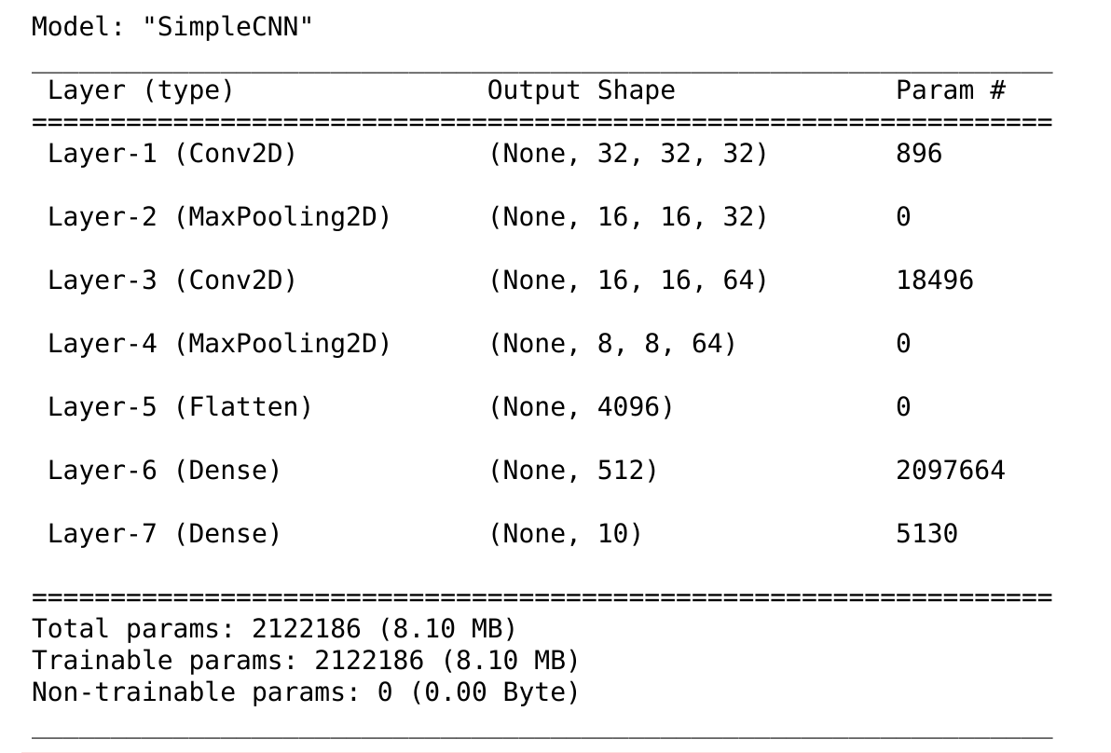
Results (from Keras)

Slide 60
Convolutional Neural Network
Now compute output shape and number of parameters at each layers again but with Padding=valid. Input Shape= 32 x 32 x 3.
Conv layer, 32 filters with a size of 3×3, padding=valid, stride =1, ReLU activation
Max Pool layer with size 2×2
Conv layer, 64 filters with a size of 3×3, padding=valid, stride =1, ReLU
Max Pool layer with size 2×2
Flatten layer
Fully connected layer with 512 units and a ReLU activation
Fully connected output layer with 10 units and a softmax activation function

Slide 61
Write your results below:
Layers | Output Shape | #Params
Conv
Max Pool
Conv
Max Pool
Flatten
Dense
Output

Slide 62
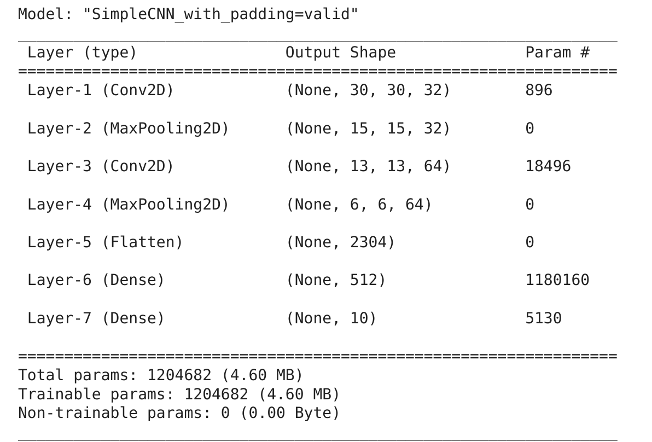
Verify with Results from Keras

Slide 63

Feedback
Kindly send us your feedback

