Slide 1

JIRA

Slide 2
What is JIRA
JIRA is a software testing tool developed by the Australian Company Atlassian. It is a bug tracking tool that reports all the issues related to your software or mobile apps. The word JIRA comes from the Japanese word, i.e., "Gojira" which means Godzilla.

Slide 3
Why JIRA?
Plan, Track and Work Faster
The main source of information
Organize the documentation tasks
Track the progress of our documentation
Helps to meet the deadlines of a documentation release.
Provides feedback faster

Slide 4
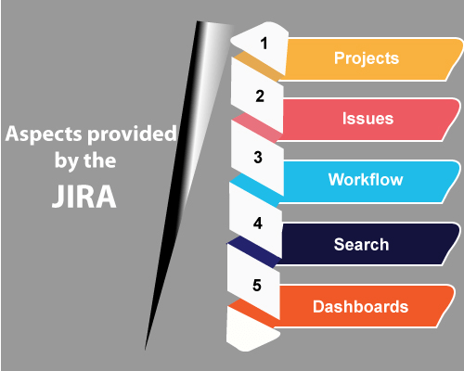
Aspect Provided By The JIRA

Slide 5
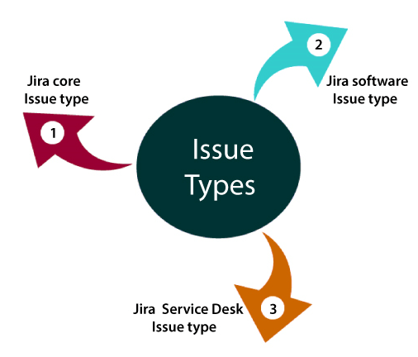
Jira Issue Types
Jira core issue type
1.Task
2.Subtask
Jira software issue type
1.Bug
2.Epic
Jira service desk issue type
1. Change
2. New feature
3. Problem
4. Support

Slide 6
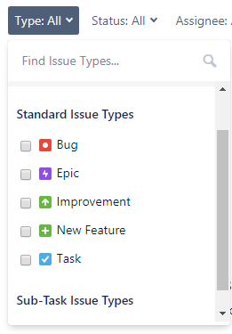
JIRA Issue Types

Slide 7
JIRA EPIC
Jira epic is a large user story
Epics can span to multiple sprints
Epics can contain stories, bugs, and tasks within them, and grouping them makes a large story.

Slide 8
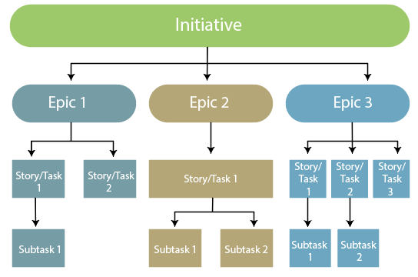
Structural flow of an Epic

Slide 9
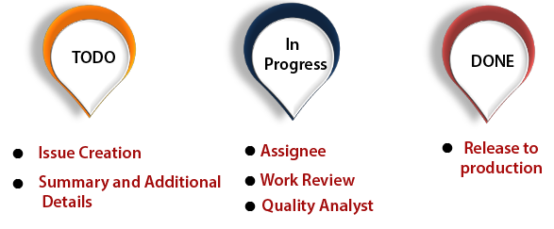
Jira work flow Phases

Slide 10
JIRA Backlog
Activities in scrum backlog
Add issues to the backlog
Prioritize the backlog
View and edit an issue's details
Identify the workload for users
Create subtasks
Transition an issue
Split an issue
Delete an issue
Find issue

Slide 11
Advantages of JIRA
Jira tool is useful for functional testing.
It is used to prioritize the tasks.
One can easily get to know about the next release of the build as Jira tool provides better visibility.
It provides a better flexibility workflow so that the team can adjust accordingly.

Slide 12
Thank You

