Slide 1
What is Rest Assured?
Rest Assured is a java based library that is used to test Restful Web Services. This behaves like headless client to access Rest Web Services
Rest Assured simple java libraries for testing Rest Web Serivice Api
Rest Assured library also provide ability to validate Http response received from the server For e.g. We can verify status code, Status message and header and even body of the response. This make Rest Assured a very flexible library that can be used for testing.
It supports both XML and JSON.

Slide 2
Why Rest Assured popular?
Integrate seamlessly with existing java based framework
TestNG/Junit/BDD
Selenium Webdriver
JDBC
We can Automate End2End business flow which include all layers
Presentation layer-> Functional Testing
Business layer-> API Testing
Database layer-> Database testing

Slide 3
Rest Assured Advantages
Support for HTTP method:- GET, POST, PATCH,PUT,DELETE
Support for BDD: - Given, When, Then
Use of Hamcrest for Response validation/Assertion
Provide inbuilt method to create request header and body
Provide inbuilt method to validate response header and body
Handles various authentication like Token auth, Basic auth, Oauth1.0 and Oauth 2.0
Send request over the network using existing protocol like http
Integrate Seamlessly with existing java based framework like selenium, testing, jdbc, poi etc
Used for complete backend automation
Framework can integrate with CI/CD pipeline
Open source headless client

Slide 4
Rest Assured project Setup
POM dependencies:-
Rest Assured – Rest Api headless client
Json-simple – To create Json Object
Jackson-mapper- To convert POJO class and parser
Apache POI - Read and write data from excel sheet
TestNG – Unit Testing framework
Selenium java – Web Automation

Slide 5
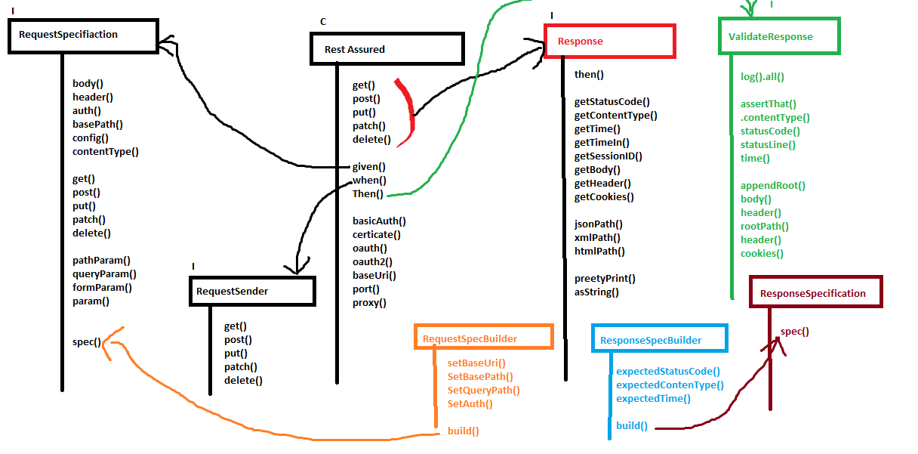
Rest Assured class diagram

Slide 6
Get
import org.testng.annotations.Test;
import io.restassured.RestAssured;
import io.restassured.response.Response;
public class GetAllProjectTest {
@Test
public void getAllProjectTest() {
Response response = RestAssured.get("http://localhost:8084/projects");
response.prettyPrint();//print only response body
}
}

