Slide 1

Department of Artificial Intelligence and Machine Learning
AcadAdvisor — An Agentic AI Based Student Academic Advisor
Nithesh Kumar S 231501114
Lena Vishal J 231501083
Lithesh M 231501084
Dr.M.Soundarya

Slide 2
Problem Statement and Motivation
Rules are scattered – attendance, passing, CGPA, Honours and degree-class rules sit across the 25-page REC UG Regulations 2023 and a 233-page AI&ML curriculum.
Mistakes are costly – missing the 65–74% condonation window means an SA grade; ignoring the 45% end-sem floor means failing despite a good CA score.
Manual advising doesn’t scale – counsellors answer the same questions every semester.
Plain LLMs and basic RAG fall short – they invent clause numbers, miscalculate CGPA, retrieve only once and can’t say “I’m not sure”.
Placement mails get missed – students miss deadlines or apply without meeting the CGPA/arrear criteria.
Need: an advisor that cites the rulebook, computes with tools, checks itself and escalates to a human – and watches the inbox for drives.

Slide 3
User and Stakeholder Analysis
Students – cited answers plus their own CGPA, attendance standing, exam mark targets and placement eligibility.
Faculty Counsellors – review only the low-confidence answers in a review queue (approve / reject).
Placement Cell – drive emails are auto-parsed; students get an eligibility check and a 3-day prep plan.
Administrators – college-domain Google login, allow-listed admins, encrypted Gmail tokens.
Academic Office – official PDFs stay the single source of truth; a rule update just means re-indexing.
Expected Outcome
Page-cited answers, exact tool-computed results, every uncertain case routed to a human, and placement alerts that arrive without opening the app.

Slide 4
Proposed Agentic AI Solution & Novel Features
AcadAdvisor – two cooperating LangGraph agent teams working over one student profile:
Advisor Team: Memory → Supervisor → ReAct Controller → Synthesis → Critic/Verifier → Reflection
Email Team: Observer → Classifier → Summarizer → Recruitment → Eligibility → Prep Plan → Critic
Novel Features
One-action ReAct controller – picks retrieve / tool / finish live; can’t answer without evidence.
“LLM never does maths” – 11 tools encode Clauses 4.10, 7, 14.1, 15.5, 16.2 exactly.
Built-in self-doubt – verifier + 2 reflection retries, then counsellor escalation.
Event-driven placement agent – reads Gmail itself, checks eligibility, builds a 3-day prep plan.
Personal what-if engine – target-CGPA goal-seek, arrear impact, “Can I skip tomorrow?”
Runs fully local – llama3.2:3b on Ollama + deterministic fallback; data stays on-device.

Slide 5
Dataset and knowledge source identification
Knowledge Sources
  REC UG Regulations 2023 (25 pages → 128 blocks) + R2023 AI&ML Curriculum & Syllabus (233 pages → 1,702 blocks)
  1,830 page-cited blocks, chunked at clause / unit / semester headings
Structured Data
  Course catalogue: 52 courses (Sem I–VIII, L-T-P-C) + 4 elective verticals
  Student grades and attendance via the app or validated CSV upload (no real data bundled)
  Sample placement drives: Zoho, Amazon AWS, Kaar Technologies
Evaluation Data
  Golden set: 10 questions with ground truth and source page (attendance, passing, CGPA, Honours, curriculum, registration, classification)
  34 automated pytest cases covering rules, agent, email agent, login and data

Slide 6
Selection of tools and Framework
Agent Frameworks
  LangGraph – typed shared state, conditional edges, bounded loops
  LangChain + langchain-ollama – ChatOllama at temperature 0 with timeouts
AI Model
  Ollama llama3.2:3b – fully local, fits a 4 GB GPU, no API keys or cost
  Deterministic fallback – heuristic actions when the model is down
Knowledge & Retrieval
  PyMuPDF – page-wise PDF extraction with stable page citations
  Hybrid retriever – TF-IDF cosine (0.72) + keyword overlap (0.28), pure Python
Database
  SQLite – 11 tables: profiles, chats + traces, reviews, goals, progress, placement, Gmail

Slide 7
Selection of tools and Framework
Deployment & UI
  Streamlit – 11-page portal with built-in Google (OIDC) sign-in
  FastAPI + Uvicorn – admin REST API (11 endpoints), bearer-token protected
Integrations
  Gmail API (read + send) via Google OAuth
  APScheduler worker – polls inboxes every 1–10 min (default 2)
Security
  Fernet encryption for refresh tokens · HMAC token check · college-domain allow-list
Testing & Evaluation
  pytest (34 tests) · evaluate.py golden-set harness → CSV · pandas for CSV validation

Slide 8
Agent workflow and Orchestration
Recall – Memory Agent loads recent turns, goals and progress.
Route – Supervisor picks 1 of 7 intents and logs its reasoning.
ReAct loop – Thought → Action (retrieve / tool) → Observation, one step at a time.
Guard-rails – must retrieve before finishing · allow-listed tools only · no repeated tool · max 6 actions.
Synthesize – drafts a cited answer from evidence and tool outputs only.
Verify & reflect – score < 0.65 → rewrite queries and retry (max 2).
Escalate – still uncertain → counsellor queue; every step saved as an execution trace.
Parallel event loop – new Gmail → classify → recruitment branch → critic → notify college + personal email.

Slide 9
Agentic RAG
Clause-aware ingestion – chunks split at clause / unit / semester headings; source + page kept on every block.
Hybrid ranking – TF-IDF cosine + exact keyword overlap keeps codes like CS23634 and “Clause 7.2” findable.
Agent-driven retrieval – the controller writes focused queries; evidence is merged, re-ranked, top 8 kept.
RAG + tools fusion – policy evidence and personal calculations combined in one answer.
Grounded output – cites [file p.N – Clause X]; retrieved text treated as data (prompt-injection guard).
Self-correction – low grounding → Reflection rewrites up to 4 queries and re-retrieves.
Results on the golden set – every answer cited; correct page in the top 4 for 8/10 questions (MRR 0.658).

Slide 10
Human-in-the-Loop (HITL)
Auto-escalation – confidence < 0.65, verifier fail or no evidence → review queue.
Bounded autonomy – max 6 actions and 2 retries, then hand over to a human.
Counsellor view – question, draft answer, why it was flagged and the full agent trace.
Approve / Reject – decision stored with the case (Counsellor Review page + /reviews API).
Email Critic – holds back alerts missing company, eligibility or prep plan.
Role-based access – only allow-listed admins see the review, evaluation and report pages.
Student control – own data upload; disconnecting Gmail deletes the stored credentials.

Slide 11
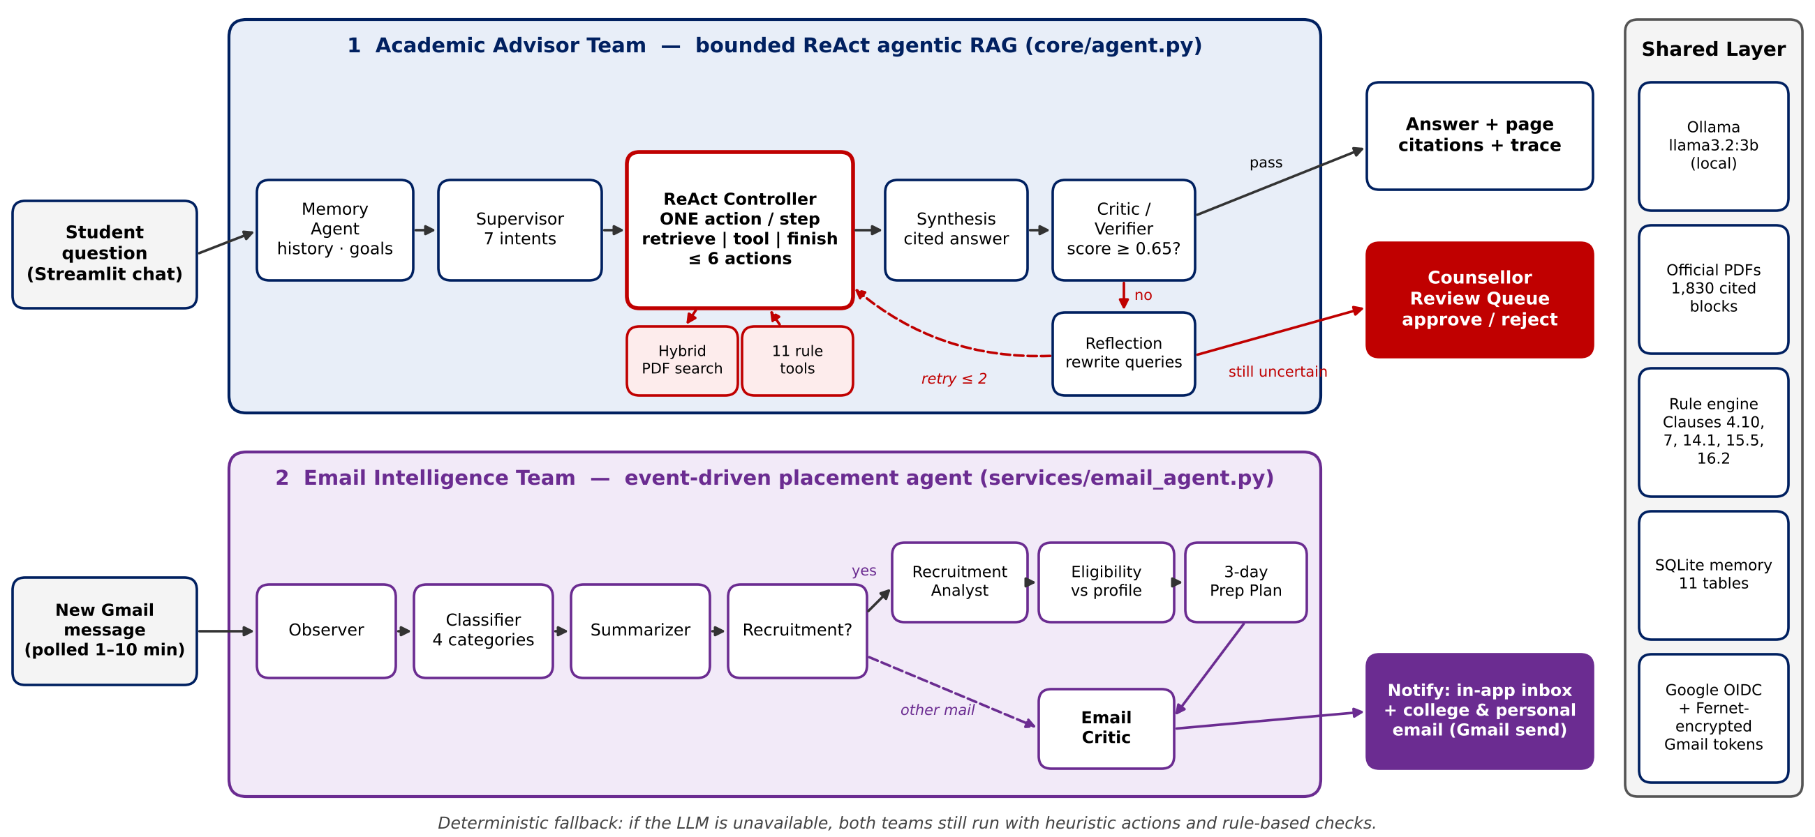
Architecture Diagram

Slide 12
Thank You

