Slide 1
Internship
Document Answering Bot

Slide 2
About the Company
Siemens AG is a global powerhouse in industrial engineering and technology, founded in 1847 by Werner von Siemens. Headquartered in Munich, Germany, Siemens has grown into one of the world's leading technology companies, focusing on electrification, automation, and digitalization. The company's diverse portfolio includes products and solutions for power generation and transmission, automation and control, medical imaging and laboratory diagnostics, and infrastructure and building technology.
Major Milestones:
• 1847: Siemens & Halske was founded.
• 1866: Invention of the dynamo machine.
• 1969: Development of the first automated high-speed train.
• 2011: Siemens introduces the world's most efficient gas turbine.
• 2020: Siemens completes the spin-off of Siemens Energy.

Slide 3
About the Company’s Department
The Digital Asset and Service Solutions (DASS) department at Siemens is dedicated to leveraging digital technologies to enhance asset performance, optimize service delivery, and drive operational efficiency. DASS integrates advanced technologies such as the Internet of Things (IoT), artificial intelligence (AI), big data analytics, and cloud computing to develop innovative solutions that meet the evolving needs of customers across various industries.

Slide 4
Abstract
The MultiPDF Chat App is a Python application that allows you to chat with multiple PDF documents. You can ask questions about the PDFs using natural language, and the application will provide relevant responses based on the content of the documents. This app utilizes a language model to generate accurate answers to your queries. The app will only respond to questions related to the loaded PDFs.

Slide 5
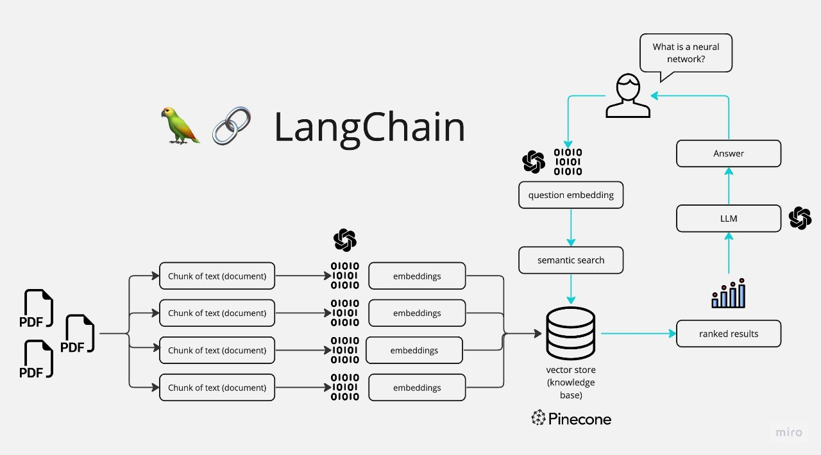
Tasks Performed

Slide 6
Steps
The application follows these steps to provide responses to your questions:
PDF Loading: The app reads multiple PDF documents and extracts their text content.
Text Chunking: The extracted text is divided into smaller chunks that can be processed effectively.
Language Model: The application utilizes a language model to generate vector representations (embeddings) of the text chunks.
Similarity Matching: When you ask a question, the app compares it with the text chunks and identifies the most semantically similar ones.
Response Generation: The selected chunks are passed to the language model, which generates a response based on the relevant content of the PDFs.

Slide 7
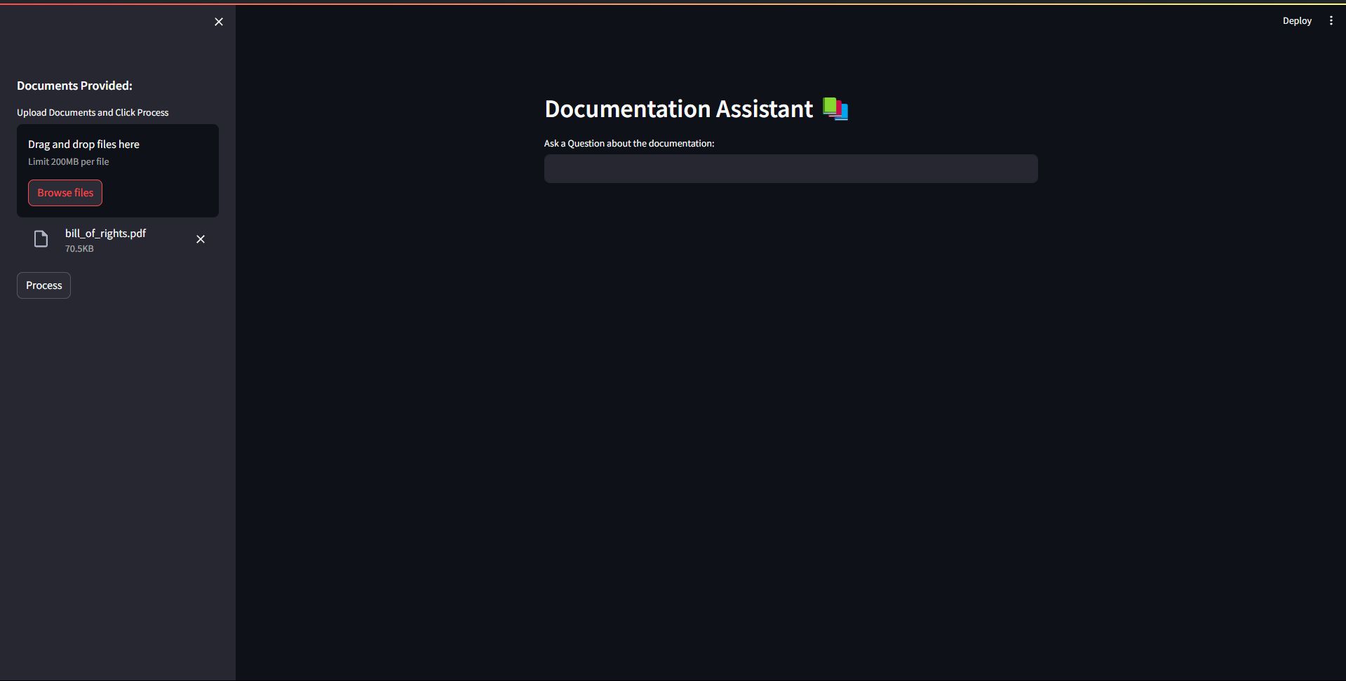
ChatBot interface using Streamlit

Slide 8
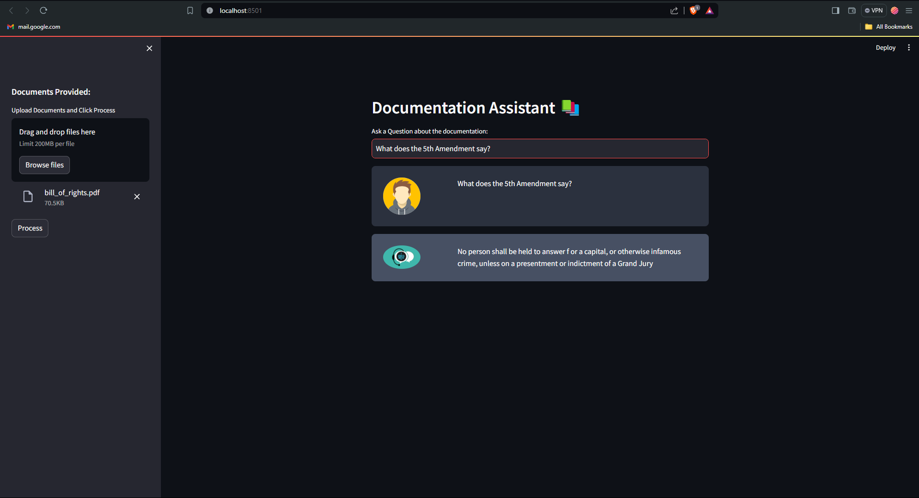
Response Generated

Slide 9
Reflection Notes
The internship at Siemens provided valuable hands-on experience in developing advanced AI-based solutions. Key technical outcomes include proficiency in NLP techniques, software development skills, and an understanding of system architecture design. Non-technical outcomes include enhanced communication skills, time management, and the ability to work effectively in a team environment. The experience has significantly contributed to personal and professional growth, providing a strong foundation for future career endeavors.

