Slide 1
Adventure Works Dashboard Presentation
Welcome to the Adventure Works Sales Intelligence Dashboard presentation. This overview will highlight key sales performance across various dimensions, empowering strategic decisions through clear, interactive visuals.

Slide 2
Adventure Works Sales Intelligence Dashboard
Presented by Nithin C
This dashboard showcases Adventure Works’ sales performance across years, regions, and product lines. It’s designed to empower strategic decisions through clear, interactive visuals.

Slide 3
Dashboard Scope & Interactivity
The dashboard covers data from 2011 to 2014 across six countries. Filters allow users to slice data by year and region, enabling tailored insights for localized strategy.
Data Range
Coverage
Interactivity
2011 - 2014
6 Countries
Year & Region Filters

Slide 4
Business Snapshot
29,589K
60,389
6
Total Sales
Customers
Products Tracked
These figures reflect strong market presence and product diversity, providing a clear overview of our business performance.

Slide 5



Sales Growth Over Time
Sales grew steadily year-over-year, peaking in 2014. Quarter-wise analysis shows Q2 and Q4 as top performers—likely driven by seasonal demand and promotional cycles.
Steady Growth
2014 Peak
Q2 & Q4 Strong
Sales increased year-over-year.
Highest sales recorded in 2014.
Top performing quarters due to seasonality.

Slide 6
Monthly Trends & Profitability
Sales and production costs rise in tandem, but margins remain healthy. December shows peak sales, suggesting strong year-end performance.
Tandem Growth
Healthy Margins
December Peak
Sales and costs move together.
Profitability maintained.
Strong year-end sales performance.

Slide 7
Best-Selling SKUs
Mountain-200 Black variants dominate the top 5, with the 42-inch model leading. This signals strong customer preference for premium mountain bikes.
1
Mountain-200 Black Dominance
2
42-inch Model Leads
3
Premium Preference
Strongest performer within the variant.
Indicates customer demand for high-end mountain bikes.
Top 5 best-selling products.

Slide 8
Sales & Profit by Product Line
Bikes lead in sales, but Accessories and Clothing show higher profit margins. Subcategories like Mountain Bikes and Helmets offer both volume and profitability.
Bikes
Accessories & Clothing
Mountain Bikes & Helmets
Lead in overall sales volume.
Higher profit margins.
Strong in both volume and profitability.

Slide 9

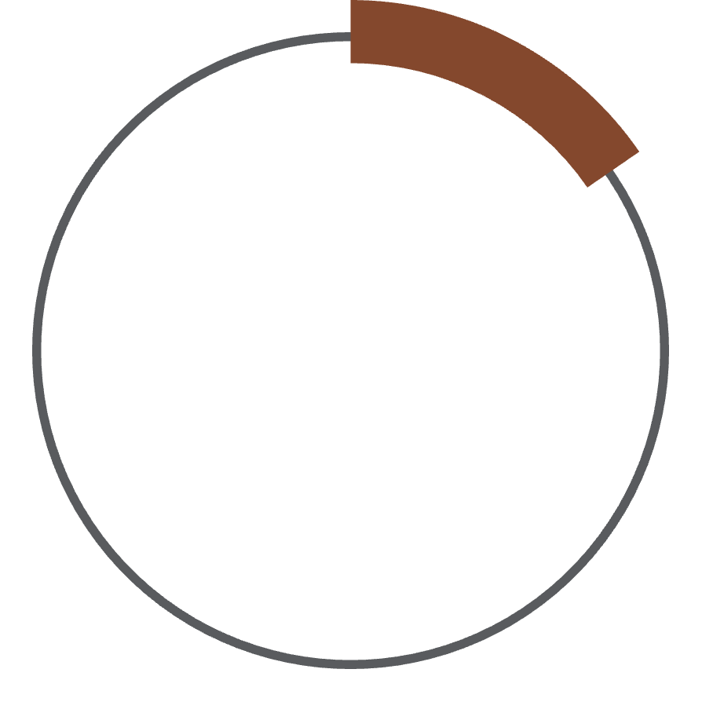
Delivery Performance
84.6% of orders were delivered successfully. While solid, the 15.4% undelivered rate highlights a logistics improvement opportunity.
84.6%
15.4%
Successful Deliveries
Undelivered Orders
Area for logistics improvement.

Slide 10
Strategic Insights
These insights guide both operational and marketing decisions for Adventure Works.
Focus on high-margin accessories.
Optimize Q2/Q4 campaigns.
Improve delivery reliability.
Expand top-performing SKUs.

