Slide 1
E-Commerce Sales & Profit Analysis
A Data-Driven Deep Dive into Regional and Segment Performance
Presented by: Nithin C – Data Analyst
“Welcome everyone. Today, I’ll walk you through a comprehensive analysis of E-Commerce sales and profit performance across categories, regions, and customer segments. Let’s dive into the data story.”

Slide 2
Executive Summary
₹2.30M
12.47%
5.91%
Consumer
Total Sales
Profit Margin
Return Rate
Top Performing Segment
Technology
Highest Profit Category
(50.79%)
“Our analysis reveals a healthy sales volume with a modest profit margin. Technology leads in profitability, while Consumer segment drives the highest sales. Let’s explore what’s fueling these numbers.”

Slide 3
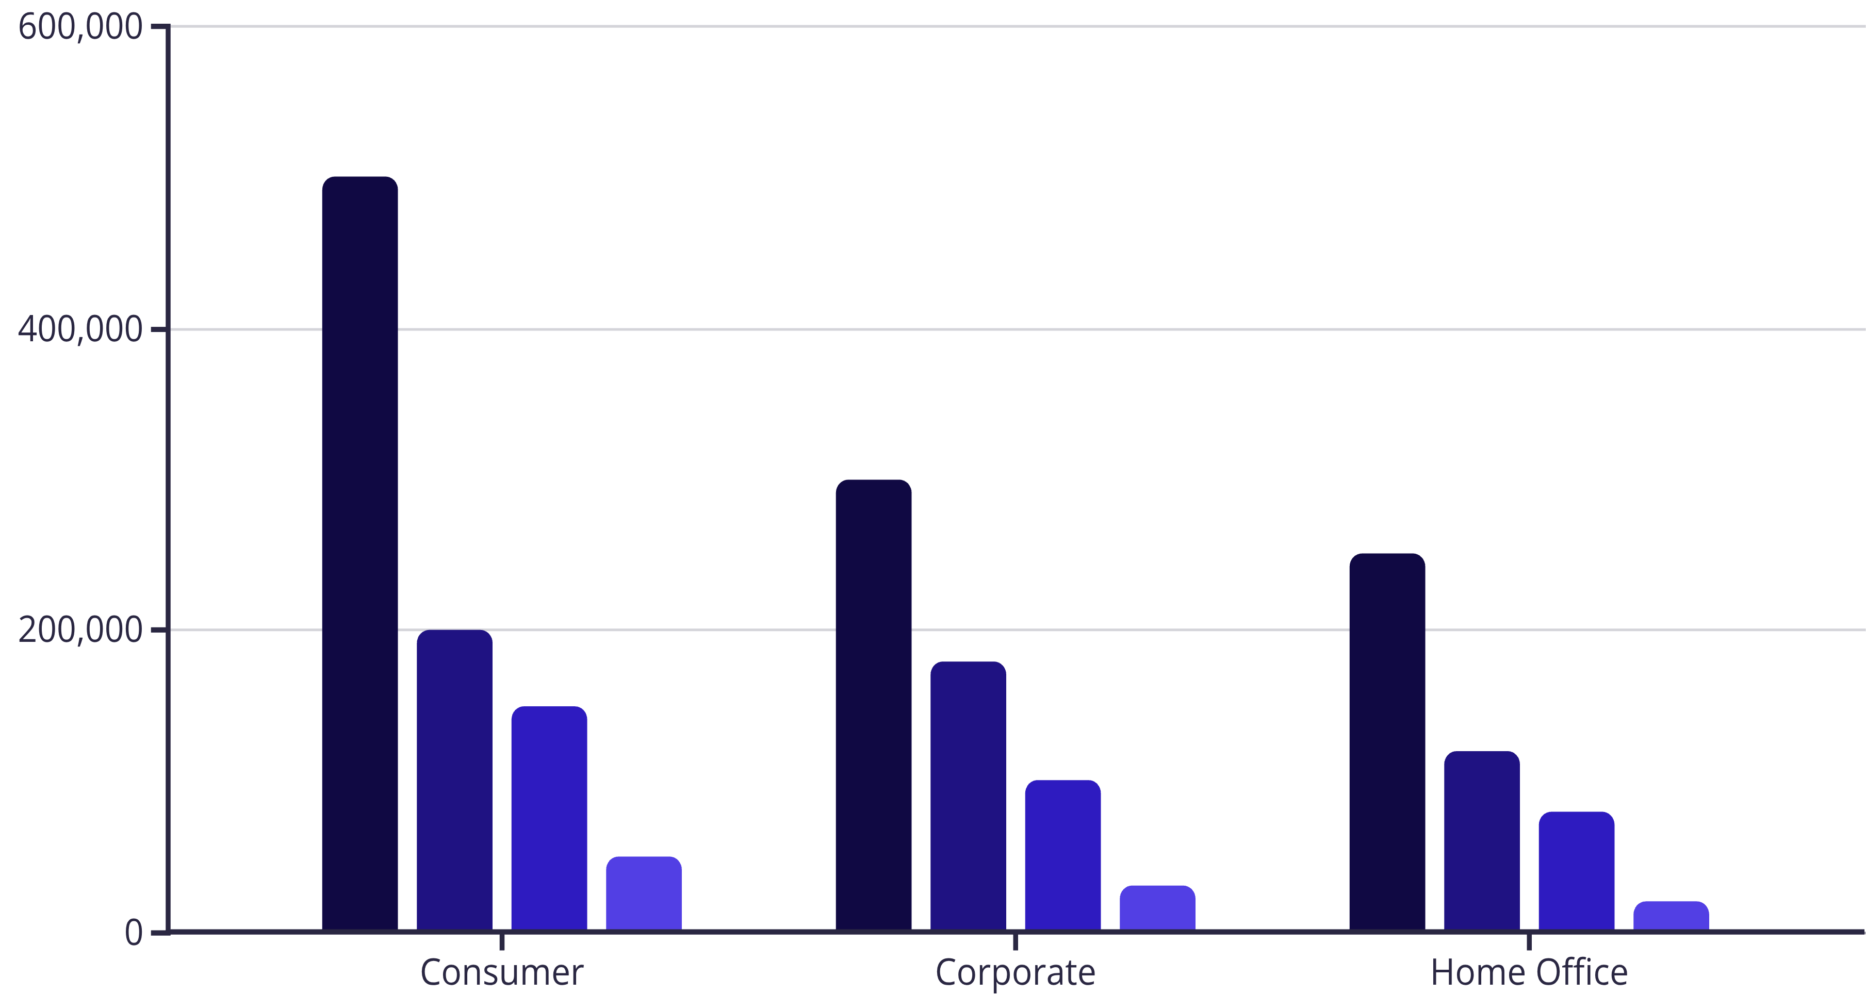
Segment Sales Breakdown
Insights:
Same Day
Standard Class
Second Class
First Class
Consumer segment dominates across all ship modes
Standard Class is the most used shipping method
Corporate segment shows strong performance in Second Class
“Shipping preferences vary by segment, but Standard Class remains the backbone of fulfillment. Consumer orders are both frequent and profitable, making them a strategic focus.”

Slide 4
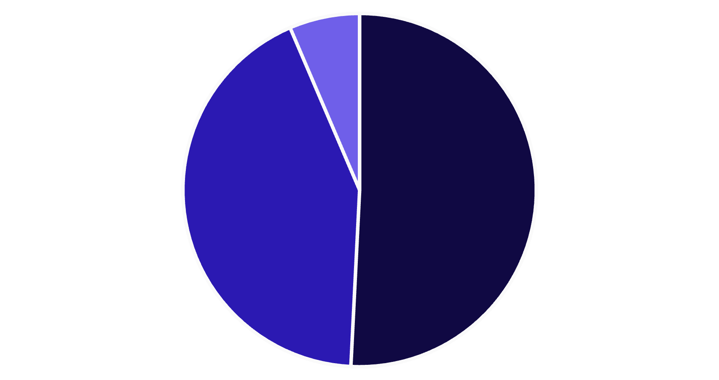
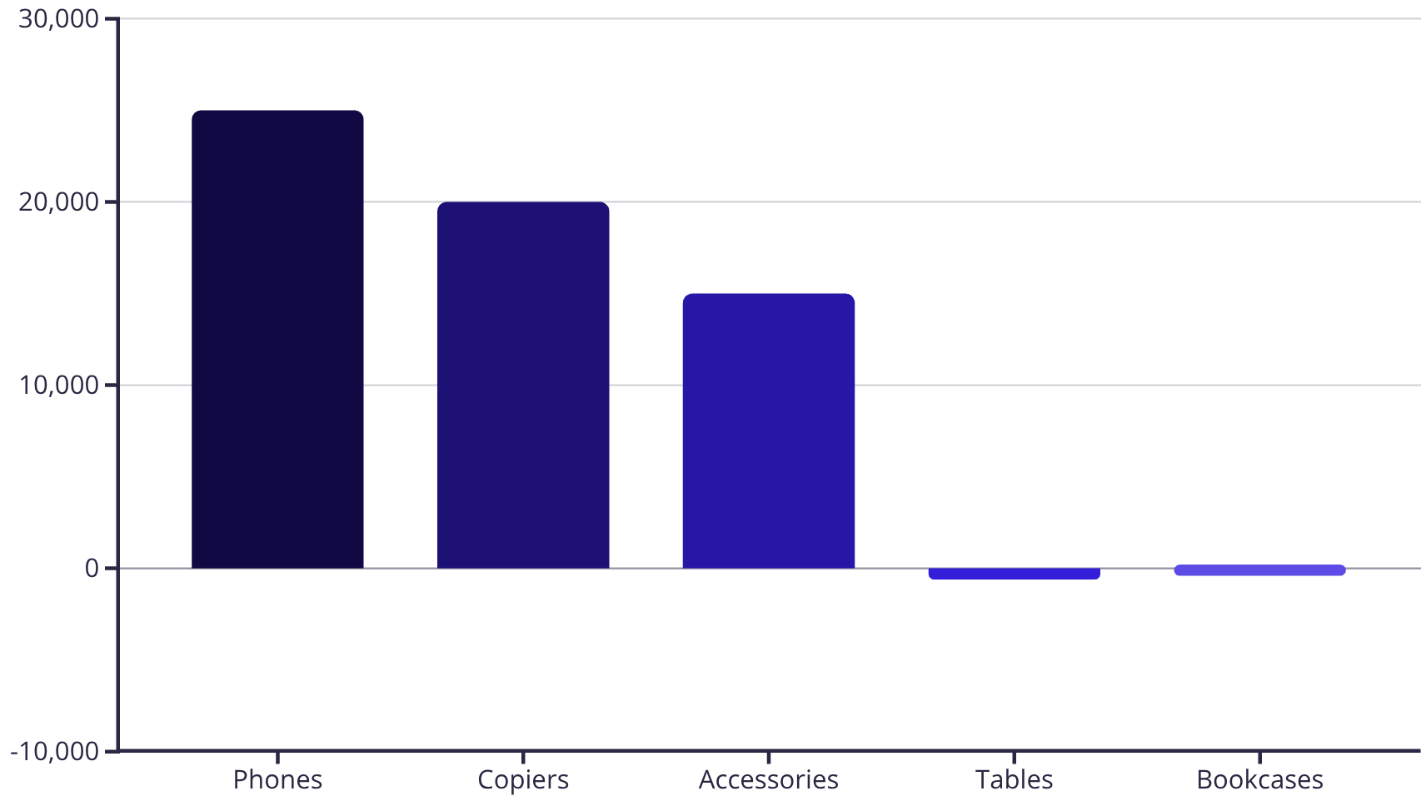
Category & Sub-Category Profitability
Technology
Office Supplies
Furniture
Highlights:
Technology: 50.79% profit share
Office Supplies: 42.77%
Furniture: Only 6.44%
Top Sub-Categories: Phones, Copiers, Accessories
Loss Leaders: Tables (-6.19%), Bookcases (-1.21%)
“Phones and Copiers are clear profit drivers, while Furniture—especially Tables and Bookcases—are underperforming. This signals a need for pricing or inventory strategy review.”

Slide 5
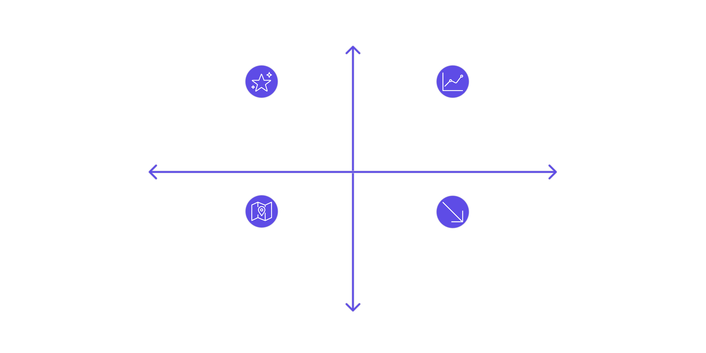




Regional Profit Distribution
High Profit ( Top)
West — Leading (CA ₹76K)
East — Strong Performance
Central & South Weakness
West vs East Strength
Central — Moderate Results
South — Underperforming
Key Insight:
California leads with ₹76K profit
Low Profit (Bottom)
West and East regions outperform Central and South
“Geographically, the West region—especially California—is a goldmine. Targeted marketing and inventory optimization here could amplify returns.”

Slide 6
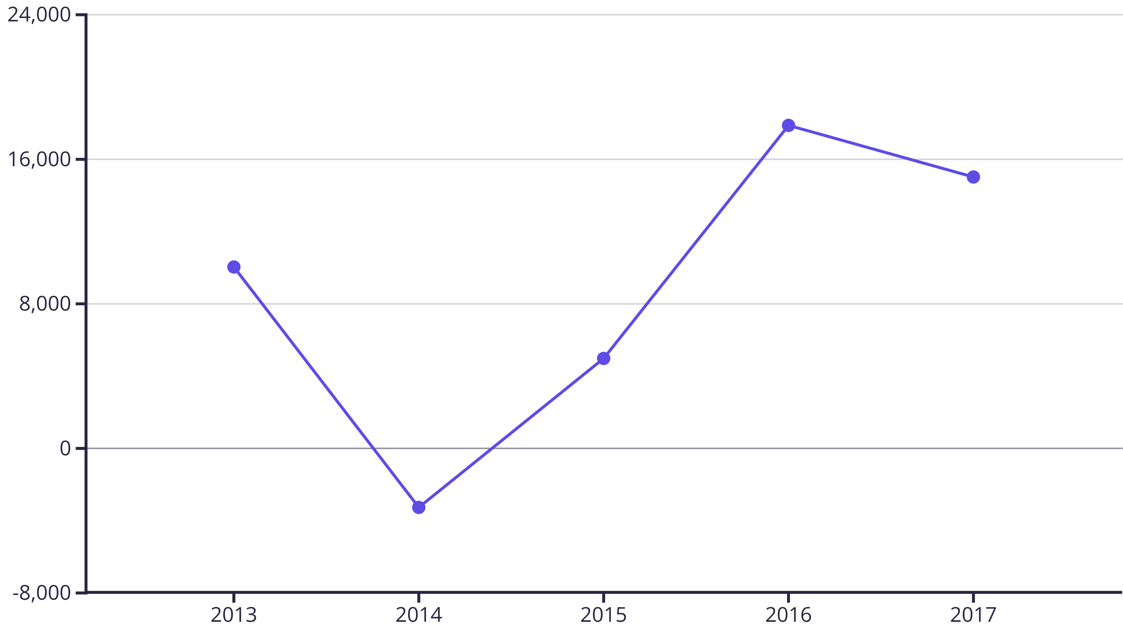
Profit Trend Over Time
Observations:
Dip in 2014 (-₹3,281)
Peak in 2016 (₹17,885)
Steady recovery post-2015
“Despite a dip in 2014, profitability rebounded strongly. This trend suggests resilience and effective corrective strategies.”

Slide 7
Sales & Profit Correlation by Region
Category
West
East
Central
South
Technology
High Profit
High Profit
High Profit
High Profit
Office Supplies
Balanced
Balanced
Balanced
Balanced
Furniture
Moderate Profit
Moderate Profit
Lags
Lags
Insights:
Technology consistently profitable across all regions
Office Supplies show balanced performance
Furniture lags in South and Central
“Cross-regional analysis shows Technology’s dominance, while Furniture struggles in certain areas. This opens doors for region-specific interventions.”

Slide 8
Top 5 Products by Profit
1
Canon imageCLASS 2200
₹25,200
2
Fellowes PB500 Binding Machine
₹7,753
3
HP LaserJet 3310
₹6,984
4
HP Designjet T520
₹4,095
5
Canon PC1060 Copier
₹4,571
“These top performers are not just revenue generators—they’re brand anchors. Promoting these further could boost overall profitability.”

Slide 9
Strategic Recommendations
Focus marketing on Consumer segment and West region
Re-evaluate Furniture pricing and inventory
Promote high-profit products like Copiers and Phones
Optimize shipping modes for cost-efficiency

Slide 10
Conclusion
Data reveals clear profit drivers and weak spots
Regional and segment insights guide targeted actions
Strategic focus on high-performing categories is key
“This analysis isn’t just about numbers—it’s about uncovering actionable insights. Thank you for your time, and I’m happy to take questions or feedback.”

