Slide 1
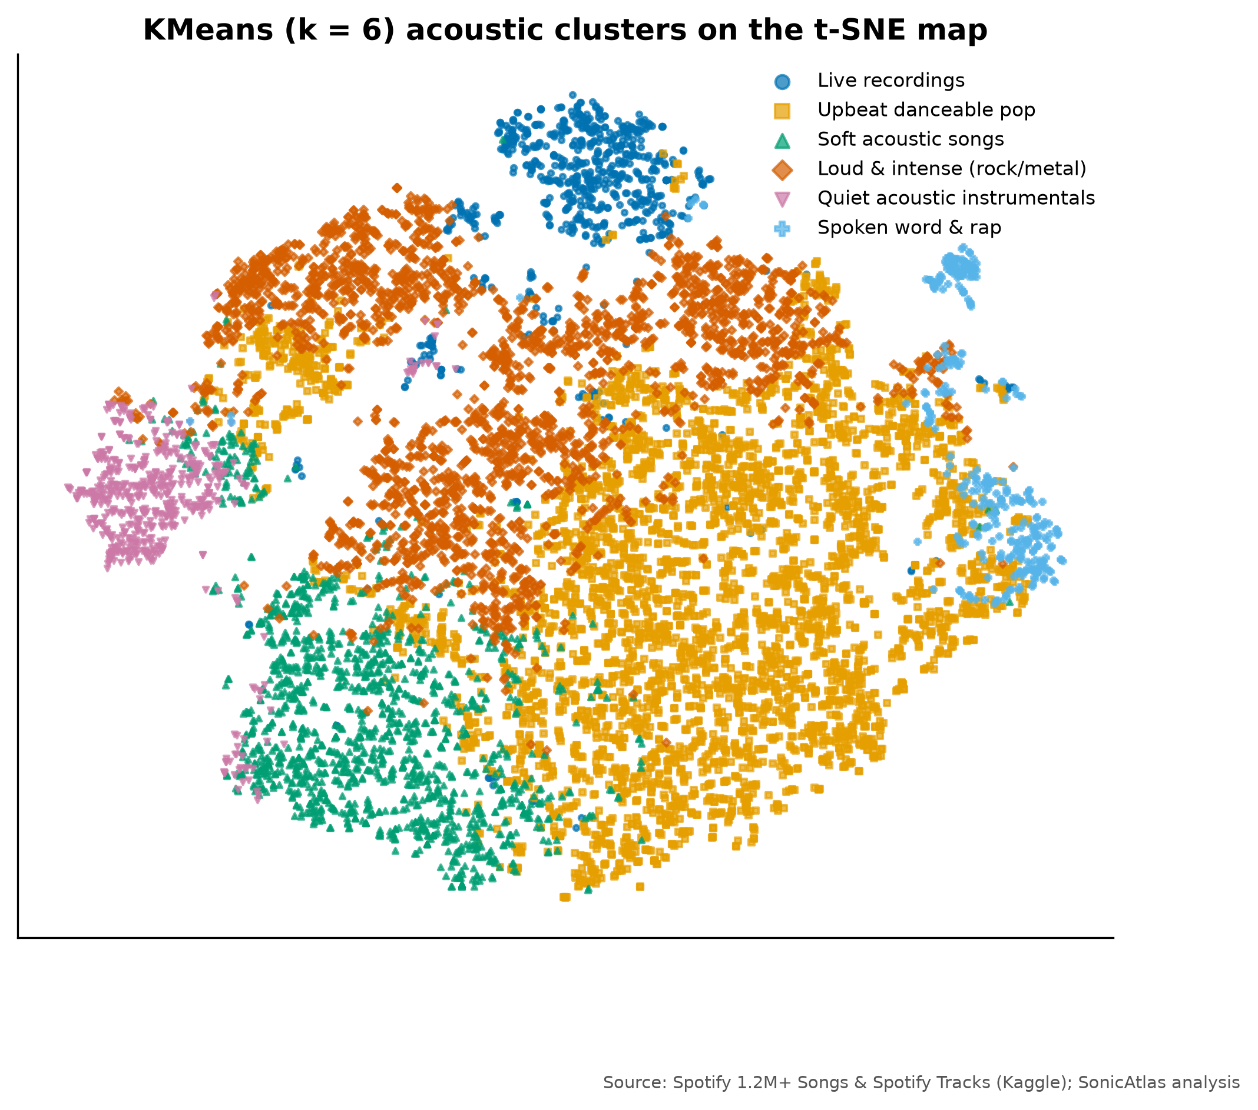
SONICATLAS
An Interactive In-Browser EDA Platform for Spotify Audio Features and Lyrics Across Genres and Eras
Review-2 | Design complete, implementation in progress
Team 05
25BDS0318 Sharvesh Prabhu
25BDS0308 Nithin S
Real acoustic map of 10,000 tracks (t-SNE)
BACSE301 Exploratory Data Analysis (Project-based Course)
Faculty: ____________
School of Computer Science and Engineering, VIT Vellore | October 2026
Notes:
Good morning. We are Team 05, Sharvesh Prabhu and Nithin S. Our project is SonicAtlas: an exploratory data analysis of more than one million Spotify tracks, delivered as a website that runs SQL queries inside the browser. In this review we show the finished design, the cleaned data and our first analysis results.

Slide 2
RECAP: ABSTRACT AND OBJECTIVES
We map how the sound of music changes across genres and eras
Abstract
Objectives
Public Spotify tables describe each track with audio features such as energy, valence and danceability. We clean 1,204,025 tracks (1900-2020) plus a genre table of 89,740 tracks in 114 genres and Genius lyrics, explore them with the course methods, and publish the results in a serverless, in-browser query tool.
Clean 1M+ tracks; validate MICE by masking 5% of values
Descriptive stats in course conventions (n-1, Tukey IQR, G1, G2)
Correlation and multivariate genre fingerprints
Compare PCA, t-SNE, LLE, UMAP; name acoustic clusters
Trends, STL seasonality, change points, forecast
ANOVA, chi-square, feature selection; lyrics sentiment
In-browser SQL with lite-data queries under 1 second
Notes:
In short: we take large public Spotify tables, clean them carefully, analyse them with the methods from our syllabus, and put everything into a website. These seven objectives are measurable, and each one maps to a notebook in our repository.

Slide 3
LITERATURE SURVEY AND GAPS
Prior work is static and studies sound and words apart
Study | What they did | Gap SonicAtlas addresses
J. Serrà et al. (2012) | Tracked pitch, timbre and loudness of Western pop over 50+ years | Static figures; no genre-level or interactive view
M. Interiano et al. (2018) | Linked audio features of 500k UK releases to chart success | No lyrics; results cannot be re-sliced by readers
C. O. Brand et al. (2019) | Measured rising negativity in song lyrics over 50 years | Lyrics only; audio mood not compared
L. van der Maaten et al. (2008) | Introduced t-SNE for 2-D maps of high-dimensional data | Global distances unreliable; no music benchmark
D. H. da Silva et al. (2025) | Streamlit web app for EDA and ML on medical data | Needs a server; not music-aware
Static results
Sound vs words
Data quality
Generic tools
fixed figures, no re-slicing
audio and lyrics never compared
zero tempos, re-issues ignored
not music-aware, need a server
25 verified papers reviewed in the report (Table I).
Notes:
We reviewed 25 published papers. This table shows five representative ones. The common gaps are: results are fixed figures that readers cannot re-slice, audio and lyrics are studied separately, data cleaning is rarely described, and generic EDA tools are not music-aware.

Slide 4
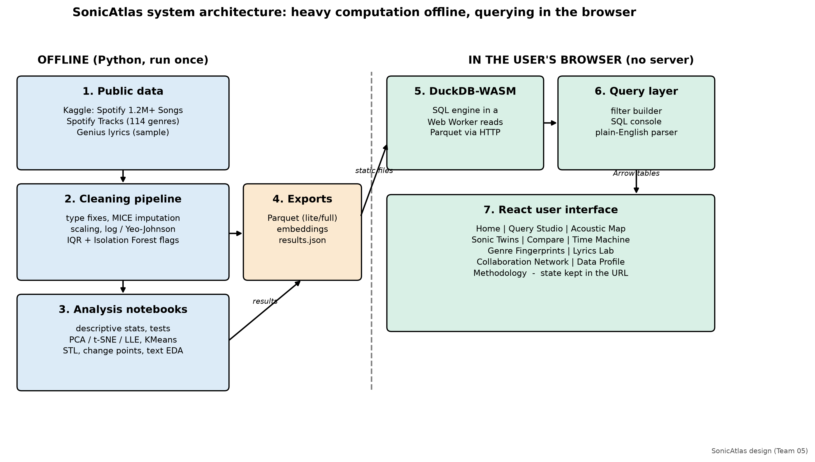
PROPOSED SYSTEM AND ARCHITECTURE
Heavy maths runs offline; querying runs in the user's browser
Notes:
Our architecture has two halves. On the left, Python notebooks clean the data and compute statistics, embeddings and clusters, and export small Parquet files. On the right, the browser loads DuckDB compiled to WebAssembly, which runs SQL on those files locally. So there is no server, the data stays private, and hosting on GitHub Pages is free.

Slide 5
DATASET AND PREPROCESSING DONE
1.2 million tracks cleaned, with every repair measured
1,204,025
2,777
57.5%
tracks in the main audio table
zero-BPM tempos imputed with MICE
lower error than mean imputation (energy, 5% masked)
90,457
24,547
10.7%
re-issues flagged, kept out of trends
Isolation Forest outliers flagged, not dropped
genre table matched to audio table (honest)
Duration skew G1 8.04 -> 0.23 after log1p; Min-Max and z-score tables stored separately.
Sources: Kaggle rodolfofigueroa/spotify-12m-songs, maharshipandya/-spotify-tracks-dataset, carlosgdcj/genius-song-lyrics-with-language-information
Notes:
We downloaded three public Kaggle datasets. 2,777 tracks had a tempo of zero, which is impossible, so we treated it as missing and used MICE. To prove MICE works we hid 5 percent of known values: its error was 57.5% lower than mean filling for energy. We flagged re-issues and outliers instead of deleting them. The genre table only matched 10.7% of tracks, and we report that honestly.

Slide 6
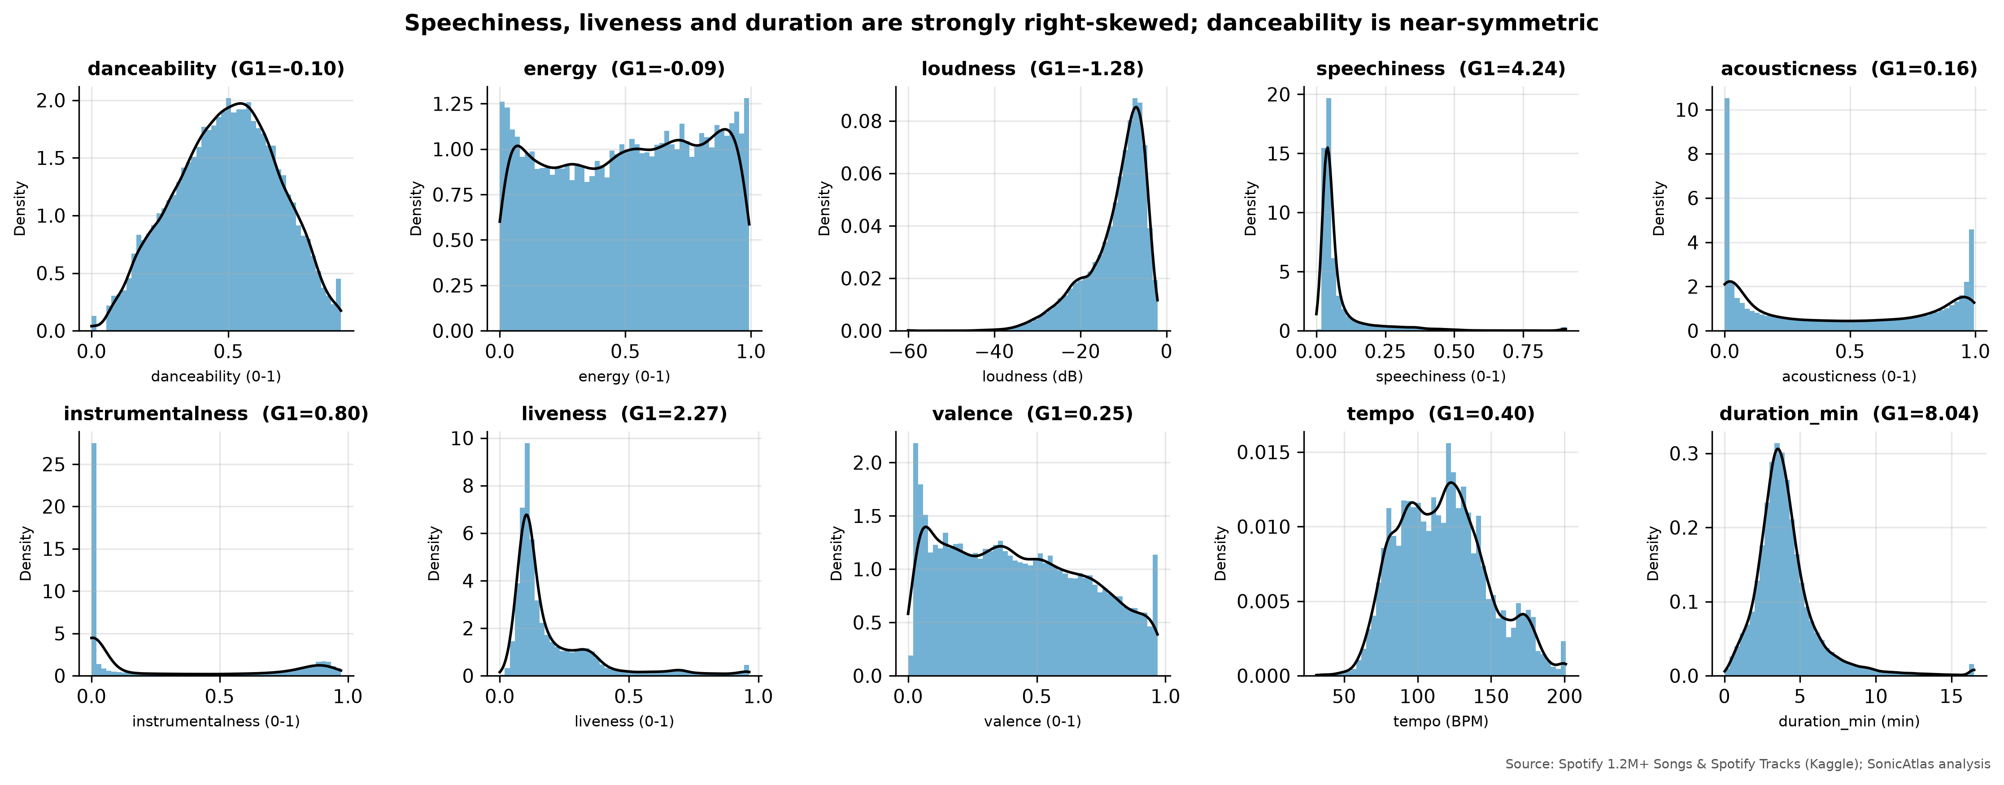
DESCRIPTIVE STATISTICS RESULTS
Speechiness and duration are right-skewed; danceability is not
Feature | Mean | Median | Var (n-1) | IQR | G1 | G2
danceability | 0.493 | 0.501 | 0.036 | 0.277 | -0.10 | -0.61
energy | 0.510 | 0.524 | 0.087 | 0.514 | -0.09 | -1.22
loudness | -11.809 | -9.791 | 48.750 | 8.537 | -1.28 | 1.78
speechiness | 0.084 | 0.045 | 0.013 | 0.037 | 4.24 | 22.35
acousticness | 0.447 | 0.389 | 0.148 | 0.823 | 0.16 | -1.64
valence | 0.428 | 0.403 | 0.073 | 0.453 | 0.25 | -1.05
tempo | 117.899 | 116.838 | 925.307 | 42.753 | 0.40 | -0.29
duration_min | 4.147 | 3.739 | 7.309 | 1.863 | 8.04 | 146.28
Tukey quartiles (median of halves), n-1 variance, adjusted G1 and bias-corrected G2, unit-tested against SciPy.
Notes:
This table uses exactly the conventions from our tutorials. Speechiness has skewness 4.24 and excess kurtosis 22.3: most songs are sung, with a long tail of spoken tracks. Danceability is almost symmetric. Loudness is left-skewed because quiet classical and ambient tracks pull the tail down.

Slide 7
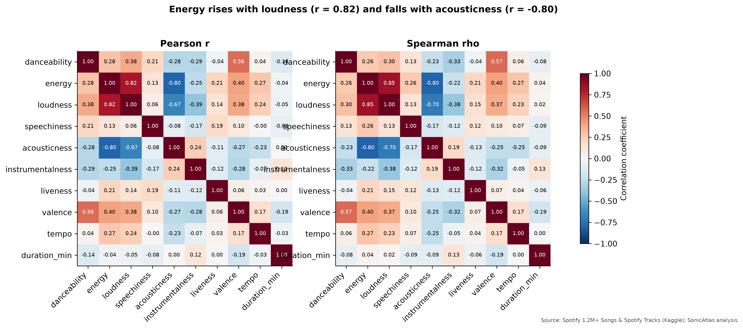
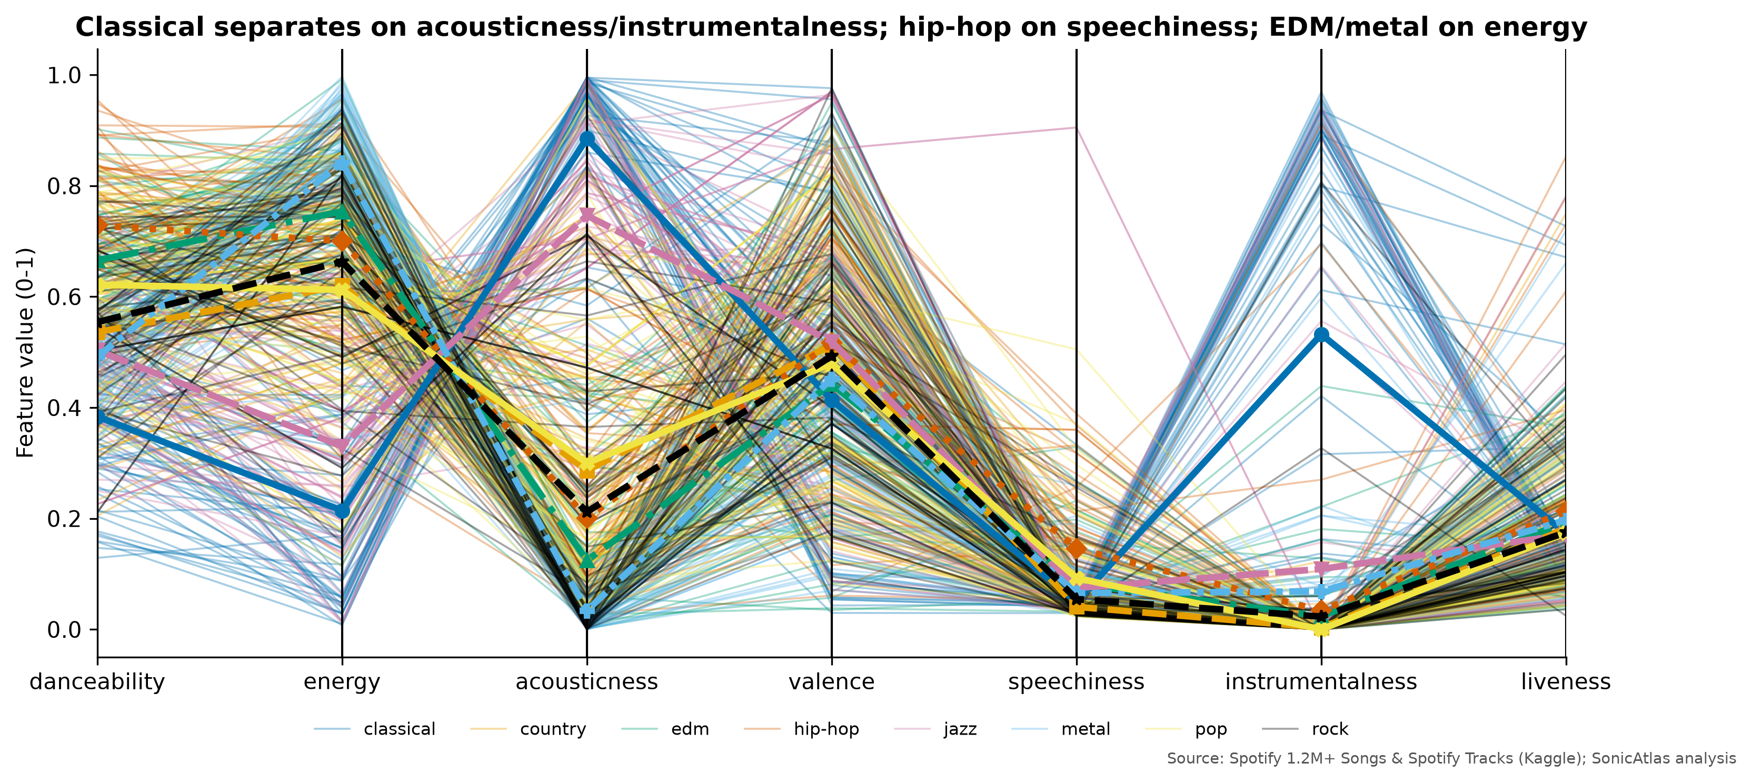
CORRELATION AND MULTIVARIATE RESULTS
Energy follows loudness and opposes acousticness
Loudness ~ energy r = 0.82; energy ~ acousticness r = -0.80
Valence ~ danceability r = 0.56: happier songs are somewhat more danceable
Parallel coordinates: classical = acoustic + instrumental; hip-hop = speechy + danceable; metal = highest energy
Notes:
The heatmap shows three trade-offs: loud songs are energetic, energetic songs are not acoustic, and happy-sounding songs are a bit more danceable. Pearson and Spearman agree, so these are not caused by outliers. On the right, parallel coordinates show each genre's fingerprint across seven features.

Slide 8
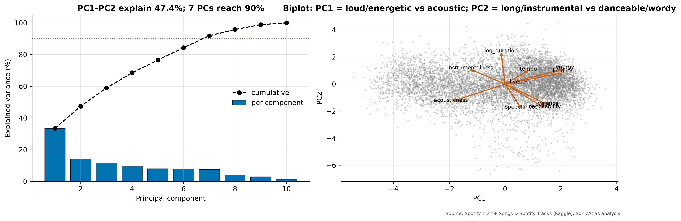
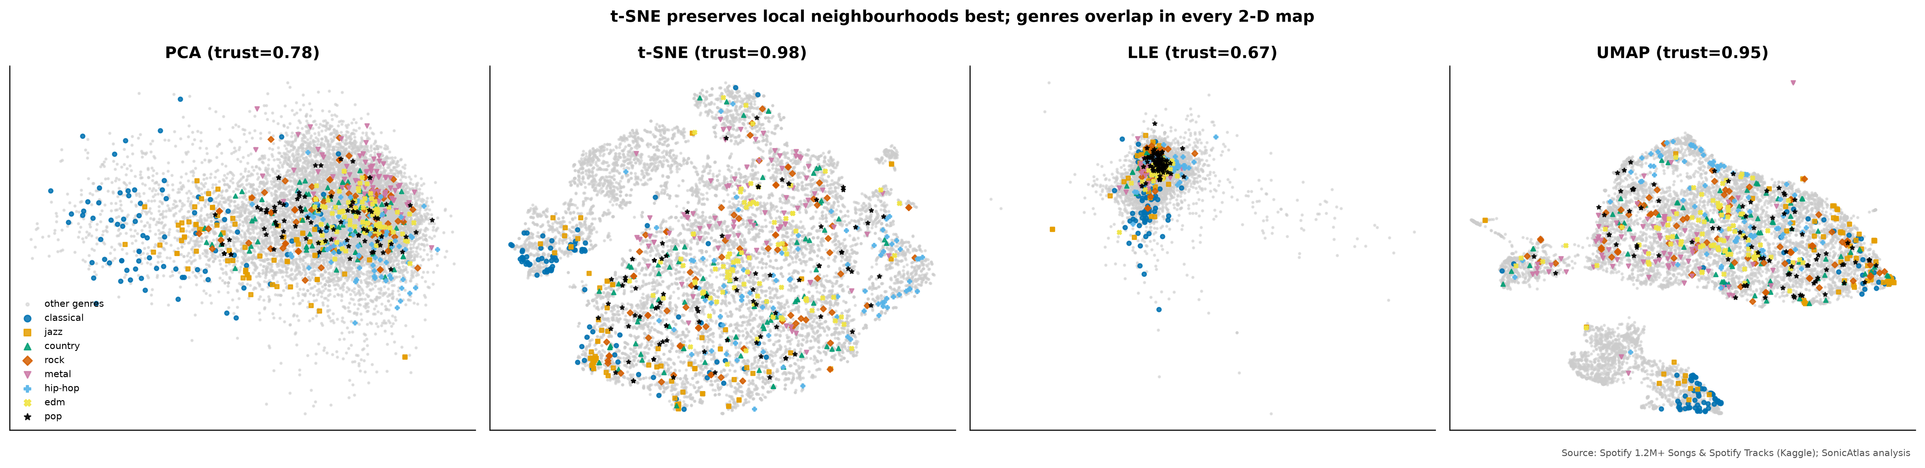
DIMENSIONALITY REDUCTION FIRST RESULTS
t-SNE keeps local structure best; genres overlap in every map
Method | Runtime (s) | Trustworthiness | Silhouette
PCA | 0.0 | 0.779 | -0.085
t-SNE | 49.8 | 0.976 | -0.061
LLE | 42.4 | 0.671 | -0.140
UMAP | 32.2 | 0.947 | -0.055
PC1 33.5%, PC2 14.0%; 7 PCs reach 90%
SVD of centred data reproduces PCA exactly
KMeans k = 6: named clusters such as "Quiet acoustic instrumentals"
Notes:
PCA's first component is an electric-versus-acoustic axis and explains 33.5% of variance. On a stratified sample of 10,000 tracks, t-SNE preserves neighbourhoods best with trustworthiness 0.98. Silhouette by genre is slightly negative for every method, which tells us genres overlap in Spotify's feature space.

Slide 9
MODULE STATUS AND WORK PLAN
Analysis core is complete; the website is the main remaining build
Data acquisition and audit
100% done
Cleaning, MICE, scaling, outliers
100% done
Descriptive statistics
100% done
Multivariate storytelling
100% done
PCA / t-SNE / LLE / clusters
100% done
Time series and trends
100% done
Hypothesis tests, features
100% done
Lyrics text mining
60% in progress
SonicAtlas website
15% in progress
IEEE paper and final report
40% in progress
Notes:
Here is our honest status. Data, cleaning, descriptive statistics, multivariate plots, dimensionality reduction, time series and hypothesis tests are complete. The website and the remaining notebooks are in progress, and the final report and paper follow.

Slide 10
NEXT STEPS AND KEY REFERENCES
Next: finish the website, lyrics, network and the IEEE paper
Next steps
Key references
Website: Query Studio, Acoustic Map, Compare, Time Machine
Lyrics sentiment vs audio valence; artist network
YData-Profiling, Sweetviz, D-Tale benchmark
Playwright tests, Lighthouse audit, GitHub Pages
IEEE paper, plagiarism self-check, final report
[9] J. Serrà et al. (2012), Measuring the Evolution of Contemporary Western Popular Music
[6] M. Interiano et al. (2018), Musical trends and predictability of success in contemporary songs in and out of the top charts
[11] C. Hutto et al. (2014), VADER: A Parsimonious Rule-Based Model for Sentiment Analysis of Social Media Text
[16] L. van der Maaten et al. (2008), Visualizing Data using t-SNE
[25] D. H. da Silva et al. (2025), A Web Application for exploratory data analysis and classification of Parkinson's Disease patients using machine learning models on different datasets
Kaggle datasets: rodolfofigueroa/spotify-12m-songs; maharshipandya/-spotify-tracks-dataset; carlosgdcj/genius-song-lyrics-with-language-information
Notes:
Our next steps are to complete the website pages, finish the lyrics and network analysis, run the automated profiling tools, and write the IEEE paper. These are some of the key papers we built on. Thank you; we are happy to take questions.

