Slide 1
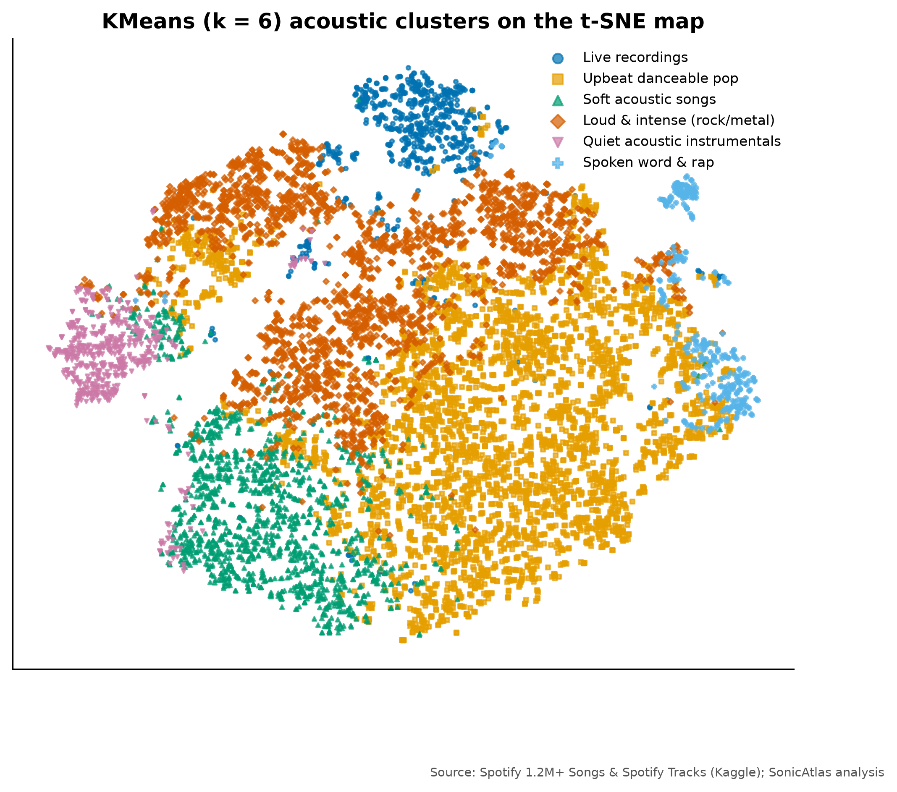
SONICATLAS
An Interactive In-Browser EDA Platform for Spotify Audio Features and Lyrics Across Genres and Eras
Review-3 | Implementation complete, evaluation and outcome
Team 05
25BDS0318 Sharvesh Prabhu
25BDS0308 Nithin S
Real acoustic map of 10,000 tracks (t-SNE)
BACSE301 Exploratory Data Analysis (Project-based Course)
Faculty: ____________
School of Computer Science and Engineering, VIT Vellore | October 2026
Notes:
Welcome to our Review-3. Since Review-2 we finished every notebook, the lyrics and network analyses, the website, the evaluation and the IEEE paper.

Slide 2
PROBLEM, OBJECTIVES AND WHAT CHANGED
Since Review-2: website, lyrics, network, tests and paper finished
Problem and objectives
What changed since Review-2
Open music data is messy and its insights are locked in static charts. Objectives: clean 1M+ tracks with validated repairs, apply the course EDA methods, compare embeddings, model trends, test genre differences, mine lyrics, and serve it all in a serverless website.
Lyrics mining on 161,401 English songs
Artist network: 84,132 artists, 189 communities
Automated EDA benchmark (YData, Sweetviz, D-Tale)
SonicAtlas website with 11 modules
Tests, Lighthouse audit, IEEE paper, self-check
Notes:
Our problem and objectives are unchanged. What is new since Review-2: the lyrics analysis, the collaboration network, the automated EDA benchmark, the full website, the evaluation and the paper.

Slide 3
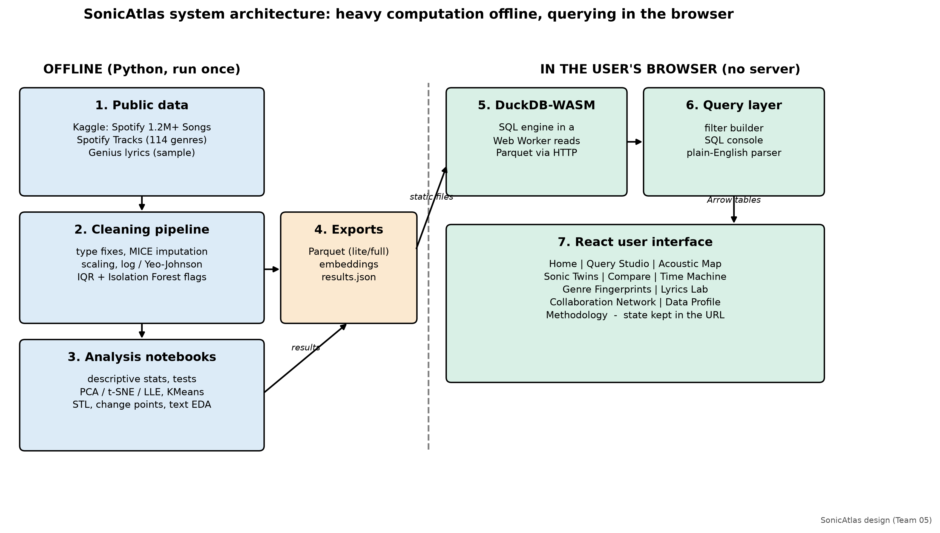
FINAL ARCHITECTURE AND MODULES
Heavy maths runs offline; querying runs in the user's browser
Notes:
Python notebooks clean the data and compute statistics, embeddings and clusters, and export compact Parquet files. In the browser, DuckDB compiled to WebAssembly runs in a Web Worker and answers SQL queries locally. The React interface has eleven modules and keeps its state in the URL.

Slide 4
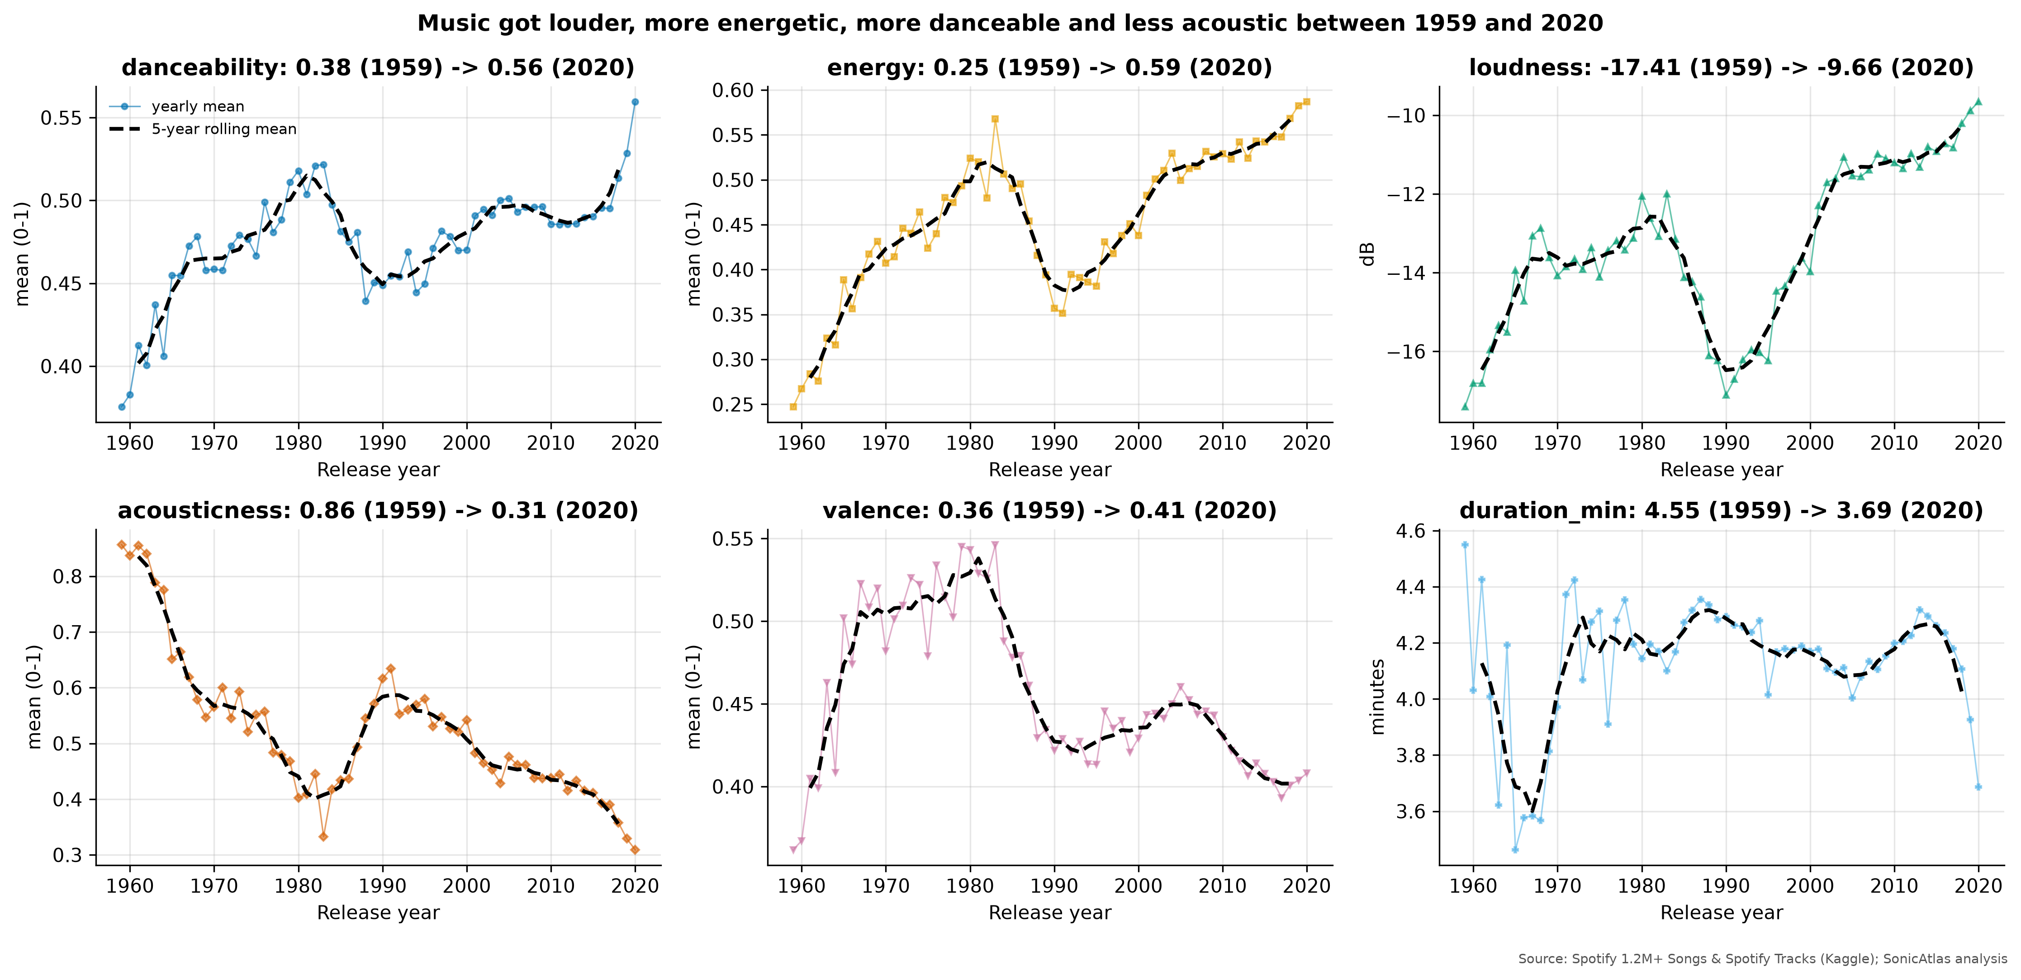
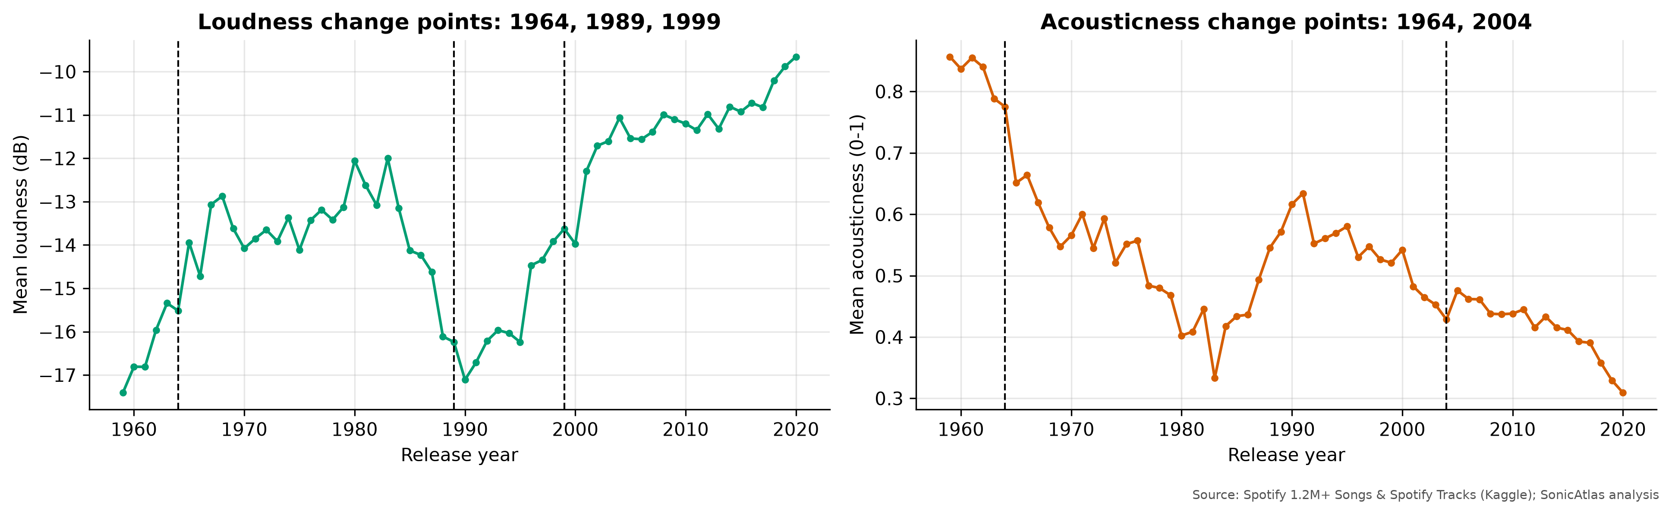
TIME-SERIES AND DECADE TRENDS
Music got 7.8 dB louder and far less acoustic
Loudness -17.4 -> -9.7 dB (1959-2020)
Acousticness 0.86 -> 0.31
Loudness change points: 1989, 1999 ("loudness war")
ARIMA MAE 0.58 dB vs naive 0.59 dB
Notes:
Yearly means of canonical releases show loudness rising from -17.4 to -9.7 decibels, energy and danceability rising, and acousticness falling. Change-point detection finds breaks in 1989 and 1999, the CD loudness-war period. Our ARIMA forecast is no better than a naive one because loudness has plateaued.

Slide 5
CLUSTERING AND ACOUSTIC MAP
Six named acoustic clusters, but genres overlap heavily
Cluster | Share | Top genres
Live recordings | 6.2% | pagode, sertanejo, samba
Upbeat danceable pop | 28.5% | salsa, dance, forro
Soft acoustic songs | 20.5% | romance, tango, honky-tonk
Loud & intense (rock/metal) | 21.9% | black-metal, grindcore, death-metal
Quiet acoustic instrumentals | 18.7% | new-age, ambient, sleep
Spoken word & rap | 4.2% | comedy, j-dance, dancehall
KMeans k = 6 on 7 PCs; HDBSCAN marks 65% as noise; genre silhouette is negative in every embedding.
Notes:
KMeans with six clusters gives groups we can name, from quiet acoustic instrumentals to spoken word and rap. The negative silhouette by genre and the high HDBSCAN noise share tell us that audio space is a continuum: genre is partly a cultural label.

Slide 6
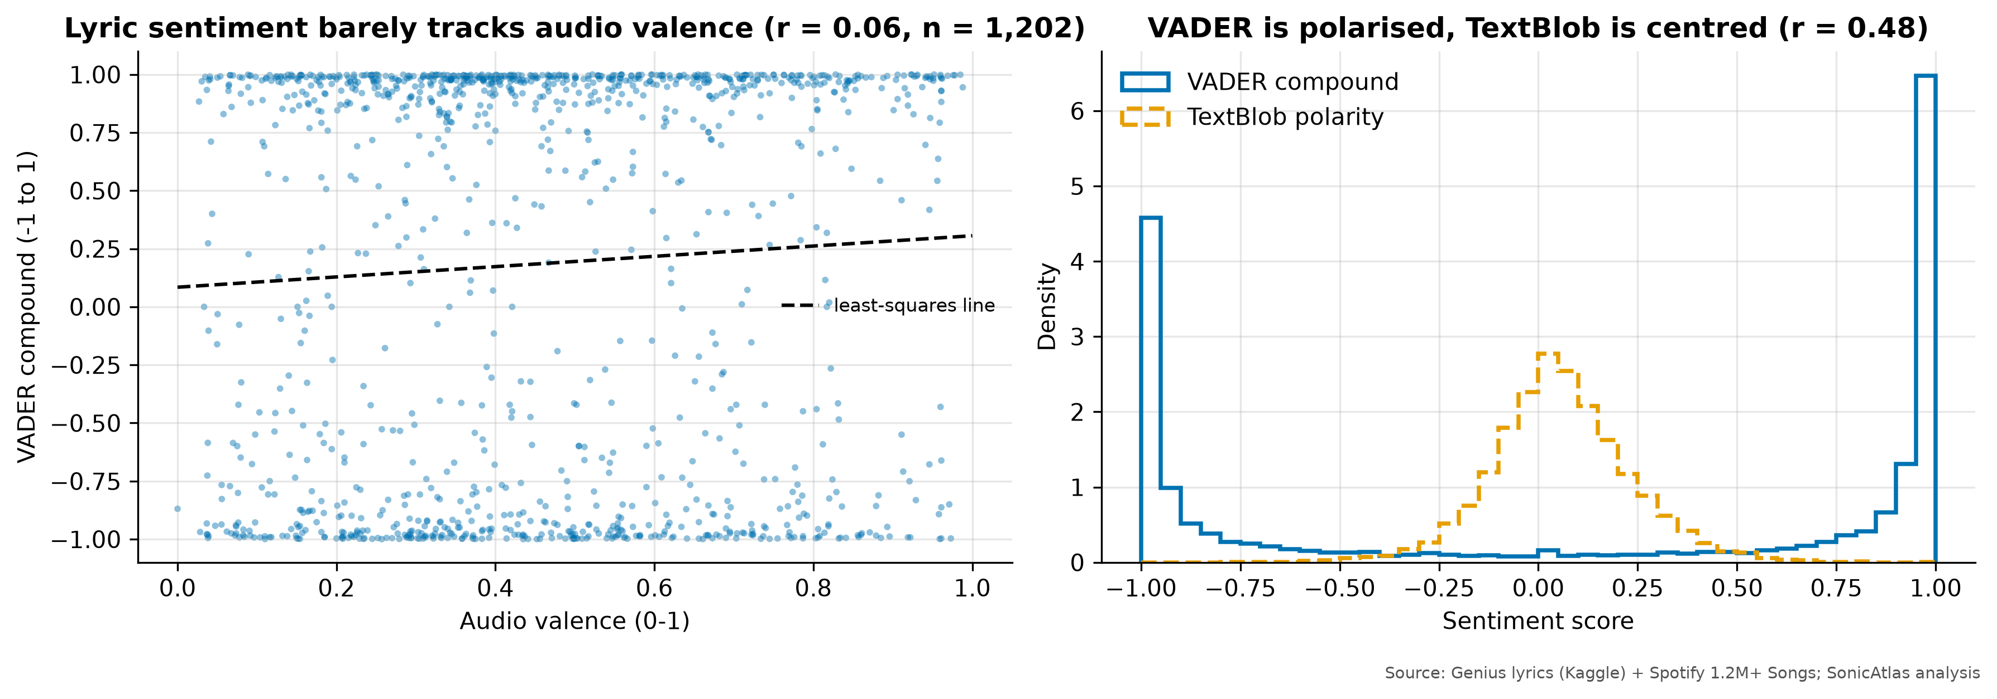
LYRICS TEXT EDA AND HYPOTHESIS TESTS
Genre shapes danceability; lyric mood barely follows the music
Test | Statistic | p | Effect size
ANOVA danceability x genre | F = 512.1 | < 0.001 | eta2 = 0.425
Kruskal-Wallis | H = 2061 | < 0.001 | eps2 = 0.423
Chi-square mode x genre | 539.4 | < 0.001 | V = 0.333
Chi-square mode x decade | 3089 | < 0.001 | V = 0.054
161,401 English songs; median 243 words, 24% repeated lines
VADER vs TextBlob agree on sign for 71.0% (r = 0.48)
Lyric sentiment vs audio valence r = 0.06 (n = 1,202)
Country most positive, rap most negative
Tukey HSD: 26/28 genre pairs differ
Large n: read effect sizes, not p-values
Top features: acousticness, loudness, energy
Notes:
Genre explains about 42% of the variance in danceability, a large effect confirmed by Kruskal-Wallis. Mode depends on genre moderately but on decade only negligibly. In the lyrics, sentiment of the words barely correlates with the musical valence, so sound and words carry different emotional information.

Slide 7
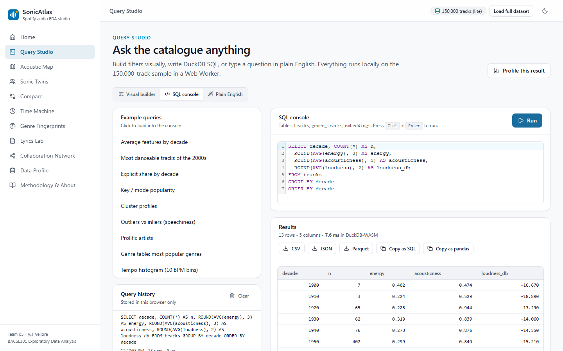
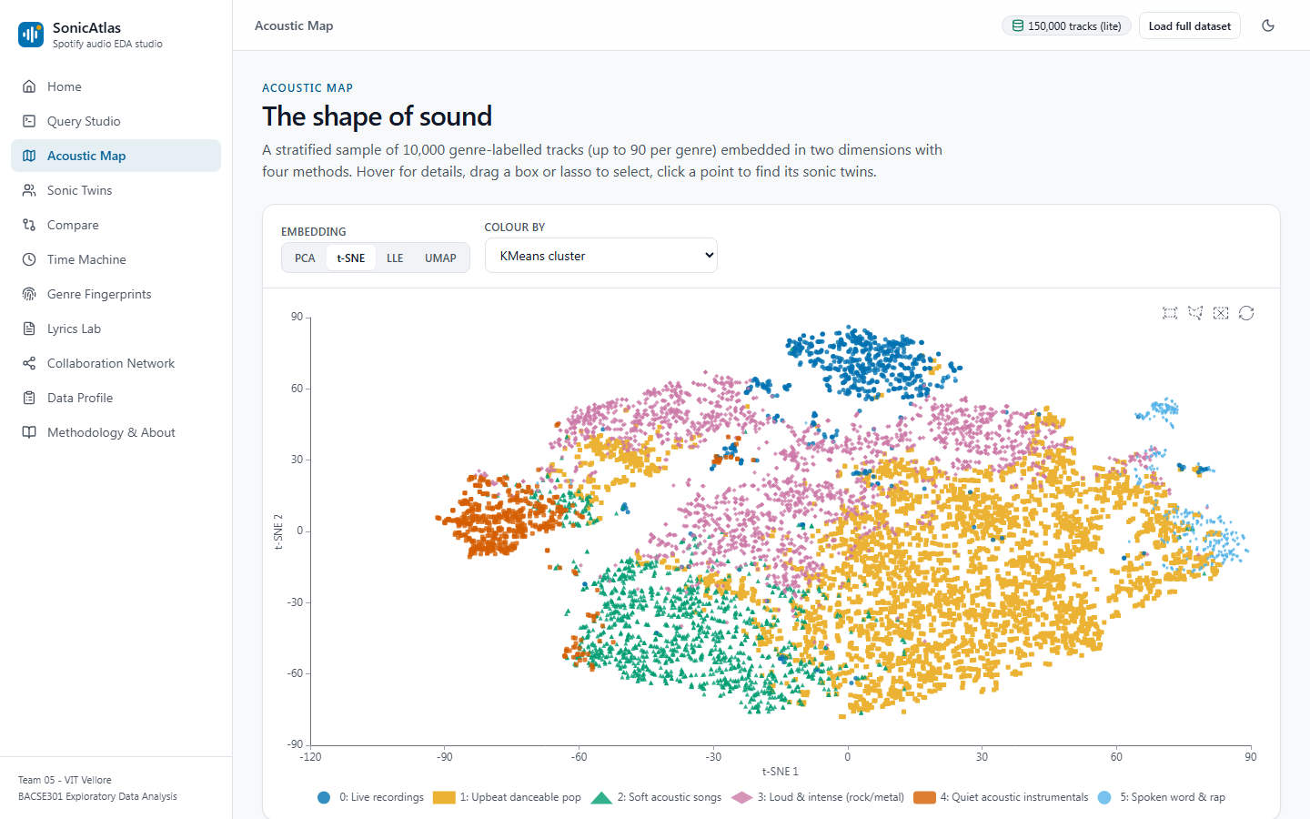
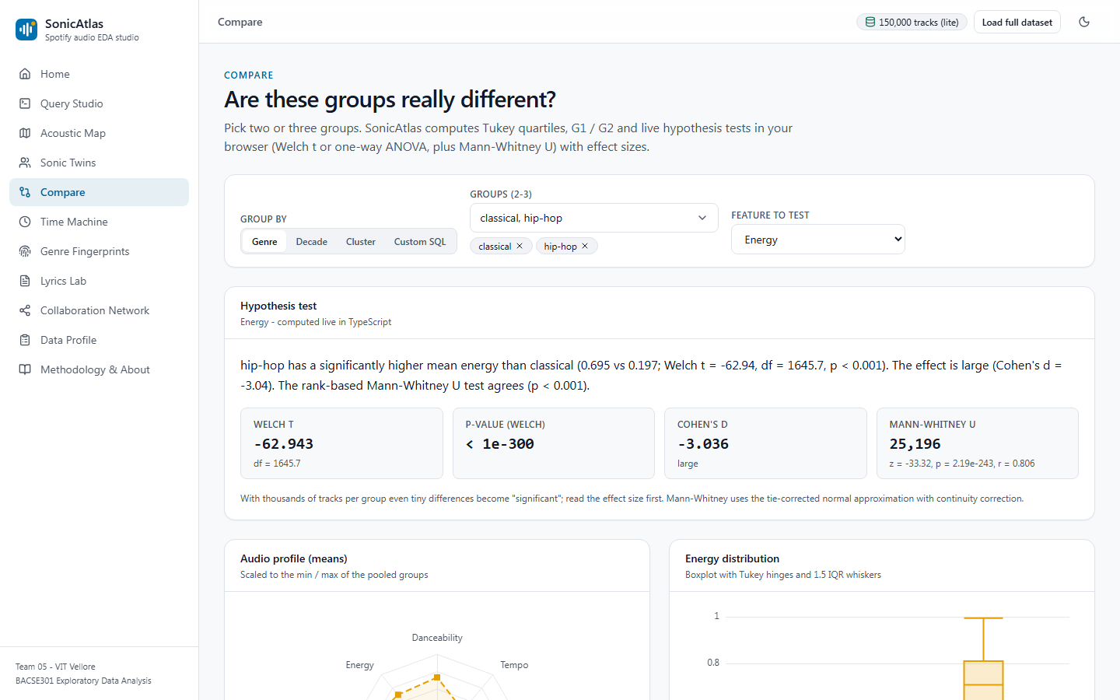
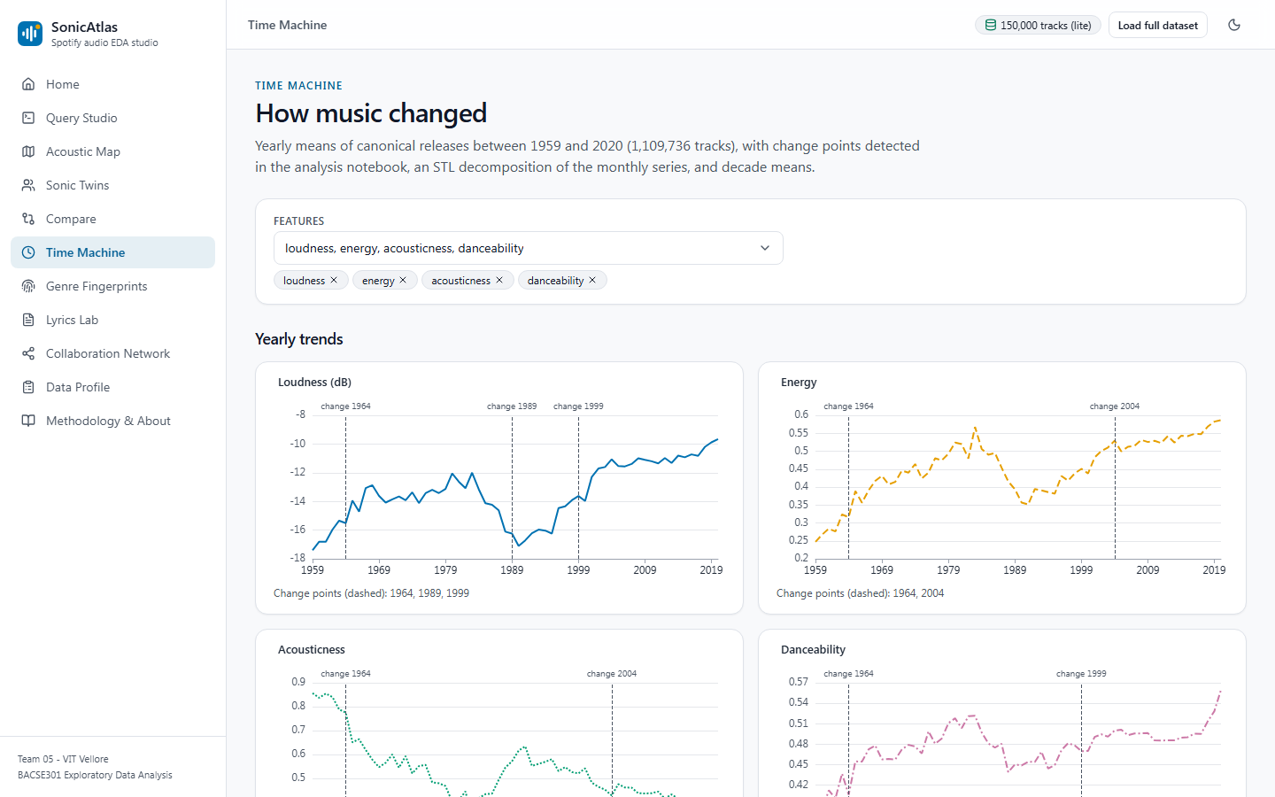
WEBSITE DEMO
SonicAtlas runs every query inside the browser
Query Studio
Acoustic Map
Compare
Time Machine
Notes:
These are real screenshots of SonicAtlas. Query Studio builds SQL from filters or plain English; the Acoustic Map switches between PCA, t-SNE, LLE and UMAP; Compare runs live significance tests; Time Machine shows trends, seasonality and change points.

Slide 8
EVALUATION
Every component is measured, not just demonstrated
Method | Time (s) | Trust. | Silh.
PCA | 0.0 | 0.779 | -0.085
t-SNE | 49.8 | 0.976 | -0.061
LLE | 42.4 | 0.671 | -0.140
UMAP | 32.2 | 0.947 | -0.055
4.7 ms
7/7
median lite-data query time
Python unit tests passed
65/65
8/8
web unit tests passed
Playwright end-to-end tests
Automated EDA: YData 4.8 s, Sweetviz 6.3 s, D-Tale 4.1 s - fast overviews, but none flagged 0-BPM tempos or ran tests/embeddings.
98-100
Lighthouse performance, accessibility, best practice, SEO (4 pages)
Notes:
We evaluated each part: embeddings by trustworthiness and silhouette, the website by query time, automated tests and Lighthouse audits, and the automated EDA tools by what they found and missed compared with our manual analysis.

Slide 9
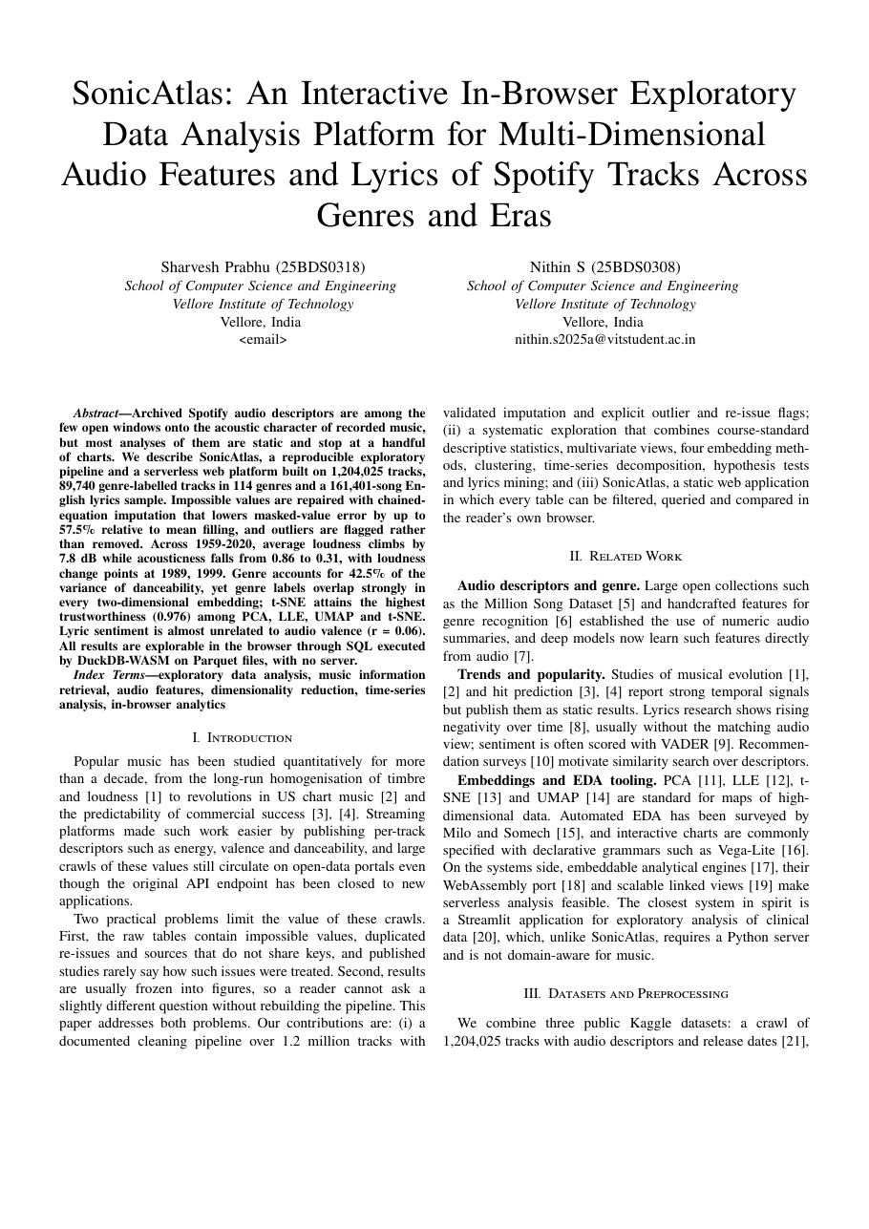
OUTCOME
An IEEE paper, an open repository and a live tool
IEEE-format paper (6 pages) - status: prepared for submission
IEEE CONECCT 2027: 29-31 July 2027, Bangalore, India
ISMIR: ISMIR 2026 runs 8-12 November 2026 in Abu Dhabi
IEEE VIS: VIS 2026 runs 9-13 November 2026 in Boston
GitHub: [GitHub Link]
Live site: [Live Website Link]
IEEE checks: A4, 6 pages, fonts embedded yes, Type-3 fonts 0
Similarity self-check: report 0.18%, paper 0.00% (not Turnitin)
Notes:
Our outcome is an IEEE-format paper prepared for submission to one of these venues, the open-source repository and the live website. Our own similarity self-check found very low overlap; the official Turnitin check is done by the university.

Slide 10
CONCLUSION, LIMITATIONS, FUTURE WORK
Louder, less acoustic, and more than genre alone
Conclusion
Limitations
Future work
Careful cleaning matters; music got louder and less acoustic; genre explains 42% of danceability but overlaps in every map; lyrics and sound carry different moods.
Spotify features are model-derived; catalogue favours recent years; genre join only 10.7%; English-only lyrics; the 2020s have one year.
Open audio features, multilingual lyrics, user study.
[9] J. Serrà et al. (2012), Measuring the Evolution of Contemporary Western Popular Music
[11] C. Hutto et al. (2014), VADER: A Parsimonious Rule-Based Model for Sentiment Analysis of Social Media Text
[16] L. van der Maaten et al. (2008), Visualizing Data using t-SNE
[25] D. H. da Silva et al. (2025), A Web Application for exploratory data analysis and classification of Parkinson's Disease patients using machine learning models on different datasets
Notes:
To conclude: careful cleaning changes the conclusions, music has become louder and less acoustic, genre matters but genres overlap, and lyrics add independent information. Our main limitations are the proprietary features and data bias. Thank you.

