Slide 1
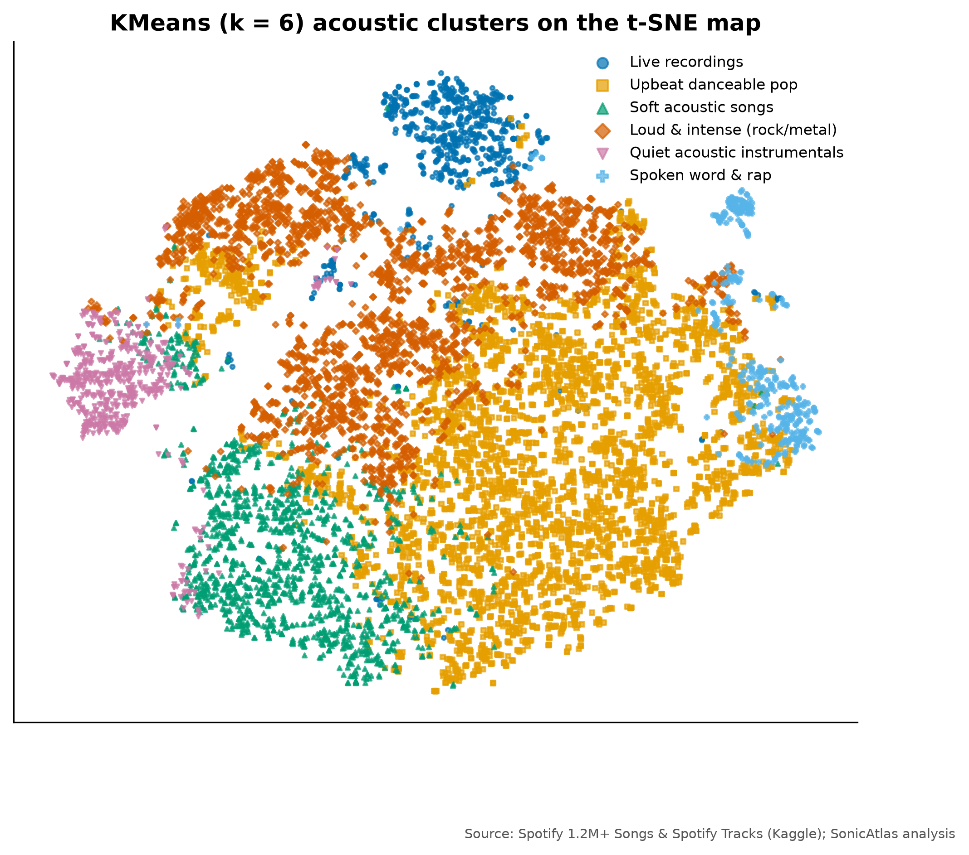
SONICATLAS
An Interactive In-Browser EDA Platform for Spotify Audio Features and Lyrics Across Genres and Eras
Final Review | Complete project
Team 05
25BDS0318 Sharvesh Prabhu
25BDS0308 Nithin S
Real acoustic map of 10,000 tracks (t-SNE)
BACSE301 Exploratory Data Analysis (Project-based Course)
Faculty: ____________
School of Computer Science and Engineering, VIT Vellore | October 2026
Notes:
Good morning. We are Team 05 and this is the complete story of SonicAtlas.

Slide 2
ABSTRACT
Mapping how the sound of music changes across genres and eras
Spotify's archived audio descriptors (energy, valence, danceability, acousticness and more) are rarely explored beyond static charts. SonicAtlas cleans 1,204,025 tracks released 1900-2020, a genre table of 89,740 tracks in 114 genres and 161,401 English lyrics, explores them with the course methods (descriptive statistics, correlation, PCA/t-SNE/LLE, time series, hypothesis tests, text mining), and publishes everything in a website that runs SQL inside the browser with DuckDB-WASM.
1,204,025
tracks analysed
114
genres compared
1959-2020
years of trends
Notes:
SonicAtlas studies how musical characteristics change across genres and decades using public Spotify data and lyrics. We cleaned over a million tracks, applied the methods from our syllabus, and built a website so anyone can explore the results.

Slide 3
LITERATURE SURVEY AND GAPS
Prior work is static and studies sound and words apart
Study | What they did | Gap SonicAtlas addresses
J. Serrà et al. (2012) | Tracked pitch, timbre and loudness of Western pop over 50+ years | Static figures; no genre-level or interactive view
M. Interiano et al. (2018) | Linked audio features of 500k UK releases to chart success | No lyrics; results cannot be re-sliced by readers
C. O. Brand et al. (2019) | Measured rising negativity in song lyrics over 50 years | Lyrics only; audio mood not compared
L. van der Maaten et al. (2008) | Introduced t-SNE for 2-D maps of high-dimensional data | Global distances unreliable; no music benchmark
D. H. da Silva et al. (2025) | Streamlit web app for EDA and ML on medical data | Needs a server; not music-aware
Static results
Sound vs words
Data quality
Generic tools
fixed figures, no re-slicing
audio and lyrics never compared
zero tempos, re-issues ignored
not music-aware, need a server
25 verified papers reviewed in the report (Table I).
Notes:
We reviewed 25 verified papers. The main gaps: results are static, audio and lyrics are studied separately, data quality is rarely discussed, and generic EDA tools are not music-aware and need a server.

Slide 4
PROBLEM IDENTIFICATION AND OBJECTIVES
Open music data exists, but it is messy and locked in static charts
Messy data
Objectives
2,777 zero-BPM tempos, 71,694 duplicate title+artist rows, no shared keys
Clean 1M+ tracks; validate MICE by masking 5% of values
Descriptive stats in course conventions (n-1, Tukey IQR, G1, G2)
Correlation and multivariate genre fingerprints
Compare PCA, t-SNE, LLE, UMAP; name acoustic clusters
Trends, STL seasonality, change points, forecast
ANOVA, chi-square, feature selection; lyrics sentiment
In-browser SQL with lite-data queries under 1 second
Frozen results
papers and notebooks show fixed figures; readers cannot ask new questions
Split modalities
audio features and lyrics are analysed in isolation
Hosting cost
interactive tools usually need a running server
Notes:
The data is public but noisy: impossible tempos, duplicates and sources without common keys. Results in the literature are static, sound and lyrics are studied separately, and interactive tools cost money to host. Our objectives address each problem with a measurable target.

Slide 5
EXISTING SYSTEMS VS PROPOSED SYSTEM
SonicAtlas combines what existing tools offer separately
System | Open data | Music-specific EDA | Audio + lyrics | Interactive | Serverless
Spotify app / Web API | No (closed) | No | No | Yes (app) | No
Static notebooks / papers | Yes | Partly | Rarely | No | No
Streamlit EDA app [25] | Yes | Generic | No | Yes | No (server)
YData / Sweetviz / D-Tale | Yes | Generic | No | Partly | No (server for D-Tale)
SonicAtlas (ours) | Yes | Yes | Yes | Yes | Yes
Only SonicAtlas is open, music-aware, combines sound with words, and runs entirely in the browser.
Notes:
Spotify's own tools are closed, notebooks are static, the Streamlit application from our faculty reading needs a Python server and is not music-aware, and automated EDA tools are generic. SonicAtlas covers all columns.

Slide 6
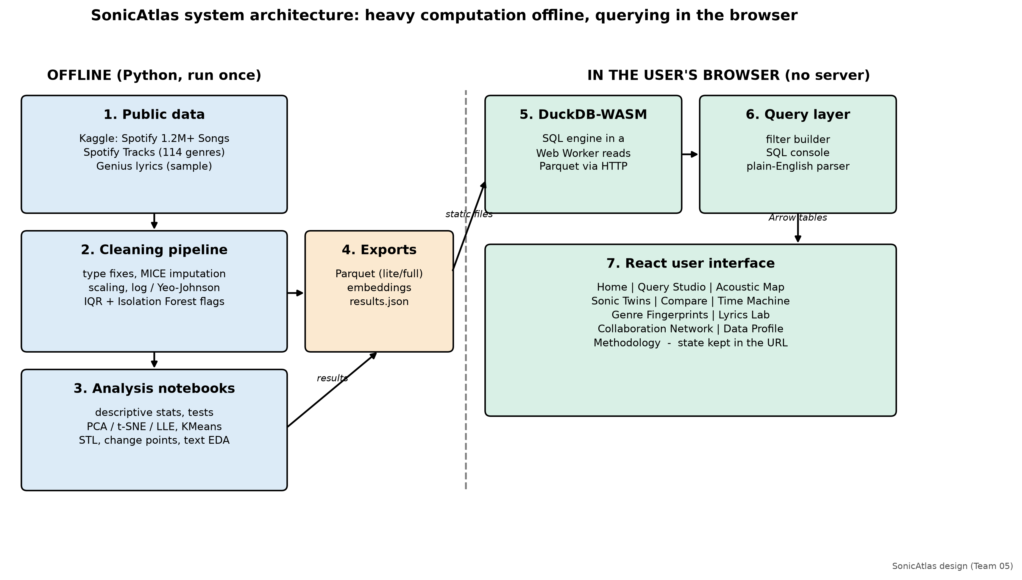
ARCHITECTURE / SYSTEM FLOW / MODULES
Heavy maths runs offline; querying runs in the user's browser
Notes:
Python notebooks clean the data and compute statistics, embeddings and clusters, and export compact Parquet files. In the browser, DuckDB compiled to WebAssembly runs in a Web Worker and answers SQL queries locally. The React interface has eleven modules and keeps its state in the URL.

Slide 7
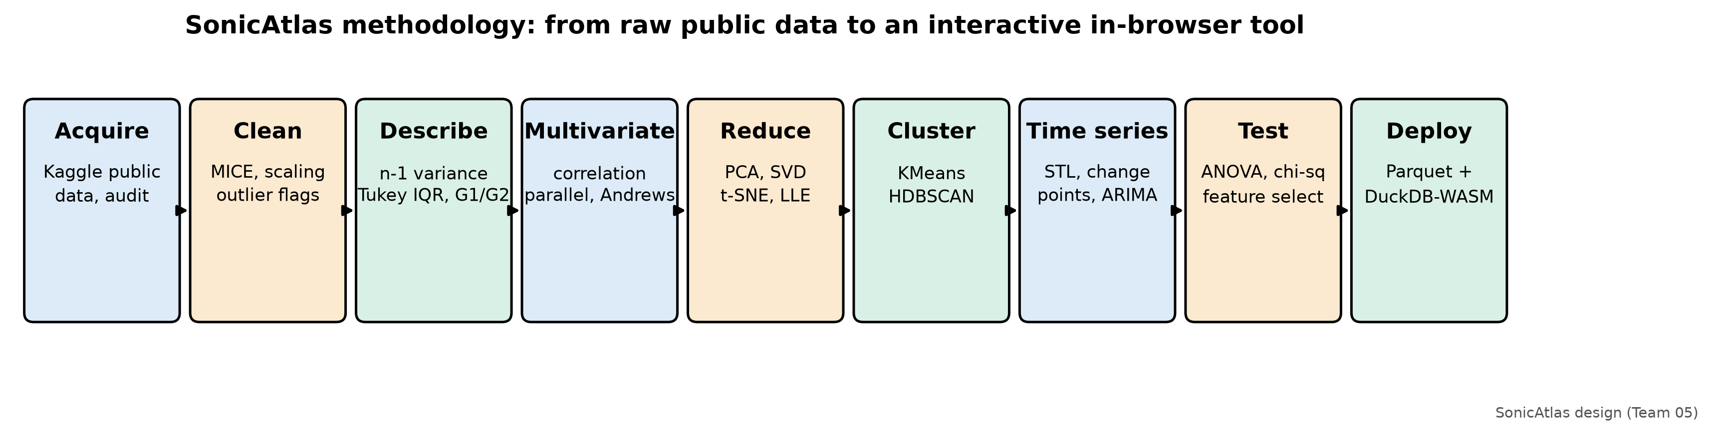
METHODOLOGY
From raw public files to an interactive in-browser tool
Course conventions: n-1 variance, Tukey quartiles, adjusted G1, bias-corrected G2
Validated MICE (energy error -58% vs mean); outliers flagged, never dropped
Embeddings on a 10,000-track genre-stratified sample; trends on canonical releases only
Every number in documents comes from results.json (cross-checked by script)
Notes:
Our methodology moves from acquisition and cleaning through statistics, multivariate views, dimensionality reduction, clustering, time series and tests to deployment. Every number in our documents is generated from a single results file.

Slide 8
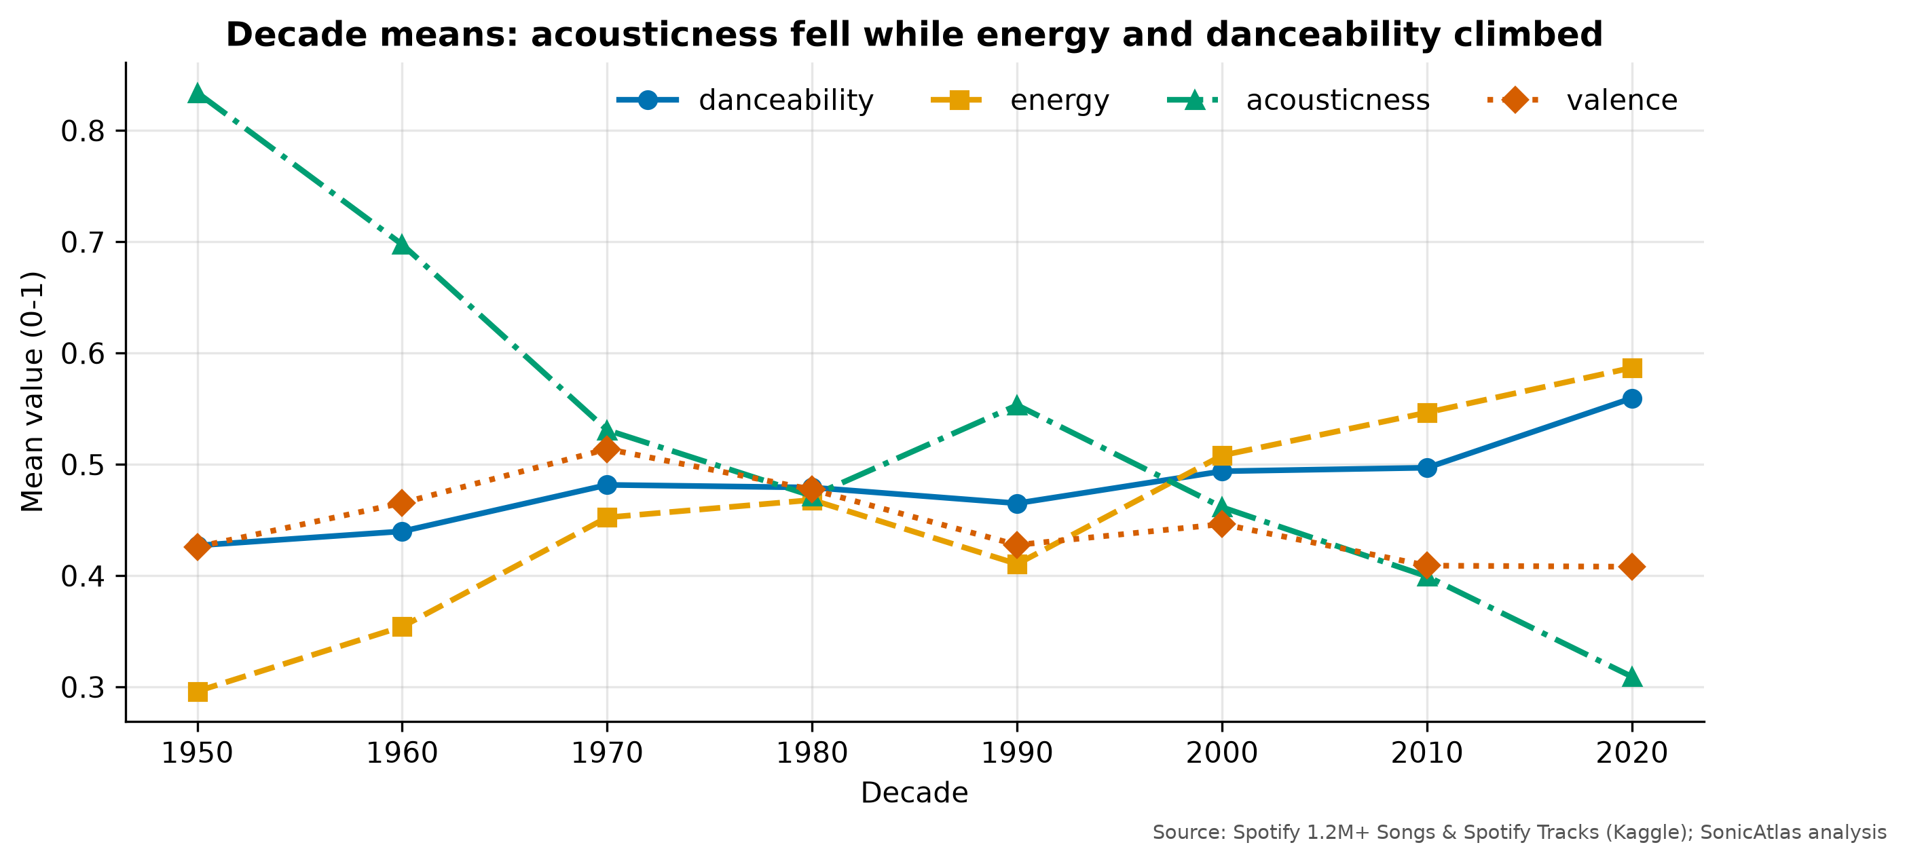
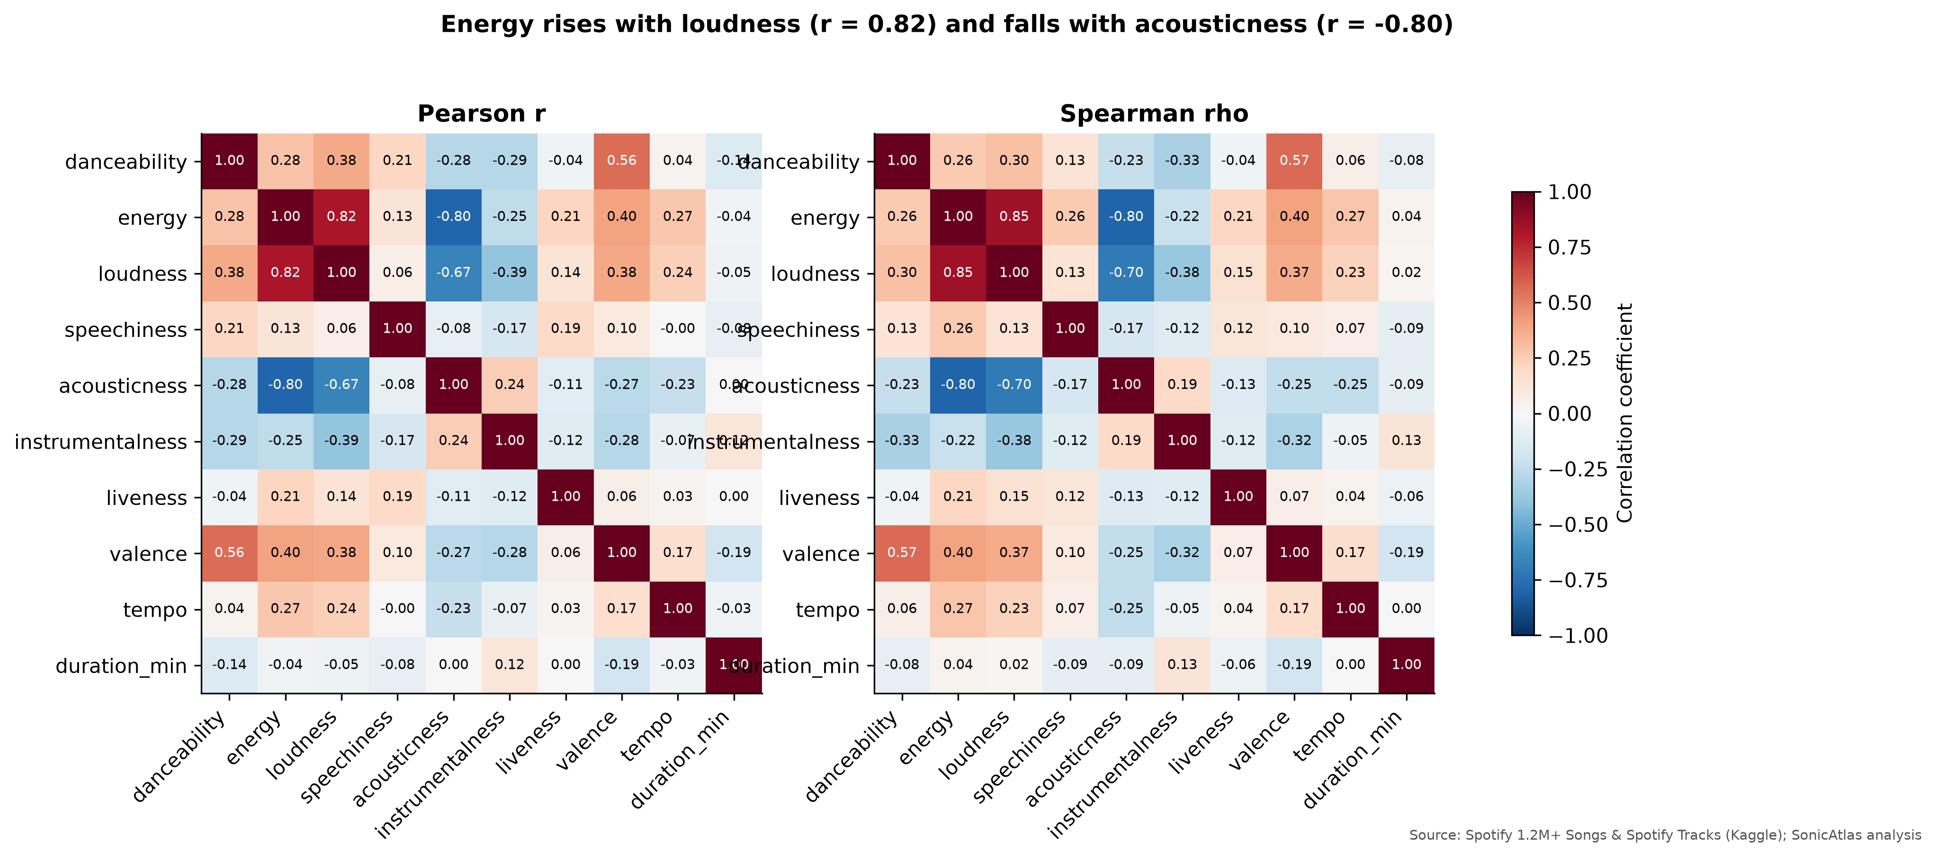
KEY FINDINGS
Five findings, all measured
+7.8 dB
louder music 1959-2020
r = 0.82
loudness vs energy
42%
of danceability explained by genre
0.976
t-SNE trustworthiness (best)
r = 0.06
lyric sentiment vs audio valence
Notes:
Our five headline findings: music became louder; energy is almost a restatement of loudness; genre strongly shapes danceability; t-SNE keeps local structure best; and lyric sentiment is nearly independent of musical mood.

Slide 9
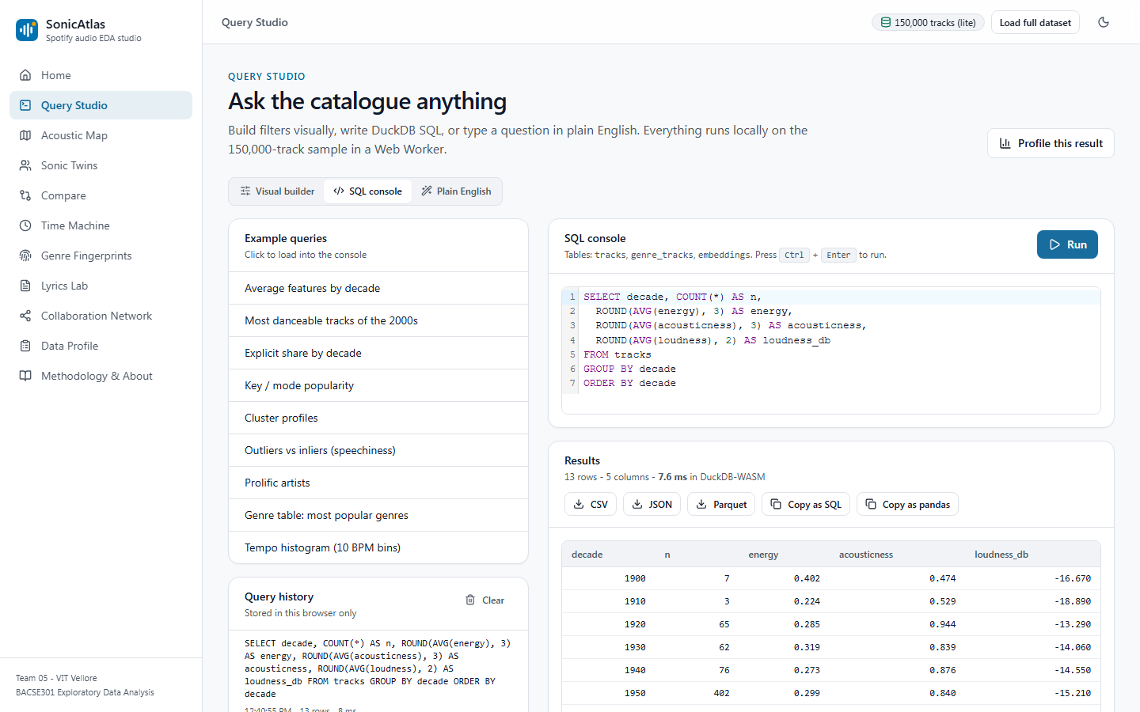
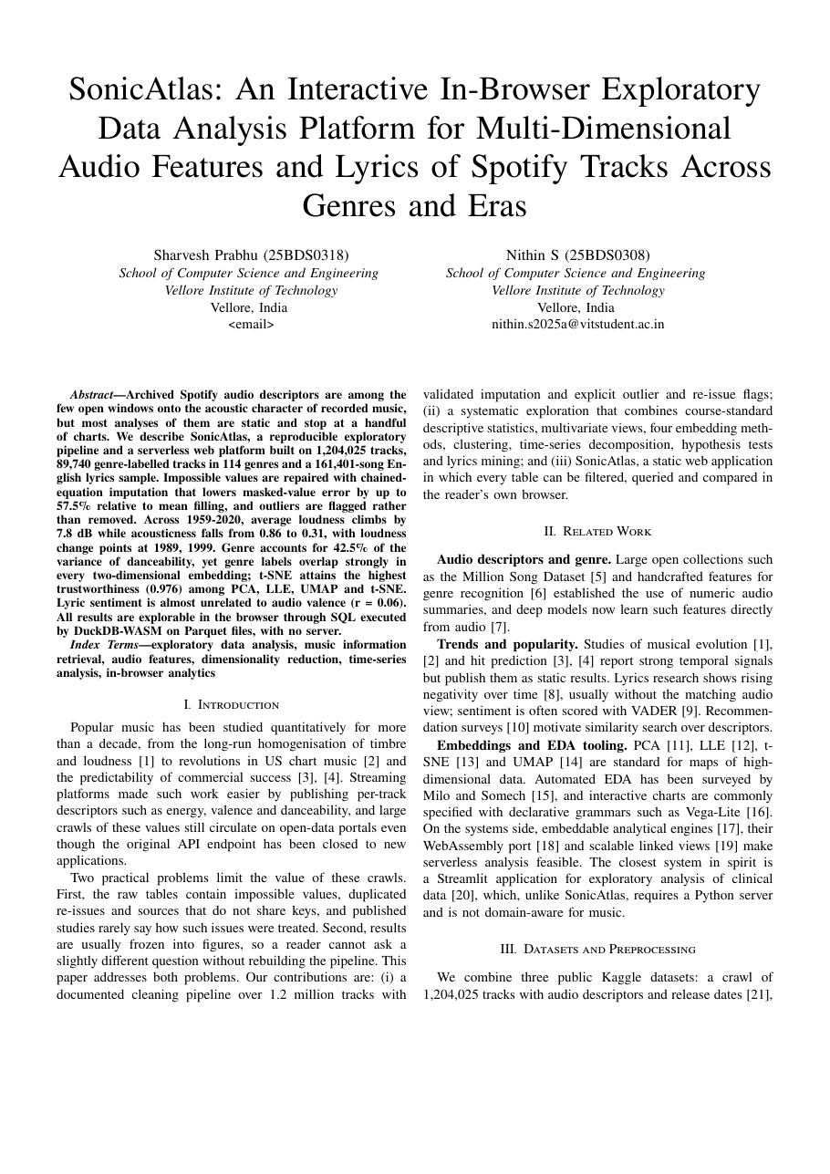
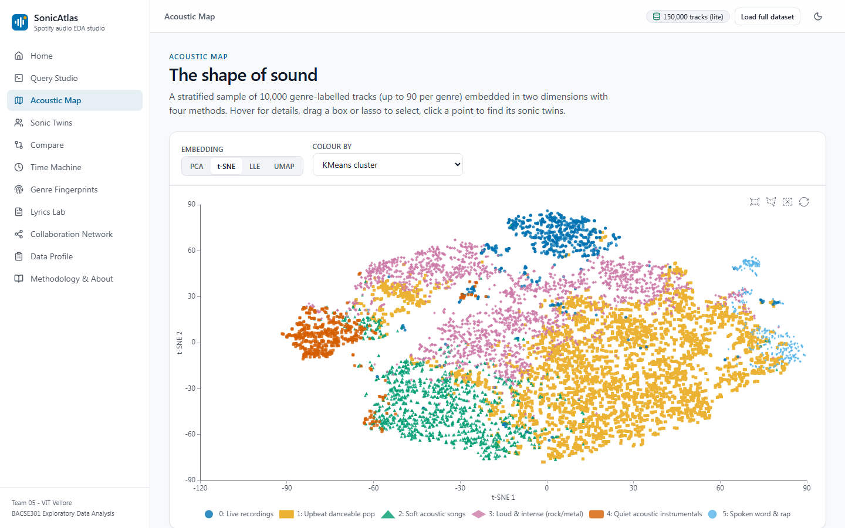
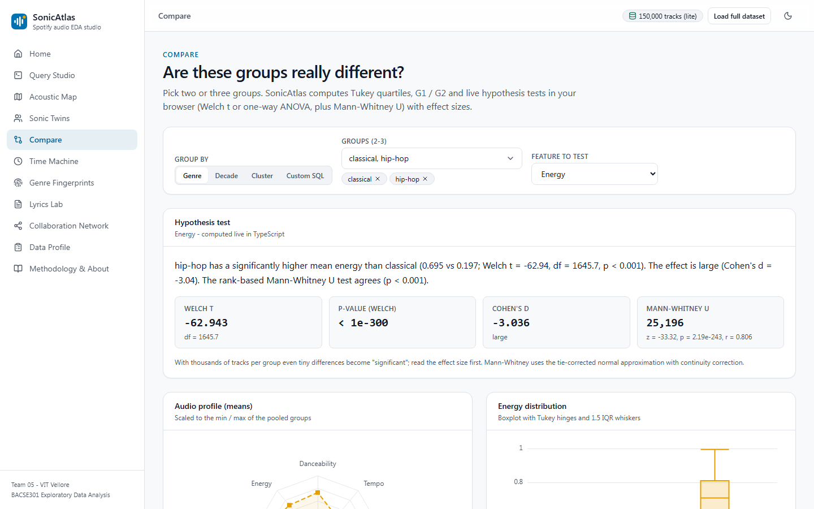
LIVE DEMO AND OUTCOME
SonicAtlas live, plus an IEEE paper prepared for submission
IEEE-format paper, 6 pages: prepared for submission
Targets: IEEE CONECCT 2027, ISMIR, IEEE VIS
GitHub: [GitHub Link]
Live: [Live Website Link]
Query Studio
Acoustic Map
Compare
Notes:
Here is SonicAtlas live: the Query Studio, the Acoustic Map and the Compare page, all running in the browser. On the right is the first page of our IEEE-format paper, prepared for submission, and links to the repository and live site.

Slide 10
CONCLUSION, FUTURE WORK AND REFERENCES
Louder, less acoustic, and more than genre alone
Conclusion
Limitations
Future work
Careful cleaning matters; music got louder and less acoustic; genre explains 42% of danceability but overlaps in every map; lyrics and sound carry different moods.
Spotify features are model-derived; catalogue favours recent years; genre join only 10.7%; English-only lyrics; the 2020s have one year.
Open audio features, multilingual lyrics, user study.
[9] J. Serrà et al. (2012), Measuring the Evolution of Contemporary Western Popular Music
[11] C. Hutto et al. (2014), VADER: A Parsimonious Rule-Based Model for Sentiment Analysis of Social Media Text
[16] L. van der Maaten et al. (2008), Visualizing Data using t-SNE
[25] D. H. da Silva et al. (2025), A Web Application for exploratory data analysis and classification of Parkinson's Disease patients using machine learning models on different datasets
Notes:
To conclude: careful cleaning changes the conclusions, music has become louder and less acoustic, genre matters but genres overlap, and lyrics add independent information. Our main limitations are the proprietary features and data bias. Thank you.

