Slide 1
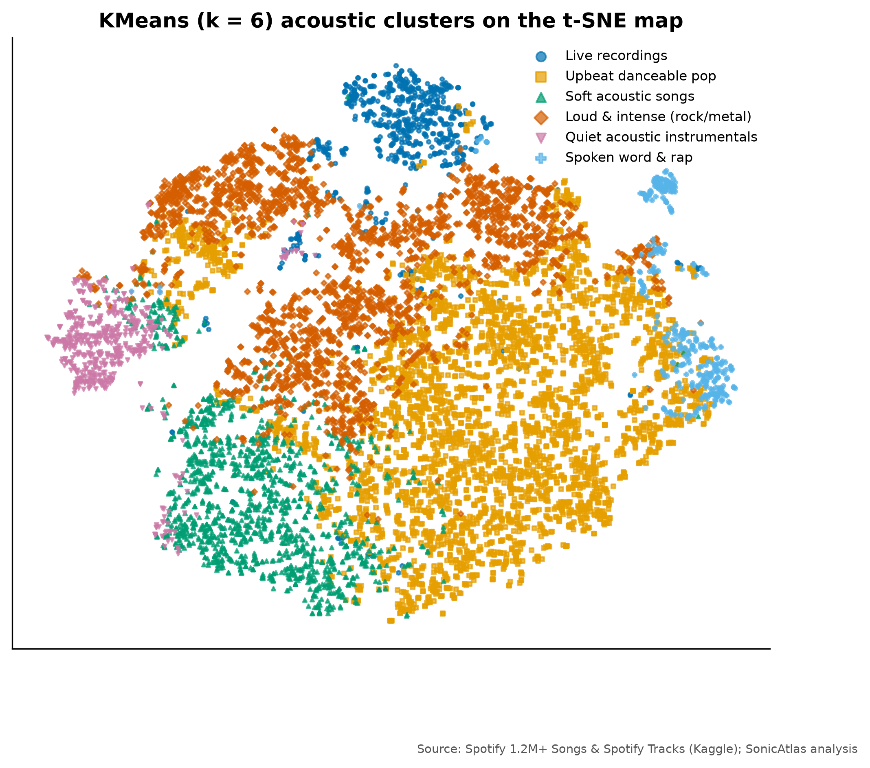
SONICATLAS
An Interactive In-Browser EDA Platform for Spotify Audio Features and Lyrics Across Genres and Eras
Review-1 | Problem, literature and design
Team 05
25BDS0318 Sharvesh Prabhu
25BDS0308 Nithin S
Real acoustic map of 10,000 tracks (t-SNE)
BACSE301 Exploratory Data Analysis (Project-based Course)
Faculty: ____________
School of Computer Science and Engineering, VIT Vellore | 2026
Notes:
We are Team 05. This Review-1 deck presents our problem, literature survey, objectives and the proposed SonicAtlas design.

Slide 2
ABSTRACT
Mapping how the sound of music changes across genres and eras
Spotify's archived audio descriptors (energy, valence, danceability, acousticness and more) are rarely explored beyond static charts. SonicAtlas cleans 1,204,025 tracks released 1900-2020, a genre table of 89,740 tracks in 114 genres and 161,401 English lyrics, explores them with the course methods (descriptive statistics, correlation, PCA/t-SNE/LLE, time series, hypothesis tests, text mining), and publishes everything in a website that runs SQL inside the browser with DuckDB-WASM.
1,204,025
tracks analysed
114
genres compared
1959-2020
years of trends
Notes:
SonicAtlas studies how musical characteristics change across genres and decades using public Spotify data and lyrics. We cleaned over a million tracks, applied the methods from our syllabus, and built a website so anyone can explore the results.

Slide 3
LITERATURE SURVEY AND GAPS
Prior work is static and studies sound and words apart
Study | What they did | Gap SonicAtlas addresses
J. Serrà et al. (2012) | Tracked pitch, timbre and loudness of Western pop over 50+ years | Static figures; no genre-level or interactive view
M. Interiano et al. (2018) | Linked audio features of 500k UK releases to chart success | No lyrics; results cannot be re-sliced by readers
C. O. Brand et al. (2019) | Measured rising negativity in song lyrics over 50 years | Lyrics only; audio mood not compared
L. van der Maaten et al. (2008) | Introduced t-SNE for 2-D maps of high-dimensional data | Global distances unreliable; no music benchmark
D. H. da Silva et al. (2025) | Streamlit web app for EDA and ML on medical data | Needs a server; not music-aware
Static results
Sound vs words
Data quality
Generic tools
fixed figures, no re-slicing
audio and lyrics never compared
zero tempos, re-issues ignored
not music-aware, need a server
25 verified papers reviewed in the report (Table I).
Notes:
We reviewed 25 verified papers. The main gaps: results are static, audio and lyrics are studied separately, data quality is rarely discussed, and generic EDA tools are not music-aware and need a server.

Slide 4
PROBLEM IDENTIFICATION
Open music data exists, but it is messy and locked in static charts
Messy data
Frozen results
2,777 zero-BPM tempos, 71,694 duplicate title+artist rows, no shared keys
papers and notebooks show fixed figures; readers cannot ask new questions
Split modalities
Hosting cost
audio features and lyrics are analysed in isolation
interactive tools usually need a running server
Notes:
The data is public but noisy: impossible tempos, duplicates and sources without common keys. Results in the literature are static, sound and lyrics are studied separately, and interactive tools cost money to host. Our objectives address each problem with a measurable target.

Slide 5
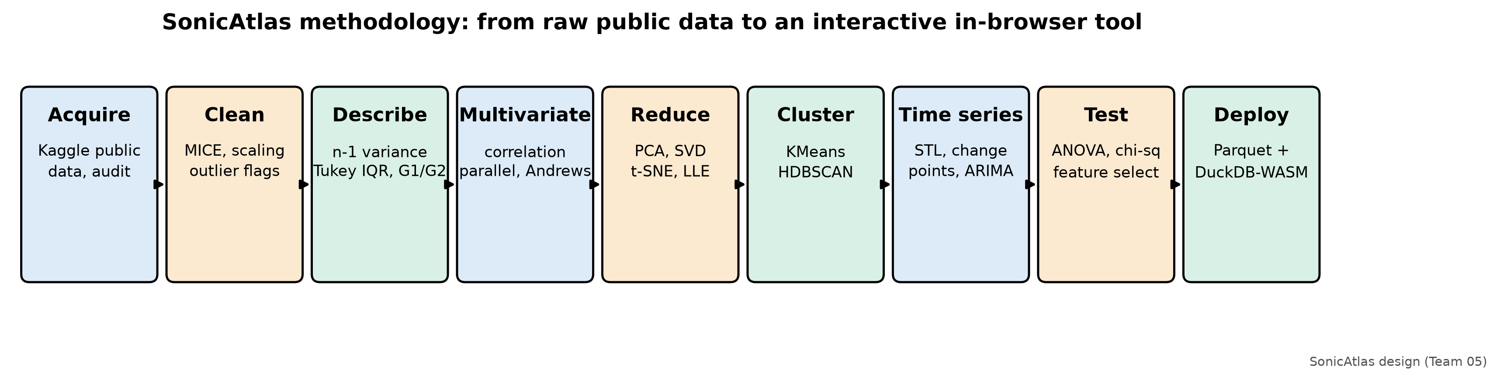
OBJECTIVES
Seven measurable objectives
Clean 1M+ tracks; validate MICE by masking 5% of values
Descriptive stats in course conventions (n-1, Tukey IQR, G1, G2)
Correlation and multivariate genre fingerprints
Compare PCA, t-SNE, LLE, UMAP; name acoustic clusters
Trends, STL seasonality, change points, forecast
ANOVA, chi-square, feature selection; lyrics sentiment
In-browser SQL with lite-data queries under 1 second
Notes:
Each objective has a measurable outcome, for example the imputation error compared with mean filling, trustworthiness scores for the embeddings, and query time in the browser.

Slide 6
EXISTING SYSTEMS
Existing systems cover only parts of the need
System | Open data | Music-specific EDA | Audio + lyrics | Interactive | Serverless
Spotify app / Web API | No (closed) | No | No | Yes (app) | No
Static notebooks / papers | Yes | Partly | Rarely | No | No
Streamlit EDA app [25] | Yes | Generic | No | Yes | No (server)
YData / Sweetviz / D-Tale | Yes | Generic | No | Partly | No (server for D-Tale)
No existing option is open, music-aware, interactive and serverless at the same time.
Notes:
Spotify's own tools are closed, notebooks are static, the Streamlit application from our faculty reading needs a Python server and is not music-aware, and automated EDA tools are generic. SonicAtlas covers all columns.

Slide 7
PROPOSED SYSTEM
A documented pipeline plus a serverless query platform
Clean
Explore
Map
Explain
Share
MICE for impossible values, re-issue and outlier flags, scaling
statistics, correlation, parallel coordinates, Andrews curves
PCA, SVD, t-SNE, LLE, UMAP and named clusters
STL, change points, ANOVA, chi-square, lyrics sentiment
static website: DuckDB-WASM SQL, maps, comparisons, URLs
Heavy computation runs once in Python; every interaction runs locally in the user's browser.
Notes:
Our proposed system has five stages: clean, explore, map, explain and share. The last stage is the website, which runs SQL in the browser so it is fast, private and free to host.

Slide 8
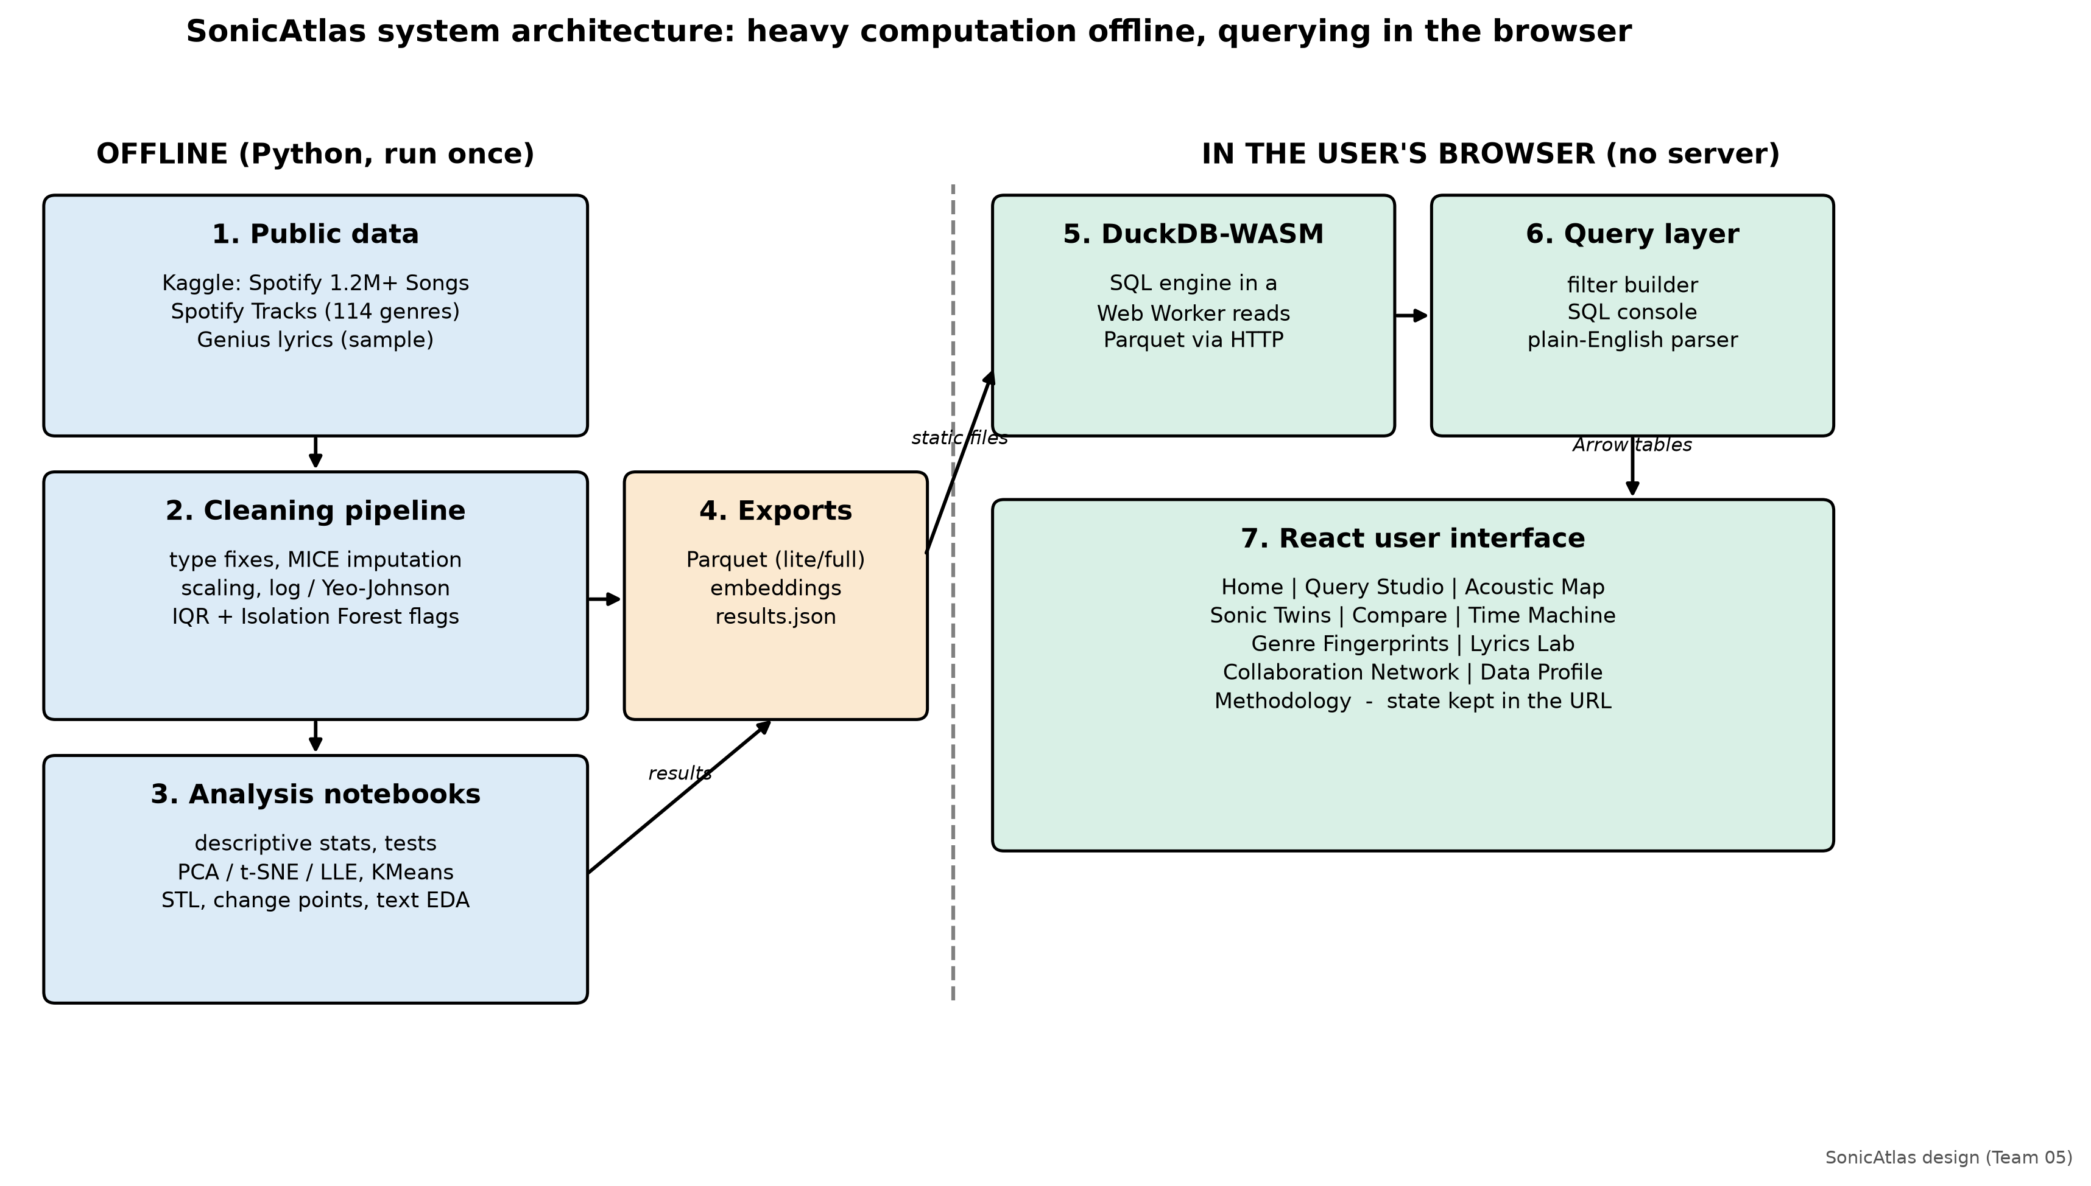
ARCHITECTURE / SYSTEM FLOW / MODULES
Heavy maths runs offline; querying runs in the user's browser
Notes:
Python notebooks clean the data and compute statistics, embeddings and clusters, and export compact Parquet files. In the browser, DuckDB compiled to WebAssembly runs in a Web Worker and answers SQL queries locally. The React interface has eleven modules and keeps its state in the URL.

