Slide 1
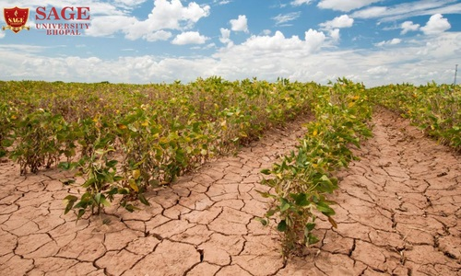

Climate change analysis anf prediction using machine learninng
UNIVERSITY OF AGRICULTURAL SCIENCES ,COLLEGE OF AGRICULTURE,
GKVK, BANGLORE
GROUP-18
NIKHILGOWDA HL(AMB2154)
NITHIN D(AMB2159)
PRAJWAL R(AMB2175)

Slide 2
Content
Tools and Technologies Used
Results
Discussion / Analysis
Conclusion and Future Work
References/Acknowledgements
Introduction
Problem Statement
Motivation
Objectives of the project
Dataset Overview
Methodlogy/approach

Slide 3
Introduction
Climate change prediction and analysis have become increasingly important as the impacts of global warming intensify across ecosystems, economies, and human societies.
Traditional climate models, while highly sophisticated, often struggle with the complexity and scale of environmental data. In recent years, machine learning (ML) has emerged as a powerful tool to enhance climate science by identifying patterns, trends, and relationships within vast datasets.
By leveraging historical climate records, satellite imagery, and real-time environmental data, ML models can improve the accuracy and efficiency of climate predictions, helping researchers better understand temperature changes, precipitation patterns, and extreme weather events.

Slide 4
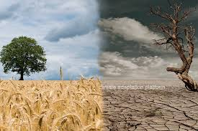
Problem Statement
The problem is formulated as a regression task: Input → Output relationship: Year, CO₂ (inputs) → Average Temperature (target). Our work addresses key challenges (data quality, feature selection, model robustness) to improve climate prediction reliability.
In this study, the goal is to predict average temperature (output) from features like year and CO₂ concentration (inputs). By doing so, we investigate how ML can enhance forecasting of climate indicators

Slide 5
Motivation
Rising Global Temperatures
Increasing temperatures highlight the urgent need for accurate prediction systems.
Frequent Natural Disasters
Growing incidents of floods, droughts, and cyclones require better forecasting tools
Agricultural Dependency
Countries like India depend heavily on climate-sensitive agriculture.
Environmental Sustainability
Need to protect ecosystems and biodiversity from climate impacts.

Slide 6
Objectives
To build robust predictive models (Linear Regression, Random Forest, Gradient
Boosting) that forecast average temperature using inputs like year and CO₂ concentration.
To integrate diverse climate data sources (synthetic data patterned after NASA/NOAA records) to enrich model inputs.
To apply thorough data preprocessing (cleaning, normalization) for high-quality input.
To compare model performance using metrics like MSE, $R^2$, and MAE, identifying which techniques best capture climate trends.

Slide 7
Dataset Overview
Snapshot: A few rows of the dataset are shown below: Year CO₂ (ppm) AvgTemp (°C)
Source: We use a synthetic climate dataset generated to mimic realistic environmental trends. This simulated data is patterned after actual climate records from agencies like NASA and NOAA (and similar to datasets found on Kaggle). It includes key variables spanning the years 1980–2020.
Features (Independent variables): Year (numeric), CO₂ concentration (parts per million). These are chosen for their known influence on temperature. In an expanded real-world scenario, additional features like humidity or solar radiation could be included.
Target Variable: Average annual temperature (°C) corresponding to each year.
Dataset Size: 41 records (one per year from 1980 to 2020). Each record has the features and target as described.

Slide 8
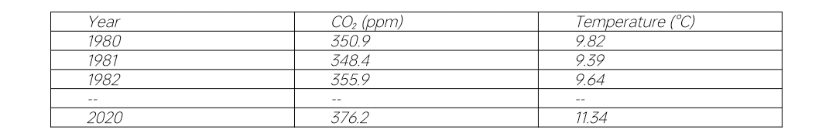
Dataset

Slide 9
Methodology / Approach
Model Selection (Regression Models) │ ▼ Model Training │ ▼ Model Testing (MSE, RMSE, R²) │ ▼ Prediction of Irrigation │ ▼ Automatic Water Control │ ▼ End
Start │ ▼ Data Collection (Sensors/Dataset) │ ▼ Data Preprocessing (Cleaning, Normalization) │ ▼ Feature Selection │ ▼ Train-Test Splitting │ ▼

Slide 10
Tools and Technologies Used
Libraries Used:
import numpy as np
import pandas as pd
import matplotlib.pyplot as plt
import seaborn as sns
Development EnvColab
ironment: Google

Slide 11
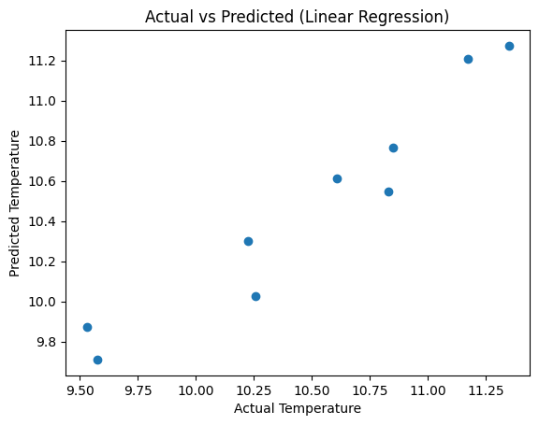
Results Actual vs Predicted (Linear Regression) Points lie close to the diagonal line, indicating good prediction accuracy. Small deviations show minor prediction errors due to noise. Confirms that the model fits the data effectively

Slide 12
Actual vs Predicted (Linear Regression)
Points lie close to the diagonal line, indicating good prediction accuracy.
Small deviations show minor prediction errors due to noise.
Confirms that the model fits the data effectively

Slide 13
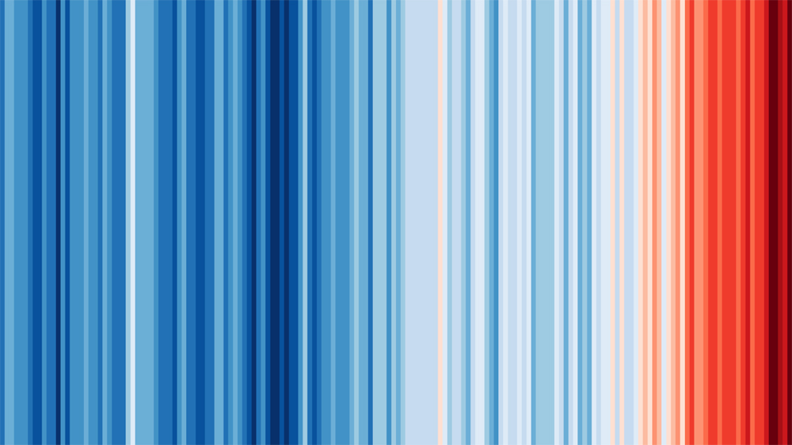
Climate stripes representing global temperature rise over nearly two centuries . Each vertical bar corresponds to one year’s average temperature (blue=cooler, red=warmer). The graphic vividly shows rapid warming in recent decades, reinforcing the need for effective predictive models. (Source: Ed Hawkins, Univ. Reading)

Slide 14
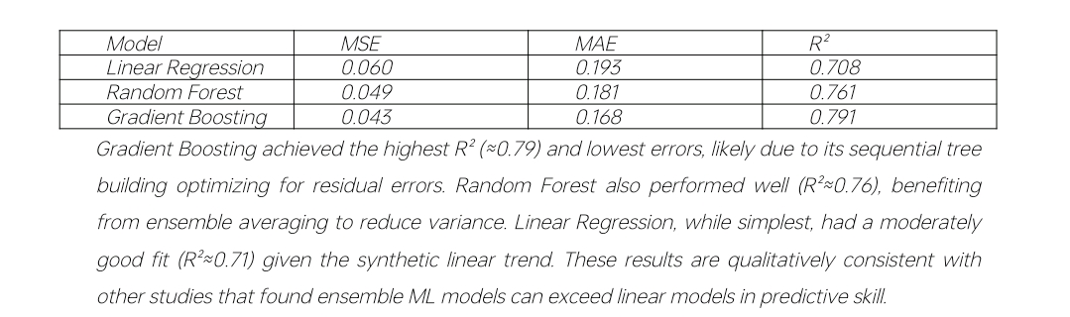
Discussion / Analysis

Slide 15
Conclusion
This study presented a comprehensive example of using machine learning to predict climate-related variables. We collected (simulated) climate data, applied preprocessing, and built multiple ML models with Python. Gradient Boosting yielded the best predictive metrics (MSE and R²), demonstrating improved performance over a simple linear model. These results support the notion from recent research that data driven methods can enhance climate prediction accuracy.

Slide 16
Practical Application
Smart Irrigation
Disease and Pest Alerts
Yield Prediction
Crop Selection and Breeding.

Slide 17
Conclusion
Data-driven system optimizes irrigation using soil and environmental parameters
Accurately predicts water requirements, reducing wastage and improving yield
Linear Regression performed best, indicating a strong linear relationship
Enables automation with minimal human intervention and real-time decisions
Cost-effective solution supporting sustainable and efficient agriculture

Slide 18
References
Sevgin, F., “Machine Learning-Based Temperature Forecasting for Sustainable Climate Change Adaptation and Mitigation,” Sustainability, vol. 17, no. 5, 2025, doi:10.3390/su17051812.
Setiawan, K. E., H. A. Shiddiqi, and P. Wicaksono, “Multi-output machine learning regression for climate prediction: a comparative study...,” Commun. Math. Biol. Neurosci., vol. 2024, Article ID 97, 2024.
Bhadra, M., “Climate Change Dataset,” Kaggle Data, 2023. [Online]. Available: https://www.kaggle.com/datasets/bhadramohit/climate-change-dataset
IPCC, “Climate Change 2021: The Physical Science Basis,” Intergovernmental Panel on Climate Change, 2021. (Illustrates climate trends and modeling techniques.)

Slide 19


