Slide 1
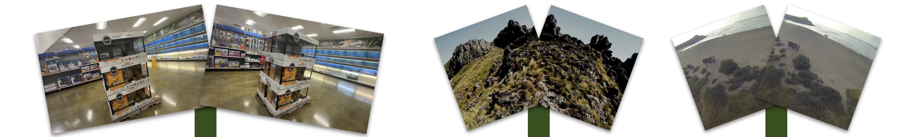
Large-scale training
and multimodal vision
Research highlights
Nithin Gopalakrishnan Nair
Ph.D., Johns Hopkins University
Notes:
Suggested time: 20 seconds.
My research connects large-scale generative learning with multimodal vision. I will cover synthetic data for novel view synthesis and restoration, physical understanding of 3D assets, robust recognition, and inference-time composition and steering. The projects span research at Google, NVIDIA, Adobe, MERL and Johns Hopkins, followed by current work on multimodal agents at Apple.
Sources
Nithin_CV_Academic.tex. Original input-view figure: https://scaling3dnvs.github.io/

Slide 2
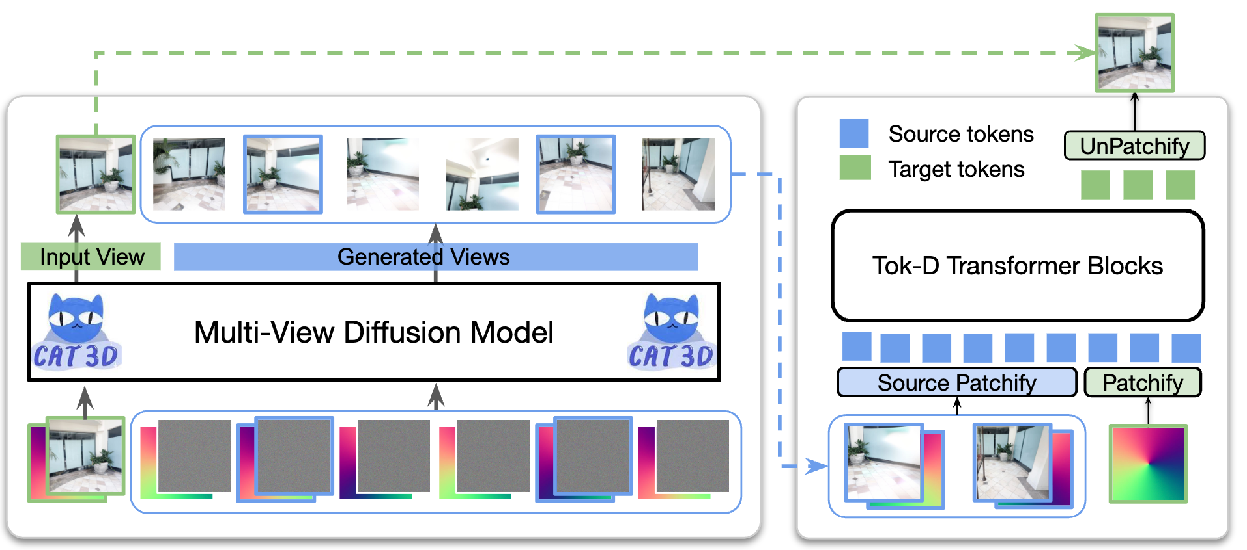
Google: training novel view synthesis
Diffusion-generated views expand the training data for transformer models.
ICCV 2025, co-first author. Training on 8 H100 GPUs.
Notes:
Suggested time: 65 seconds.
Novel view synthesis must reconstruct unseen camera views from sparse observations. Diffusion models can generate more views, but their artifacts can harm a reconstruction transformer. We introduced Tok-D to distinguish source tokens from target tokens through modulation. This lets the model use synthetic observations without treating their artifacts as equally reliable geometry. The training pipeline uses CAT3D to generate camera-conditioned views. All reported experiments use eight H100 GPUs for 100,000 iterations. The work demonstrates successful training of transformer novel view synthesis with diffusion-generated synthetic data. The next slide isolates the published real-data comparison so that synthetic-data effects and architecture gains stay distinct.
Sources
Scaling Transformer-Based Novel View Synthesis with Token Disentanglement and Synthetic Data, ICCV 2025. Sections 4, 5 and implementation details. https://scaling3dnvs.github.io/

Slide 3
Google: stronger reconstruction quality
In-distribution evaluation at 256 × 256 resolution. Higher PSNR is better.
+1.13 dB
RealEstate10K
+1.64 dB
DL3DV
ICCV 2025, Table 1. Real-data training comparison.
Notes:
Suggested time: 55 seconds.
Table 1 compares LVSM with our architecture under the in-distribution 256-pixel evaluation. The reported PSNR values are 28.89 versus 30.02 on RealEstate10K, 29.19 versus 29.47 on ACID, and 19.91 versus 21.55 on DL3DV. The improvements are 1.13 and 1.64 dB on the two highlighted datasets. These bars use the real-data training setting and measure the architecture improvement. Separately, Table 2 shows that adding synthetic views degrades LVSM but gives our method small cross-dataset gains on ACID and DL3DV. Our training uses eight H100 GPUs. GPU count alone is not a comparison of total training cost.
Sources
ICCV 2025 paper, Tables 1 and 2, Section 5.2. https://scaling3dnvs.github.io/

Slide 4
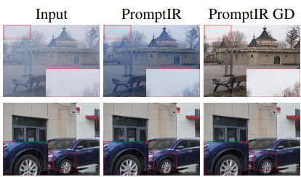
GenDeg: synthetic data for restoration
Diffusion models generate realistic degradations with controllable severity.
550K+
synthetic image pairs
Six degradation types
750K+ samples in GenDS
Better restoration on unseen
degradation patterns.
GD denotes training with GenDS.
GenDeg, CVPR 2025
Notes:
Suggested time: 60 seconds.
All-in-one restoration models often depend on a small set of hand-designed or observed degradations. GenDeg uses diffusion to synthesize realistic degraded versions of clean images, with control over the degradation type and intensity. We generated over 550,000 synthetic pairs across haze, rain, snow, motion blur, low light and raindrops. Together with existing paired data, GenDS contains over 750,000 samples. The examples compare the same PromptIR restoration architecture before and after training with GenDS. The main result is stronger generalization to unseen degradation patterns. This was collaborative work with Sudarshan Rajagopalan, Jay Paranjape and Vishal Patel.
Sources
GenDeg: Diffusion-Based Degradation Synthesis for Generalizable All-in-One Image Restoration, CVPR 2025. https://sudraj2002.github.io/gendegpage/ Original comparison image, first three columns and first two rows.

Slide 5
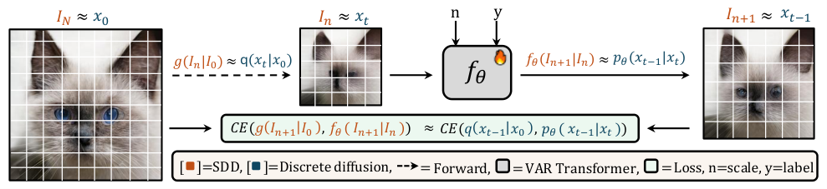
Scale-Wise VAR is Secretly Discrete Diffusion
A connection between autoregressive visual generation and discrete diffusion.
A Markovian attention mask establishes the equivalence.
SRDD uses this connection for iterative visual refinement.
arXiv preprint, 2025, co-first author
Notes:
Suggested time: 45 seconds.
This work studies the relationship between scale-wise visual autoregressive models and discrete diffusion. With a Markovian attention mask, we show a mathematical equivalence between the two formulations. The diagram aligns autoregressive scale refinement with discrete diffusion transitions and training losses. This motivates Scalable Visual Refinement with Discrete Diffusion, or SRDD. It connects my interests in autoregressive generation and diffusion rather than treating them as entirely separate model families. The work is a 2025 arXiv preprint, co-first authored with Amandeep Kumar.
Sources
Scale-Wise VAR is Secretly Discrete Diffusion. https://arxiv.org/abs/2509.22636 https://arxiv.org/html/2509.22636v1 Original Figure 1.

Slide 6
BRIAR: unconstrained face recognition
BRIAR verification at FAR 0.1%, with WebFace12M pretraining.
+31.4
percentage points
81.38%
Rank-1 with
WebFace42M
FG 2025. AdaFace (ResNet101) versus our method (Swin-B).
Notes:
Suggested time: 65 seconds.
Unconstrained recognition requires handling long range, pose, blur and low resolution. Our framework combines large-scale pretraining with a linear-probing stage, full fine-tuning and context-aware face crops. The 2025 study reports state-of-the-art results on BRIAR, TinyFace, IJB-S, IJB-B and IJB-C. On BRIAR, Table II reports a true accept rate of 39.41 percent for AdaFace and 70.84 percent for our method at a false accept rate of 0.1 percent. Both models use WebFace12M pretraining, with different architectures: ResNet101 and Swin-B. The difference is 31.43 percentage points, rounded to 31.4. A separate model pretrained on WebFace42M reaches 81.38 percent Rank-1.
Sources
Improved Representation Learning for Unconstrained Face Recognition, FG 2025, Table II. https://kartik-3004.github.io/portfolio/papers/FG2025_SwinFR.pdf

Slide 7
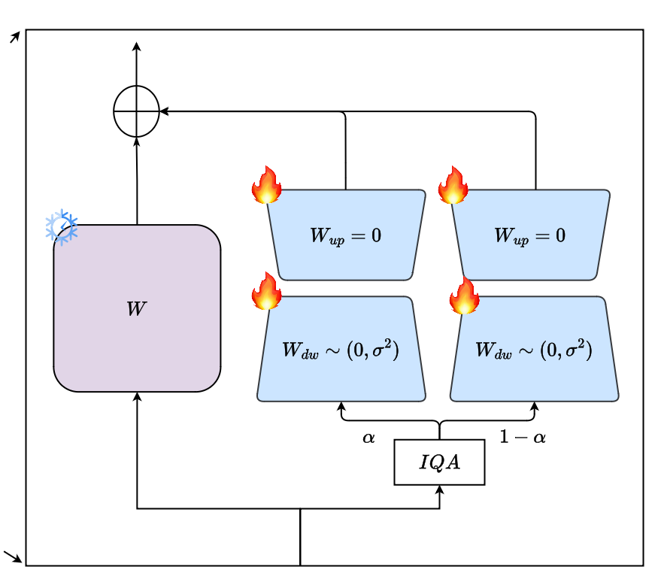
PETALface: adapting to low-resolution faces
Quality-weighted adapters preserve performance across input resolutions.
0.48%
trainable parameters
Two LoRA adapters adapt a frozen
backbone to image quality.
PETALface, WACV 2025 Oral
Notes:
Suggested time: 45 seconds.
Full fine-tuning can improve low-resolution recognition while damaging a strong high-resolution model. PETALface adapts a frozen pretrained backbone with two low-rank adapter branches. An image-quality estimate weights their contributions for each input. The method trains only 0.48 percent of the parameters and targets mixed-quality settings instead of replacing the backbone. This is complementary to the BRIAR work: one project improves representations through pretraining and adaptation, while this project controls the parameter and quality tradeoff. PETALface was presented as an oral paper at WACV 2025.
Sources
PETALface: Parameter Efficient Transfer Learning for Low-Resolution Face Recognition, WACV 2025. https://kartik-3004.github.io/PETALface/ https://github.com/kartik-3004/PETALface Original architecture, adapter module crop.

Slide 8
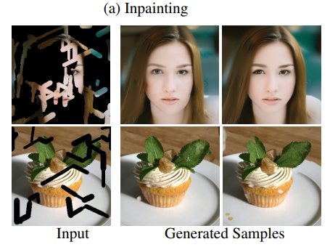
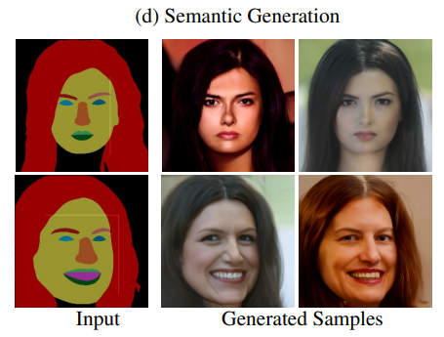
Steered Diffusion: inference-time control
First plug-and-play framework for image-to-image and label-conditioned synthesis.
Image-to-image generation
Label-conditioned generation
ICCV 2023, MERL and Johns Hopkins University
Notes:
Suggested time: 55 seconds.
Steered Diffusion introduced the first plug-and-play framework applicable to both image-to-image translation and label-conditioned synthesis within the scope studied in the paper. Pretrained auxiliary networks define energy functions for a requested condition, and guidance steers a pretrained diffusion model during sampling. This unifies tasks such as inpainting, colorization, super-resolution, semantic generation and identity-conditioned generation without training a separate generator for each task. These examples show the image-to-image and semantic cases. The contribution is a general framework for conditional synthesis, rather than a claim to have invented all inference-time guidance.
Sources
Steered Diffusion: A Generalized Framework for Plug-and-Play Conditional Image Synthesis, ICCV 2023. https://github.com/merlresearch/SteeredDiffusion Original paper figure, inpainting and semantic-generation crops.

Slide 9
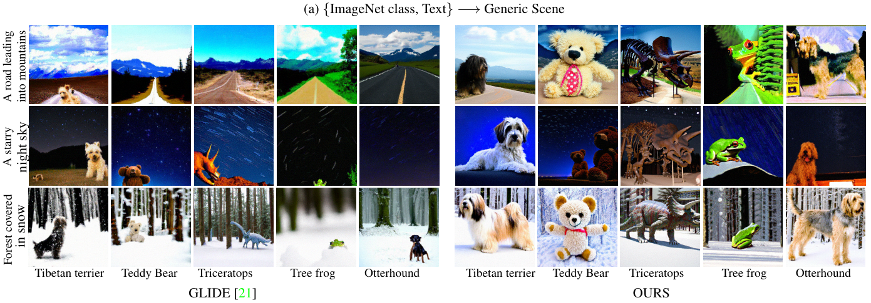
Unite and Conquer: compositional generation
Pioneered multimodal generation by composing independent diffusion models.
CVPR 2023
Notes:
Suggested time: 55 seconds.
Unite and Conquer is one of the early methods for compositional multimodal synthesis with diffusion models. Instead of jointly training a generator on every combination of modalities, it combines independently trained models through a generalized product of experts. Controllable modality weights adjust how strongly each model contributes. The figure pairs rare ImageNet classes with text descriptions such as a road leading into mountains, a starry night, or a snowy forest. Compared with a text-only baseline, the composed outputs better express the requested class while retaining the scene condition. The key contribution is composition at inference time without joint multimodal training.
Sources
Unite and Conquer: Plug & Play Multi-Modal Synthesis Using Diffusion Models, CVPR 2023, Figure 1(a). https://openaccess.thecvf.com/content/CVPR2023/papers/Nair_Unite_and_Conquer_Plug__Play_Multi-Modal_Synthesis_Using_Diffusion_CVPR_2023_paper.pdf

Slide 10
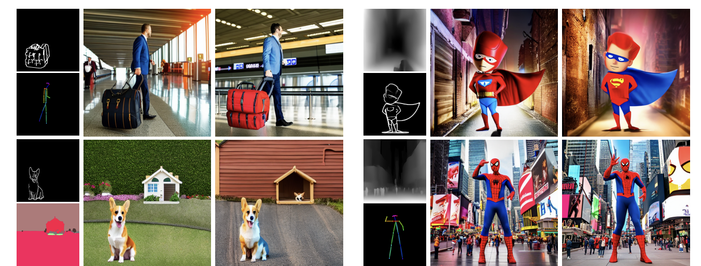
MaxFusion: multiple spatial conditions
Variance-guided feature fusion combines off-the-shelf conditional models.
ECCV 2024
Notes:
Suggested time: 50 seconds.
A user may want multiple simultaneous controls, such as the pose of a person and the geometry of nearby objects. Pretrained controllers may also provide conflicting information. MaxFusion combines the features of off-the-shelf ControlNet and T2I-Adapter models, using variance to guide the fusion. This allows multiple conditions to influence a text-to-image diffusion model without retraining it for every combination. The original examples show both complementary and conflicting spatial controls. The work extends composition from independent diffusion distributions to feature-level control inside a pretrained generation pipeline.
Sources
MaxFusion: Plug&Play Multi-Modal Generation in Text-to-Image Diffusion Models, ECCV 2024. https://nithin-gk.github.io/maxfusion.github.io/ Original teaser.

Slide 11
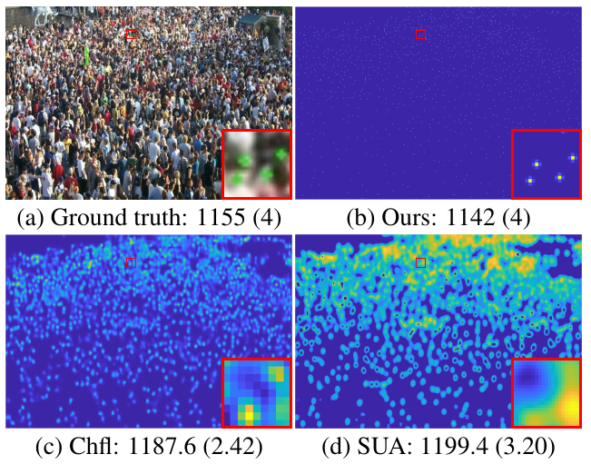
CrowdDiff: diffusion for crowd counting
Multiple density-map hypotheses improve crowd density estimation.
Conditional diffusion predicts
detailed crowd density maps.
Multiple sampled hypotheses
reduce ambiguity in counting.
One paper example shown at right.
CrowdDiff, CVPR 2024
Notes:
Suggested time: 45 seconds.
CrowdDiff applies generative modeling to a perception problem: estimating a crowd density map from an image. A conditional diffusion model represents multiple plausible density maps rather than committing immediately to one deterministic output. A regression branch supports training, and multi-hypothesis prediction improves counting. The original figure illustrates the detail in the predicted density map. It reports a ground-truth total of 1,155 and a CrowdDiff estimate of 1,142 for this particular image. Those are example counts, not aggregate benchmark scores. This project shows the broader use of diffusion in structured visual prediction.
Sources
CrowdDiff: Multi-hypothesis Crowd Density Estimation using Diffusion Models, CVPR 2024, Figure 1. https://openaccess.thecvf.com/content/CVPR2024/papers/Ranasinghe_CrowdDiff_Multi-hypothesis_Crowd_Density_Estimation_using_Diffusion_Models_CVPR_2024_paper.pdf

Slide 12
Research direction
Large-scale training of
generative and multimodal models
Synthetic data expands what models can learn.
Inference-time control makes generation more useful.
18 peer-reviewed publications, including CVPR, ICCV and ECCV
nithin-gk.github.io
Notes:
Suggested time: 25 seconds.
The common thread is learning more from scalable data and making pretrained models useful under new conditions. My interests center on large-scale training of generative and multimodal models, with synthetic data and 3D understanding as recurring themes. Inference-time steering and composition complement that work by making existing models more controllable. My publication record includes 18 peer-reviewed papers, with work at CVPR, ICCV and ECCV.
Sources
User CV and publication list. https://nithin-gk.github.io/ https://scholar.google.com/citations?user=_julgEYAAAAJ&hl=en

