Slide 1

“BUILDING VISUALIZED AND INTERCTIVE SALES DASHBOARD USING
JAVASCRIPT, HTML, CSS TECHNOLOGIES AT INNODATATICS PVT LTD”
N.NITHIN KUMAR
23MBMA14
MBA(GENERAL)
SCHOOL OF MANAGEMENT STUDIES
UNIVERSITY OF HYDERABAD

Slide 2
Contents
Objective
Requirements
Software Tools Required
Programming Languages
R&D Basic Prototype Building
Integrating with the Mysql database
Application and Logic building
Challenges Faced
Final Outputs
Thankyou

Slide 3
Objective
The objective of this project was build to Dynamic, Responsive, Realtime and a Robust Sales Dashboard applying the integrated with the Mysql database, applying the date filters, data analysis visualization, to one of the clients at Innodatatics, using JavaScript linked with HTML and CSS etc.
Core Objective
Objectives from time to time
Updated objectives

Slide 4
Objectives of developing a Sales Dashboard
Real-time insights: Provide up-to-date information on sales performance, allowing for timely decision-making.
Performance tracking: Monitor sales trends, identify areas for improvement,
and measure the impact of sales initiatives.
Goal setting and tracking: Establish sales targets and track progress towards achieving them.
Resource allocation: Optimize resource allocation based on sales performance
and identify areas where additional resources are needed.
Customer analysis: Gain insights into customer behaviour, preferences,
and purchasing patterns.

Slide 5
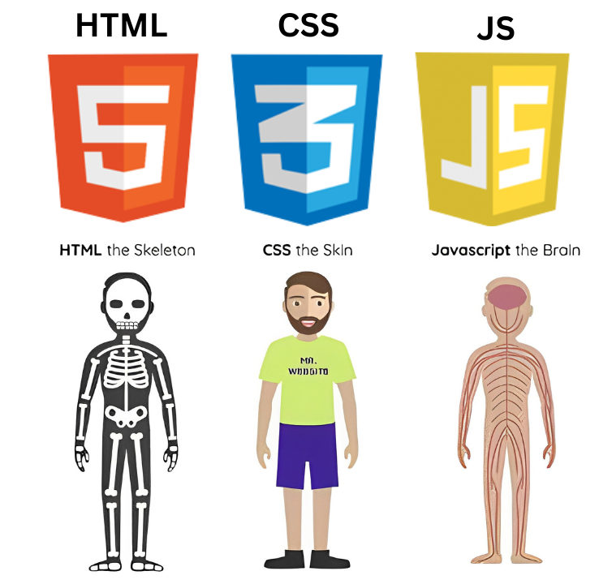
Programming Languages

Slide 6
R&D
Sources
YouTube (Building Sales dashboard using HTML, CSS, JS)
GITHUB: GitHub for the dashboard framework and protype building
Chatgpt : For the JavaScript functions, HTML framework and the CSS styles
Claude.ai: For error corrections, modifications to be made to include to the dashboard.
Prototype Building: The first basic prototype was built using the Primary data, by manually converting the excel file to JSON format and fetching it, to the js code. Below is the basic prototype built.

Slide 7



Software Tools Required
And Methodology
VISUAL STUDIO CODE
version: 1.90.0 (system setup)
download link: https://code.visualstudio.com/download
MYSQL WORKBENCH
version:8.0
download link: https://dev.mysql.com/downloads/workbench/
NODE JS Server
version: 20.15.0
download link: https://nodejs.org/en/download/package-manager

Slide 8
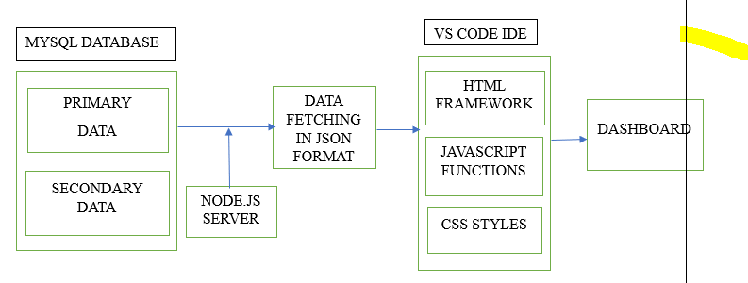
BLOCK DIAGRAM AND PROCESS FLOW

Slide 9
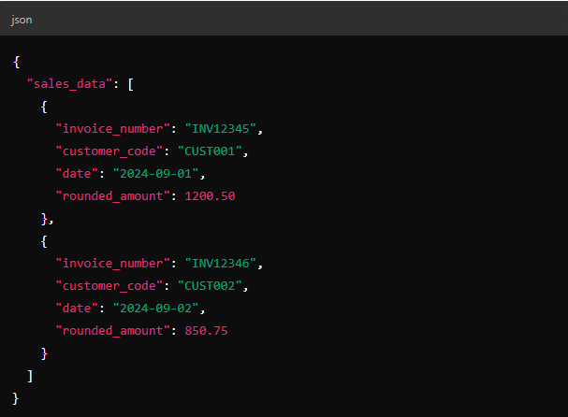
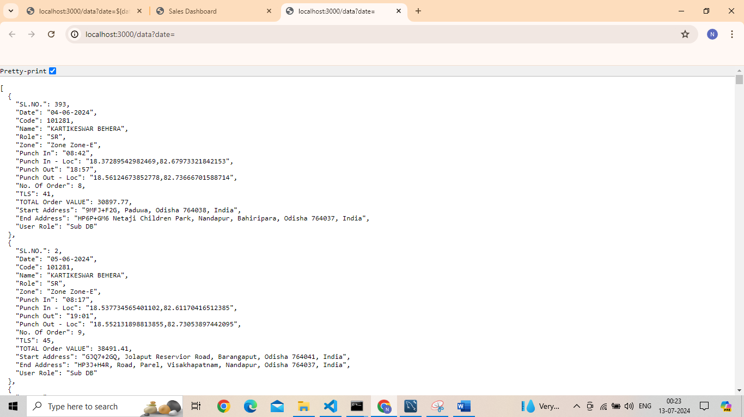

Slide 10
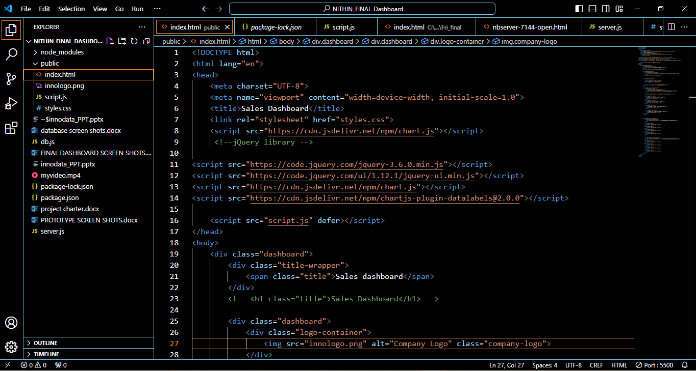

Slide 11
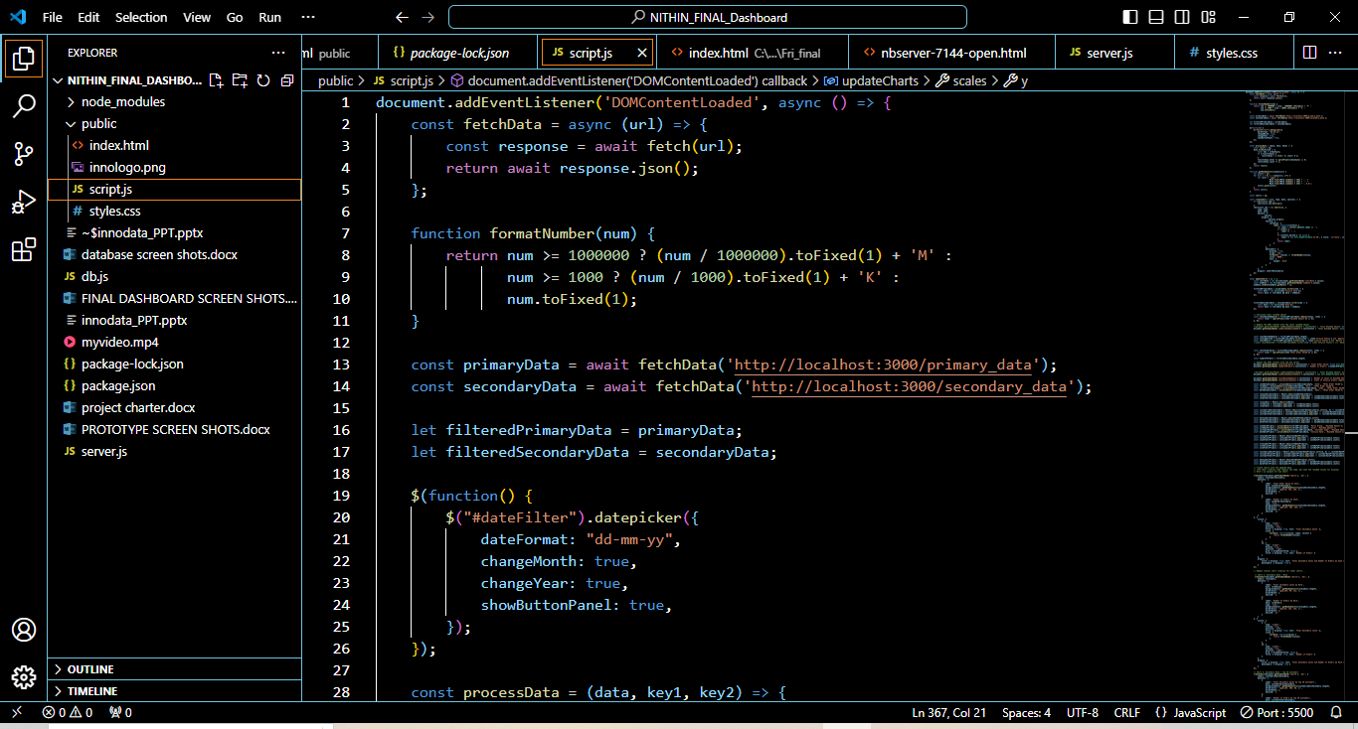

Slide 12
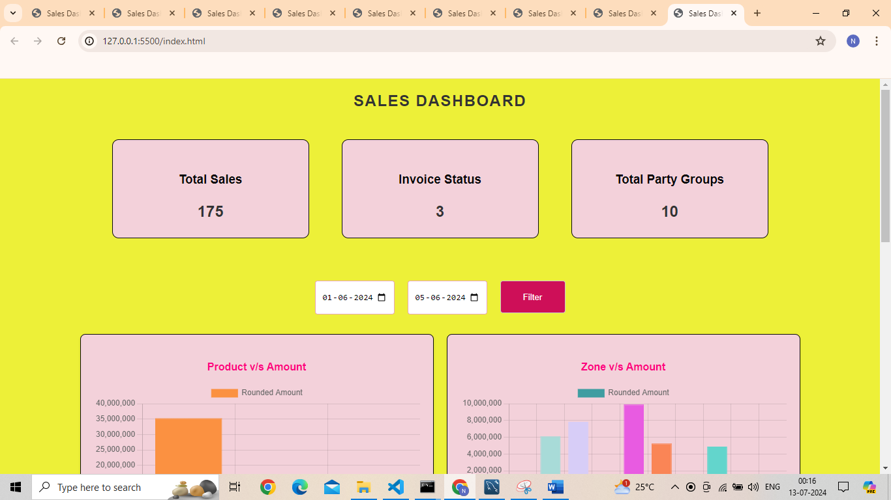
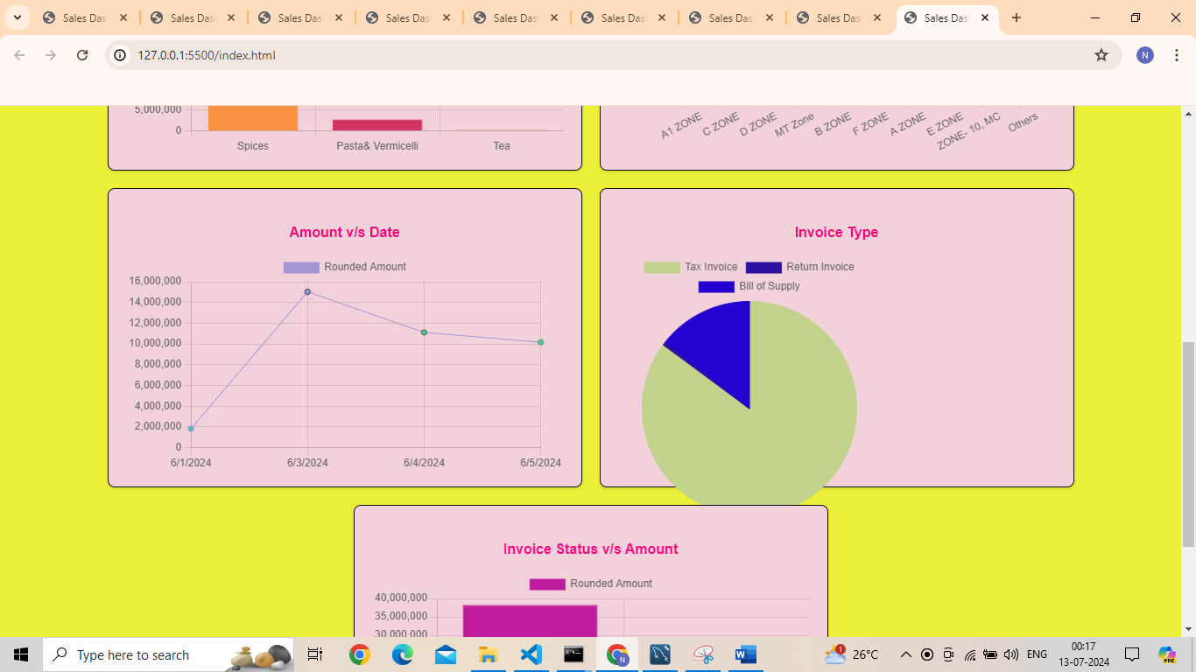
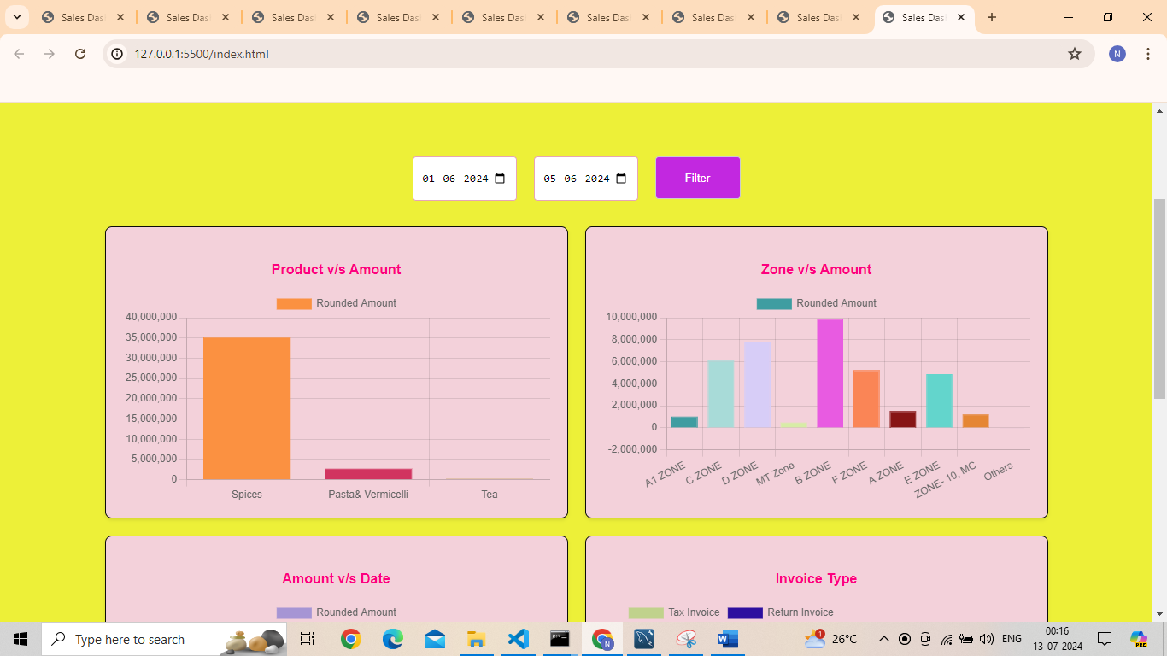
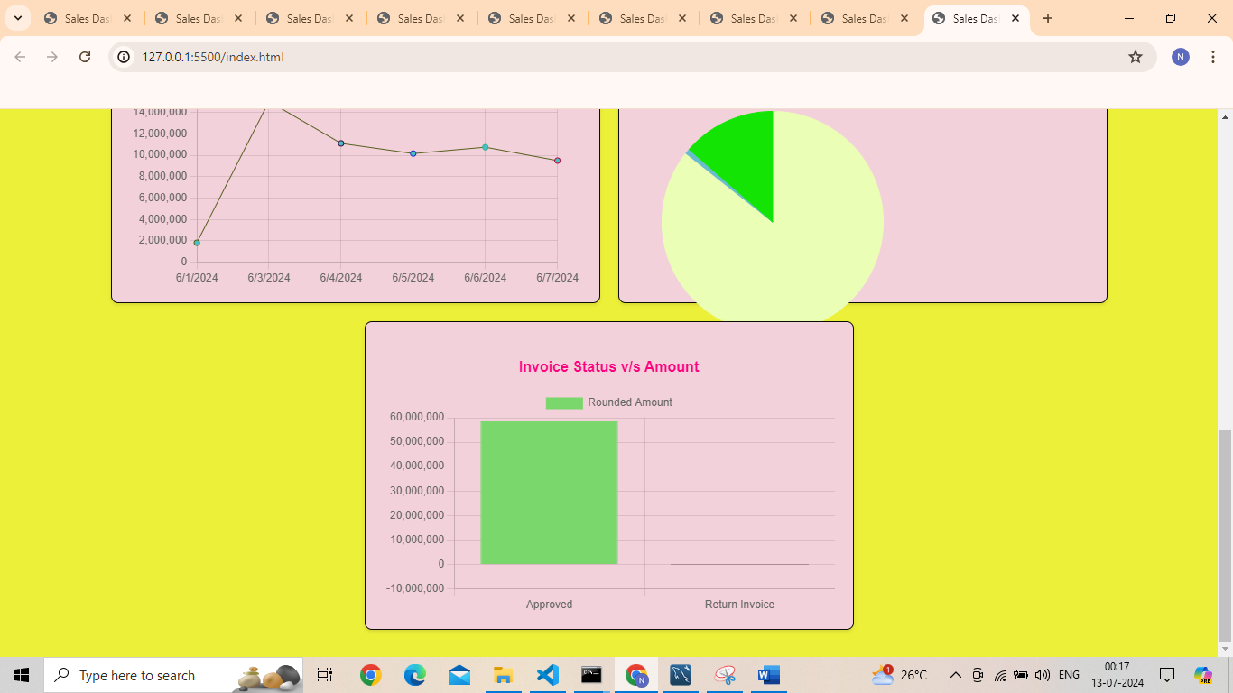

Slide 13
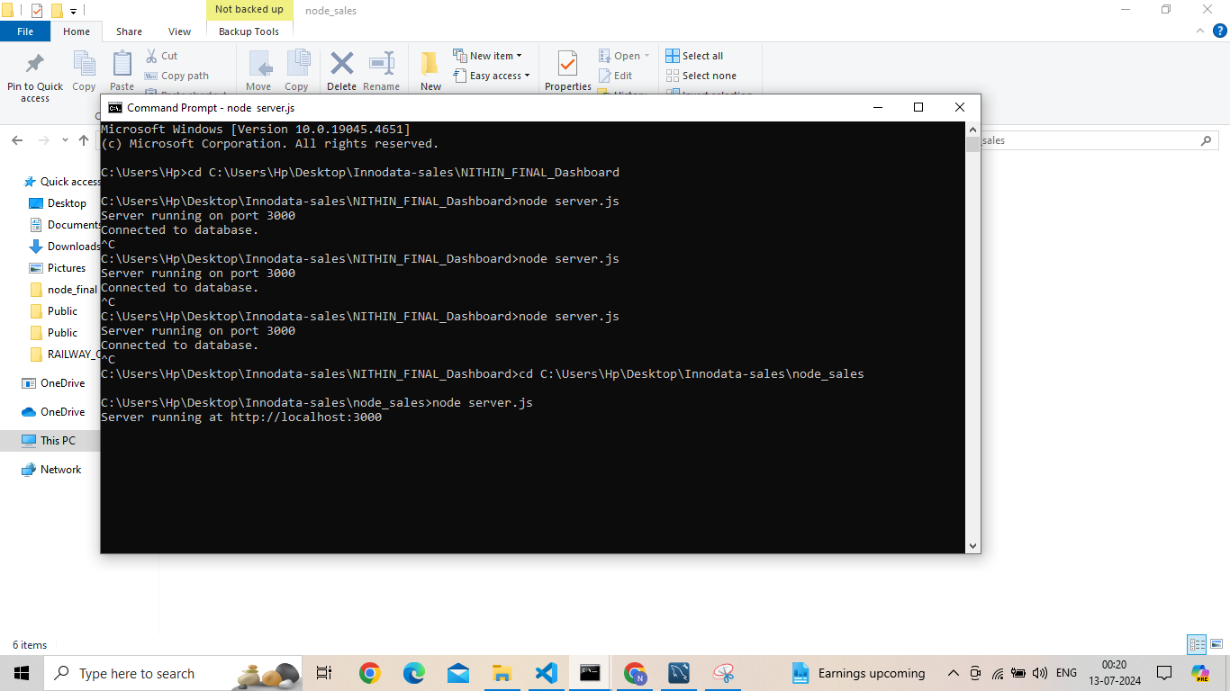
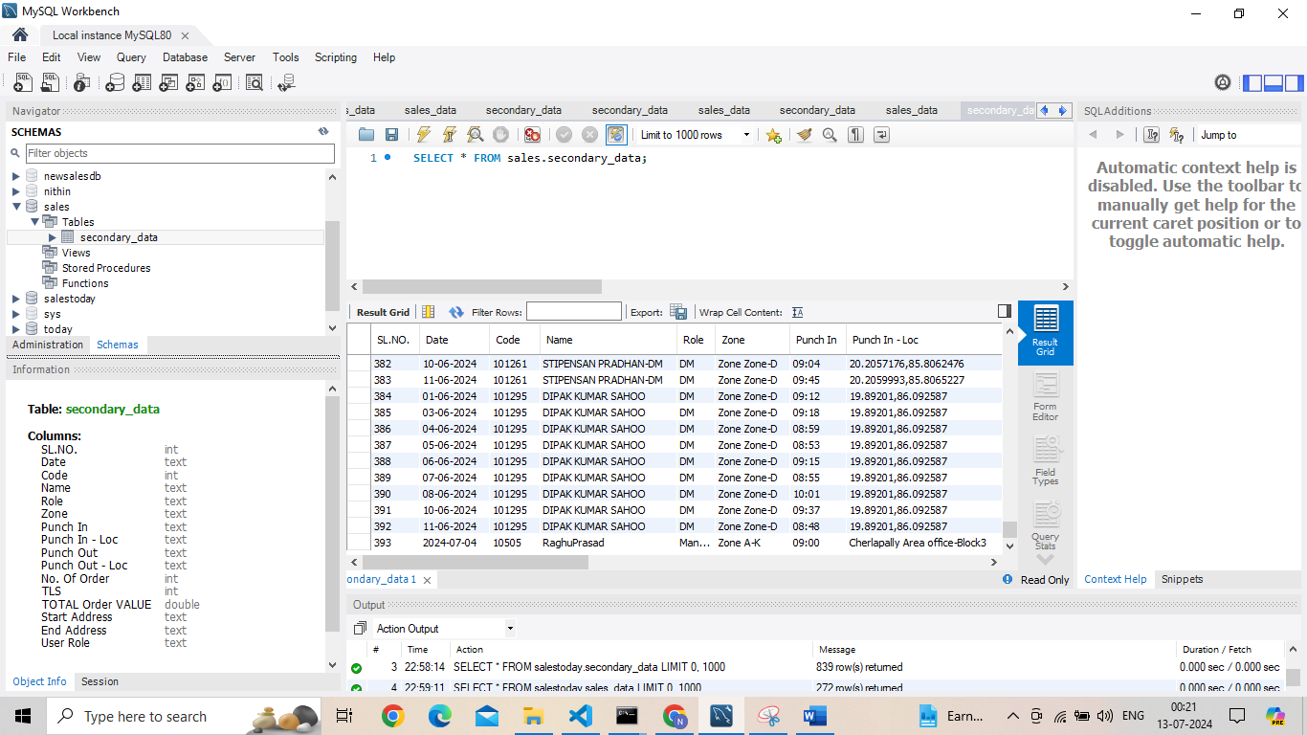
MYSQL INTEGRATION
Install the MySql workbench
Setup the environment and credentials for the Mysql database.
Create a database and import the primary and secondary data into the tables in the database.
The tables in the database can also be generated by importing the data using python pymsql library and create_engine package

Slide 14
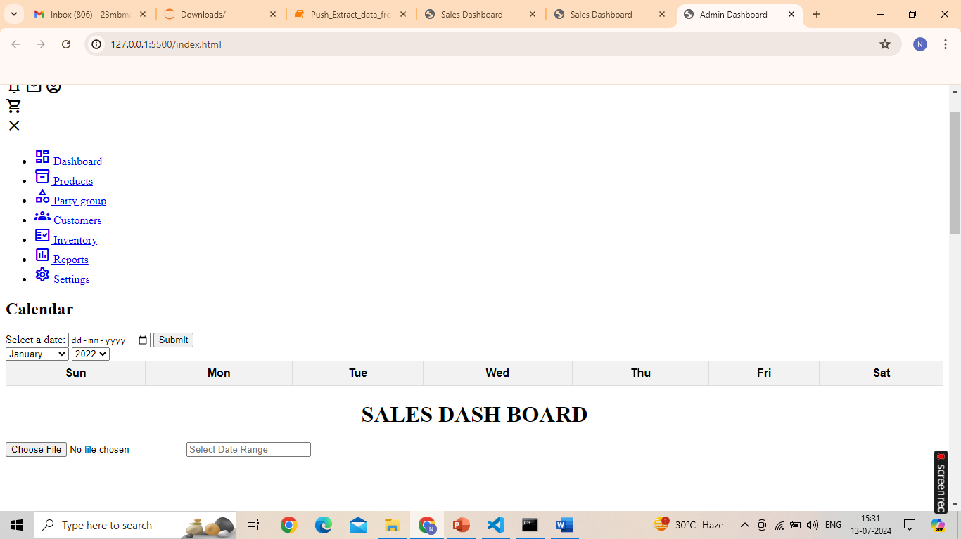
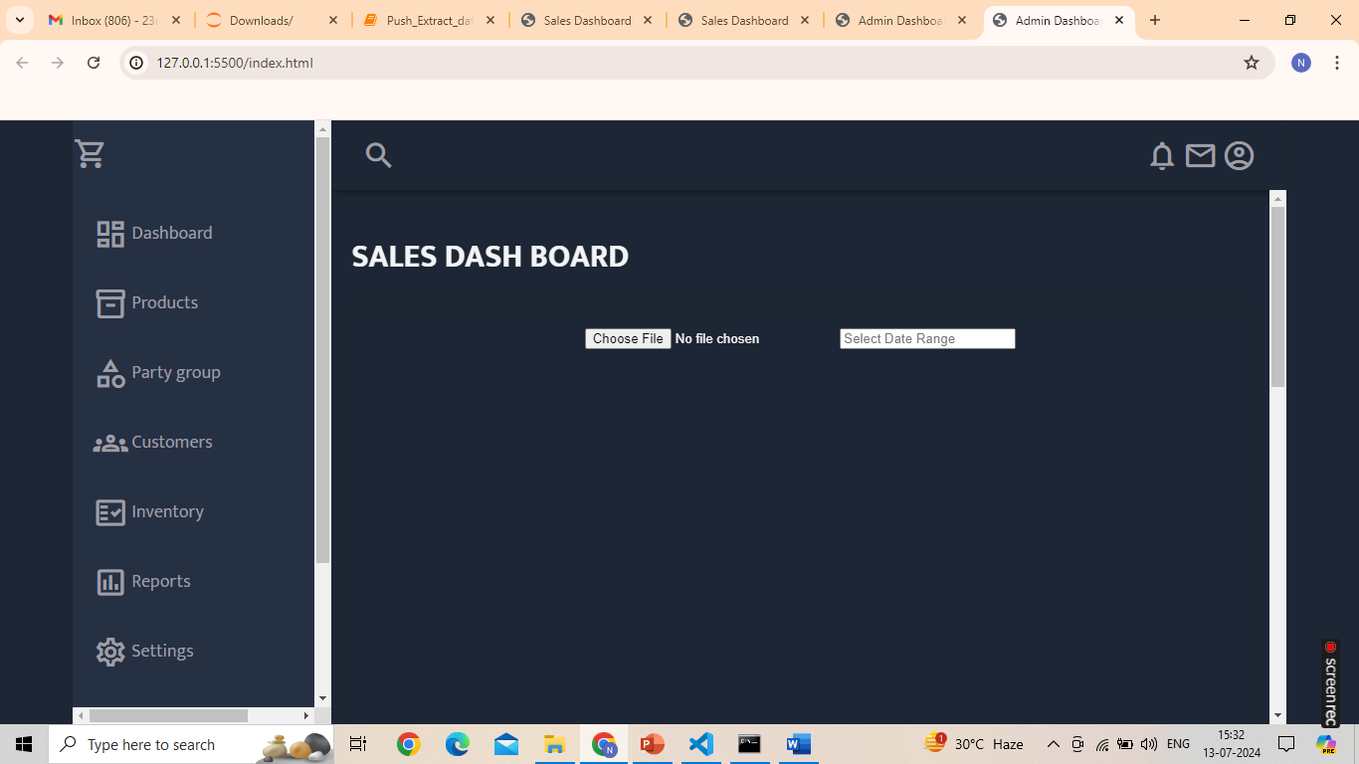
Application and Logic Building
Building the dashboard HTML framework with the container, classes, div tags. Establish the connection between CSS & JS.
In the JS define the HTML elements, functions, logic for the data fetching, data filter, date picker, update button, top cards, creating charts, dataplugins, random colors, update charts, with the all the necessary event listeners.
In the CSS, create the styles for the dashboard. Update the font size, dashboard body color, background color, button color, container size, card size etc

Slide 15
Challenges Faced
Date picker and calander integration
MYSQL database integration
Including new java script functions with adjustments and corrections
Error detection and corrections
Datatype challenges with date and sales.
Initial challenges such as building a basic prototype.
Future Scope: The project can be enhanced for adding more different charts,
Appealing visuals using CSS, Integrate with python, utilize the dashboard for other sales business with some changes etc.

Slide 16
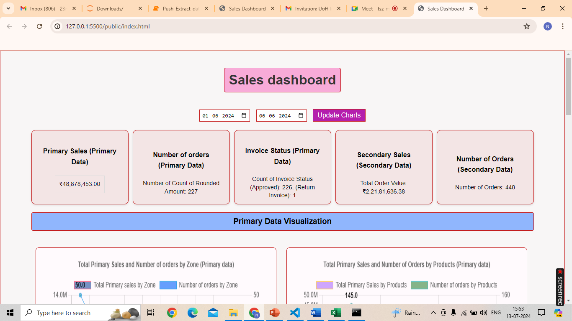

Slide 17
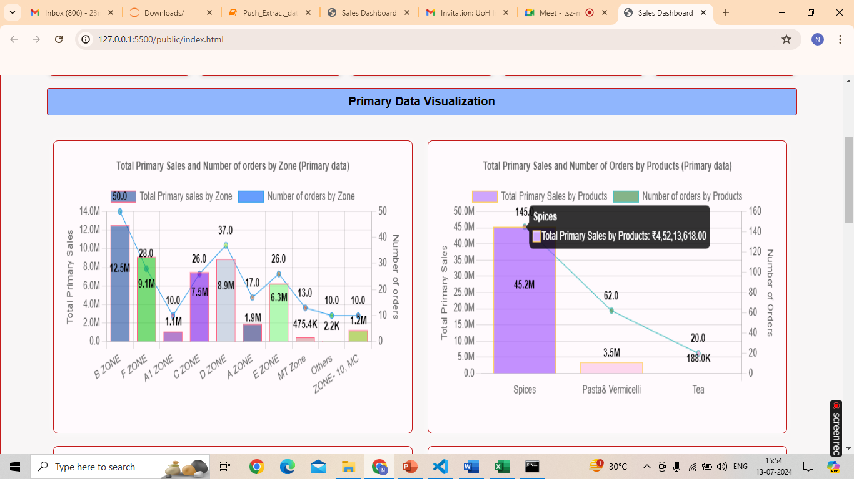

Slide 18
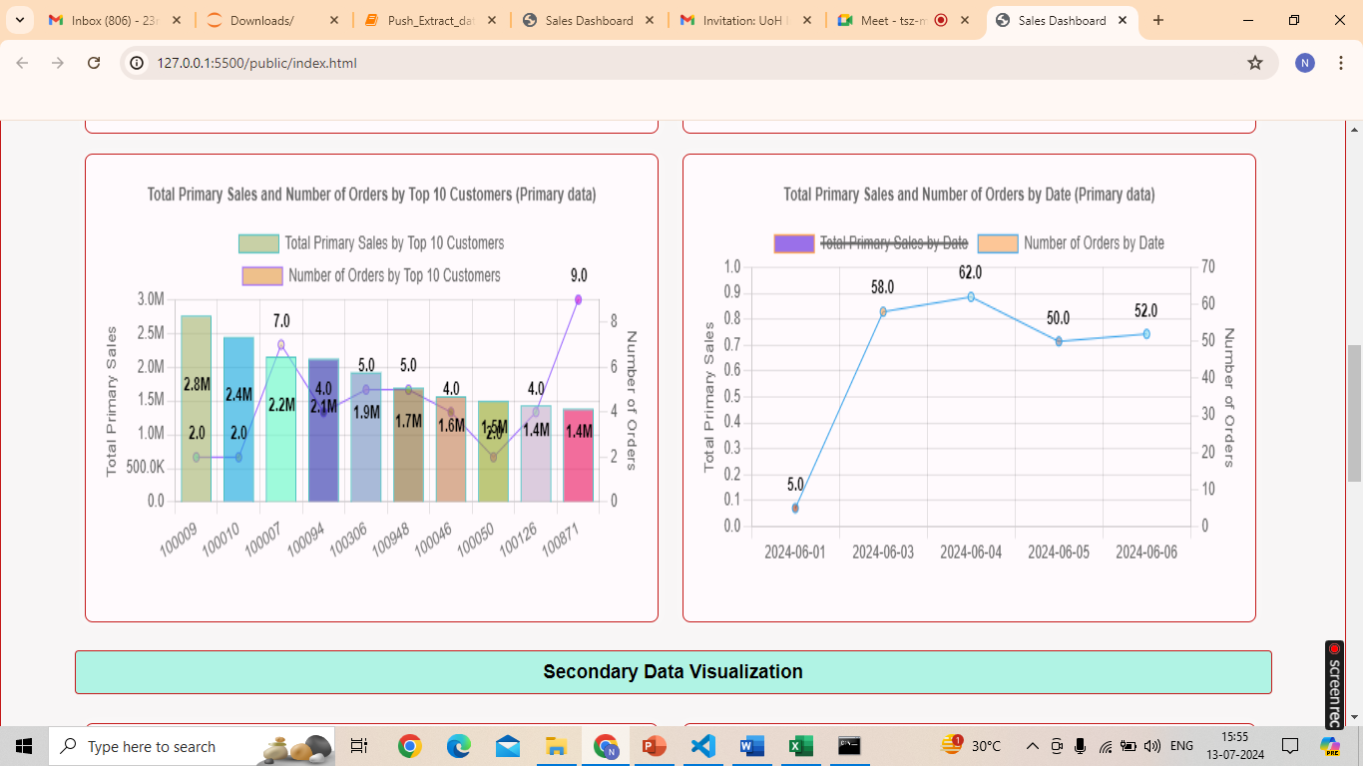

Slide 19
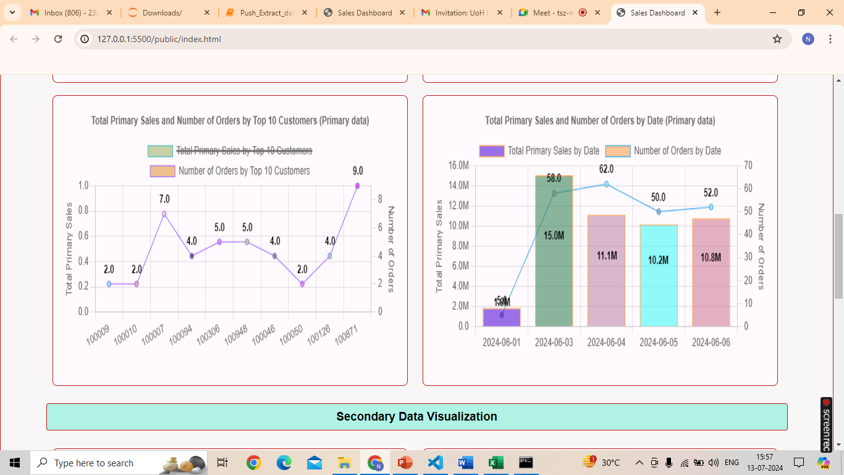

Slide 20
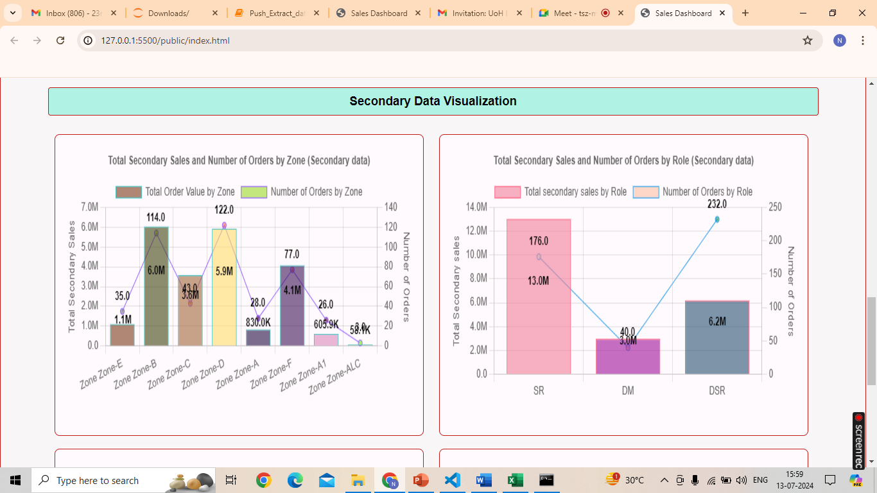

Slide 21
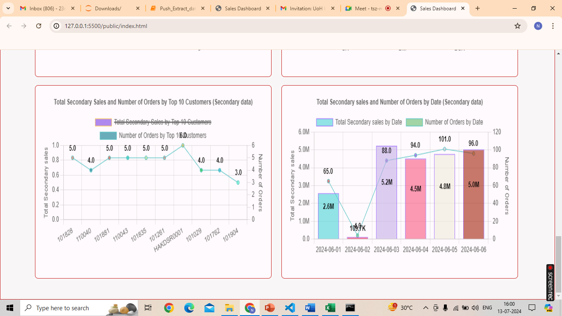

Slide 22
SCOPE AND LIMITATIONS
Scope
The dashboards built using HTML, CSS, JS are highly customizable, interactive, and visually appealing where the developer can design the dynamic user interfaces with responsive layouts for business needs.
2) These dashboards allow the users for real-time data visualization and allows for further integration with the real-time sales updates
3) Using JavaScript, data from the databases like MYSQL, PostgreSQL, or MongoDB can be easily fetched using server-side languages like (Node.Js). This makes it easier to track the sales trends.

Slide 23
Limitations of Sales Dashboards:
JavaScript being a client-side language, may lead to performance bottlenecks handling large datasets. This creates client side processing limitations.
Storing sensitive sales data can raise the security concerns and scope of data breaches.
The performance of client-side dashboards may degrade because of handling complex queries, and large datasets. This creates scalability issues.

Slide 24


