Slide 1
ET Departmentals
Shop Management System

Slide 2

Technology Stack
SQL Server
.NET (Entity Framework)
Angular CLI
Bootstrap
Visual Studio
Visual Studio Code
Jasmine & Karma
Git

Slide 3
INPUT DESIGN
The input design is the link between the information system and the user. It comprises the developing specification and procedures for data preparation.
The Input design comprises of a nav bar in which buttons(components) are included to get the respected details from the database.
Each component when opened shows the respective data and 3 buttons with functionalities add data , edit data, and delete data/record and also a search bar to search for a particular record.
When Add or Edit buttons are clicked a popup window shows up for entering the details and saving in the database.
When delete button is clicked a popup window appears to confirm that they want to delete the record or not.

Slide 4
Modules / Components:
Customer
Customer Ledger
Employee
Product
Product Purchase
Employee Designation
Sales
Purchase
Supplier
Supplier Ledger

Slide 5
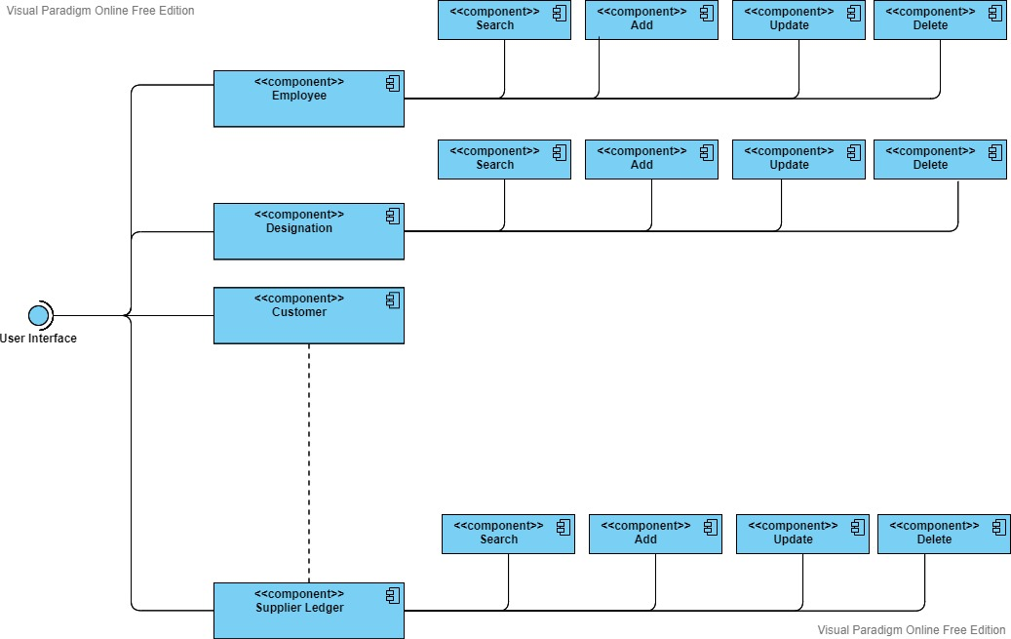
Use Case Diagram

Slide 6
THANK YOU!
Narendula Nithin

