Slide 1
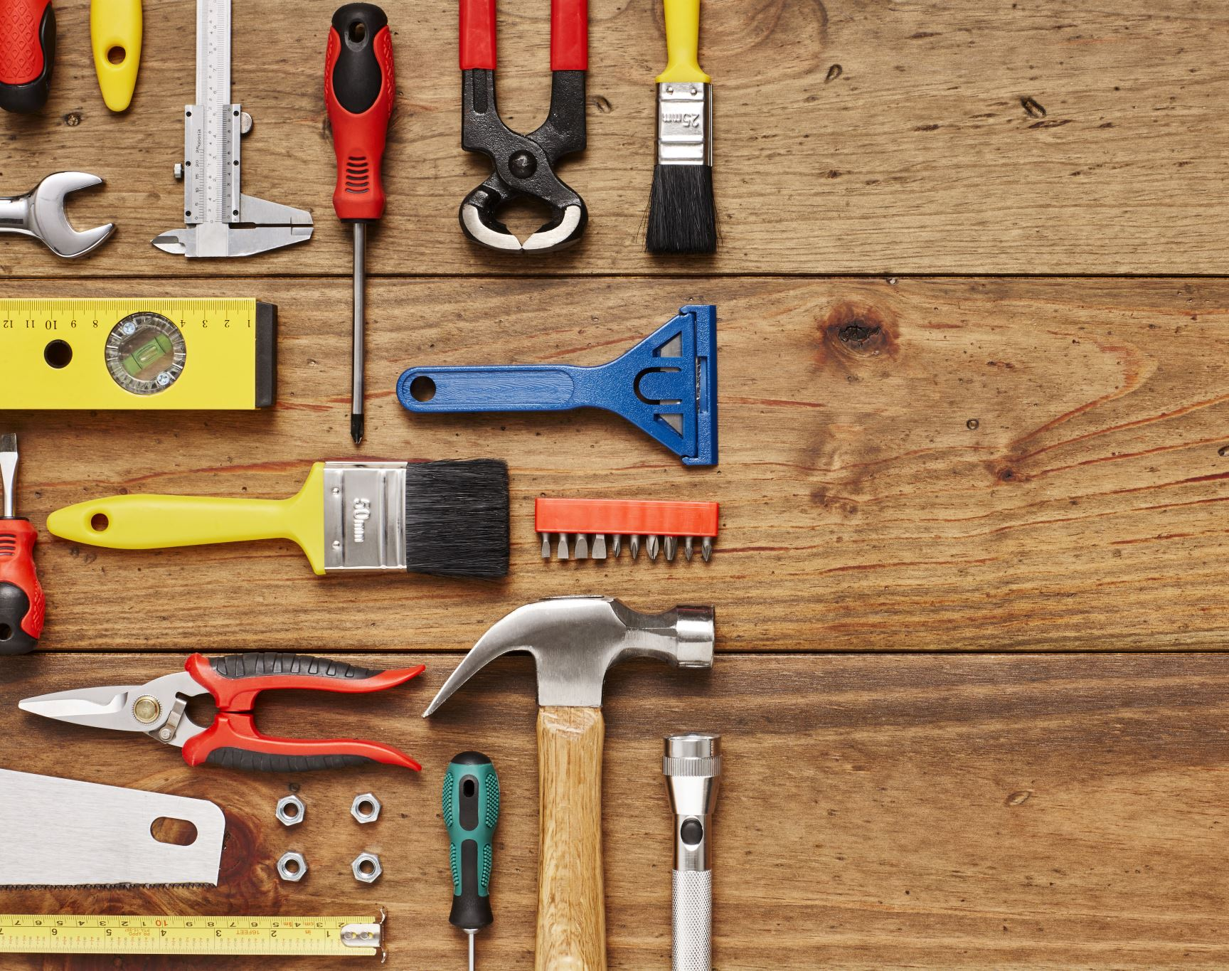
Final project Mechanical tools Recognizer
Nithin Reddy
Notes:
Hello everyone,
Today we are going to see about mechanical tools recognizer.
A day before the project pitch, my mom called me from India and said that
“she found water leakage from a tap in the backyard”.
I tried to explain her
how to repair it by sitting here at my desk .
It took time for her to pick some tools from the toolbox,
but she couldn't find the correct one
and waited for the plumber to come and fix it.
Many people don’t know which one to choose
and how to use some tools
so I thought of doing something related for this kind of problem.
Then I got an idea
why I couldn’t build a model
that recognizes the tools
and shows them how to use the tools. This is where it started

Slide 2
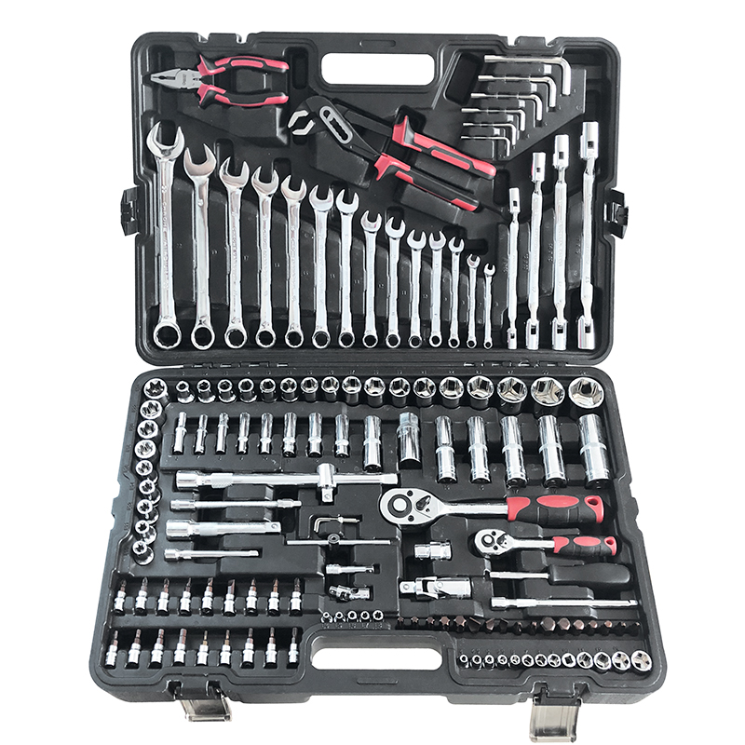
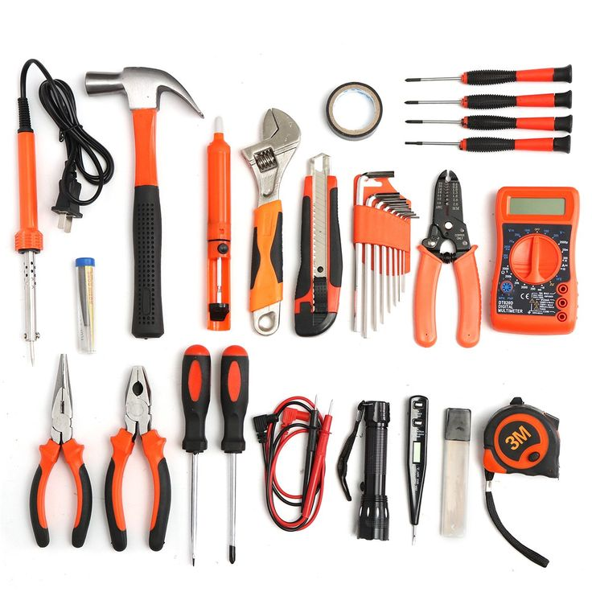
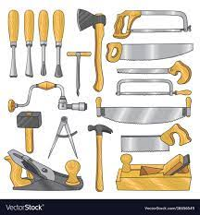
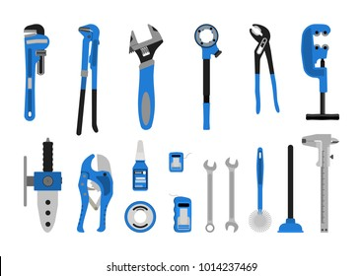
Tools

Slide 3
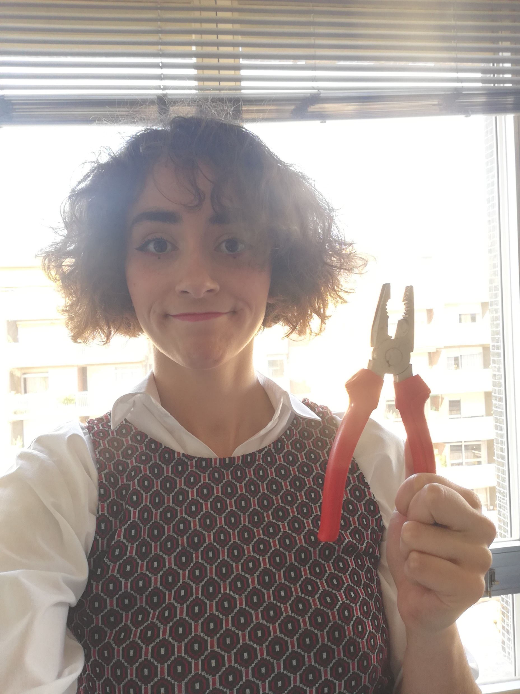
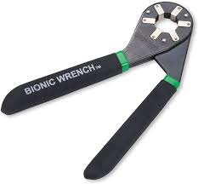
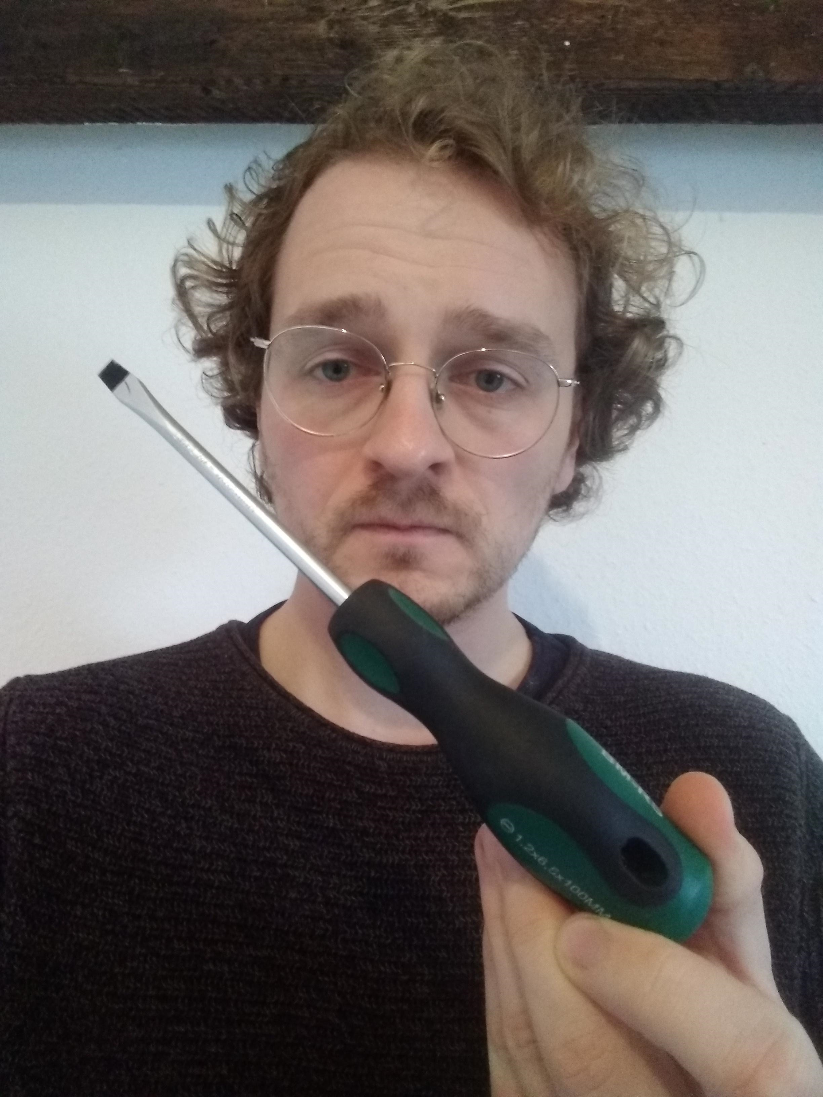
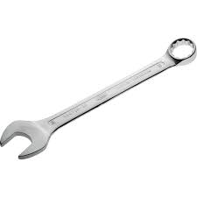
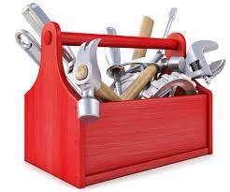
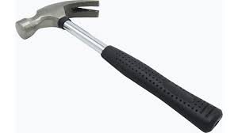
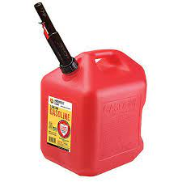
Tools Used

Slide 4
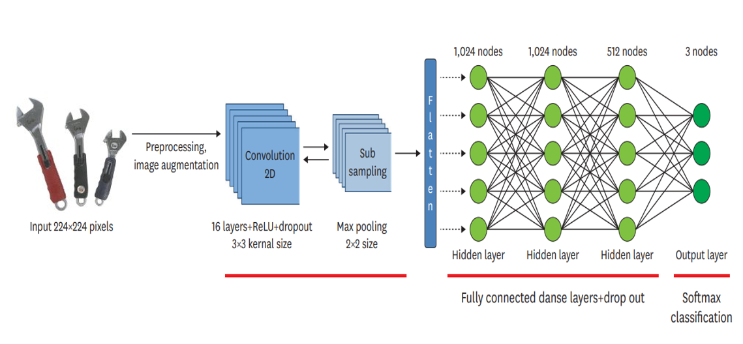
CNN Algorithm
0
1
2
Convolution Neural Network

Slide 5
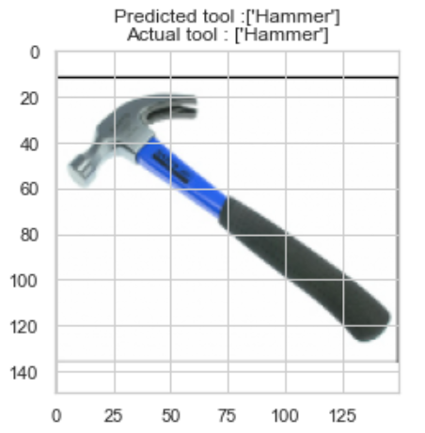
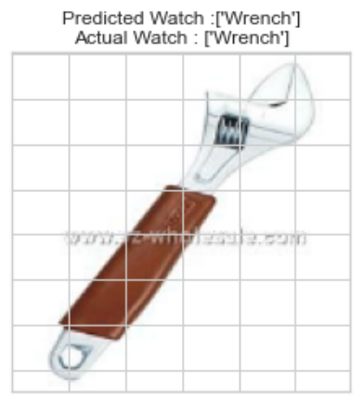
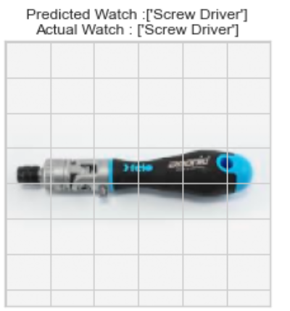
Correctly predicted

Slide 6
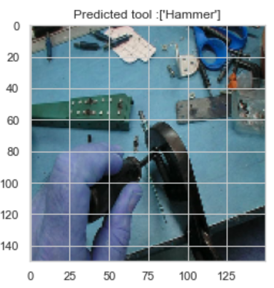
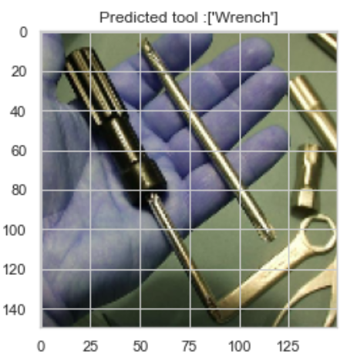
Wrongly predicted

Slide 7

Future scope
Use large dataset for better prediction accuracy
Analyse which algorithm is suitable
Optimize

