Slide 1
Clean Energy

Slide 2
☀️ What Is Solar Energy?
🌞
⚡
Energy = Light
The Sun sends us light and heat energy every single day for FREE!
The Sun
🔆
Huge Amount!
Our star, 93 million
miles away!
In just 1 hour, the Sun sends enough energy to power all humans for an ENTIRE YEAR!
♻️
Never Runs Out
Solar energy is renewable. The Sun will keep shining for billions of years!

Slide 3
🔬 How Do Solar Panels Work?
1
2
3
4
☀️
⚛️
⚡
🔌
→
→
→
Sunlight Hits Panel
Cells Get Excited
Electricity Created
Inverter Converts It
Solar panels sit in sunlight, on roofs, in fields, even in space!
Tiny silicon cells inside the panel absorb the light energy.
Electrons start moving. This movement IS electricity (DC power)!
A device changes DC electricity to AC, the kind homes use.

Slide 4
🏠 Where Do We Use Solar Power?
🏡
🏫
🚗
Homes
Schools
Electric Cars
Rooftop panels power lights, TVs, fridges & more!
Many schools run on solar to save money for learning!
Solar charges EV batteries, you can drive on sunshine!
🛰️
🌾
🔋
Space Stations
Farms
Batteries
The ISS gets ALL its power from giant solar wings!
Solar pumps water and powers tools on farms.
Solar charges batteries to use power at night!

Slide 5
🤔 Challenges of Solar Power
Solar power is awesome, but it's not perfect yet! Here's what scientists are working on:
🌧️
Cloudy Days & Night
💰
Upfront Cost
Solar panels only make power when the Sun is shining. No Sun = no fresh power!
Solar panels can be expensive to buy and install, though they save money over time!
🗺️
Needs Lots of Space
♻️
Panel Recycling
Big solar farms need a LOT of land. That's space other things could use!
Old solar panels are hard to recycle. Scientists are working on better solutions!

Slide 6
🚀 How Are We Improving Solar?
🔋
Better Batteries
New batteries store extra solar power so we can use it at night or when it's cloudy.
🪟
Solar Windows
Scientists made special glass that makes electricity, windows that are also solar panels!
🎨
Flexible Solar Panels
Thin, bendy solar panels can go on backpacks, clothes, and curved surfaces!
🤖
AI Tracking
Smart computers turn panels to follow the Sun all day, making 30% more power!

Slide 7
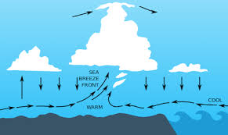
Wind
Wind is the movement of air from high pressure to low pressure areas
The sun heats Earth's surface unevenly; land heats faster than water, equator more than poles
These temperature differences cause air to rise and fall, creating pressure gaps
Wind is nature's way of balancing pressure differences across the atmosphere

Slide 8
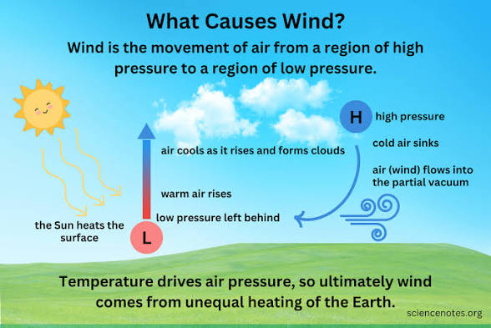
How is wind created?
The sun heats the ground, warming the air above it
Warm air becomes lighter and rises
Cooler, denser air rushes in to fill the gap: that movement is wind
This happens at every scale, from a beach breeze to global wind patterns

Slide 9
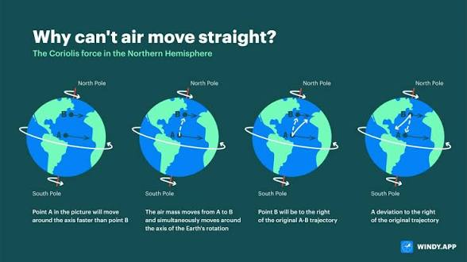
Why does wind curve?
Wind doesn't blow in a straight line; it curves due to the Coriolis Effect
The Coriolis Effect is caused by Earth's rotation
In the Northern Hemisphere, wind deflects to the right; in the Southern, to the left
This is why hurricanes spin counterclockwise in the north and clockwise in the south

Slide 10
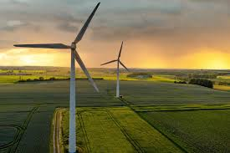
Wind Energy
Why does wind matter for Earth day? WE CAN USE IT TO MAKE ENERGY!
When wind blows, it spins the blades, this helps create electricity
Best part?
Doesn’t pollute air! A single modern turbine can power hundreds of homes
Land around turbines can still be used for farming
Denmark generates over 50% of its electricity wind

Slide 11
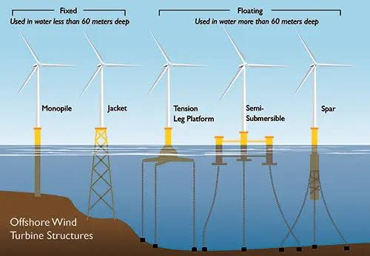
Challenges and Solutions
What happens if the wind stops blowing? Do we still get energy?
That’s one of the biggest problems.
Scientists are working on solutions.

Slide 12
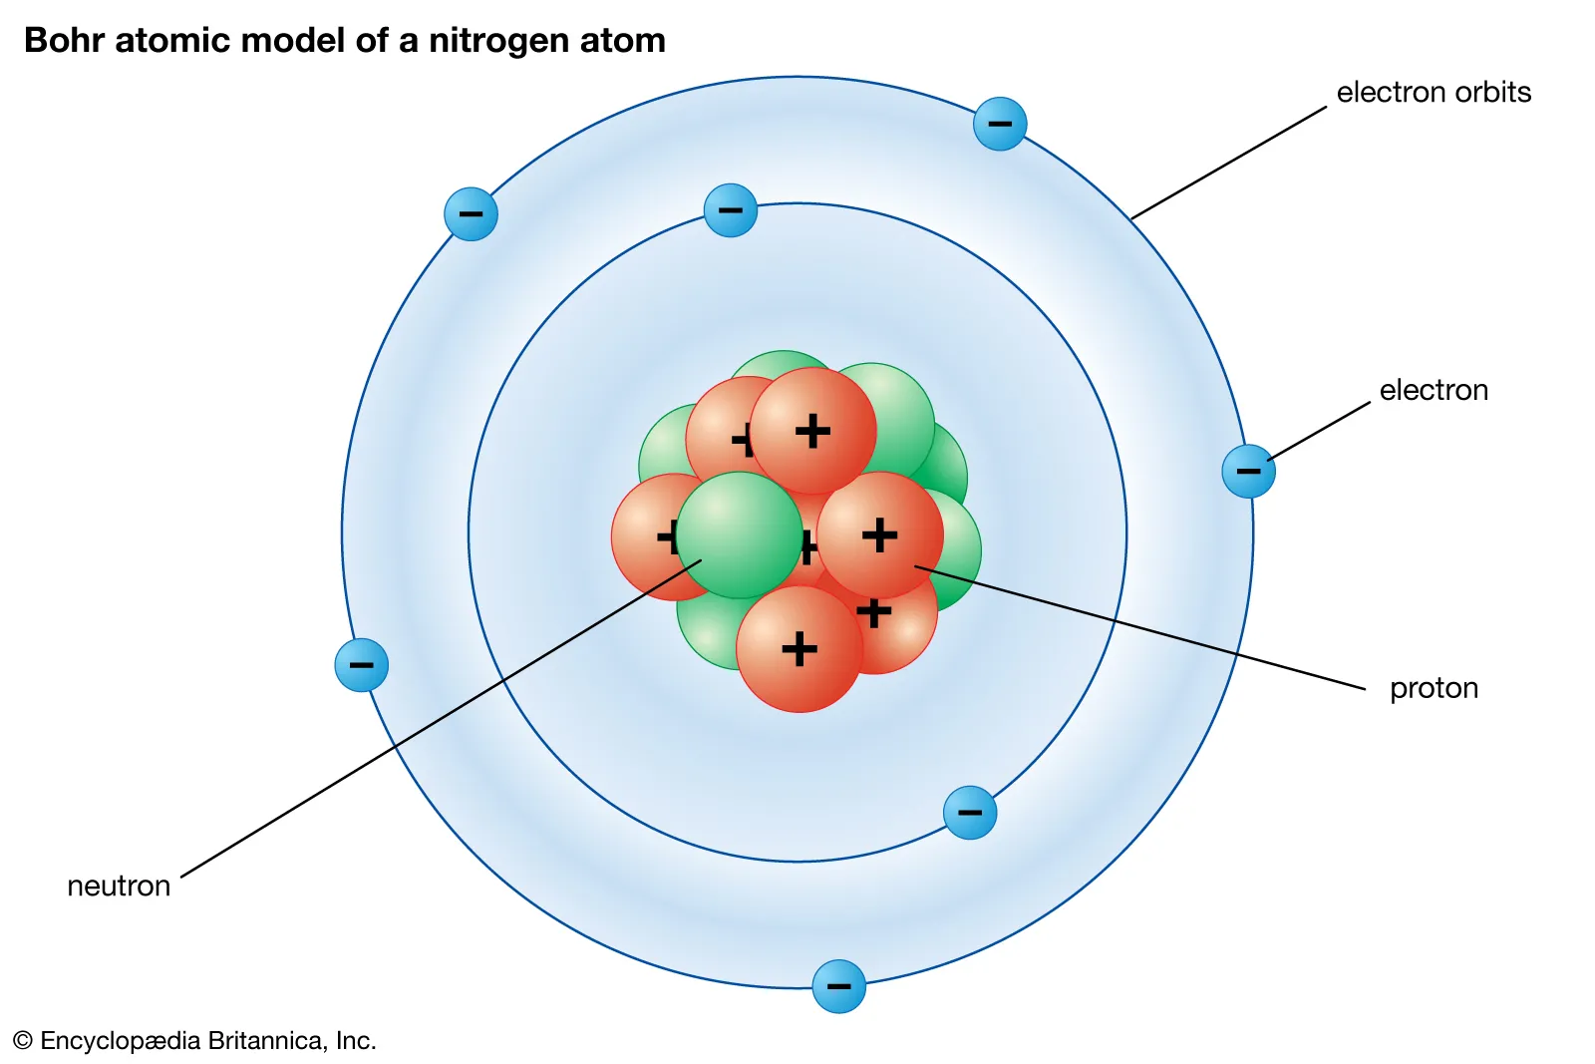

Nuclear
Atomic Interactions:

Slide 13
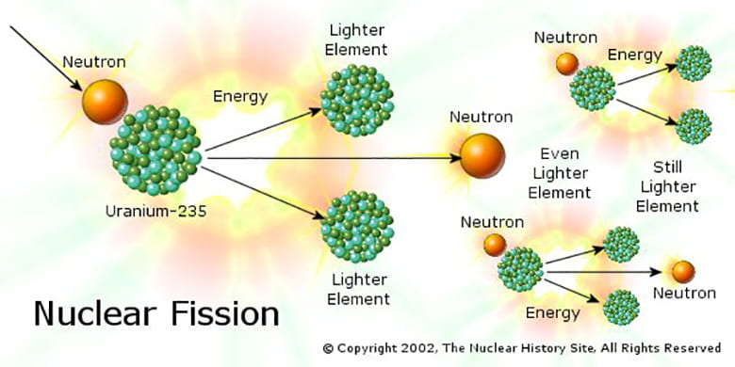
Fission

Slide 14
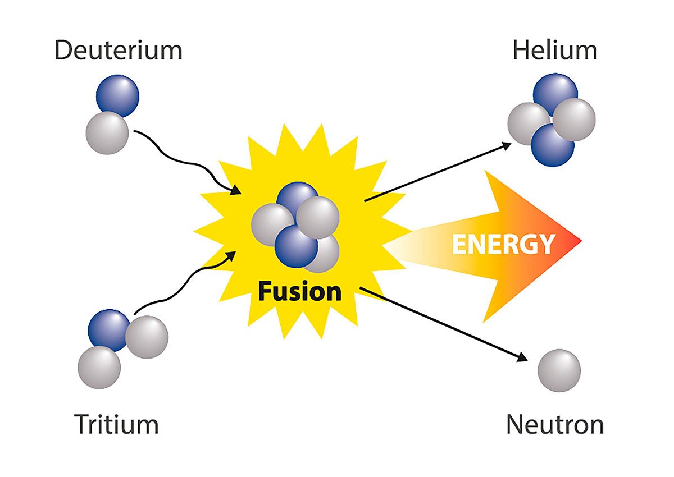
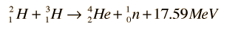
Fusion

Slide 15
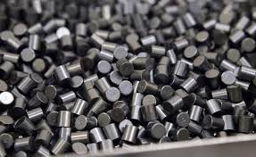
Benefits/Drawbacks to Nuclear
Nuclear Waste
Used nuclear fuel is still radioactive and can be very harmful
Reliability
Nuclear reactors are able to operate at 93% efficiency
Energy Density
A small pellet of uranium produces the same energy as a ton of coal
Money
Costs a lot of money to build

