Slide 1
Bangladesh Pharmaceutical Market Analysis – Power BI Dashboard
Comprehensive Data Analysis & Insights

Slide 2
Project Summary
• Analyzed 6 pharmaceutical datasets.
• Built data model with relationships.
• Extracted price, dosage, package size.
• Identified top dosage forms, manufacturers.
• Competitor analysis for key medicines.

Slide 3
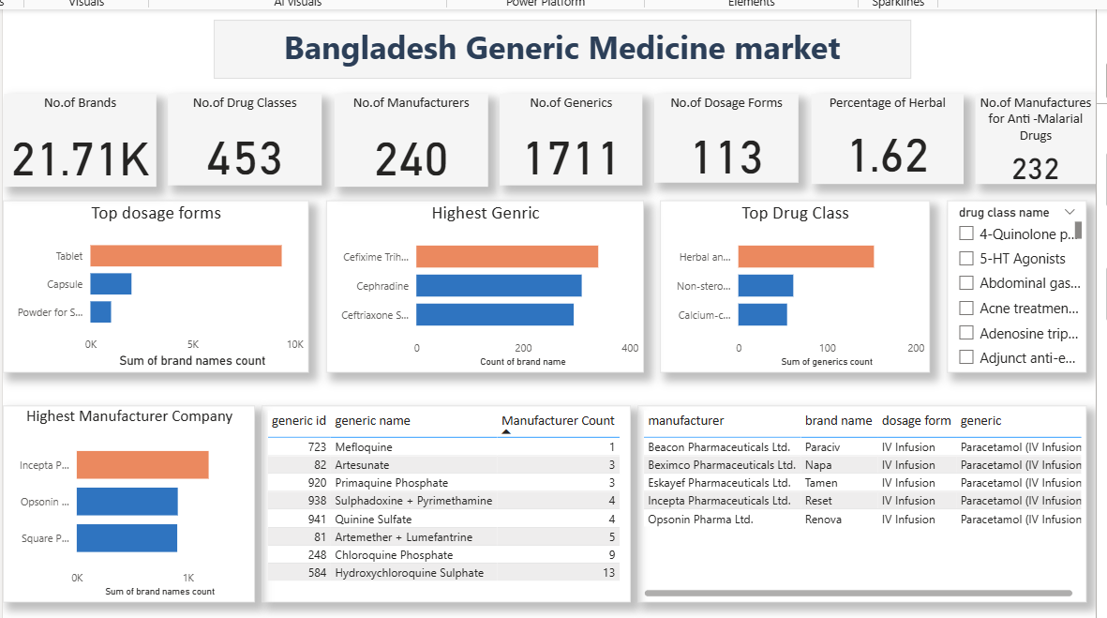

Slide 4
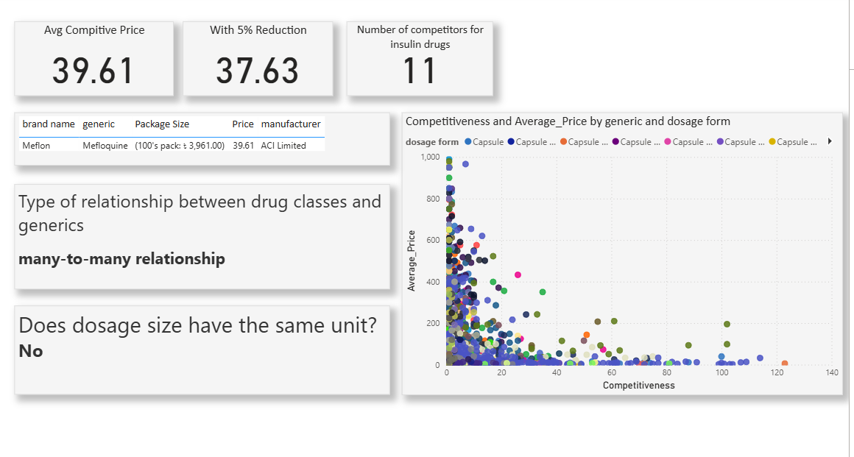

Slide 5
💡 Key Insights:
• Tablet is the most widely available dosage form
• Some generics have only one competitor — creating opportunities for new entrants
• Manufacturer competitiveness varies significantly by drug class
• Price does not always correlate directly with number of competitors

