Slide 1

TIMES OF SRM -News Aggregator
This presentation covers the full-stack design of TIMES OF SRM.
We explore backend, frontend, libraries, and security.

Slide 2
Backend Overview with Flask
Flask Framework
Database Integration
Lightweight Python framework for web development.
SQLite3 is the embedded database for storing news and user data.
Manages routing, API endpoints, and server logic.
Simple, efficient, and file-based solution.

Slide 3
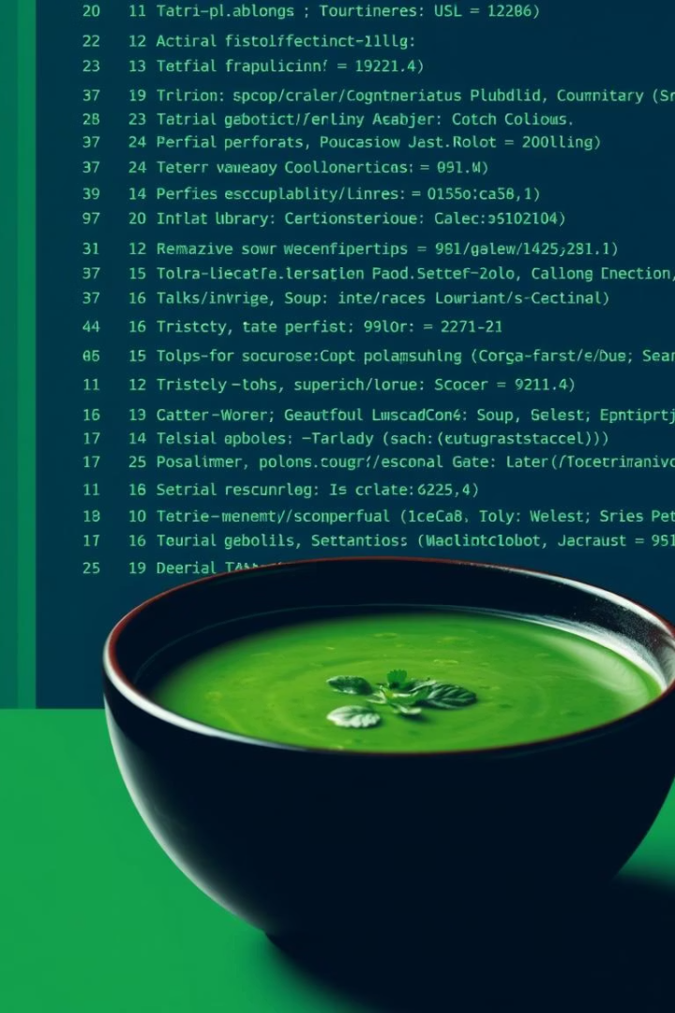
Scraping and Parsing Libraries
Beautiful Soup
Requests
Extracts and navigates HTML/XML content from news sites.
Fetches web page content with HTTP methods securely and efficiently.
Feedparser
Parses RSS/Atom feeds to aggregate news updates automatically.

Slide 4
Frontend Technologies
HTML & CSS
Bootstrap
Jinja Templates
Structure and style the news content pages effectively.
Ensures responsiveness and mobile-friendly UI components.
Dynamically renders backend data into HTML frontend.

Slide 5




Security with Werkzeug
Password Hashing
Session Management
Uses Werkzeug security for safe password storage and verification.
Secure user sessions to protect login states and credentials.
Input Validation
Prevents injection attacks with strict input sanitation.

Slide 6
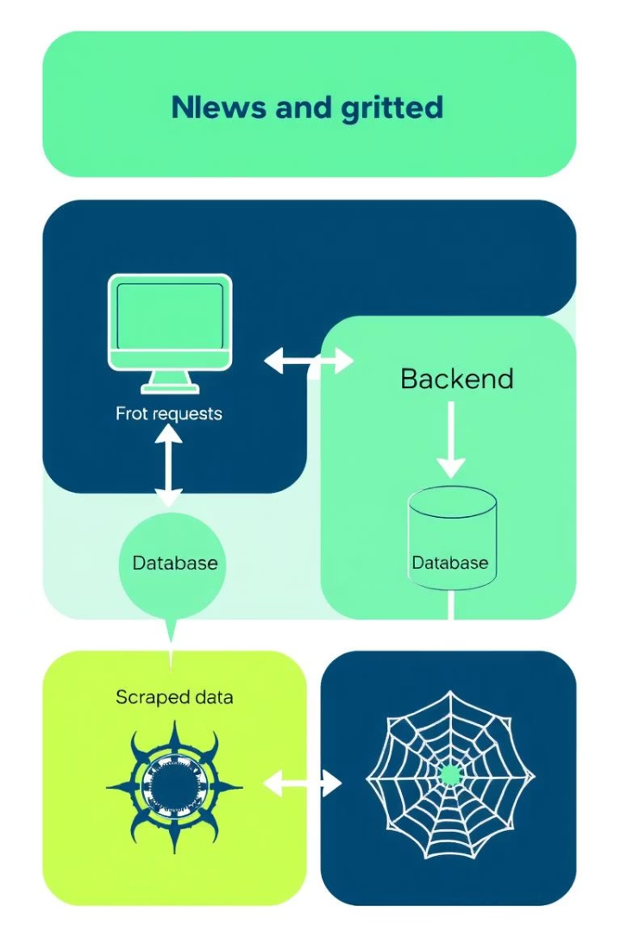




Data Flow Architecture
Web Requests
User actions sent to Flask backend.
Data Fetching
Requests library scrapes external news sources.
Parsing
Beautiful Soup and Feedparser extract articles.
Storage & Serve
SQLite stores data, served via Jinja templates.

Slide 7




Key Features of TIMES OF SRM
Real-time News Feeds
Aggregates updates continuously from multiple sources.
Advanced Search
Users can filter news by topics and dates.
Responsive Design
Optimized for desktops, tablets, and mobile devices.

Slide 8

Deployment and Scalability
Lightweight Server
Scalability
Modular code and caching allow scaling with traffic growth.
Flask runs efficiently on modest server resources.
Data Backup
SQLite backups ensure data integrity and recovery options.

Slide 9
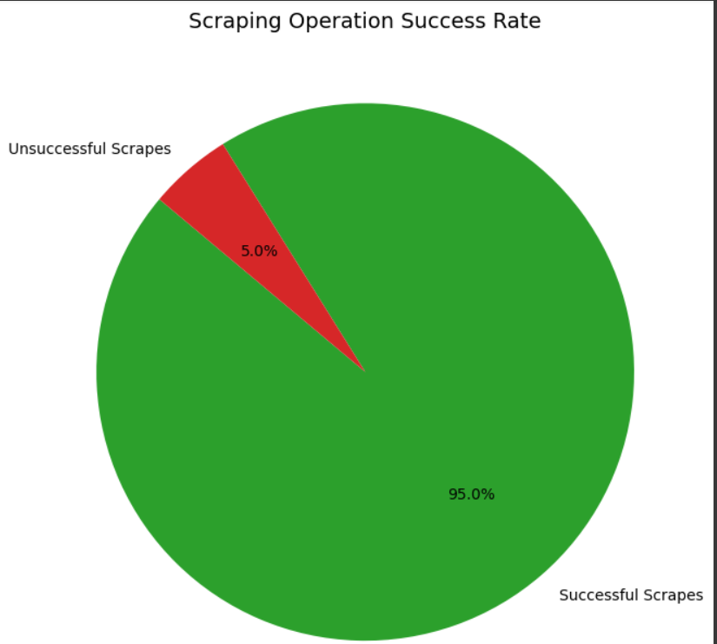
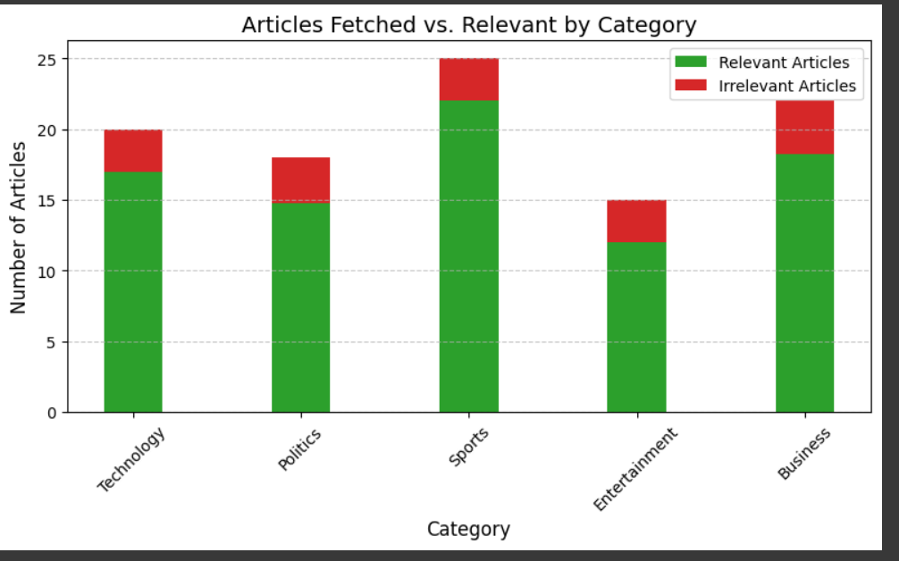
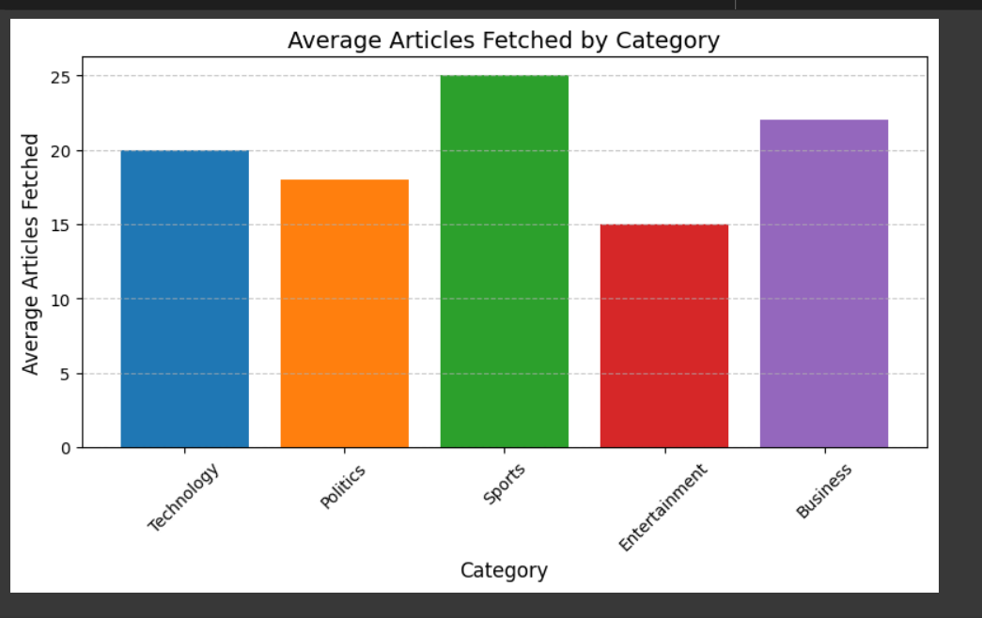
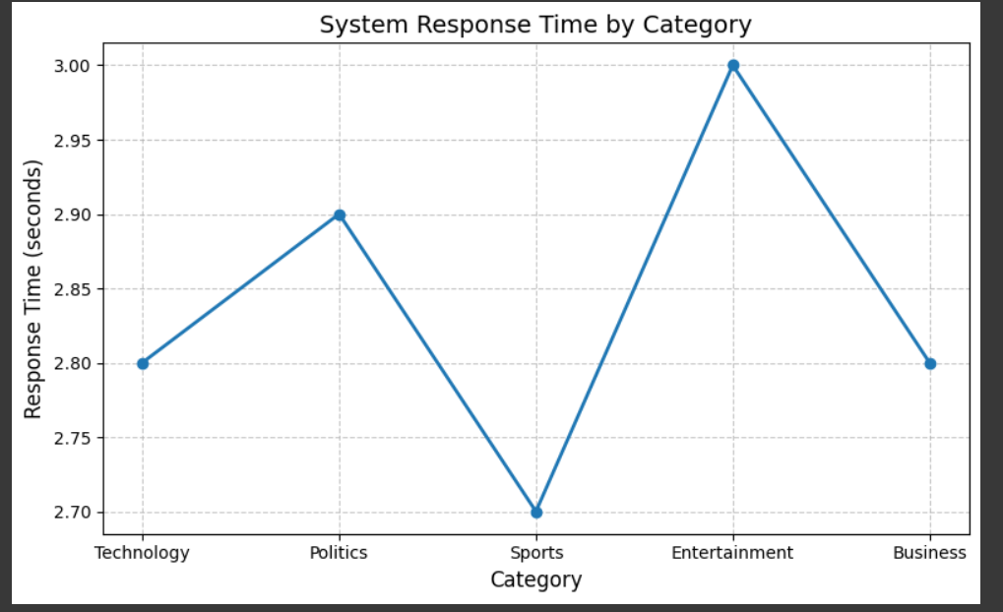

Slide 10

Summary & Next Steps
1
Architecture Recap
2
Security Priority
3
Next Steps
Flask backend, scraping libs, frontend with Bootstrap and Jinja.
Robust user protection via Werkzeug security mechanisms.
Enhance AI-driven content personalization and mobile app support.

Slide 11
Thank You

