Slide 1
Student Innovation
CSE7101- Capstone Project
Review-1
Smart Education, a concept that describes learning in digital age.
It enables learner to learn more effectively ,efficiently ,flexibly and comfortably.
Batch Number: ISE_11
Under the Supervision of,
Mr. John Bennet J
Assistant Professor
School of Computer Science and Engineering
Presidency University
Roll Number 20221ISE0066 20221ISE0032 20221ISE0062 | Student Name Nithin M S Aditya V S Chiranthan T C Nadig
Name of the Program: Information Science and Engineering
Name of the HOD: Dr. Zafar Ali Khan N
Name of the Program Project Coordinator: Ms .Suma N G
Name of the School Project Coordinators: Dr. Sampath A K , Dr. Geetha Arjunan

Slide 2
Content
Problem Statement.
Objectives.
Background and Related work for title Selection.
Analysis of Problem Statement.
Software and Hardware requirements.
Git-hub Link.
Flow Diagram.
Timeline of the Project.
References.

Slide 3
Problem Statement: PSCS_132
Organization:AICTE, MIC-Student Innovation
Category: Software
Problem Description:
Smart Education, a Concept that Describes learning in digital age. It enables learner to learn more effectively ,efficiently ,flexibly and comfortably. By building a search engine integrated with the concepts of NLP and recommendation system for efficient search results.
Quick Search(Search Engine): The Google for Developers, endeavours to establish singular online platform designed for comprehensive information retrieval and ranking from disparate data sources.

Slide 4
Objectives:
To design and develop a smart search engine that provides categorized academic resources (Research Papers, Datasets, and Videos).
To apply Natural Language Processing (NLP) techniques for query preprocessing and expansion to improve search accuracy.
To enable effective filtering of results based on resource type (e.g., videos, code/datasets, research papers).
To enhance learning by providing relevant and organized search results for students and researchers.
To support the vision of Smart Education by making learning more effective, efficient, flexible, and comfortable.
To integrate APIs (e.g., YouTube, Kaggle, scholarly databases) for retrieving real-time educational content.

Slide 5
Background and Related Work
Researchers face challenges in retrieving relevant and diverse information (datasets, research papers, code, videos).
Traditional search engines rely heavily on keyword matching, often leading to incomplete or irrelevant results.
Natural Language Processing (NLP) enables better query understanding, expansion, and semantic matching.
Hybrid search systems can combine content-based, semantic, and popularity-based features for improved results.
Related Work:
Query Expansion Techniques improve retrieval accuracy by reformulating short/ambiguous queries.
(Azad & Deepak, “Query Expansion Techniques for Information Retrieval: A Survey,” 2017)
NLP in Education & Intelligent Search shows how semantic processing enhances personalized and adaptive search.
(C.C. Lin, “Artificial intelligence in intelligent tutoring systems toward sustainable education,” 2023)
Hybrid Semantic Search integrates keyword-based and semantic approaches for deeper intent understanding.
(Ahluwalia et al., “Hybrid Semantic Search: Unveiling User Intent Beyond Keywords,” 2024)

Slide 6
Analysis of Problem Statement
Information overload
No categorization (mixed results)
Irrelevant search results
Students waste time searching across multiple sources
Queries are not expanded/processed → ambiguous results
Lack of academic focus → barrier to Smart Education
PROBLEM
ANALYSIS
NLP-based Query Processing
Categorized Results (Research Papers, Datasets, Videos)
Unified Smart Education Search Engine.
SOLUTION

Slide 7



Software and Hardware Requirements:
Frontend: HTML5, CSS3, React.js ,axios
Backend: FastAPI (Python)
Database: Supabase (PostgreSQL)
Server: Vercel

Slide 8
Github Link
The Github link provided should have public access permission.
Github Link
https://github.com/Nithin3003/ISE_11-Capstone-Project

Slide 9
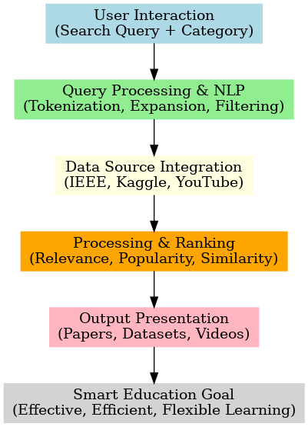
Flow Diagram

Slide 10
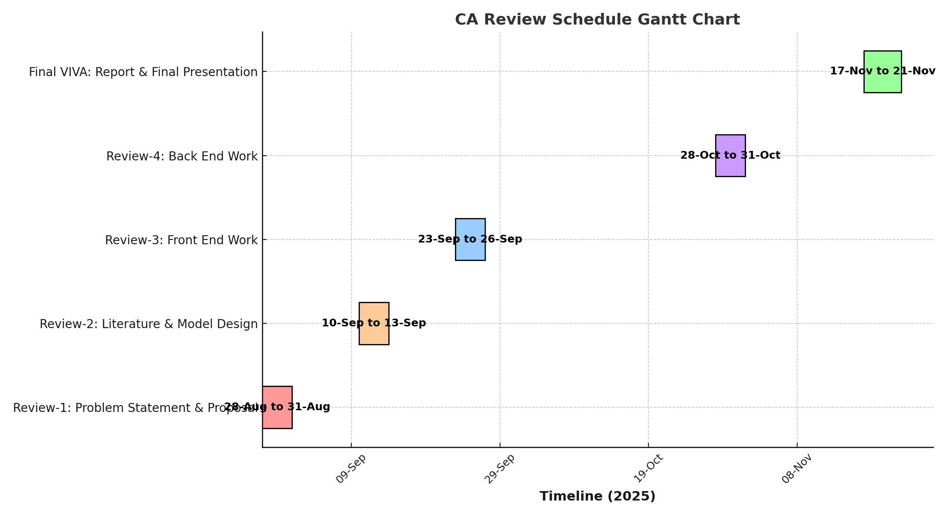
Timeline of the Project (Gantt Chart)

Slide 11
References (IEEE Paper format)
1. Query Expansion Techniques for Improving Information Retrieval
Title: Query expansion techniques for information retrieval: A survey
Authors: Hiteshwar Kumar Azad, Akshay Deepak
Link: https://arxiv.org/abs/1708.00247 arXiv
2. NLP-Based Intelligent Search Systems for Education
Title: Artificial intelligence in intelligent tutoring systems toward sustainable education
Author: C.C. Lin
Link: https://slejournal.springeropen.com/articles/10.1186/s40561-023-00260-y SpringerOpen
3. Hybrid Information Retrieval with NLP & Semantic Analysis
Hybrid Semantic Search: Unveiling User Intent Beyond Keywords
Authors: Aman Ahluwalia, Bishwajit Sutradhar, Karishma Ghosh, Indrapal Yadav, Arpan Sheetal, Prashant Patil
Link: https://arxiv.org/pdf/2408.09236 arXiv

Slide 12


