Slide 1
Student Innovation
CSE7101- Capstone Project
Final Viva
A UNIFIED EDUCATIONAL RESOURCE SEARCH ENGINE WITH INTELLIGENT RANKING FOR SMART EDUCATION
Batch Number: ISE_11
Under the Supervision of,
Mr. John Bennet J
Assistant Professor
School of Computer Science and Engineering
Presidency University
Roll Number 20221ISE0066 20221ISE0032 20221ISE0062 | Student Name Nithin M S Aditya V S Chiranthan T C Nadig
Name of the Program: Information Science and Engineering
Name of the HOD: Dr. Zafar Ali Khan N
Name of the Program Project Coordinator: Ms .Suma N G
Name of the School Project Coordinators: Dr. Sampath A K , Dr. Geetha Arjunan

Slide 2
Content
Abstract
Introduction
Literature Survey
Problem Definition
Objectives
Existing System and Drawbacks
SDG Goal Mapping
Block Diagram
Methodology
Modules
Results
Future Enhancements
Conclusion
Timeline / Gantt Chart
References
GitHub Repository Link
Thank You

Slide 3
Abstract:
The proposed study search engine provides a unified platform to access videos, code repositories, research papers, and datasets.
It simplifies the process of finding educational resources by integrating multiple trusted sources.
Previous systems were limited to single domains and lacked personalization or ranking mechanisms.
Our updated system bridges these gaps by introducing user management, feedback collection, and ranked search results for a more interactive learning experience.

Slide 4
Introduction
In today’s digital era, learners depend on multiple online platforms such as YouTube, GitHub, arXiv, and Kaggle for accessing educational materials.
Each of these platforms provides valuable resources — videos for tutorials, repositories for code, papers for research, and datasets for experiments.
However, due to content fragmentation, users spend a significant amount of time manually searching and filtering results across sources.
This lack of a unified system reduces learning efficiency and productivity for students and researchers.

Slide 5
Introduction
To overcome these challenges, our project introduces a Study Search Engine that integrates multiple learning sources into a single platform.
It applies a ranking mechanism to sort results based on relevance, popularity, and recency, ensuring the most useful content appears first.
In this enhanced version, a user management system allows individuals to register, log in, and maintain personalized profiles, while the feedback module collects user opinions to refine recommendations.
This makes the system not only a multi-source search platform but also an intelligent, user-driven learning assistant.

Slide 6
Literature Survey
Efficient Retrieval Using Semantic Search with NLP and RDF
Link:https://ieeexplore.ieee.org/document/10246838
Existing Work | Method | Model | Research Gap | Proposed Plan
NLP + RDF triples boost semantic retrieval efficiency. RDF links heterogeneous data effectively. | NLP entity extraction. RDF triple storage & SPARQL queries. | Semantic IR pipeline: NLP → RDF → retrieval. RDF knowledge graph structure. | Focused on engineering domain. Lacks personalization and categorization. | Use RDF-like ideas to structure multi-API metadata. Apply to multi-source educational search.

Slide 7
Literature Survey
From Code to Ratings: Converting Programming Data to Enhance Collaborative Filtering in Educational Online Judge Systems
Link: https://ieeexplore.ieee.org/document/10813164
Existing Work | Method | Model | Research Gap | Proposed Plan
Code logs converted to ratings for collaborative filtering. Improves recommendation accuracy. | Log analysis & rating conversion. Neural Collaborative Filtering (NCF) | Conversion pipeline: logs → ratings → NCF. Implicit feedback-based recommender. | Domain-limited to coding platforms. Doesn’t generalize to multi-source data. | Use multi-source APIs (YouTube, GitHub, Kaggle, arXiv) to gather programming and educational content. Apply collaborative filtering combined with semantic ranking and user feedback for personalization.

Slide 8
Literature Survey
Using Research Literature to Generate Datasets of Implicit Feedback for Recommending Scientific Items
Link:https://ieeexplore.ieee.org/document/8924687
Existing Work | Method | Model | Research Gap | Proposed Plan
Implicit feedback (authorship, citations) forms datasets. Useful when explicit ratings are missing. | Literature mining & entity mapping. Utility matrix generation from implicit signals. | LIBRETTI workflow: entity → mapping → dataset. Implicit rating-based recommender. | Limited to scientific literature. No coverage for code, videos, or datasets. | Use multi-source APIs (YouTube, GitHub, Kaggle, arXiv) to collect interactions Generate implicit feedback-based recommendations across videos, datasets, and code, integrating them into the search engine.

Slide 9
Literature Survey
An Intelligent Video Tag Recommendation Method for Improving Video Popularity in Mobile Computing Environment
Link :https://ieeexplore.ieee.org/document/8938802
Existing Work | Method | Model | Research Gap | Proposed Plan
Intelligent tagging improves video discoverability and engagement. Helps recommend relevant content to users in mobile environments. | Analyze video content and metadata to generate tags. Use machine learning for tag prediction and relevance scoring.. | Video tag recommendation pipeline: Video → Feature extraction → Tag prediction → Recommendation. Popularity-aware ranking for recommended videos. | Focused only on video platforms. Not integrated with multi-source educational resources. | Use multi-source APIs (YouTube, GitHub, Kaggle, arXiv) to fetch educational videos. Apply ML-based tagging and semantic ranking to improve discoverability and relevance in the search engine.

Slide 10
Literature Survey
Automatic Adaptation of Open Educational Resources: An Approach From a Multilevel Methodology Based on Students’ Preferences, Educational Special Needs, Artificial Intelligence and Accessibility Metadata
Link:https://ieeexplore.ieee.org/document/9669174
Existing Work | Method | Model | Research Gap | Proposed Plan
Adaptive OERs personalize content using student preferences & accessibility. AI-driven adaptation improves inclusivity. | User profiling & preference-based adaptation. AI/ML-driven multilevel content delivery.. | Profile → Matching → Resource delivery pipeline. Multilevel adaptation framework. | Limited to OER only. Small-scale evaluation; lacks cross-platform integration. | Extend personalization to multi-source educational search. Include videos, datasets, code, and papers.

Slide 11
Literature Survey
Enhanced Search Engine Using Proposed Framework and Ranking Algorithm Based on Semantic Relations
Link: https://ieeexplore.ieee.org/document/8840848
Existing Work | Method | Model | Research Gap | Proposed Plan
Semantic relations improve ranking, precision & recall. Outperforms keyword-based search engines.. | Semantic query expansion using ontologies. Custom semantic ranking algorithms.. | Expansion + relation extraction → re-ranking. Semantic ranking framework. | Evaluated on small datasets only. Doesn’t categorize by resource type. | Apply semantic ranking to multi-source API integration. Categorize results by videos, code, datasets, and papers.

Slide 12
Literature Survey
A Semantic Approach to Ranking Techniques: Improving Web Page Searches for Educational Purposes
Link:https://ieeexplore.ieee.org/document/9807311
Existing Work | Method | Model | Research Gap | Proposed Plan
Semantic ranking improves relevance of educational web searches. Better matches learner intent compared to traditional keyword search. | Ontology mapping for concept understanding. Semantic similarity scoring and re-ranking of search results. | Semantic re-ranking model for educational content Education-specific semantic ontology to guide ranking. | Works mainly for educational websites. Lacks support for multi-source content like videos, datasets, or code. | Generalize semantic ranking to multiple educational sources. Implement API-driven integration for videos, code, datasets, and papers.

Slide 13
Literature Survey
How to Use Search Engine Optimization Techniques to Increase Website Visibility
Link:https://ieeexplore.ieee.org/document/6463486
Existing Work | Method | Model | Research Gap | Proposed Plan
SEO improves website visibility on search engines. Increases organic traffic and engagement | On-page optimization: keywords, meta tags, internal links. Off-page optimization: backlinks, social promotion; Technical SEO & content strategy. | SEO workflow: Keyword research → On-page + Off-page → Technical setup → Content publishing → Monitoring. Iterative optimization loop based on analytics feedback. | Limited to organic search; no multi-platform coverage. Effectiveness varies with competition and algorithm changes. | Use multi-source APIs (YouTube, GitHub, Kaggle, arXiv) to fetch educational content. Apply semantic ranking, categorization, and feedback-based personalization.

Slide 14
Literature Survey
GENAUM: New Semantic Distributed Search Engine
Link:https://ieeexplore.ieee.org/document/11079888
Existing Work | Method | Model | Research Gap | Proposed Plan
Distributed semantic search improves scalability. Agent-based systems provide faster responses. | Multi-agent search architecture. Ontology-driven semantic indexing. | Agent-based distributed engine. Decentralized semantic search nodes. | Prototype-level; small-scale testing. Not applied to education or multi-source APIs. | Extend distributed architecture for multi-source APIs. Improve response time and scalability.

Slide 15
Literature Survey
Information Retrieval: Recent Advances and Beyond
Link:https://ieeexplore.ieee.org/document/10184013
Existing Work | Method | Model | Research Gap | Proposed Plan
Two-stage retrieval (fetch + re-ranking) widely used. Neural ranking improves precision & recall. | Lexical search methods (BM25, TF-IDF). Semantic/neural re-ranking.. | Two-stage IR pipeline. Combination of lexical + neural methods. | Broad survey; no focus on education. Doesn’t handle multi-source or API integration. | Adopt modular fetch + semantic re-ranking. Apply to educational multi-source API search.

Slide 16
Problem Definition
Students, developers, and researchers face difficulty in finding relevant learning materials because information is scattered across multiple platforms such as YouTube, GitHub, arXiv, and Kaggle.
Existing search engines are either keyword-based or limited to a single source, leading to incomplete and repetitive results.
There is also no mechanism for ranking, feedback collection, or user-specific recommendations.
Hence, there is a need for a unified system that retrieves, ranks, and personalizes results from multiple educational sources in one place.

Slide 17
Objectives:
Develop a unified platform that combines videos, research papers, code, and datasets.
Implement a ranking algorithm to sort results by relevance, popularity, and recency.
Enable user authentication with secure login and registration.
Add a feedback module for users to share suggestions and improve results.
Store user history to provide personalized recommendations.
Create a responsive and interactive frontend interface for easy access.

Slide 18
Existing Methods and Drawbacks
Existing Methods:
  Traditional search engines rely mostly on keywords.
  Many platforms provide search for single sources only (e.g., only papers or only videos).
  Some educational tools adapt content but lack comprehensive search capabilities.
Drawbacks:
  Fragmented results across different platforms.
  Context and intent of queries often ignored in keyword-based searches.
  No categorization of resources (videos, code, datasets, papers).
  Time-consuming for users to gather and filter relevant materials.

Slide 19
Sustainable Development Goal (SDG) Mapping
SDG Goal | Description | Project Contribution
SDG 4 – Quality Education | Make sure that all students receive high-quality education that is inclusive and equitable, and encourage opportunities for lifelong learning. | Offers well-organized, easily accessible, and cost-free learning materials across several platforms.
SDG 9 – Industry, Innovation and Infrastructure | Encourage innovation, advance sustainable industrialization, and construct robust infrastructure. | Encourages open-source innovation by facilitating cross-disciplinary access and GitHub integration.
SDG 10 – Reduced Inequalities | Minimize disparities in access to technology and education. | Permits students to access global resources without any restrictions on subscriptions.
SDG 12 – Responsible Consumption and Production | Make sure patterns of production and consumption are sustainable. | Reduces the need for printed materials while promoting the use of digital learning.

Slide 20
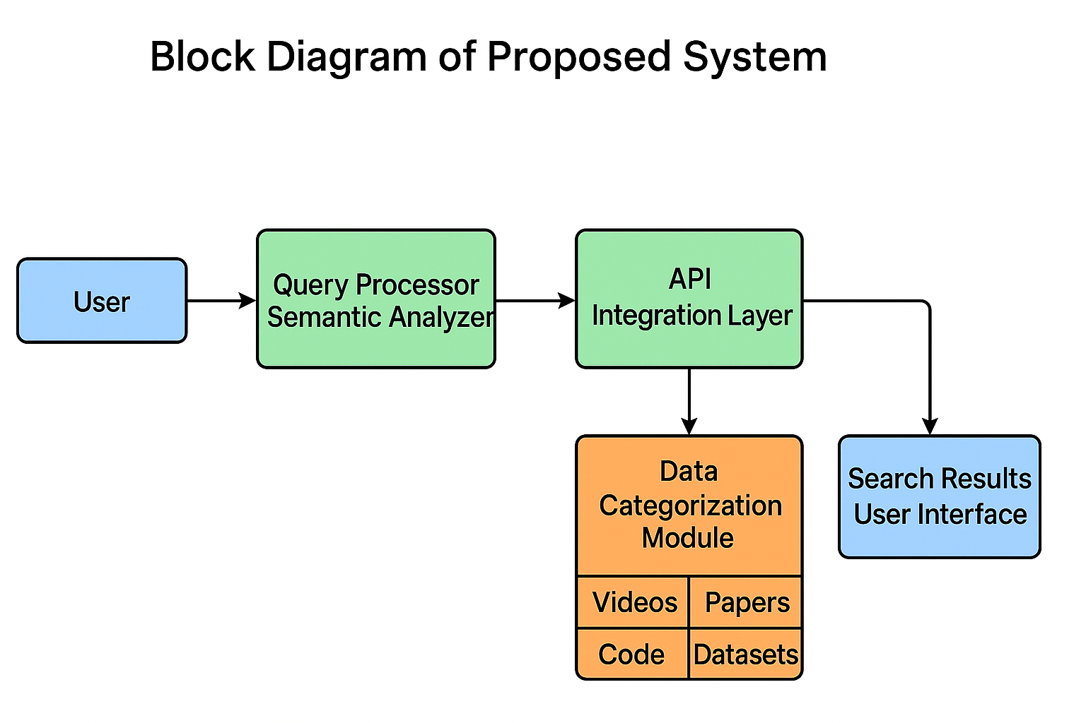
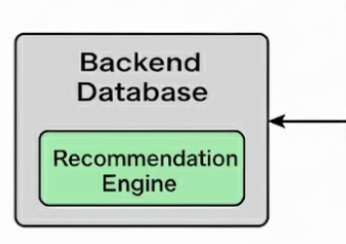
Block Diagram
Block Diagram of the Proposed System

Slide 21
Methodology
Ranking Algorithm
YouTube: Score = (0.6 × Views) + (0.4 × Likes)
GitHub: Score = (0.7 × Stars) + (0.3 × Forks)
arXiv Papers: Score = Recency = 1 / (CurrentYear - PublishedYear + 1)
Kaggle Datasets: Score = (0.5 × Downloads) + (0.5 × Usability × 1000)

Slide 22
Modules
User Interface Module.
Input & Control Module.
API Integration Module.
Ranking Algorithm Module.
Data Categorization Module.
Database Management Module.
Recommendation Module.
Feedback Module.
Admin / Backend Module.
Skeleton Loader Module (UX Enhancement).

Slide 23
Modules
User Interface Module: Manages login, registration, and search interface; built using HTML, CSS, and JavaScript.
Input & Control Module: Processes user queries and directs them to the respective API.
API Integration Module: Connects to YouTube, GitHub, arXiv, and Kaggle to fetch relevant resources.
Ranking Algorithm Module: Sorts and displays results based on relevance, popularity, and recency.
Data Categorization Module: Groups fetched data into Videos, Code, Research Papers, and Datasets.

Slide 24
Modules
Database Management Module: Uses PHP + MySQL to store users, search history, feedback, and recommendations.
Recommendation Module: Suggests related resources using stored search history.
Feedback Module: Collects user opinions to improve platform performance.
Admin / Backend Module: Allows administrators to view and manage data through XAMPP/phpMyAdmin.
Skeleton Loader Module: Improves user experience by showing animated placeholders while results load.

Slide 25
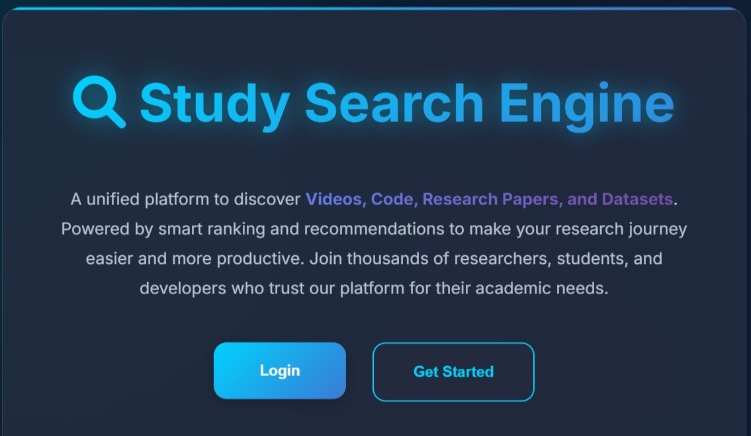
Results
Main Page

Slide 26
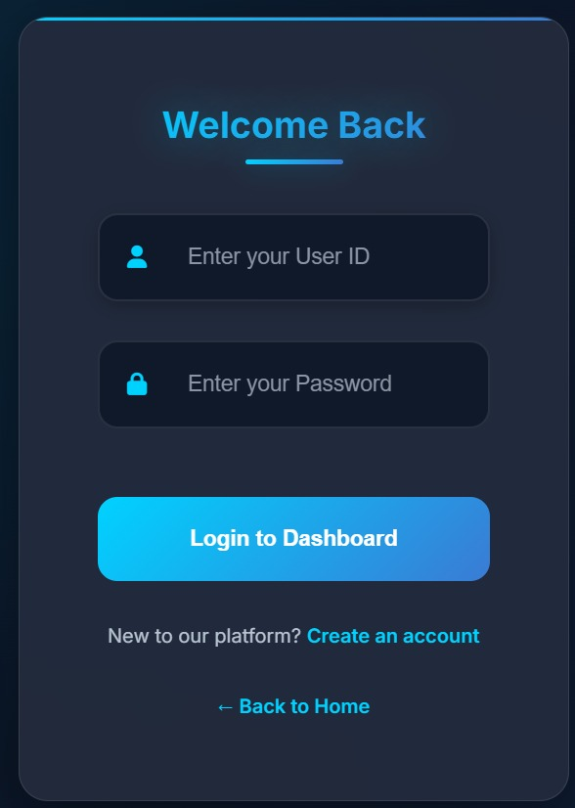
Results
Login Page

Slide 27
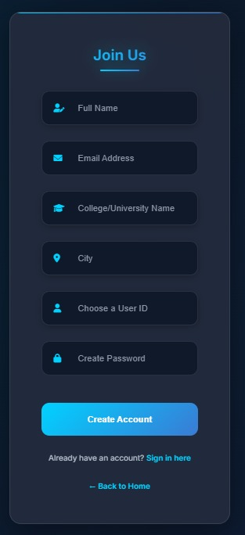
Results
Registration Page

Slide 28
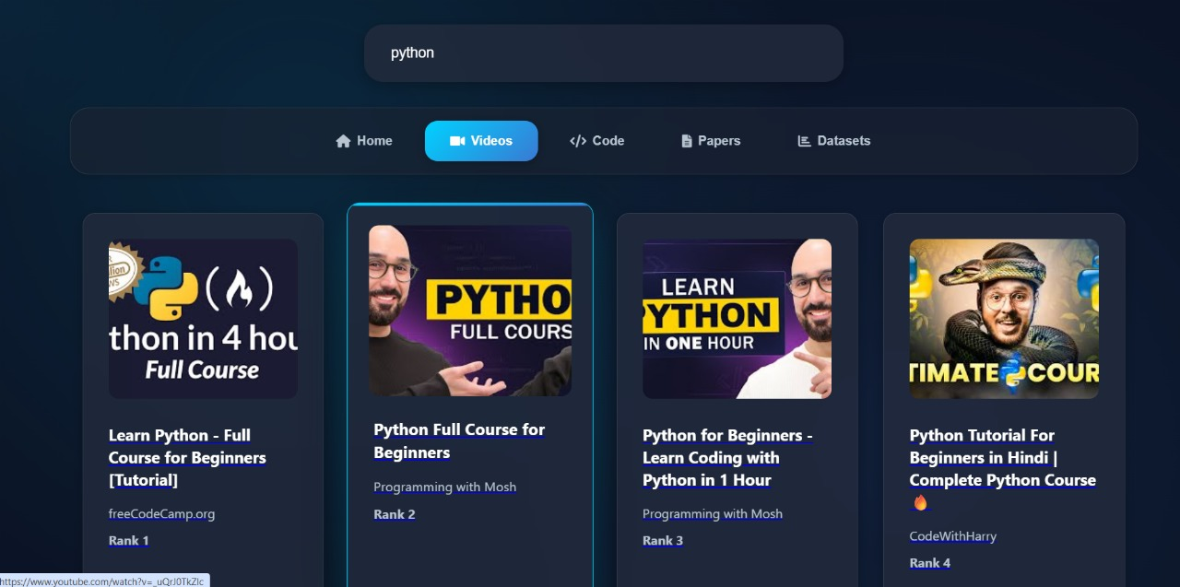
Results
Results with their ranks(eg: python(videos))

Slide 29
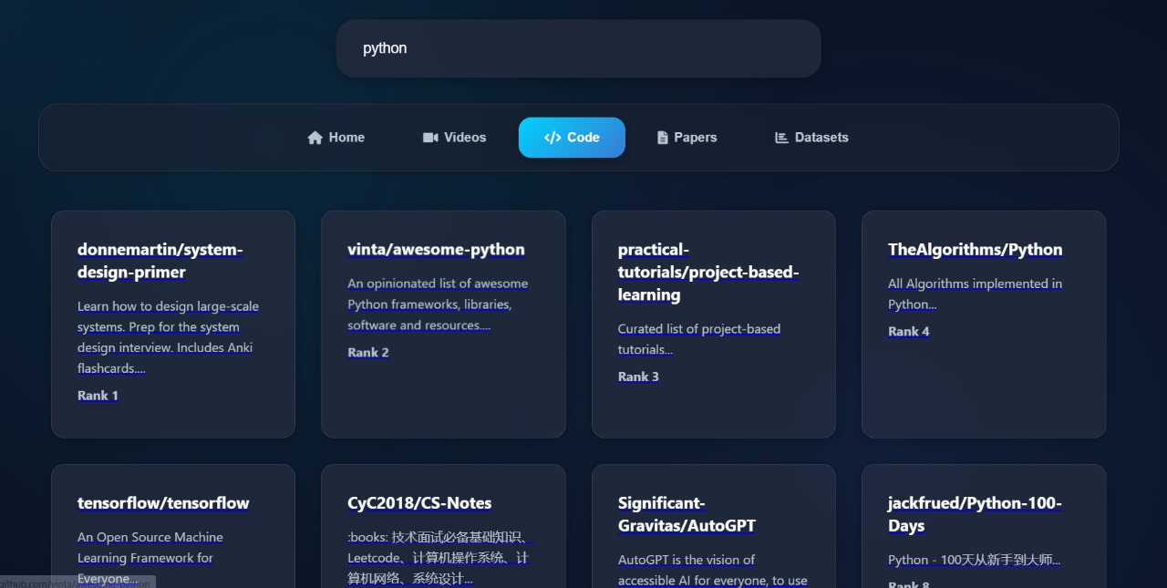
Results
Results with their ranks(eg: python(code))

Slide 30
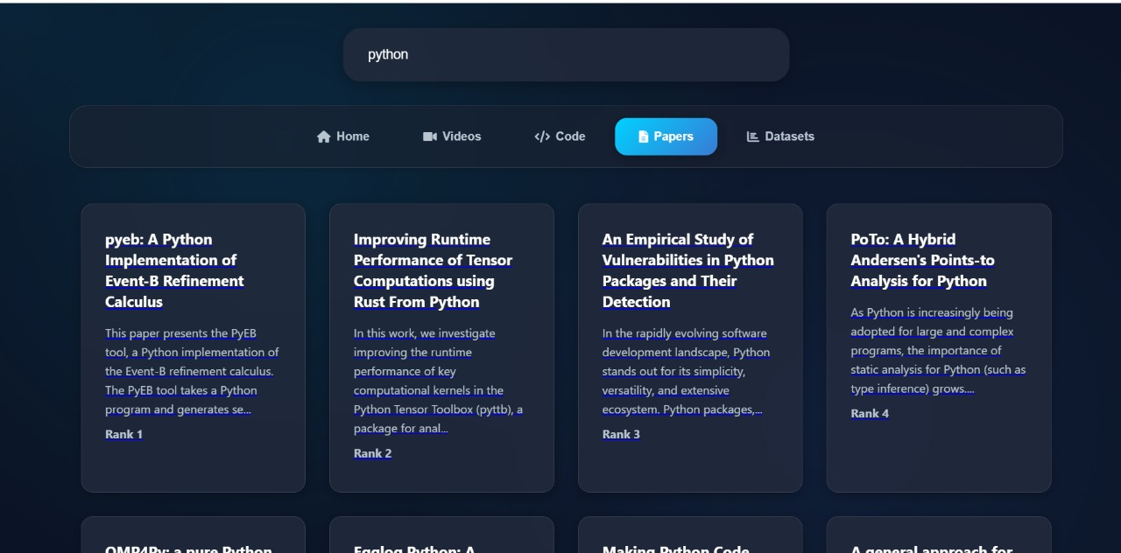
Results
Results with their ranks(eg: python(Research Papers))

Slide 31
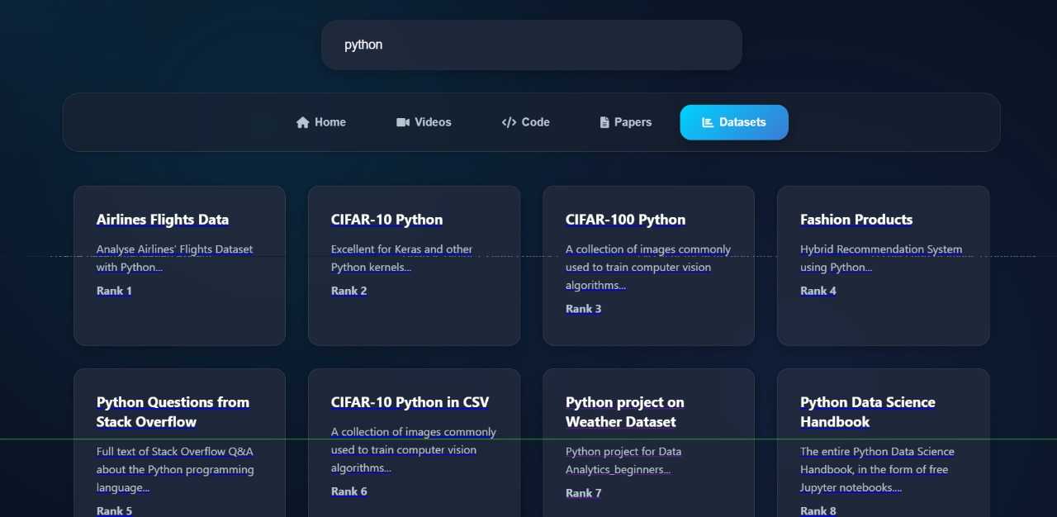
Results
Results with their ranks(eg: python(Datasets))

Slide 32
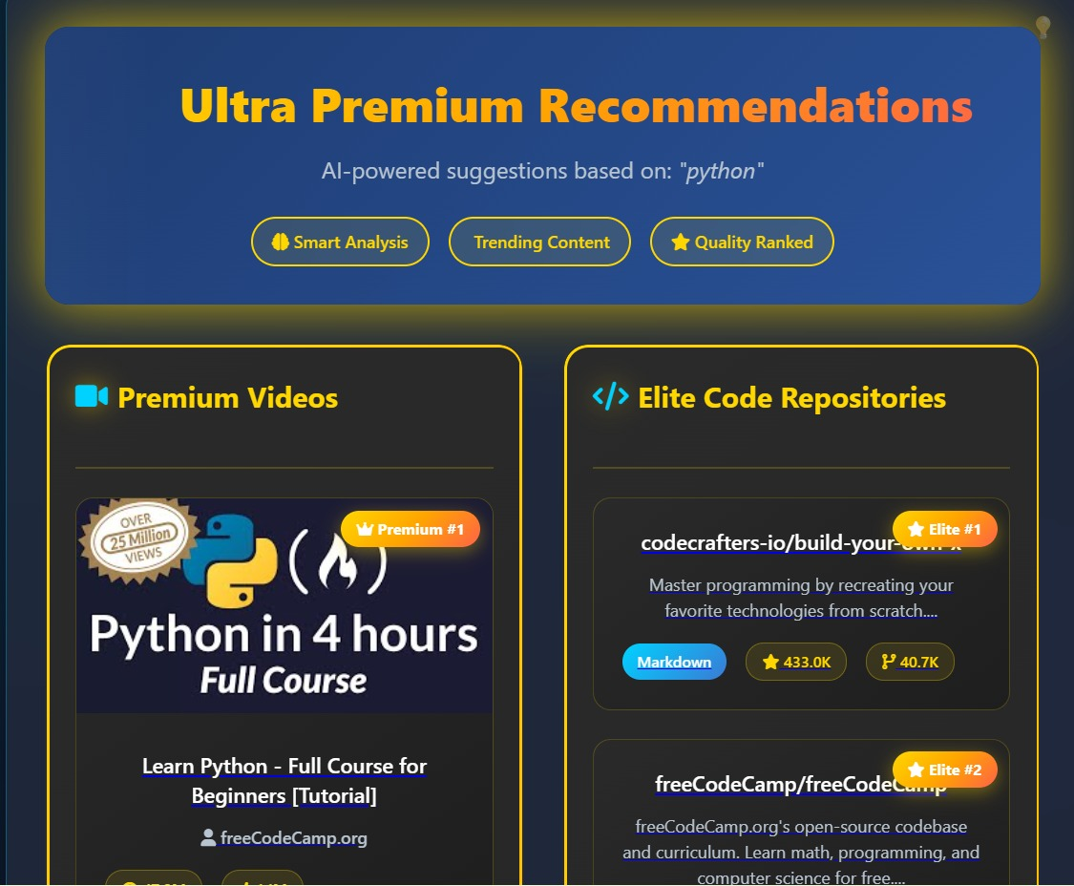
Results
Recommendations based on search history(Videos & Code)

Slide 33
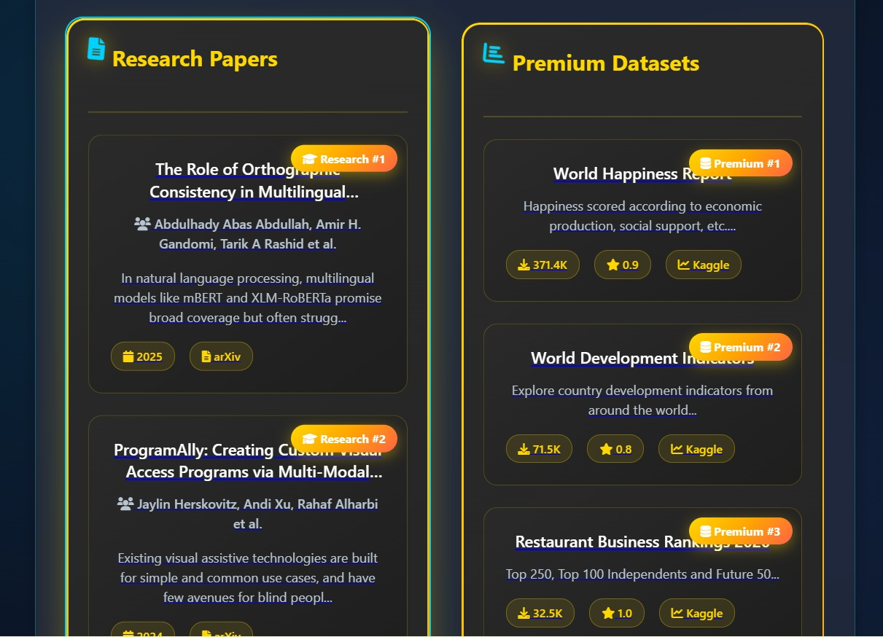
Results
Recommendations based on search history (Datasets & Papers)

Slide 34
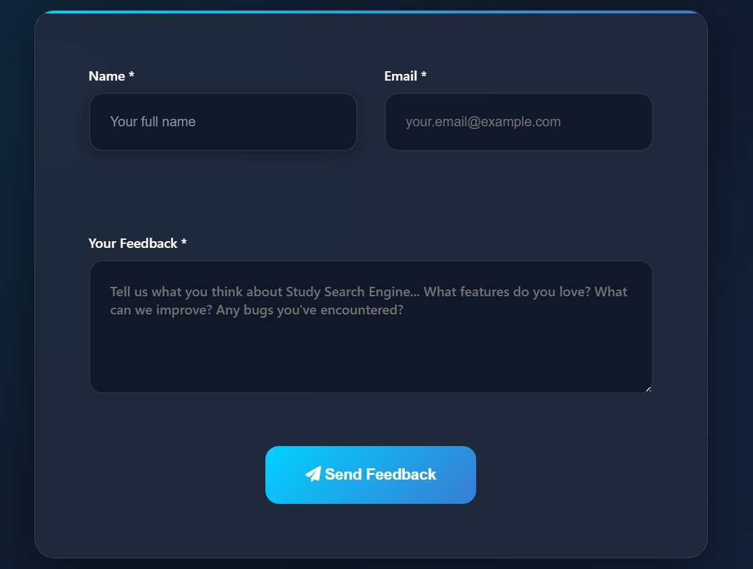
Results
Feedback Form

Slide 35

Results
Feedback Submission Message

Slide 36
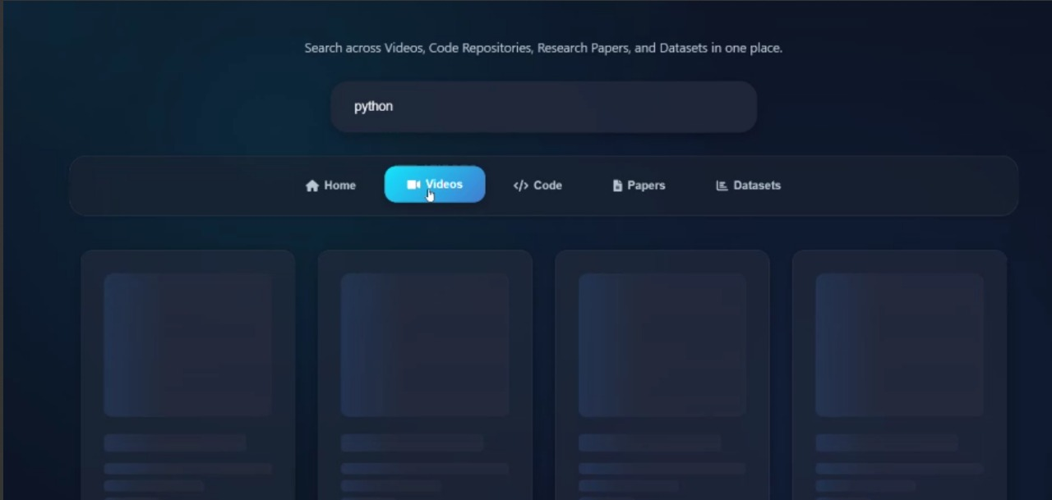
Results
Skeleton Loader Module for user engagement.

Slide 37
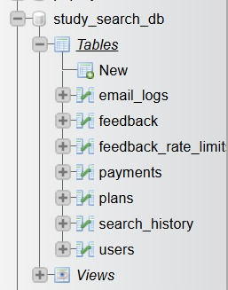
Results
Backend-List of Tables(Admin View)

Slide 38
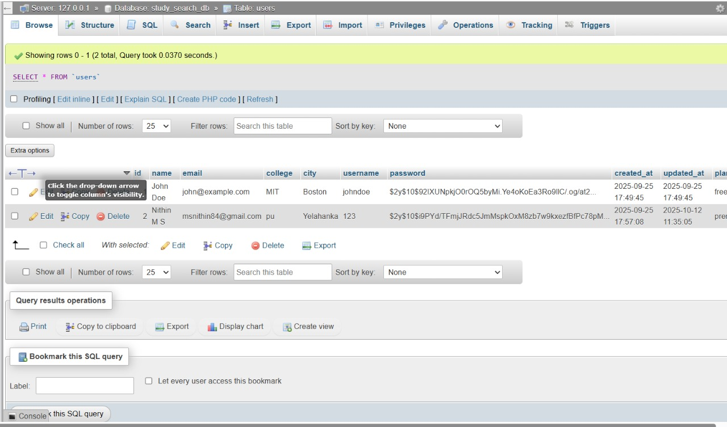
Results
Backend-User Details(Admin View)

Slide 39
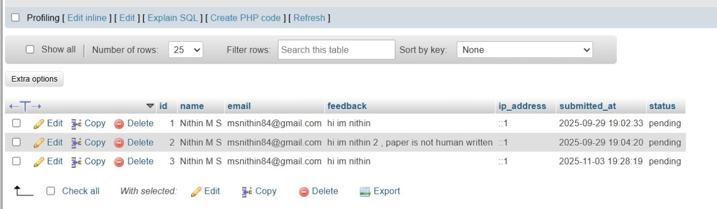
Results
Backend- User Feedbacks(Admin View)

Slide 40
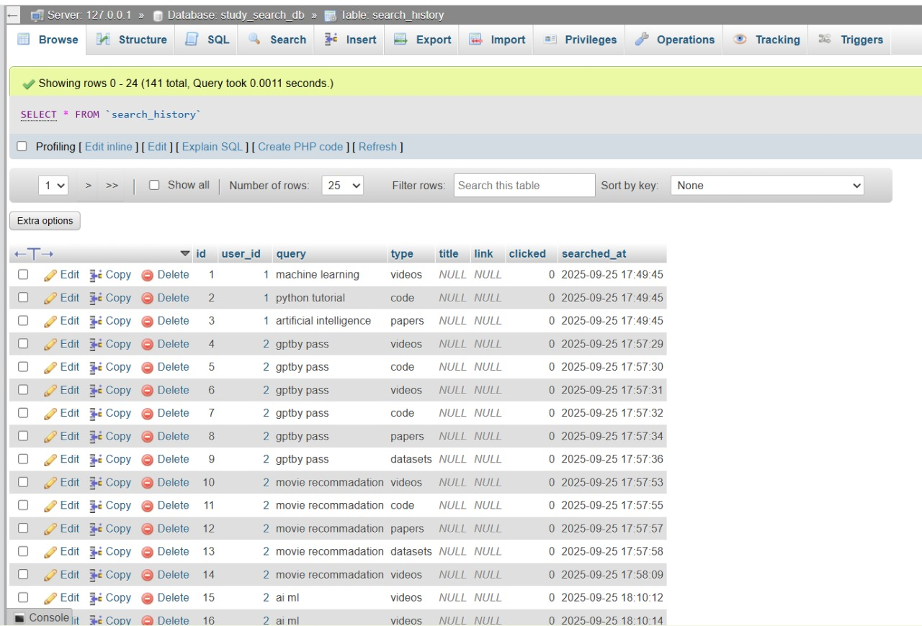
Results
Backend- Search History(Admin View).

Slide 41
Future Enhancements
Payment Integration:
A payment option will be added to enable users to upgrade to a premium version. Premium users can browse without interruptions or limits and access higher-quality and exclusive educational content.
Extended Ranking System:
The current system displays the top 25 ranked results. In the future, this will be expanded to 50 ranked results per category to provide users with a wider range of high-quality learning materials.

Slide 42
Conclusion
The Study Search Engine successfully integrates multiple educational platforms like YouTube, GitHub, arXiv, and Kaggle into a single unified system.
The system allows user authentication, personalized recommendations, and feedback collection, ensuring an interactive learning experience.
The backend integration using PHP, XAMPP, and MySQL enables secure data storage and efficient system management.
The project is currently 80% complete, with all major modules functional and tested.
Future updates will include payment integration and extended ranking up to 50 results to further enhance user experience.

Slide 43
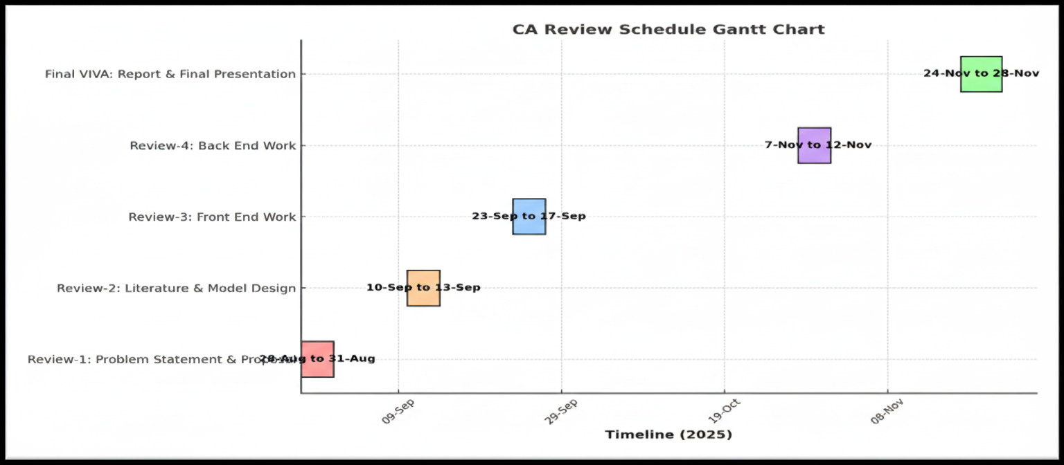
Timeline of the Project (Gantt Chart)

Slide 44
References (IEEE Paper format)
  Usha Yadav and Neelam Duhan,” Efficient Retrieval of Data Using Semantic Search Engine Based on NLP and RDF”, in proc. VOLUME 6, 27 October 2021
    - https://ieeexplore.ieee.org/document/10246838
  Daniel M. Muepu, Yutaka Watanobe,"From Code to Ratings – Enhancing Collaborative Filtering in OJ Systems”, in proc. VOLUME 7, 2019,31 December 2024.
    - https://ieeexplore.ieee.org/document/10813164
  Diomidis Spinellis, Panagiotis Louridas, George Gousios, Ioannis Chatzigiannakis,” Using Research Literature to Generate Datasets of Implicit Feedback (LIBRETTI)”, in proc. VOLUME 7, 2019 ,December 23, 2019.
  - https://ieeexplore.ieee.org/document/8924687

Slide 45
References (IEEE Paper format)
Renjie Zhou, Dongchen Xia, Jian Wan, Sanyuan Zhang,” An Intelligent Video Tag Recommendation Method for Improving Video Popularity in Mobile”, in proc. VOLUME 8, 2020, January 14, 2020.
  https://ieeexplore.ieee.org/document/8938802
PAOLA INGAVÉLEZ-GUERRA , VLADIMIR E. ROBLES-BYKBAEV 1 , ANGEL PÉREZ-MUÑOZ ,JOSÉ HILERA-GONZÁLEZ , AND SALVADOR OTÓN-TORTOSA ,” Automatic Adaptation of Open Educational Resources: An Approach From a Multilevel Methodology Based on Students’ Preferences, Educational Special Needs, Artificial Intelligence and Accessibility Metadata”, in proc. VOLUME 10, 2022, January 27, 2022.
  https://ieeexplore.ieee.org/document/9669174
M. M. EL-GAYAR , N. E. MEKKY1, A. ATWAN2 , AND H. SOLIMAN, “Enhanced Search Engine Using Proposed Framework and Ranking Algorithm Based on Semantic Relations”,in proc. VOLUME 7, 2019, October 7, 2019.
  https://ieeexplore.ieee.org/document/8840848

Slide 46
References (IEEE Paper format)
CARLA LIMONGELLI , MATTEO LOMBARDI , ALESSANDRO MARANI, AND DAVIDE TAIBI, “A Semantic Approach to Ranking Techniques: Improving Web Page Searches for Educational Purposes ”, in proc. VOLUME 10, 2022, 27 June 2022.
  https://ieeexplore.ieee.org/document/9807311
JOHN B. KILLORAN, “How to Use Search Engine Optimization Techniques to Increase Website Visibility”, in proc. VOLUME 56, 1, MARCH 2013.
  https://ieeexplore.ieee.org/document/6463486
ICHRAK SAIF, ABDELAZIZ SDIGUI DOUKKALI, ADIL ENAANAI,” GENAUM: NEW SEMANTIC DISTRIBUTED SEARCH ENGINE “, Mobile Multimedia, Vol. 12, No.3&4 (2017) 210-221.
  https://ieeexplore.ieee.org/document/11079888
KAILASH A. HAMBARDE AND HUGO PROENÇA,” Information Retrieval: Recent Advances and Beyond”, VOLUME 11, 2023, 14 July 2023.
  https://ieeexplore.ieee.org/document/10184013

Slide 47
Github Link
https://github.com/Nithin3003/ISE_11-Capstone-Project

Slide 48


