Slide 1
Student Innovation
CSE7101- Capstone Project
Review-3
Smart Education, a concept that describes learning in digital age.
It enables learner to learn more effectively ,efficiently ,flexibly and comfortably
Batch Number: ISE_11
Under the Supervision of,
Mr. John Bennet J
Assistant Professor
School of Computer Science and Engineering
Presidency University
Roll Number 20221ISE0066 20221ISE0032 20221ISE0062 | Student Name Nithin M S Aditya V S Chiranthan T C Nadig
Name of the Program: Information Science and Engineering
Name of the HOD: Dr. Zafar Ali Khan N
Name of the Program Project Coordinator: Ms .Suma N G
Name of the School Project Coordinators: Dr. Sampath A K , Dr. Geetha Arjunan

Slide 2
Content
Abstract
Introduction
Literature Survey
Problem Definition
Objectives
Existing Methods and Drawbacks
Block Diagram
Methodology
Modules
Results
Future Enhancements
References
Timeline

Slide 3
Abstract:
The proposed study searching provides a single platform to access videos, code repositories, research papers, and datasets.
It aims to simplify access to educational resources by combining multiple trusted sources.
Previous research focused on semantic methods, recommendation systems, and adaptive learning.
However, most existing approaches were domain-specific, lacked scalability, and did not support cross-platform integration.
Our project bridges these gaps by delivering a unified, learner-centric, and multi-source search experience.

Slide 4
Introduction(Context & Motivation)
The rapid growth of online educational resources has led to abundant content across multiple platforms.
Popular platforms include:
  YouTube - video tutorials.
  GitHub - code repositories.
  arXiv - research papers.
  Kaggle - datasets.
However, these resources are fragmented and require users to manually search on each platform.
This creates challenges in time, efficiency, and relevance for learners and researchers.

Slide 5
Introduction(Need & Scope)
A unified search system can bring together videos, code, papers, and datasets in one place.
By applying a ranking algorithm, the most relevant and popular resources can be displayed first.
Such a system helps:
  Students → find tutorials and projects quickly.
  Researchers → access latest papers and datasets.
  Developers → discover useful code repositories.
This project lays the foundation for an integrated, ranked, and user-friendly search engine for learning resources

Slide 6
Literature Survey
Efficient Retrieval Using Semantic Search with NLP and RDF
Link:https://ieeexplore.ieee.org/document/10246838
Existing Work | Method | Model | Research Gap | Proposed Plan
NLP + RDF triples boost semantic retrieval efficiency. RDF links heterogeneous data effectively. | NLP entity extraction. RDF triple storage & SPARQL queries. | Semantic IR pipeline: NLP → RDF → retrieval. RDF knowledge graph structure. | Focused on engineering domain. Lacks personalization and categorization. | Use RDF-like ideas to structure multi-API metadata. Apply to multi-source educational search.

Slide 7
Literature Survey
From Code to Ratings: Converting Programming Data to Enhance Collaborative Filtering in Educational Online Judge Systems
Link: https://ieeexplore.ieee.org/document/10813164
Existing Work | Method | Model | Research Gap | Proposed Plan
Code logs converted to ratings for collaborative filtering. Improves recommendation accuracy. | Log analysis & rating conversion. Neural Collaborative Filtering (NCF) | Conversion pipeline: logs → ratings → NCF. Implicit feedback-based recommender. | Domain-limited to coding platforms. Doesn’t generalize to multi-source data. | Use multi-source APIs (YouTube, GitHub, Kaggle, arXiv) to gather programming and educational content. Apply collaborative filtering combined with semantic ranking and user feedback for personalization.

Slide 8
Literature Survey
Using Research Literature to Generate Datasets of Implicit Feedback for Recommending Scientific Items
Link:https://ieeexplore.ieee.org/document/8924687
Existing Work | Method | Model | Research Gap | Proposed Plan
Implicit feedback (authorship, citations) forms datasets. Useful when explicit ratings are missing. | Literature mining & entity mapping. Utility matrix generation from implicit signals. | LIBRETTI workflow: entity → mapping → dataset. Implicit rating-based recommender. | Limited to scientific literature. No coverage for code, videos, or datasets. | Use multi-source APIs (YouTube, GitHub, Kaggle, arXiv) to collect interactions Generate implicit feedback-based recommendations across videos, datasets, and code, integrating them into the search engine.

Slide 9
Literature Survey
An Intelligent Video Tag Recommendation Method for Improving Video Popularity in Mobile Computing Environment
Link:https://ieeexplore.ieee.org/document/8938802
Existing Work | Method | Model | Research Gap | Proposed Plan
Intelligent tagging improves video discoverability and engagement. Helps recommend relevant content to users in mobile environments. | Analyze video content and metadata to generate tags. Use machine learning for tag prediction and relevance scoring.. | Video tag recommendation pipeline: Video → Feature extraction → Tag prediction → Recommendation. Popularity-aware ranking for recommended videos. | Focused only on video platforms. Not integrated with multi-source educational resources. | Use multi-source APIs (YouTube, GitHub, Kaggle, arXiv) to fetch educational videos. Apply ML-based tagging and semantic ranking to improve discoverability and relevance in the search engine.

Slide 10
Literature Survey
Automatic Adaptation of Open Educational Resources: An Approach From a Multilevel Methodology Based on Students’ Preferences, Educational Special Needs, Artificial Intelligence and Accessibility Metadata
Link:https://ieeexplore.ieee.org/document/9669174
Existing Work | Method | Model | Research Gap | Proposed Plan
Adaptive OERs personalize content using student preferences & accessibility. AI-driven adaptation improves inclusivity. | User profiling & preference-based adaptation. AI/ML-driven multilevel content delivery.. | Profile → Matching → Resource delivery pipeline. Multilevel adaptation framework. | Limited to OER only. Small-scale evaluation; lacks cross-platform integration. | Extend personalization to multi-source educational search. Include videos, datasets, code, and papers.

Slide 11
Literature Survey
Enhanced Search Engine Using Proposed Framework and Ranking Algorithm Based on Semantic Relations
Link: https://ieeexplore.ieee.org/document/8840848
Existing Work | Method | Model | Research Gap | Proposed Plan
Semantic relations improve ranking, precision & recall. Outperforms keyword-based search engines.. | Semantic query expansion using ontologies. Custom semantic ranking algorithms.. | Expansion + relation extraction → re-ranking. Semantic ranking framework. | Evaluated on small datasets only. Doesn’t categorize by resource type. | Apply semantic ranking to multi-source API integration. Categorize results by videos, code, datasets, and papers.

Slide 12
Literature Survey
A Semantic Approach to Ranking Techniques: Improving Web Page Searches for Educational Purposes
Link:https://ieeexplore.ieee.org/document/9807311
Existing Work | Method | Model | Research Gap | Proposed Plan
Semantic ranking improves relevance of educational web searches. Better matches learner intent compared to traditional keyword search. | Ontology mapping for concept understanding. Semantic similarity scoring and re-ranking of search results. | Semantic re-ranking model for educational content Education-specific semantic ontology to guide ranking. | Works mainly for educational websites. Lacks support for multi-source content like videos, datasets, or code. | Generalize semantic ranking to multiple educational sources. Implement API-driven integration for videos, code, datasets, and papers.

Slide 13
Literature Survey
How to Use Search Engine Optimization Techniques to Increase Website Visibility
Link:https://ieeexplore.ieee.org/document/6463486
Existing Work | Method | Model | Research Gap | Proposed Plan
SEO improves website visibility on search engines. Increases organic traffic and engagement | On-page optimization: keywords, meta tags, internal links. Off-page optimization: backlinks, social promotion; Technical SEO & content strategy. | SEO workflow: Keyword research → On-page + Off-page → Technical setup → Content publishing → Monitoring. Iterative optimization loop based on analytics feedback. | Limited to organic search; no multi-platform coverage. Effectiveness varies with competition and algorithm changes. | Use multi-source APIs (YouTube, GitHub, Kaggle, arXiv) to fetch educational content. Apply semantic ranking, categorization, and feedback-based personalization.

Slide 14
Literature Survey
GENAUM: NEW SEMANTIC DISTRIBUTED SEARCH ENGINE
Link:https://ieeexplore.ieee.org/document/11079888
Existing Work | Method | Model | Research Gap | Proposed Plan
Distributed semantic search improves scalability. Agent-based systems provide faster responses. | Multi-agent search architecture. Ontology-driven semantic indexing. | Agent-based distributed engine. Decentralized semantic search nodes. | Prototype-level; small-scale testing. Not applied to education or multi-source APIs. | Extend distributed architecture for multi-source APIs. Improve response time and scalability.

Slide 15
Literature Survey
Information Retrieval: Recent Advances and Beyond
Link:https://ieeexplore.ieee.org/document/10184013
Existing Work | Method | Model | Research Gap | Proposed Plan
Two-stage retrieval (fetch + re-ranking) widely used. Neural ranking improves precision & recall. | Lexical search methods (BM25, TF-IDF). Semantic/neural re-ranking.. | Two-stage IR pipeline. Combination of lexical + neural methods. | Broad survey; no focus on education. Doesn’t handle multi-source or API integration. | Adopt modular fetch + semantic re-ranking. Apply to educational multi-source API search.

Slide 16
Problem Definition
Students and researchers face difficulty in finding relevant learning resources because they are scattered across multiple platforms like YouTube, GitHub, arXiv, and Kaggle.
Existing search engines are either keyword-based or limited to a single source, leading to incomplete results.
There is no unified system that retrieves and ranks results from multiple platforms in one place.
Lack of effective ranking mechanisms makes it harder for users to identify the most useful resources quickly.

Slide 17
Objectives:
Build a unified searching for educational resources.
Integrate multiple platforms like YouTube, GitHub, and academic repositories.
Provide semantic search that understands the intent behind queries.
Return categorized results with their ranks: videos, research papers, datasets, and code.
Help students and researchers find relevant resources efficiently.

Slide 18
Existing Methods and Drawbacks
Existing Methods:
Traditional search engines rely mostly on keywords.
Many platforms provide search for single sources only (e.g., only papers or only videos).
Some educational tools adapt content but lack comprehensive search capabilities.
Drawbacks:
Fragmented results across different platforms.
Context and intent of queries often ignored in keyword-based searches.
No categorization of resources (videos, code, datasets, papers).
Time-consuming for users to gather and filter relevant materials.

Slide 19
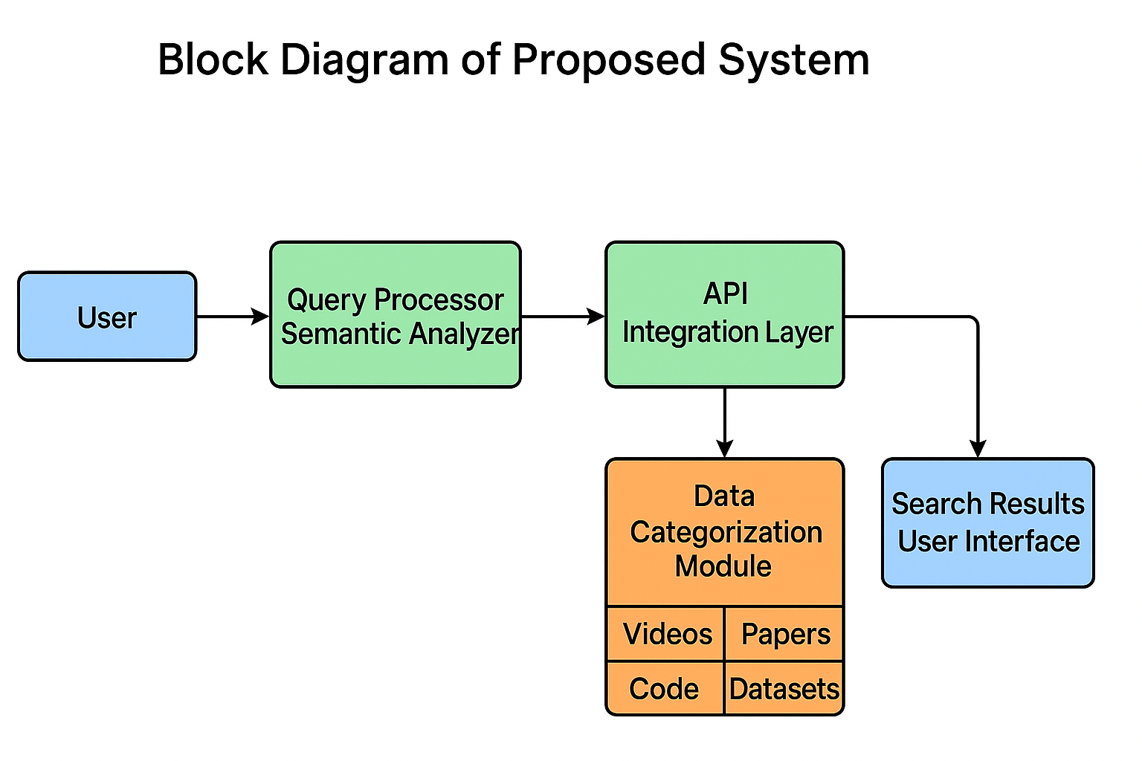
Block Diagram

Slide 20
Methodology
Ranking Algorithm
YouTube: Score = (0.6 × Views) + (0.4 × Likes)
GitHub: Score = (0.7 × Stars) + (0.3 × Forks)
arXiv Papers: Score = Recency = 1 / (CurrentYear - PublishedYear + 1)
Kaggle Datasets: Score = (0.5 × Downloads) + (0.5 × Usability × 1000)

Slide 21
Modules
User Interface Module
Input & Control Module
API Integration Modules
Result Display Module
Skeleton Loader Module (UX Enhancement)

Slide 22
Modules
User Interface Module
  Provides the search bar, tabs (Videos, Code, Papers, Datasets), and results area.
  Styled with dark theme, responsive grid, animations, and skeleton loaders for better UX.
Input & Control Module:
  Function : search(type)
    Takes user query from the search bar
    Controls which API is triggered based on the tab selected.
API Integration Modules
  YouTube Search Module : searchYouTube(query)
  GitHub Search Module : searchGitHub(query)
  Research Papers Module : searchPapers(query)
  Datasets Module : searchKaggle(query)

Slide 23
Modules
Result Display Module
  Dynamically creates result cards (<div class="result-card">)
  Displays title, description/summary, thumbnails (for videos), and links
  Includes error handling (“No results found”, “Error fetching ...”).
  Ranking Functions applied before displaying.
Skeleton Loader Module (UX Enhancement)
  showSkeleton() :
    shows animated placeholder cards while API results are loading.
    Improves user experience by reducing “blank waiting time.”

Slide 24
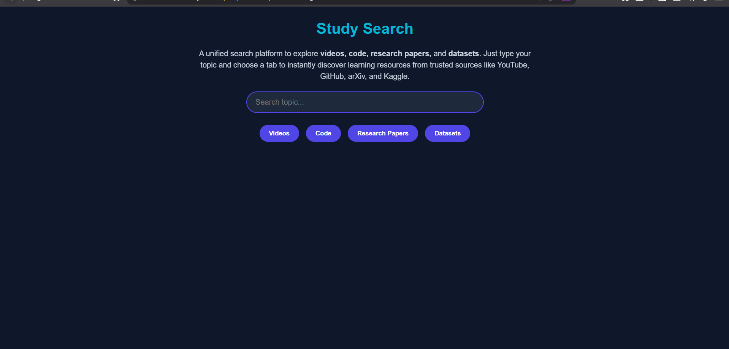
Results
Main Web Page(Home Page)

Slide 25
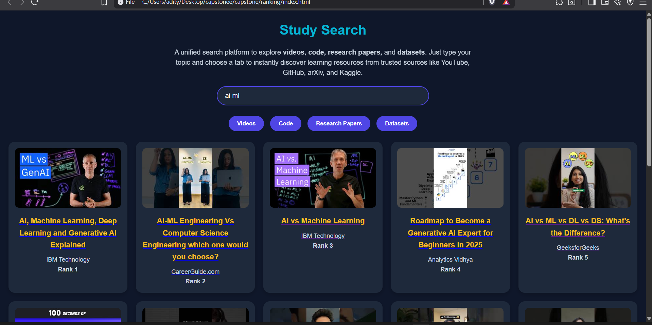
Results
Results with their ranks(eg: ai ml(videos))

Slide 26
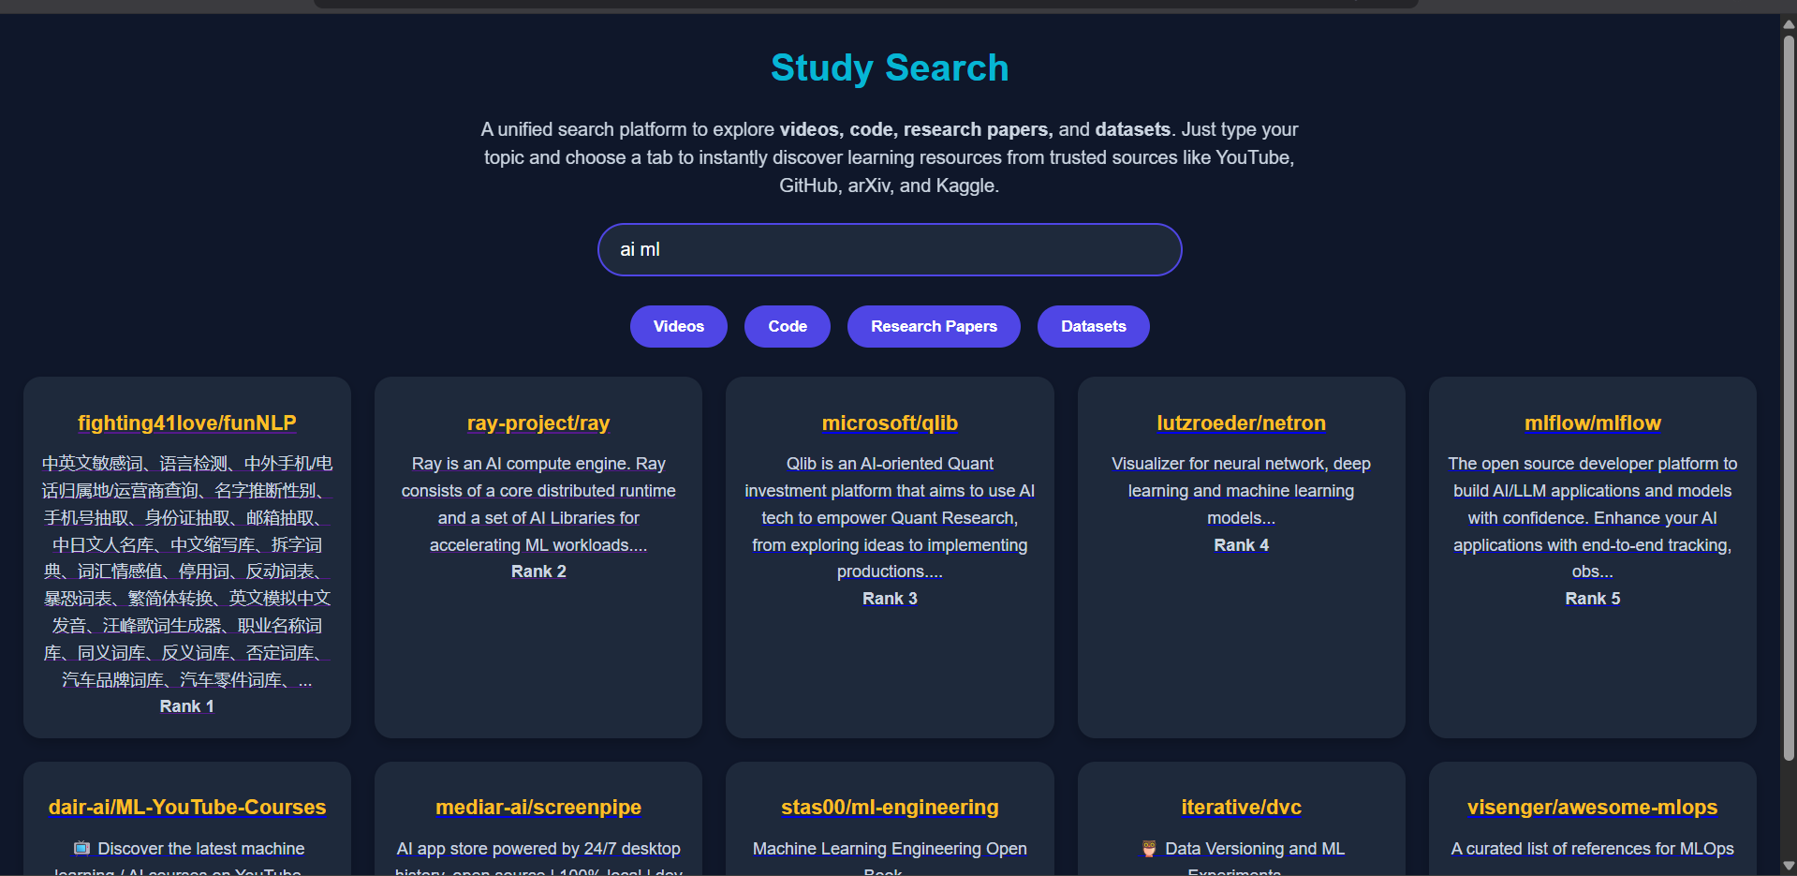
Results
Results with their ranks(eg: ai ml(code))

Slide 27
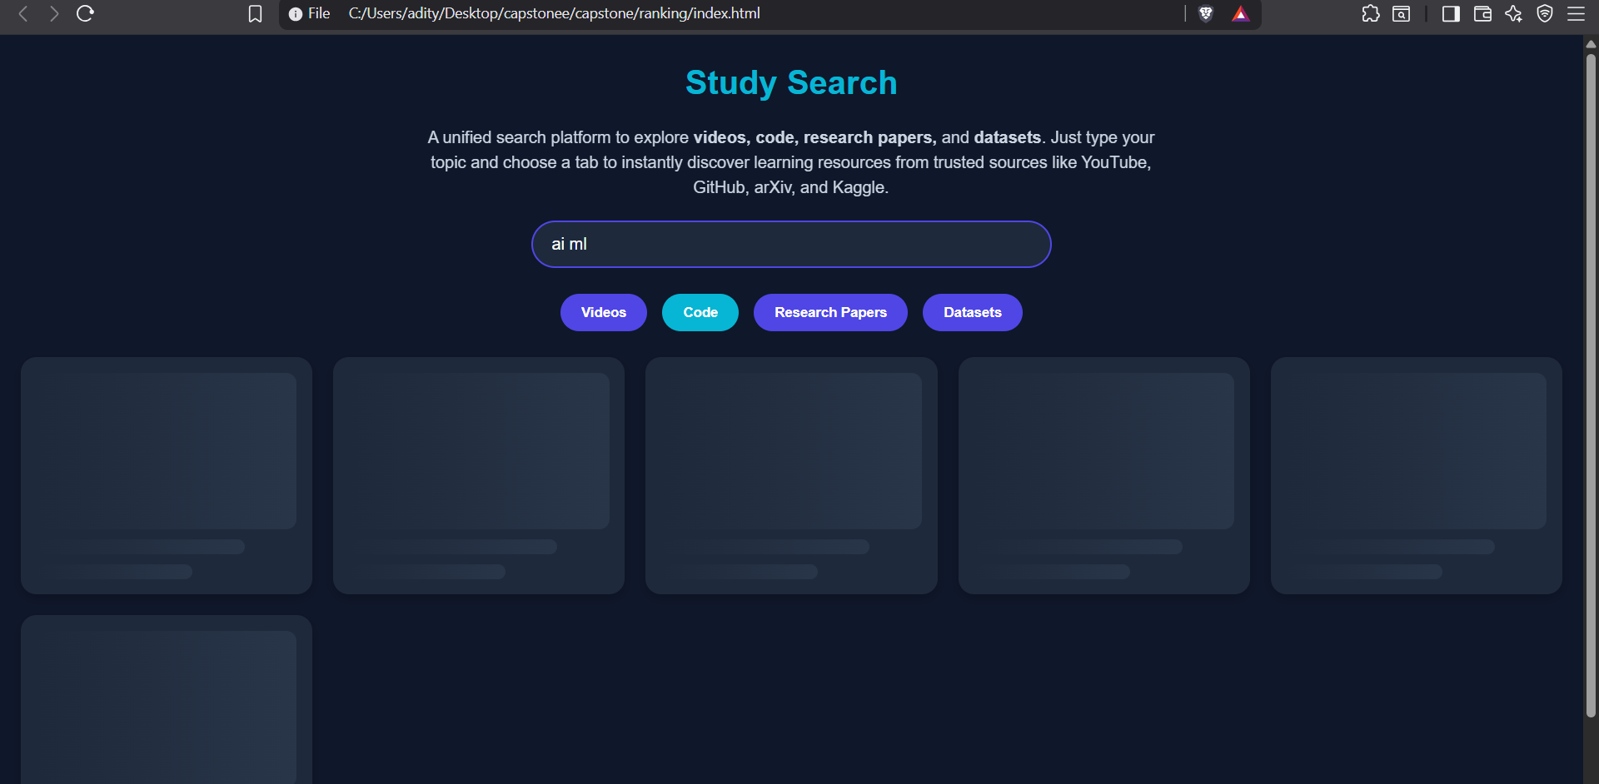
Results
Skeleton Loader Module for user engagement.

Slide 28
Future Enhancements
Add Backend with PHP + XAMPP
  Connect frontend with a MySQL database.
  Enable secure data storage and retrieval.
User Management (Login, Register)
  Provide authentication with login & signup forms.
  Manage personalized profiles for each user.
Recommendation System on Home Page (Based on History)
  Suggest videos, code, papers, datasets from past searches.
  Improve personalization using stored user activity.

Slide 29
References (IEEE Paper format)
  Usha Yadav and Neelam Duhan,” Efficient Retrieval of Data Using Semantic Search Engine Based on NLP and RDF”, in proc. VOLUME 6, 27 October 2021
    - https://ieeexplore.ieee.org/document/10246838
  Daniel M. Muepu, Yutaka Watanobe,"From Code to Ratings – Enhancing Collaborative Filtering in OJ Systems”, in proc. VOLUME 7, 2019,31 December 2024.
    - https://ieeexplore.ieee.org/document/10813164
  Diomidis Spinellis, Panagiotis Louridas, George Gousios, Ioannis Chatzigiannakis,” Using Research Literature to Generate Datasets of Implicit Feedback (LIBRETTI)”, in proc. VOLUME 7, 2019 ,December 23, 2019.
  - https://ieeexplore.ieee.org/document/8924687

Slide 30
References (IEEE Paper format)
Renjie Zhou, Dongchen Xia, Jian Wan, Sanyuan Zhang,” An Intelligent Video Tag Recommendation Method for Improving Video Popularity in Mobile”, in proc. VOLUME 8, 2020, January 14, 2020.
  https://ieeexplore.ieee.org/document/8938802
PAOLA INGAVÉLEZ-GUERRA , VLADIMIR E. ROBLES-BYKBAEV 1 , ANGEL PÉREZ-MUÑOZ ,JOSÉ HILERA-GONZÁLEZ , AND SALVADOR OTÓN-TORTOSA ,” Automatic Adaptation of Open Educational Resources: An Approach From a Multilevel Methodology Based on Students’ Preferences, Educational Special Needs, Artificial Intelligence and Accessibility Metadata”, in proc. VOLUME 10, 2022, January 27, 2022.
  https://ieeexplore.ieee.org/document/9669174
M. M. EL-GAYAR , N. E. MEKKY1, A. ATWAN2 , AND H. SOLIMAN, “Enhanced Search Engine Using Proposed Framework and Ranking Algorithm Based on Semantic Relations”,in proc. VOLUME 7, 2019, October 7, 2019.
  https://ieeexplore.ieee.org/document/8840848

Slide 31
References (IEEE Paper format)
CARLA LIMONGELLI , MATTEO LOMBARDI , ALESSANDRO MARANI, AND DAVIDE TAIBI, “A Semantic Approach to Ranking Techniques: Improving Web Page Searches for Educational Purposes ”, in proc. VOLUME 10, 2022, 27 June 2022.
  https://ieeexplore.ieee.org/document/9807311
JOHN B. KILLORAN, “How to Use Search Engine Optimization Techniques to Increase Website Visibility”, in proc. VOLUME 56, 1, MARCH 2013.
  https://ieeexplore.ieee.org/document/6463486
ICHRAK SAIF, ABDELAZIZ SDIGUI DOUKKALI, ADIL ENAANAI,” GENAUM: NEW SEMANTIC DISTRIBUTED SEARCH ENGINE “, Mobile Multimedia, Vol. 12, No.3&4 (2017) 210-221.
  https://ieeexplore.ieee.org/document/11079888
KAILASH A. HAMBARDE AND HUGO PROENÇA,” Information Retrieval: Recent Advances and Beyond”, VOLUME 11, 2023, 14 July 2023.
  https://ieeexplore.ieee.org/document/10184013

Slide 32
Github Link
https://github.com/Nithin3003/ISE_11-Capstone-Project

Slide 33
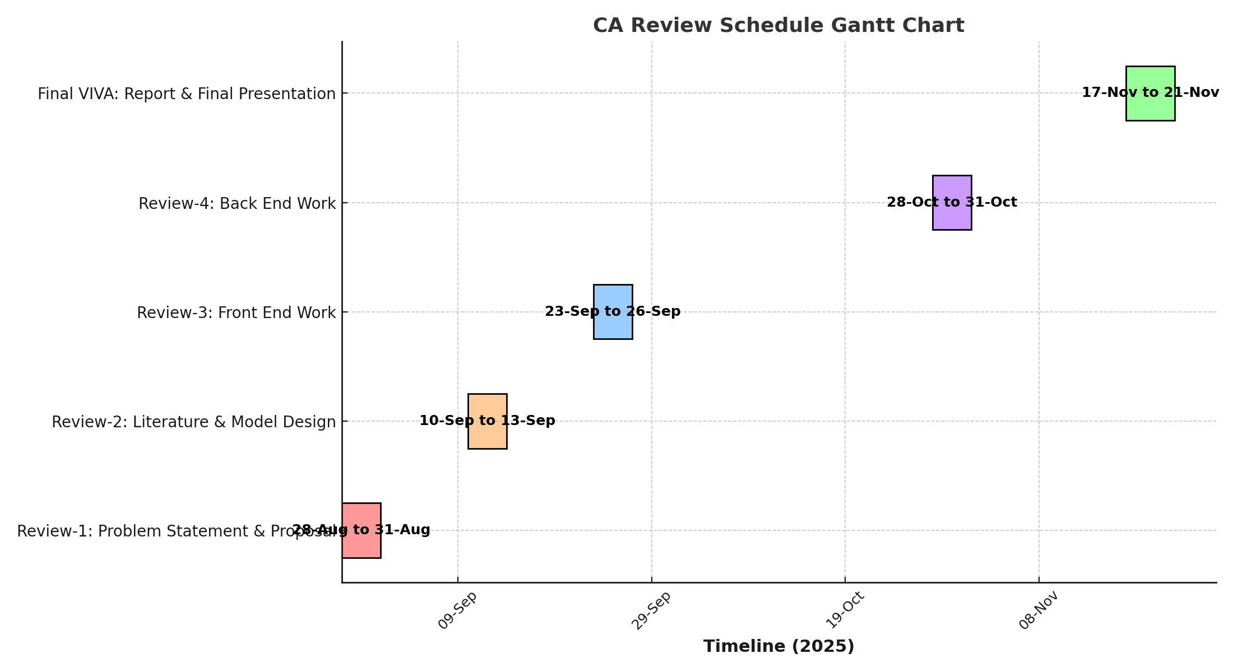
Timeline of the Project (Gantt Chart)

Slide 34


