Slide 2
Configuring and Deploying an Engaging Service Portal
LAB0261: Platform Essentials
Sushruth Chandrashekar
Dylan Lindgren
Senior UI Developer, Platform Innovation
Senior UI Developer, Platform Innovation

Slide 3
Agenda
Introductions
Portals & Pages
Widgets
External Dependencies & Best Practices
Bonus Lab!

Slide 4
Speaker introduction
Name: Sushruth Chandrashekar
Title: Senior UI Developer
Function: Platform Innovation Practice
Company: ServiceNow (San Diego, USA)
Experience/Expertise:
Current Projects:

Slide 5
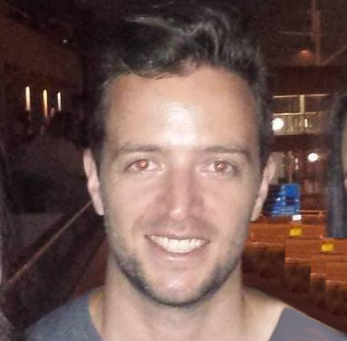
Speaker introduction
Name: Dylan Lindgren
Title: Senior UI Developer
Function: Platform Innovation Practice
Company: ServiceNow (Sydney, Australia)
Experience/Expertise: 20 years of building web pages and apps as a full-stack web developer
Current Projects: Working on building innovative solutions for clients on the ServiceNow platform, with a focus on UX and pushing boundaries.

Slide 6
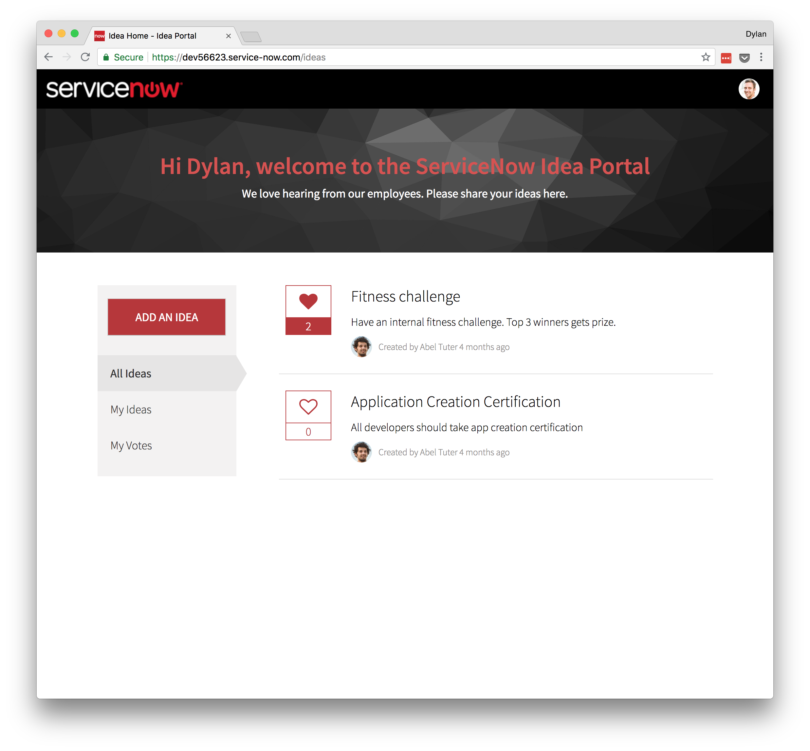
What are we building?
Ideation portal
Submit new ideas
Vote on other ideas
Filter ideas
All ideas
Ideas I’ve submitted
Ideas I’ve voted on
Notes:
So let’s go over what we’re building…

Slide 7
Lab 1
The Portal Record

Slide 8
Lab 2
Cloning and Creating Pages

Slide 9
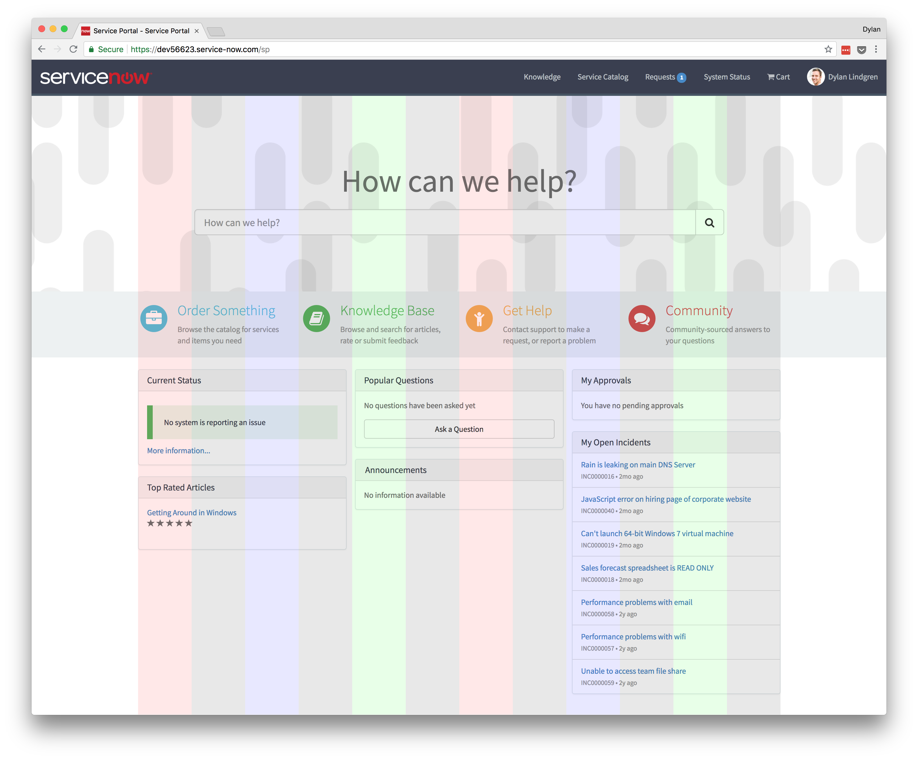
Bootstrap
CSS framework
12 columns
Notes:
Bootstrap is a core part of Service Portal.
Bootstrap is a CSS framework that was developed by Twitter.
Bootstrap partitions your page into a grid of 12 columns.
you can arrange your items on this grid
See in the screenshot of the OOB Service Portal that the items all align to the grid of columns?

Slide 10
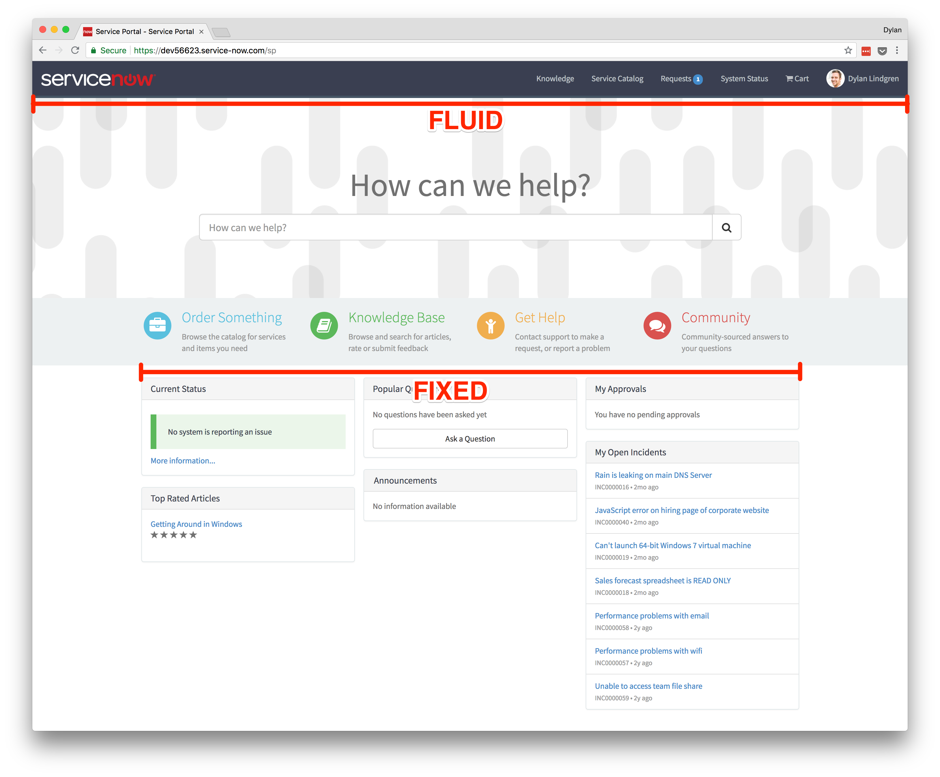
Service Portal + Bootstrap
In Service Portal, bootstrap columns are embedded inside containers.
Containers can be…
Fixed
Default
Fixed container width for each screen size
Extra small
Small
Medium
Large
Fluid
Takes up full width of screen for all screen sizes

Slide 11
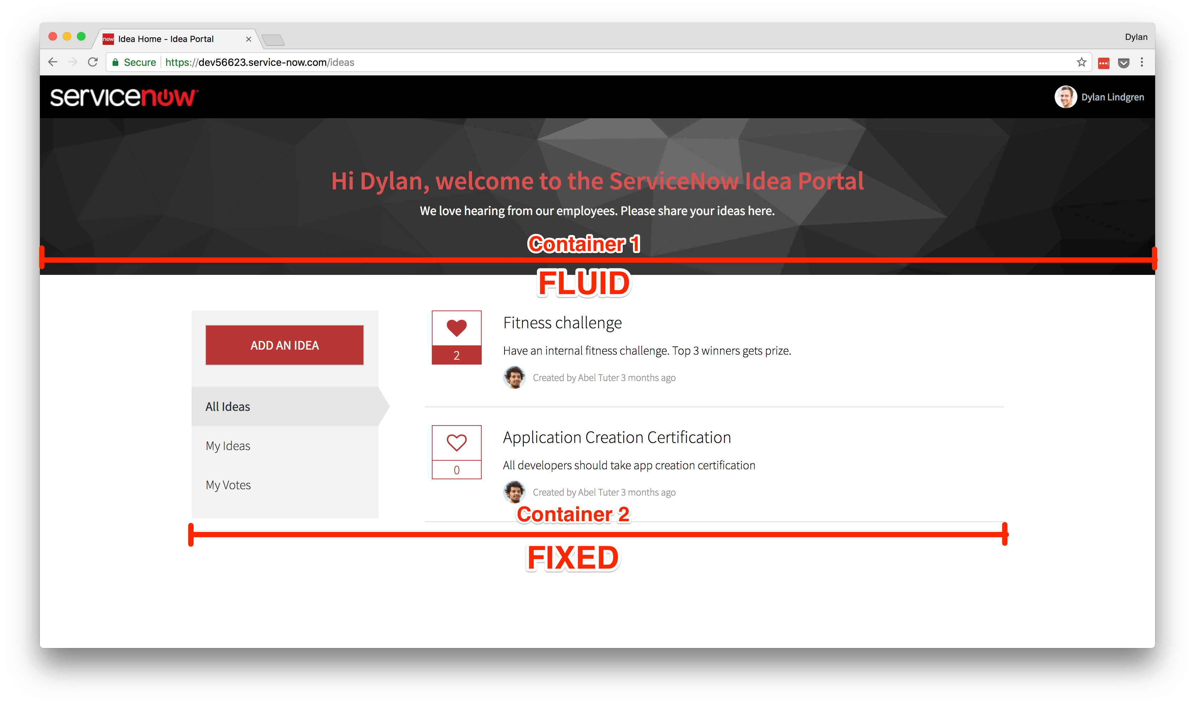
Idea Home Container Layout
Notes:
You can see that on our Idea Home page…
We have two containers
The top container is fluid, hence why it takes up the full width of the page
The bottom container is fixed, hence that on a large screen the most the container will expand to is 1170px.
Fixed containers will always be horizontally centered.

Slide 12
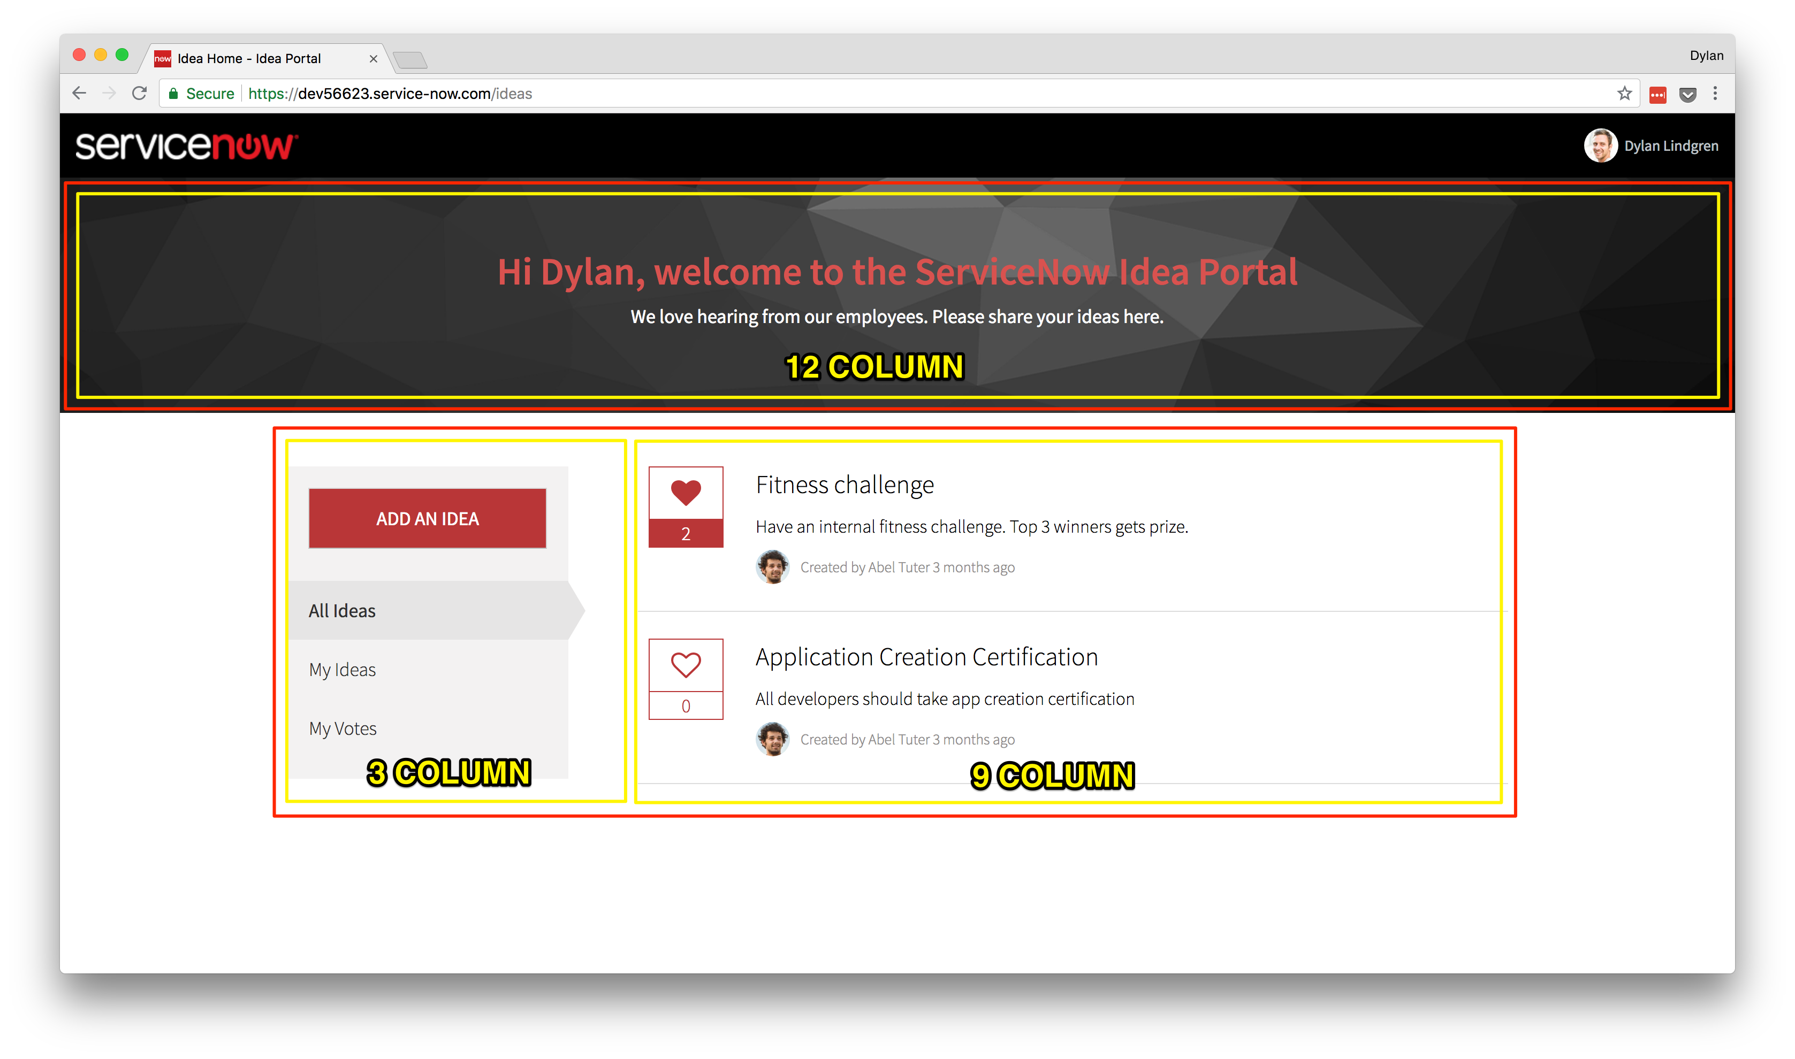
Idea Home Columns
Notes:
Within each container we can have columns.
You can have as many columns in a container as you like, however the max width of a column is 12 units.
You can see in our top container, we have a single column which is set to 12 units.
In our bottom container, we have 2 columns, the first taking 3 units, the second taking 9 units.

Slide 13
Lab 3
Banner Widget

Slide 14
Lab 4
Sidebar Widget

Slide 15
$broadcast(), $emit(), and $on()
Built-in event system of AngularJS.
Can use it to pass data between widgets.
Listen for events using $on() function.
Whether you use $broadcast() or $emit() is informed by:
Where you’re calling the event
Where you will be listening for the event

Slide 16
$broadcast(), $emit(), and $on()
$broadcast() passes the message downwards through the scope tree.
$emit() passes the message upwards through the scope tree.
All functions exist in both local-scope ($scope) and root-scope ($rootScope).
Notes:
All functions exist in both local-scope ($scope) and root-scope ($rootScope)
Which of these you use is informed by:
Where you’re calling the event
Where you will be listening for the event

Slide 17
Local-scope Events
Use this when you have nested widgets
We can’t use this, as all widgets on our page are siblings of each other in the scope tree (i.e. none are embedded).

Slide 18
Root-scope Events
Use this when you have sibling widgets (no parent-child relationship)
Event will be broadcast to all scopes on the page.
We will be using this communicate between our widgets.
Example:
$rootScope.$broadcast(”EventName", "data");
Event can be caught using $scope.$on() or $rootScope.$on()
Example:
$scope.$on("EventName", function (evt, data) { //Do something });

Slide 19
Lab 5
List Widget

Slide 20
Lab 6
Submit an Idea Page

Slide 21
Bonus Lab!
Data Tables

Slide 22
Questions?

Slide 23
Thank You!
Sushruth Chandrashekar
Dylan Lindgren

