Slide 1
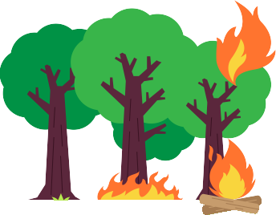
FOREST FIRE DETECTION
DOMAIN : ENVIRONMENT
TEAM NAME : SAVAGE
TEAM MEMBERS :
ANUSHA M S
AISHWARYA PATEL
KEERTHANA B CHITRASHREE R M

Slide 2
INTRODUCTION
The most common hazard in forests is ‘Forest fire’.
A forest fire is an uncontrolled fire that occurs mainly in forest areas.
They pose a threat not only to the forest wealth but also to the entire regime to fauna and flora seriously disturbing the bio-diversity and the ecosystem.

Slide 3
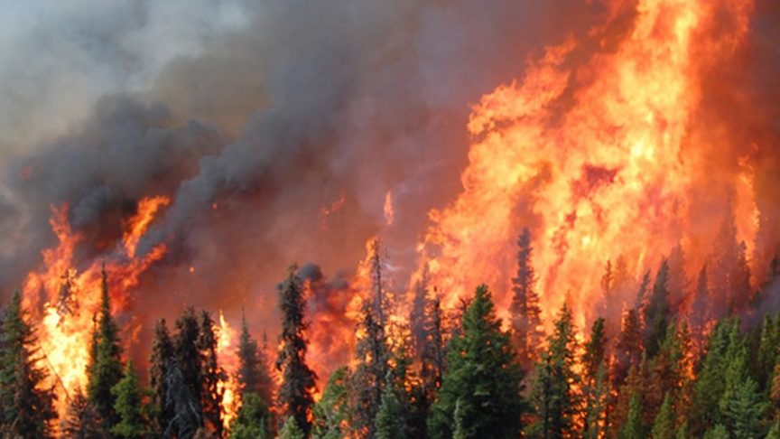
CAUSES OF FOREST FIRE
Causes of forest fires can be divided into two categories :-
Environmental ( beyond control )
Human related ( controllable )

Slide 4
ENVIRONMENTAL
Many forest fires start from natural causes such as lightning which set trees on fire.
Weather factors such as temperature, humidity , air stability and wind speed & direction directly affect the way that fires burn.
The weather’s long-term climatic influence on fuels and their dryness, indirectly affect fires.
Other natural causes are the friction of bamboos swaying due to high wind velocity and rolling stones that result in sparks setting off fire.

Slide 5
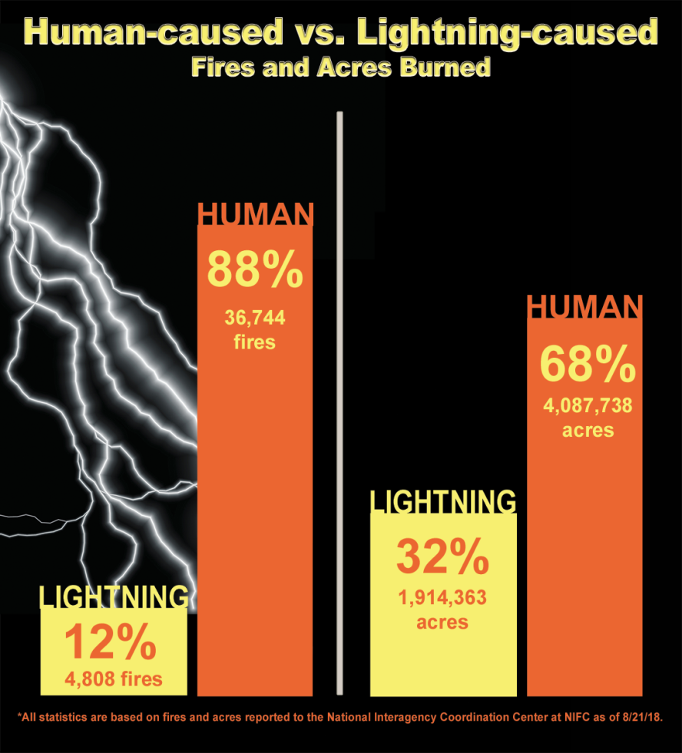
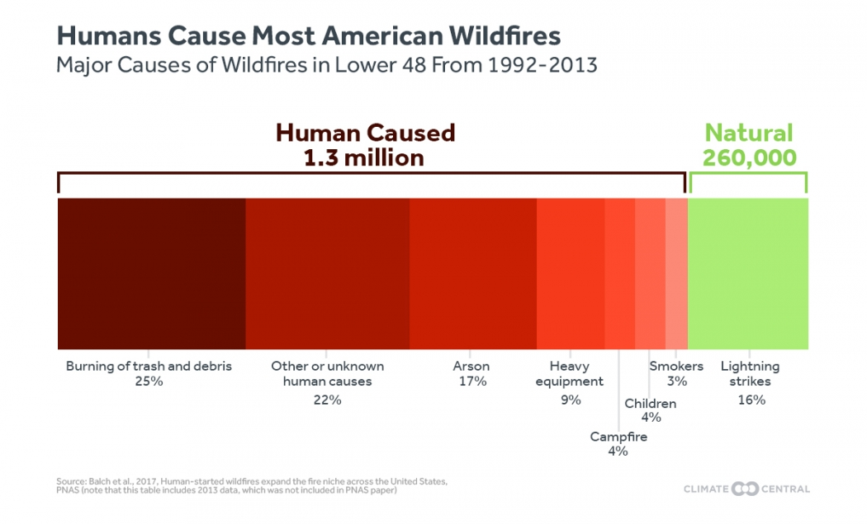
2. Human related
Fire is caused when a source of fire like naked flame, cigarette , electric spark or any source of ignition comes into contact with inflammable material.

Slide 6
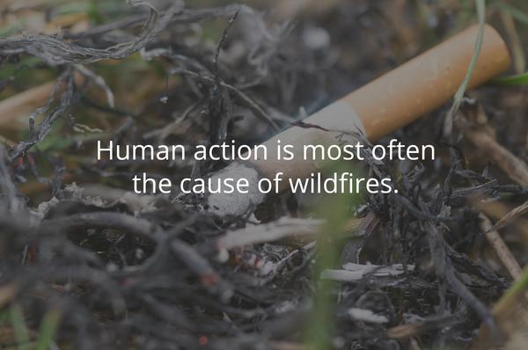
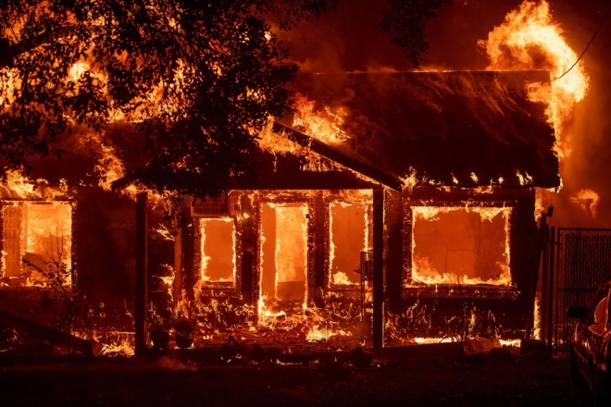
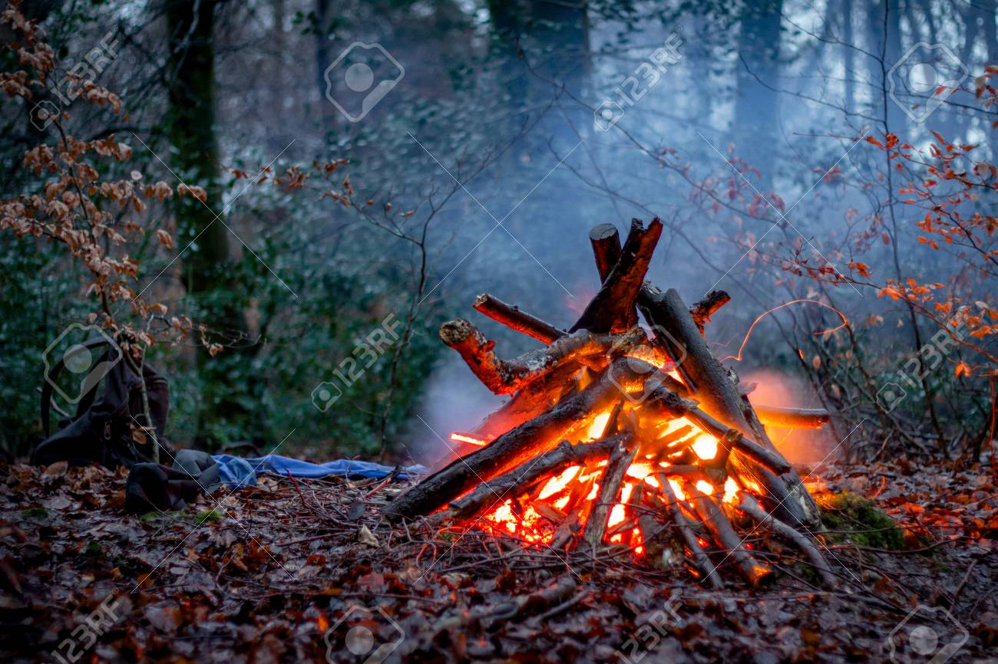
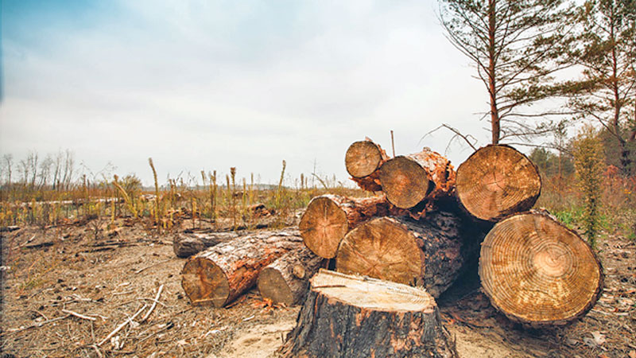

Slide 7
Effects of forest fire
Fire can be deadly, destroying homes, wildlife habitat and timber ,and polluting the air with emissions harmful to human health.
Fire also releases carbon dioxide-a key greenhouse gas- into the atmosphere .
Fire’s effect on the landscape may be long-lasting.
Best example is the Amazon forest which is experiencing a more severe dry season than last year.

Slide 8
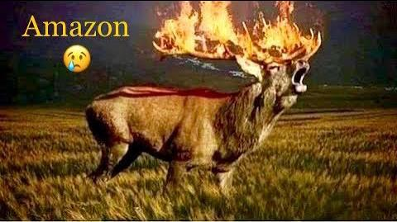
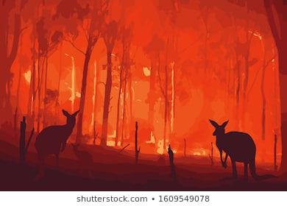
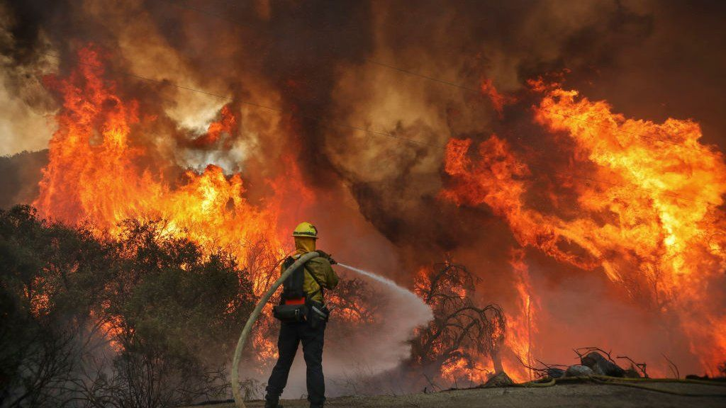

Slide 9
The entire Amazon, which spans nine countries, currently has 28,892 active fires according to a fire monitoring tool funded in part by the US space agency NASA.
Eastern Australia is one of the most fire-prone regions of the world.
However , the fires can cause significant property damage and loss of both human and animal life .
Bushfires have killed approximately 800 people in Australia since 1851,and billions of animals

Slide 10

prevention
Plantation – planting more trees.
Technology – To predict the occurrence of forest fire based on the previously occurred fire.
To make a webpage to predict the probability of occurrence of forest fire.
The major factors are:-
Temperature
Oxygen
Humidity

Slide 11
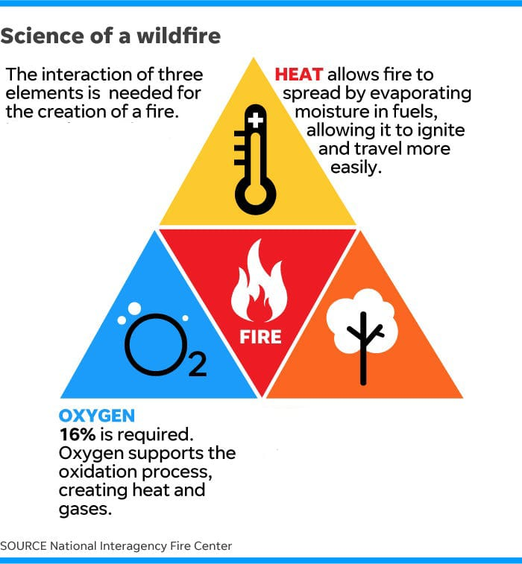
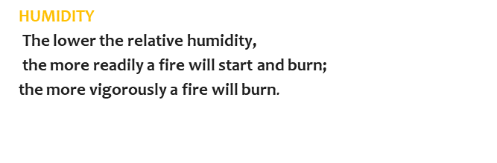
If the temperature & oxygen content is high & humidity is low, The probability of occurrence of forest fire is high.

Slide 12
Implementation
The user needs to provide the temperature, oxygen content & humidity of the area.
This data is then sent to the Python program where it is given to machine learning model.
The machine learning model uses that and predicts the probability of forest fire.
This output is reflected back onto the webpage.
Input data Python program Machine learning model Predicted output

Slide 13


