Slide 1

Identifying Financial Fraud Detection in real time.
Name: Nithin Joshi Cherkupally
Student ID:15127022
Module Code: 7151CEM
Supervisor: Omid Chatrabgoun

Slide 2
Table of Contents
1.Introduction
2.Research Questions
3.Aim and Objectives
4.Methodology
5.Common Algorithms Used
6.Experimental Design and Evaluation Metrics
7.Results
8.Case Study
9.Future directions in Fraud Detection
10.Conclusions
11.References

Slide 3

Introduction to Financial Fraud Detection
The Importance Financial fraud detection is crucial for maintaining the integrity of financial systems and protecting consumers. Fraudulent activities can lead to significant financial losses and reputational damage. Role of Machine Learning (ML)
Machine Learning is a subset of Artificial Intelligence which uses statistical methods and focus on system that can learn from and make decisions and predictions based on the experience and data. Machine learning plays an increasingly vital role in enhancing fraud detection mechanisms. ML algorithms can analyze vast amounts of data to identify patterns indicative of fraudulent behavior, often more effectively than traditional methods. Overview This presentation will explore the application of ML in financial fraud detection using different Machine Learning Models and giving solutions to the problems .

Slide 4
Research Questions

Slide 5
“How does feature engineering impact logistic regression’s precision in real-time fraud detection compared to raw transactional data?” What is the effectiveness of a real-time logistic regression –based machine learning model in detecting financial fraud in transactional data, and how can its accuracy and efficiency be optimized for live deployment?

Slide 6
Aim and Objectives

Slide 7
Aim and Objectives
Aim:
To design and implement a robust – real time financial fraud detection system using advanced data analytics and machine learning techniques to enhance the accuracy, speed and reliability of fraud identification in financial transactions.
Objectives:
1.To analyze the nature and patterns of financial fraud transactions in real – time.
2.Data preprocessing and feature engineering customized to the features of financial transactions.
3.Using a labelled fraud detection dataset – Logistic Regression, Random Forest, XG Boost, Neural Network(MLP) models is trained and validated.
4.Comparison with more intricate models (such neural networks or random forests) to comprehend speed and interpretability trade – offs.

Slide 8
Methodology
1.Collecting and Interpreting data
2. Preprocessing data
3.Feature Selection
4.Model selection and Training.
5.Hyper Parameter Tuning.

Slide 9
Data Collection and Preprocessing

Slide 10
Data Collection:
Data Source: Mendeley Dataset(~900000 data , csv format)
Target Variable: credit_risk_score
Features: Income, customer_age, payment_type, employment_status, days_since_request
Data Preprocessing:
Missing Values: Impute missing values like Categorical columns with mode() and Numerical columns with median().
Encoding: Using LabelEncoder() for binary/ordinal categories.
Feature Scaling: To normalize numeric data we are applying StandardScaler
Train – Test Split: Data will splitting into Training – 80% and Testing – 20% using train_test_split.

Slide 11
Data cleaning and Preparation
Handling Missing values:
Handling missing values is a critical preprocessing steps in data science and machine learning, especially in financial fraud detection, where the accuracy of models depends on clean and consistent data and dropping missing values.
Feature Selection:
Feature selection is for contribute to predicting the target variable by choosing the most relevant variables from dataset . Used for the Improves model accuracy, Reduces overfitting, Speeds up training time.
Normalization and Encoding:
Normalization is the process of scaling numeric features so they fall within a specific range(0,1).Encoding transforms categorical (text-based) features into numerical format that ML models can understand.

Slide 12
Common Algorithms Used
Logistic Regression
Random Forest
XG Boost
Neural Network(MLP)
Logistic Regression is a supervised classification ML algorithm which is used to predict the probability that a financial transaction is fraudulent based on input features such as transaction amount, time and user behaviour patterns.
Its output is 0 or 1.
Random Forest is used in financial fraud detection to accurately classify whether a transaction is fraudulent or legitimate.
It works by constructing multiple decision trees during training and aggregating their predictions.
XG boost is a ensemble learning algorithm where widely used for its high accuracy speed.in financial fraud detection.
XG boost works by building a series of decision trees sequentially.
By Using gradient descent optimization , new tree corrects the errors of old one.
A neural Network, Multilayer Perceptron(MLP), is a deep learning model to identify complex, non-linear patterns in transaction data.
It consists of different layers of interconnected neurons which includes input layer, one output layers and one or more than one hidden layers.

Slide 13
Speed vs. Interpretability Trade-offs
Model Speed
Interpretability and Practical Preferences
Comparison of model speeds:
Logistic Regression: Generally faster due to its simplicity
Random Forests: Can be fast, but decision trees to make predictions.
XG Boost: Can be known for its speed,efficiency and handle with large datasets.
Neural Networks: Often the slowest due to computational complexity.
Comparison of model interpretability:
Logistic Regression: Highly interpretable; coefficients indicate feature importance.
Random Forests : Relatively interpretable, especially for decision trees.
XG Boost : Less interpretable; difficult to understand the impact of individual features.
Neural Networks: Black boxes; very difficult to interpret. Practical Preferences: The choice depends on the specific application. If interpretability is crucial, logistic regression or random forests might be preferred. If high accuracy is the priority, neural networks might be considered despite their complexity.

Slide 14
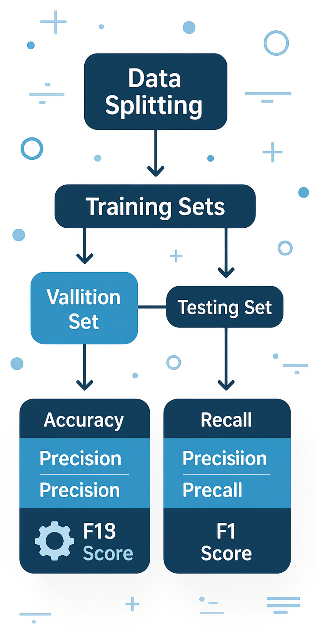
Evaluation Metrics
Accuracy and Precision.
Accuracy refers to how close a measurement is true or accepted value.
Precision refers to the consistency or reproducibility of measurements, regardless of whether they are close to the true value.
Recall and F1 Score:
Recall measures a model’s ability to identify all relevant instances (True/Positive) out of all actual positives in a dataset.
F1 Score is the harmonic mean of precision and recall. It provides a balanced measure of a model’s performance , especially useful when precision and recall are in a trade – off relationship.
F1 = 2 * (precision * recall) / (precision + recall).
AUC and ROC curve
The AUC(Area Under the Curve) is a scalar value that summarizes the classifiers overall performance, representing the area under the ROC curve.
The ROC(Receiver Operating Characteristic) curve is a graphical representation of a binary classifier’s performance across various classification thresholds.
Goal: The goal is to determine which model provides the best results of accuracy, precision, and recall for fraud detection.

Slide 15
Results Comparison of Models
Logistic Regression
Random Forest
Logistic Regression is used for predicting the binary outcomes. Output is 0 or 1.
Predicting fraud transactions or genuine .
Simple for use and giving output fast and accurate.
Accuracy: 0.5906
Precision: 0.6218
Recall: 0.5873
F1-Score: 0.6040
ROC – AUC:0.6262
AUC : 0.63
Random Forest is a ML algorithm that uses an ensemble of decision trees to make predictions.
It combines the outputs of many decision trees.
Accuracy: 0.5860
Precision: 0.5990
Recall: 0.6697
F1-Score: 0.6324
ROC – AUC: 0.6149
AUC : 0.61

Slide 16
Comparison of Models
XG Boost
Neural Network(MLP)
XG BOOST(Xtreme Gradient Boosting) is a popular
open – source ML library that implements the gradient boosting algorithm.
Known for speed, efficiency, handling large datasets.
Used for both Classification and Regression tasks.
Accuracy: 0.5964
Precision: 0.6091
Recall: 0.6722
F1-Score: 0.6391
ROC – AUC: 0.6301
AUC : 0.63
Multilayer Perceptron(MLP) is a type of artificial neural network that utilizes multiple layers of interconnected nodes(neurons) to process information.
It is a feedforward network, which means information moves in one direction – from input to output through the layers.
Used for handling data, learn complex and non linear relationships within data.
Accuracy: 0.5364
Precision: 0.5653
Recall: 0.5539
F1-Score: 0.5596
ROC – AUC: 0.5436
AUC : 0.54

Slide 17
Case Study: Real-world Application
Exploration
Practical Implementation
Results
This section explores a successful case study where ML has been utilized for fraud detection.
The case study illustrates how ML models are implemented in a real financial system.
ML models significantly increased the detection rate of fraudulent transactions, reduced false positives, and led to substantial cost savings by preventing fraudulent activities.

Slide 18
Future Directions in Fraud Detection
Emerging Trends
Areas of Research
Potential Advancements
The discussion will cover emerging trends and future research areas in financial fraud detection using machine learning.
Key areas of research include adversarial machine learning, federated learning, and explainable AI (XAI).
These advancements promise to further enhance the effectiveness and reliability of fraud detection systems.

Slide 19

Conclusion: The Future of Fraud Detection in Finance
Summation This presentation has examined the application of machine learning in financial fraud detection, comparing traditional methods with ML models. Key Findings ML models generally outperform logistic regression,random forest, XG Boost ,Neural network(MLP) in terms of accuracy, precision, and recall. The choice of model depends on the specific application and the trade-offs between speed and interpretability. Implementing ML models presents challenges related to data quality, model bias, and interpretability. Reflections The evolving landscape of fraud detection in the financial industry is increasingly shaped by ML innovations, promising more effective and reliable solutions for protecting financial systems and consumers.

Slide 20
References
Liu, J., Wang, S., & Rao, M. (2025) Big data-driven fraud detection using machine learning and real-time stream processing frameworks. Journal of Financial Data Science, 7(2), pp. 45–58. https://www.jfds.org/article/big-data-aml-ml-streaming
Kostova, V. & Zhelev, P. (2024) Machine learning as a tool for assessment and management of fraud risk in banking transactions. Journal of Risk and Financial Management, 17(1), pp. 30–45.
https://www.mdpi.com/1911-8074/17/1/30
Talukder, M. et al. (2024) A hybrid dependable ensemble ML model using IHT-LR for credit card fraud detection. Expert Systems with Applications, 237, 122408.
https://doi.org/10.1016/j.eswa.2023.122408
Mohammed, Y., Hussain, A., & Zhang, T. (2023) High-performance computing of logistic regression: A comparative study between CPU and GPU implementations for real-time fraud detection. IEEE Access, 11, pp. 105032–105045.
https://ieeexplore.ieee.org/document/10050789

