Slide 1
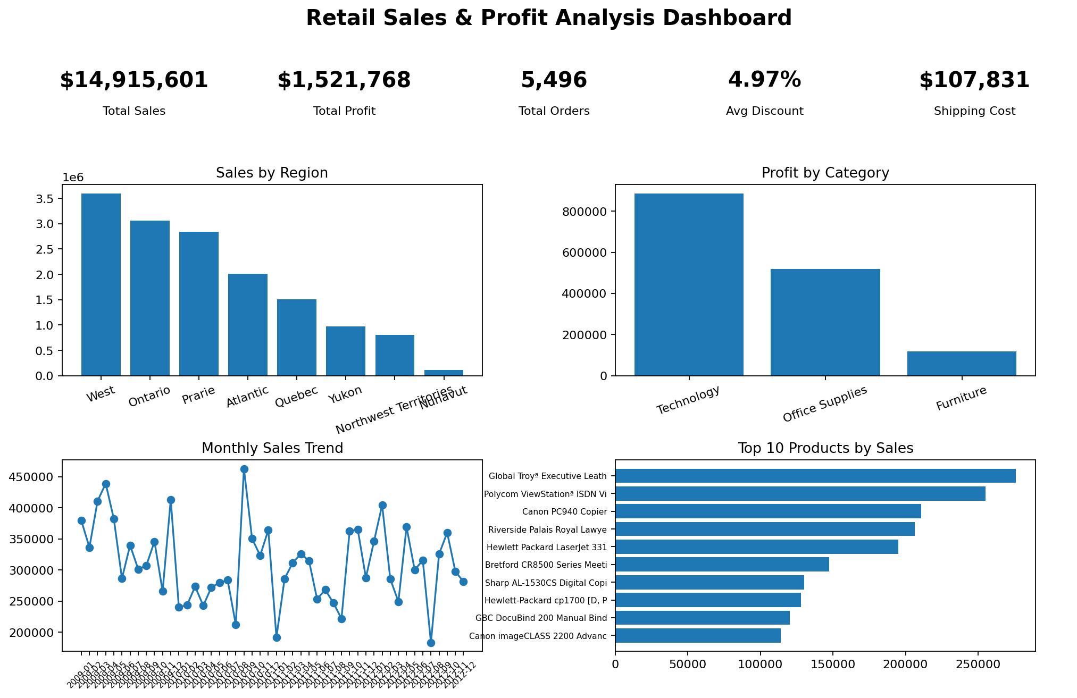
Retail Sales & Profit Analysis
Final Internship Project Submission
Mentor: Tarun Kumar
Prepared by: Nithin Medipelly
Cleaned data | KPI analysis | Dashboard | Business insights

Slide 2
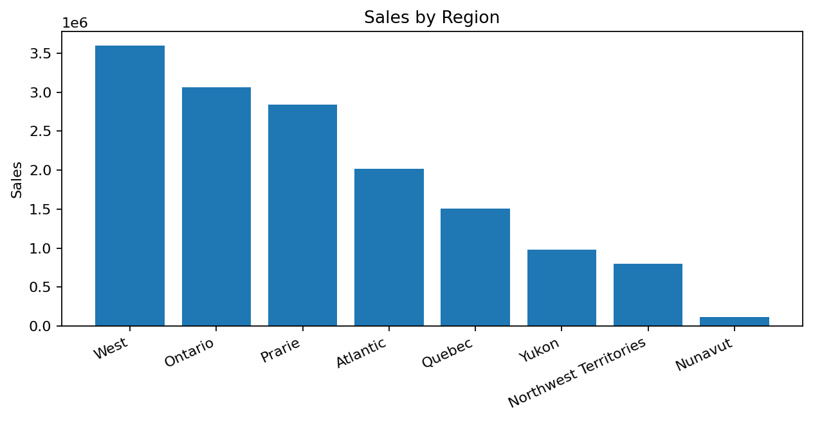
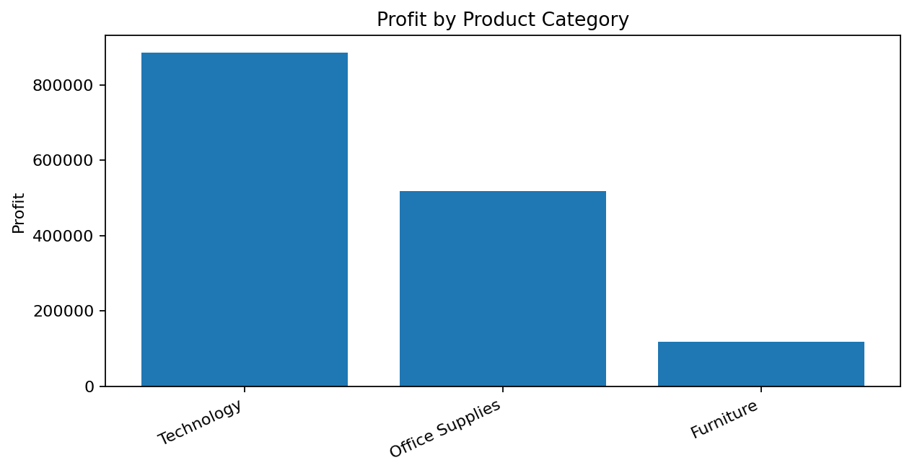
Project Objective & Workflow
From raw retail orders to mentor-ready insights
Objective
Workflow used
Analyze retail sales performance, clean the dataset, calculate KPIs, identify business trends, and build a dashboard-ready submission package.
Data Cleaning
KPI Calculation
Business Analysis
Dashboard Creation
Final Report
Retail Sales & Profit Analysis | 2

Slide 3
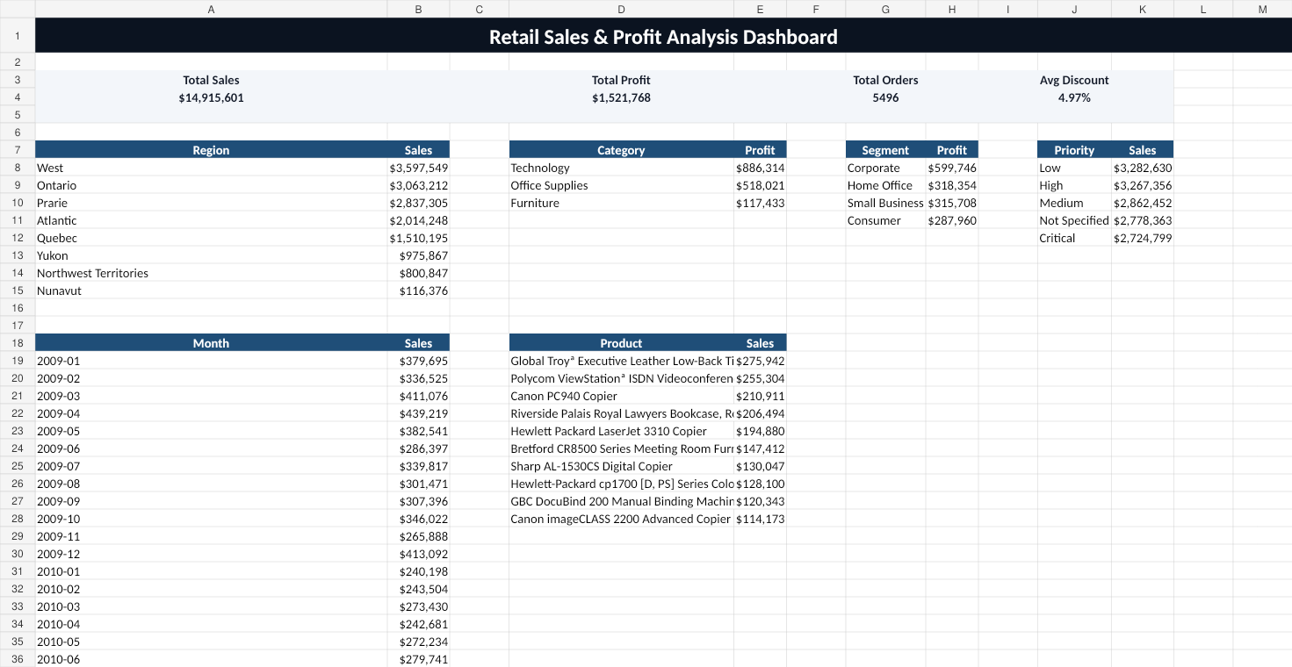
Data Cleaning Summary
Cleaning actions completed before analysis
Cleaning Checklist
Rows after cleaning
8,399
Duplicates removed
0
Missing Product Base Margin
63
Date fields standardized
Order Date + Ship Date
Numeric fields formatted
Sales, Profit, Discount, Cost
Dates were unified and missing Product Base Margin values were filled using the median to preserve valid order records.
Retail Sales & Profit Analysis | 3

Slide 4
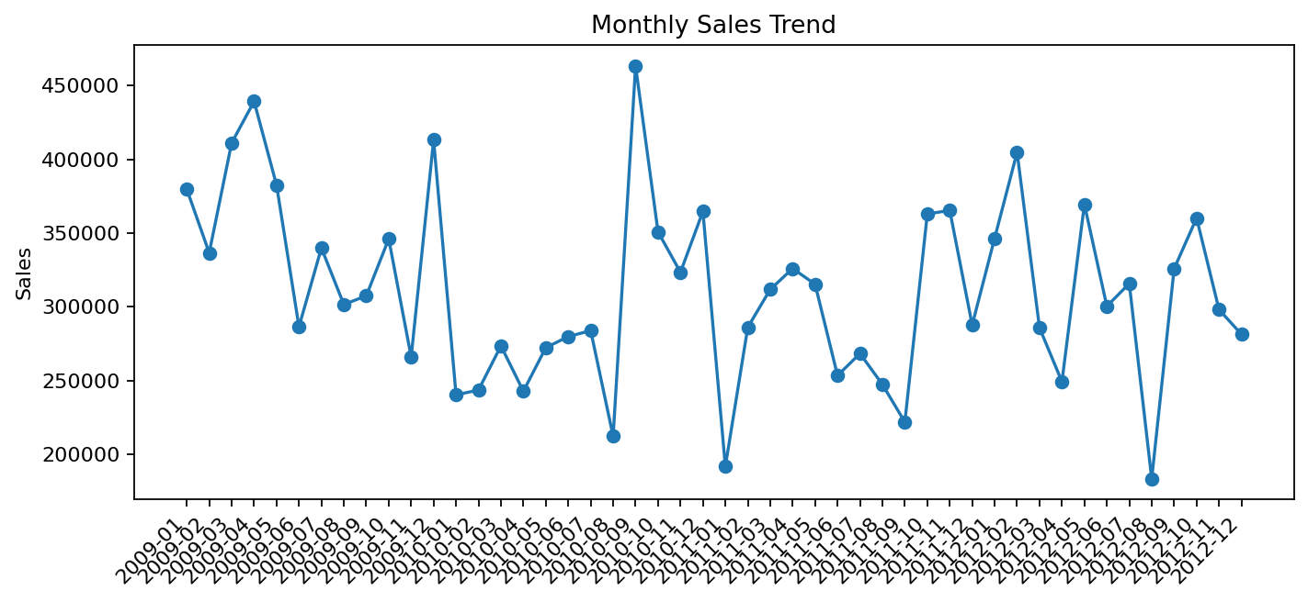
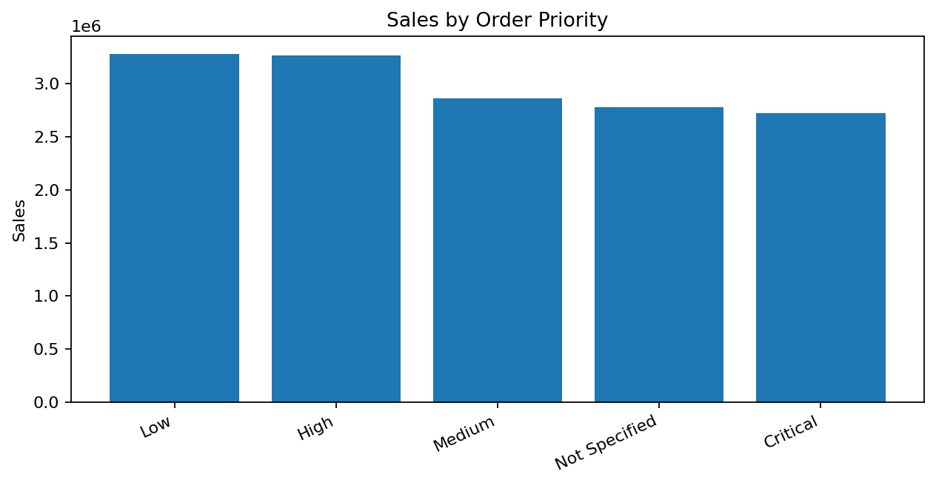
KPI Performance Overview
Core business metrics calculated from the cleaned dataset
$14,915,601
$1,521,768
5,496
4.97%
$107,831
Total Sales
Total Profit
Total Orders
Avg Discount
Shipping Cost
Retail Sales & Profit Analysis | 4

Slide 5
Regional & Product Insights
Where revenue and profit are concentrated
Highest sales region: West ($3,597,549)
Most profitable category: Technology ($886,314)
The analysis shows that sales concentration and profitability do not always tell the same story; therefore, region and category should be reviewed together.
Retail Sales & Profit Analysis | 5

Slide 6
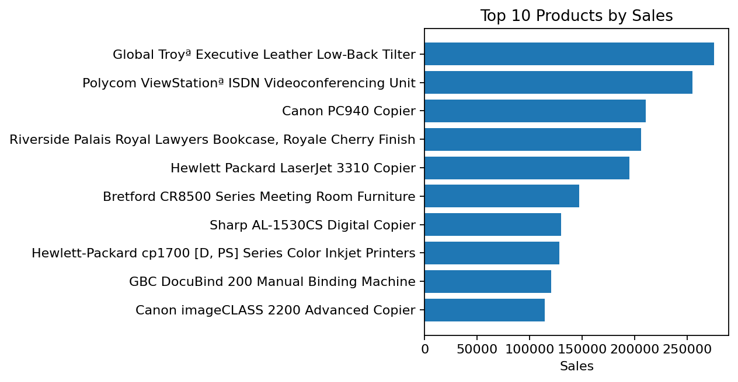
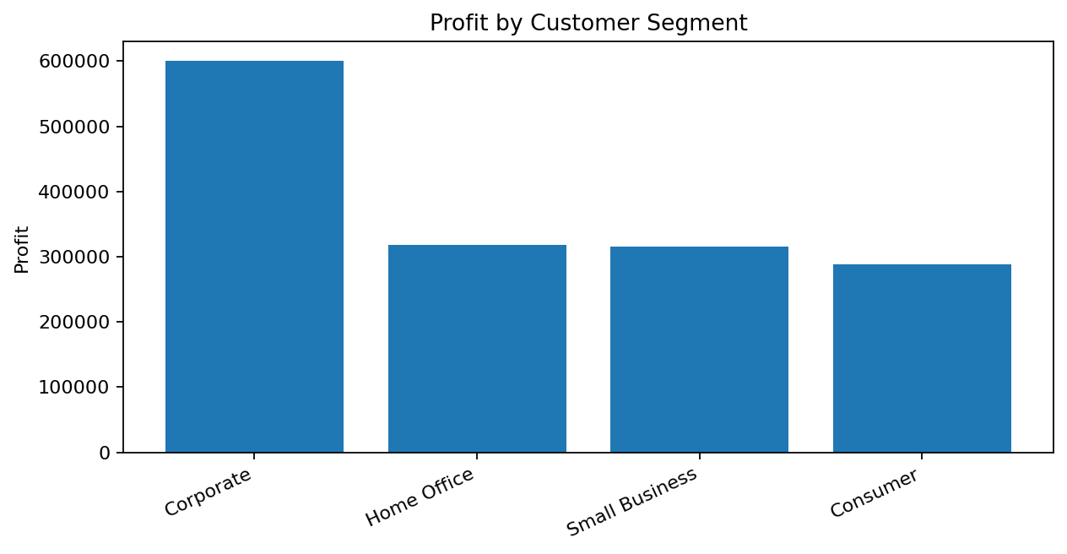
Top Products & Customer Segment Profit
Products drive revenue while segments explain profit contribution
Top revenue product: Global Troyª Executive Leather Low-Back Tilter
Most profitable segment: Corporate ($599,746)
Retail Sales & Profit Analysis | 6

Slide 7
Answers, Recommendations & Submission Files
Final deliverables are packaged for mentor review
Required Question Answers
Final Package Includes
1. Highest sales region: West
• Cleaned dataset
2. Most profitable category: Technology
• Excel analysis workbook
3. Highest revenue product: Global Troyª Executive Leather Low-Back Tilter
• Dashboard screenshots
4. Top profit segment: Corporate
• Project report DOCX/PDF
• Presentation PPTX
5. Peak sales month: 2010-09
• Power BI build guide
Recommendation: focus on the top-performing region and most profitable category while reviewing discounts, shipping cost, and product-level margins.
Retail Sales & Profit Analysis | 7

