Slide 1


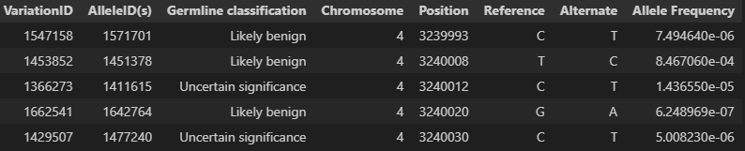
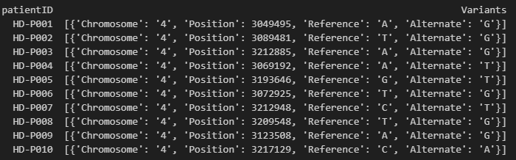




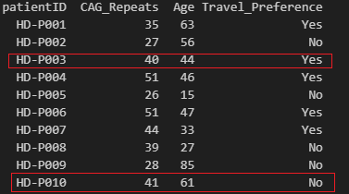
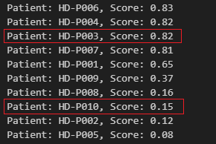

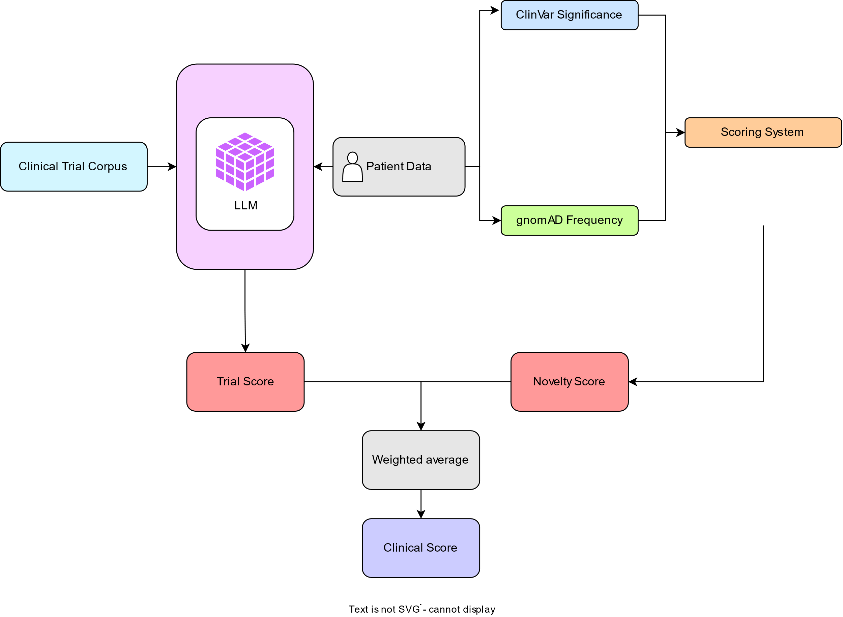
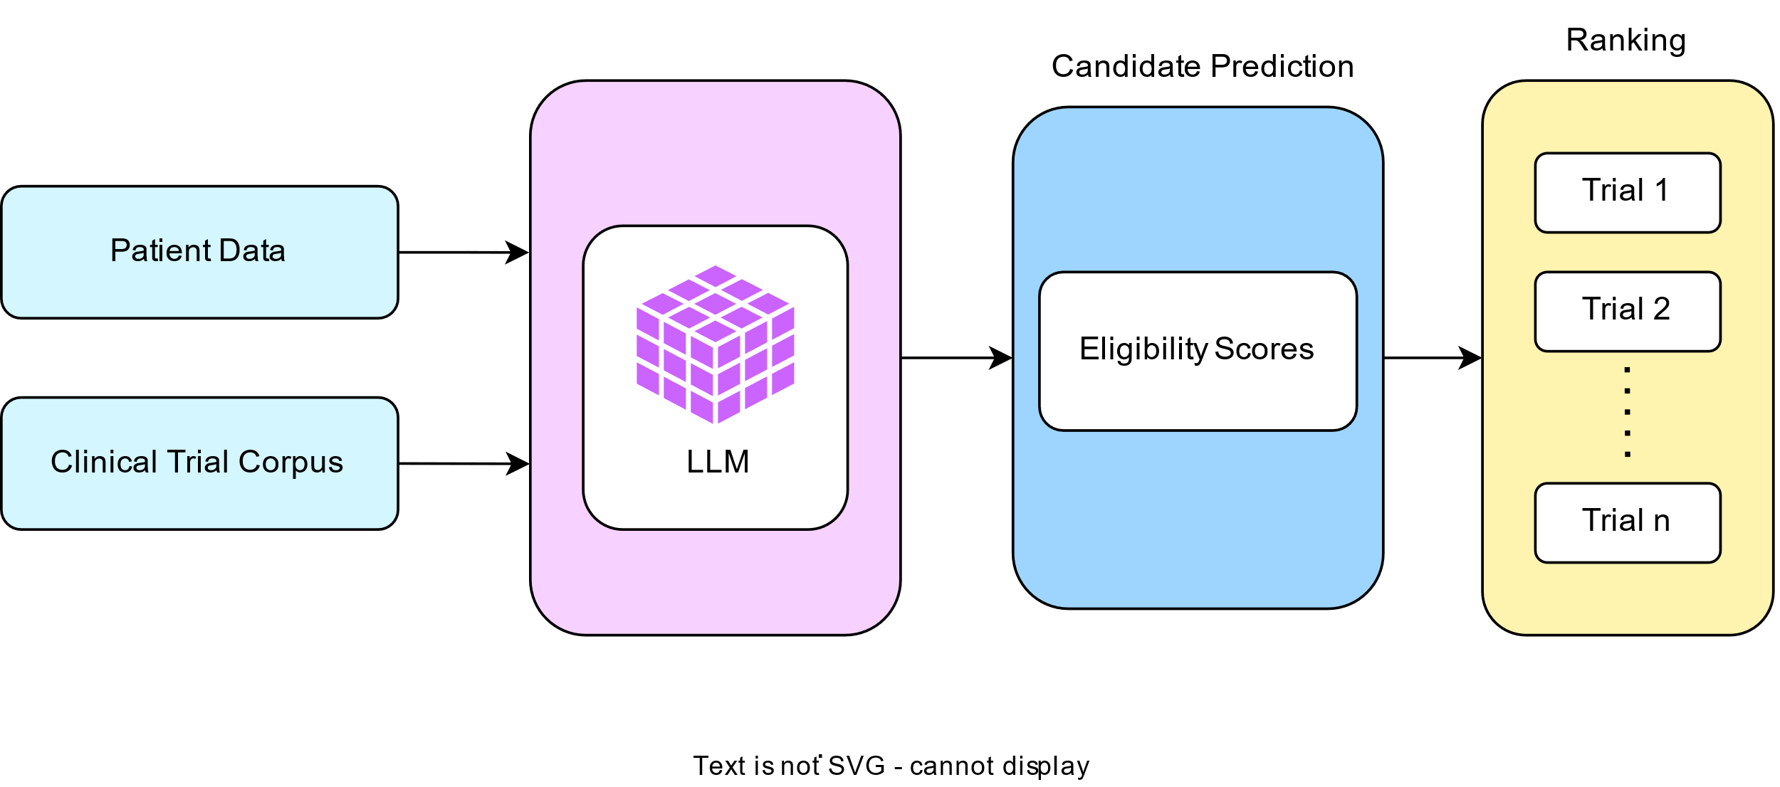
HELIX-RARE: A NOVEL APPROACH TO MATCH PATIENTS
WITH CLINICAL TRIALS
Vinod Nithin Kumar Rachakonda, Sai Nithisha Marripelly, Yuqi Yan, Kruthi Dhanani Nukaraju and Neha Manjrekar
Data Analytics Program, School of Professional Studies
Clark University, Worcester, MA
22nd Annual
Graduate Multidisciplinary
Conference (MDC)
Abstract
Contributions/Objectives
Results
"NCTId": "NCT01234567",
"BriefTitle": "Huntington's Disease Trial 1",
"EligibilityCriteria": "Inclusion Criteria: Confirmed diagnosis of Huntington's disease via CAG-repeat length analysis, Higher CAG_repeats will lead to higher probability of having the disease. Patient must be between 18 and 74 years of age. Mild to moderate chorea,"
“Exclusion criteria: No severe psychiatric disorders. No depression.",
"StudyStatus": "Recruiting",
"TrialCity": "New York",
"Travel_Required": "Yes" #Trial travel requirement.
Recruiting participants for rare disease clinical trials is a formidable challenge due to the complexity of patient profiles and limitations of current matching methods. This study introduces HelixRare, an innovative AI-driven algorithm designed to address this critical bottleneck. Our approach combines rule-based clinical matching with a novel variant novelty assessment, leveraging gnomAD and ClinVar databases to prioritize patients with rare or potentially impactful genetic variations. Furthermore, we employ a Large Language Model (LLM) to evaluate nuanced eligibility criteria, incorporating patient medical history, demographics, and geographic considerations. Evaluated on simulated Huntington’s Disease patient data, HelixRare demonstrates a capacity to accurately identify potential trial participants, prioritize those with novel variants, and generate a ranked list for efficient recruitment. With small improvements, this AI-powered solution can be applied to any disease, offering a powerful tool to accelerate clinical trial recruitment and ultimately improve patient outcomes..
The existing limitation in TrialGPT lies in its inability to effectively prioritize patients with genetically driven rare diseases, which make up approximately 72% of all rare conditions. These diseases often require not just phenotypic matching but also genomic evidence to accurately assess a patient’s eligibility or diagnostic relevance. Our approach addresses this gap by integrating data from ClinVar and gnomAD — enabling the identification of rare and pathogenic variants.
Trial Corpus
Introduction & Background
This genomic layer is essential for enhancing prioritization accuracy, especially in cases where clinical symptoms alone are insufficient to guide decision-making. By doing so, we aim to improve the inclusivity and precision of rare disease triage and trial matching.
Merged dataset of gnomAD & ClinVar
A rare disease is a condition that affects a small percentage of the population. In the United States, it's defined as affecting fewer than 200,000 people at any given time. Rare diseases affect millions worldwide but are often underdiagnosed due to limited data, clinical heterogeneity, and lack of awareness.
Methodology & Procedure
Patient genome data
Our methodology is designed to enhance rare disease patient prioritization by integrating genomic variant analysis with clinical phenotype data. The process begins with the preprocessing of patient records, including structured clinical data and genomic sequencing results. From the genomic data, we extract variants that are either rare or potentially disease-causing, utilizing trusted public databases like ClinVar (for clinical significance annotations) and gnomAD (for population-level allele frequencies).Each identified variant is then assigned a novelty and pathogenicity score, considering multiple factors. This scoring helps highlight candidates most likely to be relevant for a rare disease diagnosis.
Simultaneously, we apply a Large Language Model (LLM)-based framework—inspired by approaches like TrialGPT—to assess patient compatibility with available clinical trials by evaluating unstructured text such as eligibility criteria and clinical notes. Finally, we fuse the genomic scores with the LLM-based trial matching results to generate a unified prioritization score. This enables a ranked list of patients, optimized not only for trial eligibility but also for diagnostic relevance in the context of rare, genetically driven diseases.
300+ million people affected globally
7,000+ rare diseases identified
70% of cases affect children
Average diagnostic delay: 5–7 years
The model correctly prioritized patients willing to travel, aligning with the trial’s requirements.
Clinical Trials
Clinical trials are a cornerstone of evidence-based medicine, enabling the evaluation of new treatments and improving patient outcomes. However, matching patients to suitable trials remains a major bottleneck due to complex eligibility criteria, unstructured clinical data, and manual screening processes. This mismatch often delays trials and limits patient access to potentially life-saving therapies.
Inputs
Outputs
Future Work and Conclusion
TrialGPT
Architectural Diagram
In the future, we aim to significantly enhance the scope and impact of our rare disease prioritization framework by addressing both data depth and user accessibility. One major direction is the integration of real-world Electronic Health Records (EHR), which will allow for the construction of more comprehensive and clinically relevant patient profiles. Additionally, we plan to expand the genomic variant database by incorporating other trusted sources such as HGMD and
TrialGPT, a AI-powered framework for patient-to-trial matching, leverages LLMs to address these challenges. It introduces a novel end-to-end framework for zero-shot patient-to-trial matching using LLMs, achieving expert-level accuracy and reducing screening time by over 40%. It integrates three stages: retrieval of relevant trials, eligibility prediction at the criterion level, and ranking based on patient-trial compatibility.
Pathogenic
Likely pathogenic
Benign
Likely Benign
Variant of Uncertain Significance (VUS)
Absence in ClinVar
Presence of VUS
Low gnomAD frequency
OMIM, thus improving the breadth and precision of variant interpretation. To make the system more usable for clinicians and researchers, we will develop a user-friendly graphical interface that enables easy configuration of trial parameters and real-time patient matching. On the modeling front, we intend to fine-tune the existing LLM prompts and potentially adopt more advanced language models to improve matching accuracy and contextual understanding of eligibility criteria. Finally, establishing a feedback loop with domain experts such as geneticists and clinicians will be crucial for refining the scoring logic, adjusting weighting schemes, and ensuring the system’s outputs align with real-world diagnostic and clinical priorities. Together, these directions will push our framework toward becoming a robust, clinically deployable tool for rare disease diagnostics and trial matching.
Eligibility criteria
Inclusion rules
Exclusion rules
Participant Demographics
Intervention details
Demographics
Medical history
Variant information
Allele frequency
ClinVar significance
Very rare
Rare
Common
However, despite its promising performance, TrialGPT faces several key limitations:
Poor performance on rare diseases: The model struggles with zero-shot matching in rare disease cases due to data scarcity and complex, non-standard eligibility criteria.
Limited to clinical trials: TrialGPT is specifically tailored for patient-to-trial matching and does not extend to broader use cases like diagnostics or treatment recommendation.
Generalization limits for underrepresented populations: The model may underperform for demographic or clinical subgroups underrepresented in the training data.
References
It quantifies how well a patient's clinical profile aligns with the eligibility criteria of a clinical trial. It is computed by an LLM that interprets trial descriptions and patient information to assess inclusion and exclusion fit.
It evaluates the rarity and potential clinical significance of a patient’s genomic variants. It factors in ClinVar annotations, gnomAD allele frequencies, and the presence of variants of uncertain significance (VUS) to prioritize cases likely linked to rare diseases.
Jin, Q., Wang, Z., Floudas, C. S., Chen, F., Gong, C., Bracken-Clarke, D., Xue, E., Yang, Y., Sun, J., & Lu, Z., “Matching patients to clinical trials with large language models”, Nature Communications, 2024, 15(1).
Kadam, R. A., Borde, S. U.,Madas, S. A., Salvi, S. S. & Limaye, S. S., “Challenges in recruitment and retention of clinical trial subjects”, Perspectives in clinical research, 2023, 7(3), 137–143.

