Slide 1







SMART INDIA HACKATHON 2026
TITLE PAGE
Problem Statement ID – SIH26104
Problem Statement Title- AI-Powered Real-Time Detection and Prevention of Voice Cloning Impersonation Attacks
Theme- Blockchain & Cybersecurity
PS Category- Software
Team ID-
Team Name : AURAfox

Slide 2

















PROPOSED SOLUTION
AURA
fox
PROBLEM STATEMENT
1
AI VOICE CLONING
1
LIVE DETECTION
Built an AI-powered system that detects AI-generated and cloned voices during live calls.
2
VOICE INTELLIGENCE
Analyzes voice features such as sound patterns, tone, speech style, and speaker characteristics in real time.
AI-generated voice cloning enables attackers to convincingly impersonate trusted individuals.
2
HIGH-RISK ATTACKS
Can lead to financial fraud, social engineering, and unauthorized actions.
3
DEEPFAKE DETECTION
Uses deepfake detection models to identify synthetic or manipulated speech.
4
SPEAKER VERIFICATION
Compares the caller's voice with trusted reference voice samples to detect impersonation.
3
REAL-TIME GAP
Existing systems lack reliable real-time detection and prevention of voice-cloning attacks.
5
DYNAMIC RISK SCORE
Generates a live 0–100 Impersonation Risk Score that updates throughout the call.
6
THREAT FUSION
Combines voice authenticity, speaker consistency, and other risk signals to assess the threat level.
4
AI-POWERED NEED
Need to detect synthetic voices, verify identity, and assess risk dynamically.
7
PRIVACY-FIRST INTEGRATION
Provides privacy-focused APIs and SDKs for banking, enterprises, telecom, and government systems.
5
SAFE DEPLOYMENT
The solution must provide real-time alerts and preventive actions with privacy and scalability.
2
Notes:
1.7.2013
1.7.2013
2
‹#›
‹#›

Slide 3
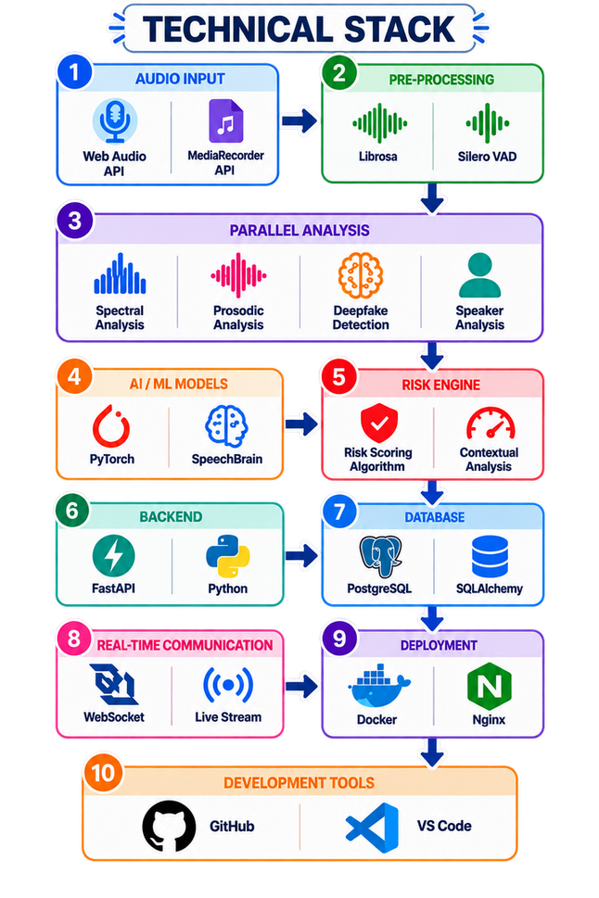
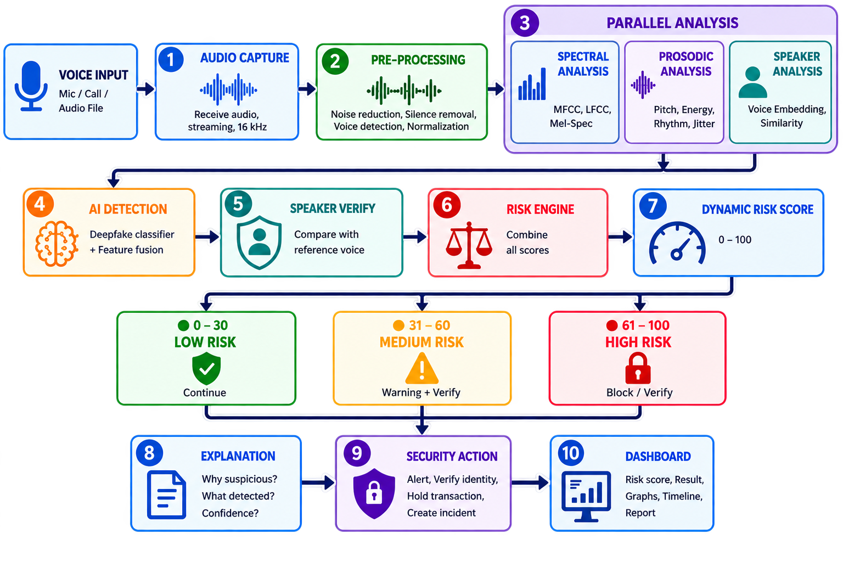
AURA
fox
TECHNICAL APPROACH
3
Notes:
1.7.2013
1.7.2013
3
‹#›
‹#›

Slide 4
AURA
fox
FEASIBILITY
▣
⌁
◇
◒
EXISTING
INFRASTRUCTURE
REAL-TIME
PROCESSING
MODULAR
ARCHITECTURE
OPEN DATASETS &
BENCHMARKS
Uses existing
microphones, VoIP
and communication
infrastructure;
no specialized
hardware is
mandatory.
Audio can be
processed in short
streaming chunks,
enabling near-
real-time
detection.
Modular architecture
allows individual AI
components to be
upgraded without
redesigning the
entire system.
Open research
datasets and
established audio
anti-spoofing
benchmarks enable
model training and
evaluation.
01
02
03
04
VIABILITY
♢
☷
♧
◎
FRAUD RISK
REDUCTION
CUSTOMIZABLE
DEPLOYMENT
INDIAN LANGUAGES
& ACCENTS
MULTI-SECTOR
SCALABILITY
Reduces risk of
voice-cloning fraud,
social engineering
and unauthorized
approvals.
Risk thresholds can be
customized for different
environments such as
banking, government
and corporate
operations.
Can support Indian
languages, regional
accents and diverse
communication
environments through
suitable training and
evaluation.
Long-term platform
potential across
banking, telecom,
enterprises, government
and customer-support
systems.
05
06
07
08
4

Slide 5
AURA
fox
IMPACT & BENEFITS
01
F
FRAUD PREVENTION
FINANCIAL SECURITY
F
05
Detects AI-generated voices before attackers can manipulate high-risk transactions or approvals.
DETECT
PROTECT
Provides additional protection for high-value transactions and sensitive financial instructions.
02
R
REAL-TIME PROTECTION
PRIVACY PRESERVATION
P
06
Provides warnings while the conversation is still happening instead of analyzing the call afterward.
AI VOICE SECURITY
Supports edge processing and feature-level logging to minimize retention of sensitive voice recordings.
REDUCED SOCIAL ENGINEERING
Detect • Verify • Assess • Protect
IMPROVED TRUST
03
R
I
07
Helps identify impersonation of executives, officials, employees and trusted individuals.
Strengthens confidence in voice-based communication for organizations and users.
C
CYBER RESILIENCE
ANALYZE
RESPOND
SCALABLE DEPLOYMENT
S
04
Creates a reusable security layer against emerging AI-powered voice impersonation attacks.
Can be integrated into banking, telecom, enterprise and government communication environments.
08
OUTCOME
S
Safer Communication
L
Reduced Losses
O
Operational Efficiency
E
Stronger Security Ecosystem
5
Notes:
1.7.2013
1.7.2013
5
‹#›
‹#›

Slide 6

RESEARCH AND REFERENCES
AURA
fox
[1] Z. Wu et al., “ASVspoof 2019: A Large-Scale Public Database of Synthetic, Converted and Replayed Speech,” Computer Speech & Language, 2021.
[2] X. Wang et al., “ASVspoof 2021: Towards Spoofed and Deepfake Speech Detection in the Wild,” IEEE/ACM Transactions on Audio, Speech, and Language Processing.
[3] A. Jung et al., “AASIST: Audio Anti-Spoofing Using Integrated Spectro-Temporal Graph Attention Networks,” ICASSP, 2022.
[4] H. Tak et al., “Automatic Speaker Verification Spoofing and Deepfake Detection,” ASVspoof research literature.
[5] P. Chinchmalatpure et al., “Defense Against Synthetic Speech: Real-Time Detection of RVC Voice Conversion Attacks,” arXiv, 2026.
6
Notes:
1.7.2013
1.7.2013
6
‹#›
‹#›

