Slide 1

SMART INDIA HACKATHON 2026
TITLE PAGE
Problem Statement ID – SIH26104
Problem Statement Title- AI-Powered Real-Time Detection and Prevention of Voice Cloning Impersonation Attacks
Theme- Blockchain & Cybersecurity
PS Category- Software
Team ID-
Team Name : AURAfox

Slide 2
PROPOSED SOLUTION
AURA
fox
PROBLEM STATEMENT
1
AI VOICE CLONING
1
LIVE DETECTION
Built an AI-powered system that detects AI-generated and cloned voices during live calls.
2
VOICE INTELLIGENCE
Analyzes voice features such as sound patterns, tone, speech style, and speaker characteristics in real time.
AI-generated voice cloning enables attackers to convincingly impersonate trusted individuals.
2
HIGH-RISK ATTACKS
DEEPFAKE DETECTION
Uses deepfake detection models to identify synthetic or manipulated speech.
SPEAKER VERIFICATION
Compares the caller's voice with trusted reference voice samples to detect impersonation.
Can lead to financial fraud, social engineering, and unauthorized actions.
3
4
3
REAL-TIME GAP
Existing systems lack reliable real-time detection and prevention of voice-cloning attacks.
5
DYNAMIC RISK SCORE
Generates a live 0–100 Impersonation Risk Score that updates throughout the call.
6
THREAT FUSION
Combines voice authenticity, speaker consistency, and other risk signals to assess the threat level.
4
AI-POWERED NEED
Need to detect synthetic voices, verify identity, and assess risk dynamically.
7
PRIVACY-FIRST INTEGRATION
Provides privacy-focused APIs and SDKs for banking, enterprises, telecom, and government systems.
5
SAFE DEPLOYMENT
The solution must provide real-time alerts and preventive actions with privacy and scalability.

Slide 3
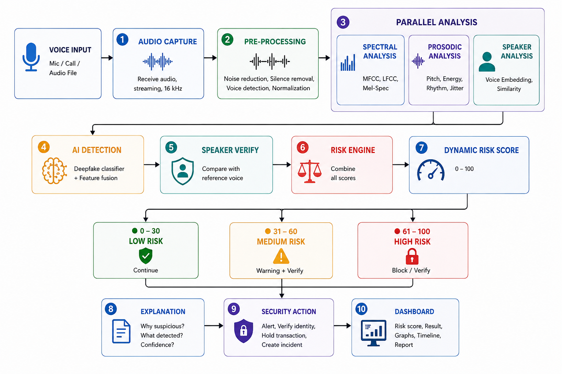
TECHNICAL APPROACH
AURA
fox
Real-time pipeline • Parallel analysis • Explainable risk decision

Slide 4
AURA
fox
FEASIBILITY
Uses existing microphones, VoIP and communication infrastructure; no specialized hardware is mandatory.
Audio can be processed in short streaming chunks, enabling near-real-time detection.
Modular architecture allows individual AI components to be upgraded without redesigning the entire system.
Open research datasets and established audio anti-spoofing benchmarks enable model training and objective evaluation.
VIABILITY
Reduces risk of voice-cloning fraud, social engineering and unauthorized approvals.
Risk thresholds can be customized for different environments such as banking, government and corporate operations.
Can support Indian languages, regional accents and diverse communication environments through suitable training and evaluation.
Long-term platform potential across banking, telecom, enterprises, government and customer-support systems..

Slide 5
IMPACT AND BENEFITS
AURA
fox
Fraud Prevention: Detects AI-generated voices before attackers can manipulate high-risk transactions or approvals.
Financial Security: Provides additional protection for high-value transactions and sensitive financial instructions.
Real-Time Protection: Provides warnings while the conversation is still happening instead of analyzing the call afterward.
Privacy Preservation: Supports edge processing and feature-level logging to minimize retention of sensitive voice recordings.
Reduced Social Engineering: Helps identify Impersonation of executives, officials, employees and trusted individuals.
Improved Trust: Strengthens confidence in voice-based communication for organizations and users.
Cyber Resilience: Creates a reusable security layer against emerging AI-powered voice impersonation attacks.
Scalable Deployment: Can be integrated into banking, telecom, enterprise and government communication environments.

Slide 6
RESEARCH AND REFERENCES
AURA
fox
[1] Z. Wu et al., “ASVspoof 2019: A Large-Scale Public Database of Synthetic, Converted and Replayed Speech,” Computer Speech & Language, 2021.
[2] X. Wang et al., “ASVspoof 2021: Towards Spoofed and Deepfake Speech Detection in the Wild,” IEEE/ACM Transactions on Audio, Speech, and Language Processing.
[3] A. Jung et al., “AASIST: Audio Anti-Spoofing Using Integrated Spectro-Temporal Graph Attention Networks,” ICASSP, 2022.
[4] H. Tak et al., “Automatic Speaker Verification Spoofing and Deepfake Detection,” ASVspoof research literature.
[5] P. Chinchmalatpure et al., “Defense Against Synthetic Speech: Real-Time Detection of RVC Voice Conversion Attacks,” arXiv, 2026.

