Slide 1
Florida K12 Strategy Workshop

Slide 2
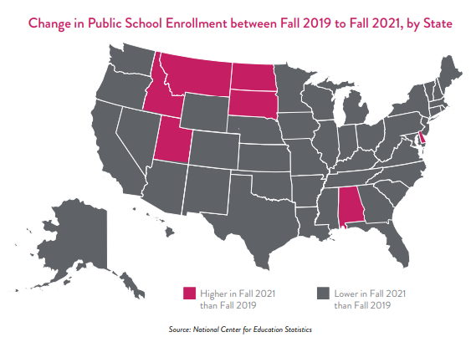

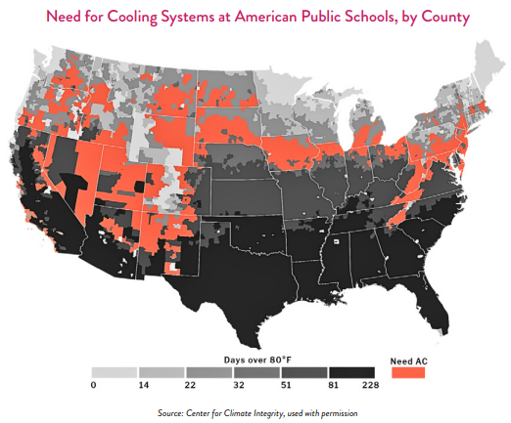
Market Data indicates significant needs in K12 schools
With aging schools, growing deferred maintenance and stressed budgets, the need for infrastructure solutions in K12 has never been greater
The 2025 American Society of Civil Engineers (ASCE) gave the condition of our nation’s public school infrastructure a D+ grade, the same as their last report in 2021.
An estimated $270B in deferred maintenance¹
Average age of a public school in the U.S.: 49 years
Total enrollment is expected to decline from 49.4 million students in 2021-22 to 46.9 million students in 2031-32, with declines continuing after that. This is forcing many districts to consider how/where to invest in upgrades while also planning for fewer students.
Aging infrastructure needs in our nation’s schools include:
  32% of schools have poor condition windows
  30% have failing HVAC systems
  25% have failing roofs
Over 40% of public school districts require significant HVAC updates in at least half of their schools
The annual standard for school maintenance is 4% but many districts only allocate 2% of operating funds, leading to more expensive emergency repairs
1 – Facility Management Advisor, August 2025

Slide 3
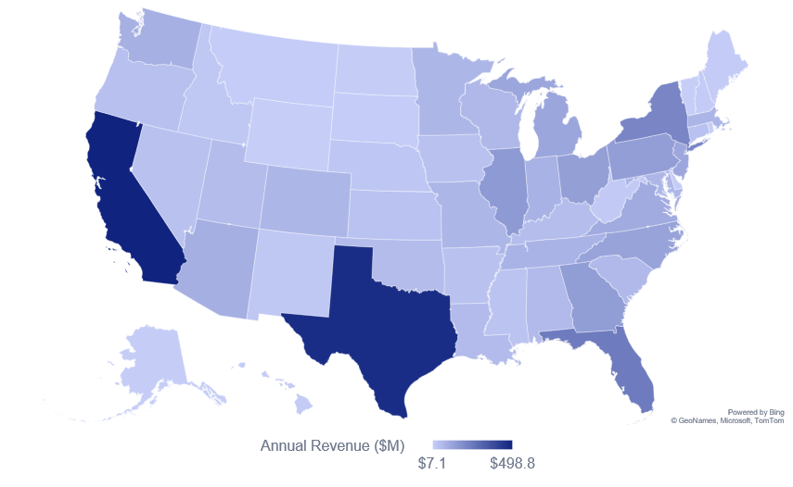
Market size ranges from $7.1M to nearly $500M per year across the 50 states, with the Top 10 accounting for over 50% of the market
Top 10 States – Annual K12 Market Opportunity
2026 TAM¹: $4.221B
State | Opportunity ($M)
California | $498.8
Texas | $470.5
Florida | $244.7
New York | $215.7
Illinois | $157.9
Georgia | $149.3
Pennsylvania | $144.3
Ohio | $143.3
North Carolina | $131.4
Michigan | $122.2
Total – Top 10 | $2,278.1
1 – TAM: Total Available Market

Slide 4
Florida K12 Problem Statement #1 (Johnson Controls)

Slide 5
Johnson Controls - Florida K12 Problem Statement #1
K12 represents the largest potential market opportunity for ESPC in Florida yet historically K12 has drastically underutilized ESCO services:
  ESCO market size for Florida K12 ~ $245 Million annually
  5-year ~ $1.2 Billion
  Estimated actual penetration ~ 10% -15%
  Untapped Market Potential ~ 85%

Slide 6
Johnson Controls - Florida K12 Problem Statement #1
K12 represents the largest potential market opportunity for ESPC yet historically K12 has drastically underutilized ESCO services
  ESCO market size for Florida K12 ~ $245 Million annually
  5-year ~ $1.2 Billion
  Estimated actual penetration ~ 10% -15%
  Untapped Market Potential ~ 85%
Florida K12 is especially favorable for ESCOs:
  High energy intensity (cooling load)
  Aging infrastructure and poorly maintained
  Strong enabling legislation
  Large centralized districts (scalable deals):
    28 of 67 large districts contain 89.7% of students
    31 of 67 medium districts

Slide 7
Johnson Controls - Florida K12 Problem Statement #1
K12 represents the largest potential market opportunity for ESPC yet historically K12 has drastically underutilized ESCO services
  ESCO market size for Florida K12 ~ $245 Million annually
  5-year ~ $1.2 Billion
  Estimated actual penetration ~ 10% -15%
  Untapped Market Potential ~ 85%
Florida K12 is especially favorable for ESCOs:
  High energy intensity (cooling load)
  Aging infrastructure and poorly maintained
  Strong enabling legislation
  Large centralized districts (scalable deals):
    28 of 67 large districts contain 89.7% of students
    31 of 67 medium districts
Johnson Controls has a highly experienced sales and development team with an excellent track record of performance and K12 references:
  Broward County Schools – 5 Phases > $57M (2021-2026)
  Gulf County Schools – $20M (2020)
  16 of 67 districts have done ESPC with JCI - Almost ¼ of all districts (only 2 since 2000)

Slide 8
Johnson Controls - Florida K12 Problem Statement #1
Florida K‑12 represents one of the largest and most attractive ESCO markets in the U.S., yet only ~10–15% of the opportunity has been realized—not because districts lack need, but because the market itself is structurally constrained.
The challenge for Johnson Controls is not to compete within the existing market—but to reshape how school districts define, fund, and prioritize infrastructure modernization—unlocking the remaining 85% of latent demand and scaling ESPC adoption across Florida K‑12.

Slide 9
Florida K12 Problem Statement #2 (Customer)

Slide 10
Florida K12 Problem Statement #2
Energy, operations, and maintenance costs are rising sharply across Florida school districts. Districts saw $857M increase in these expenses over the last three fiscal years (24%).

Slide 11
Florida K12 Problem Statement #2
Energy, operations, and maintenance costs are rising sharply across Florida school districts. Districts saw $857M increase in these expenses over the last three fiscal years (24%).
For the first time in history, student enrollment at Florida K12 public schools is decreasing, not as a result of population decrease, but due to transfers to private, charter, and homeschooling.

Slide 12
Florida K12 Problem Statement #2
Energy, operations, and maintenance costs are rising sharply across Florida school districts. Districts saw $857M increase in these expenses over the past three fiscal years (24%).
For the first time in history, student enrollment at Florida K12 public schools is decreasing, not as a result of population decrease, but due to transfers to private, charter, and homeschooling.
Energy, operations, and maintenance costs are not proportional to student counts: they track building square footage, age, HVAC, efficiency, local utility rate structures, and labor/material costs. Under this scenario, cost per student increase exponentially.

Slide 13
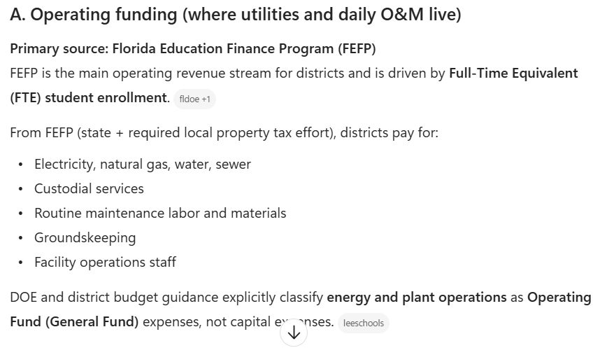
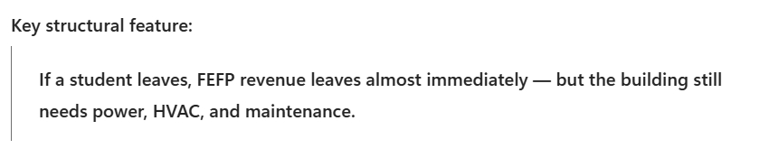
Florida K12 Problem Statement #2
How Florida K‑12 districts fund energy, operations, and maintenance:
Florida separates operating dollars from capital dollars, and that distinction is critical to understanding facilities funding.

Slide 14
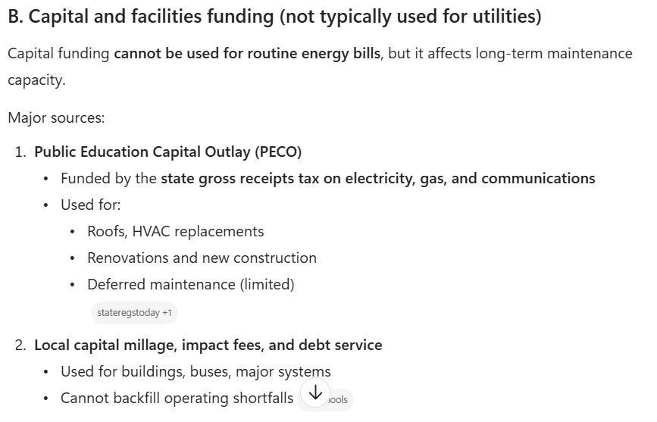
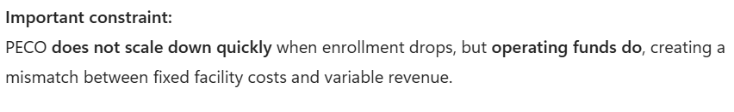
Florida K12 Problem Statement #2
How Florida K‑12 districts fund energy, operations, and maintenance:
Florida separates operating dollars from capital dollars, and that distinction is critical to understanding facilities funding.

Slide 15
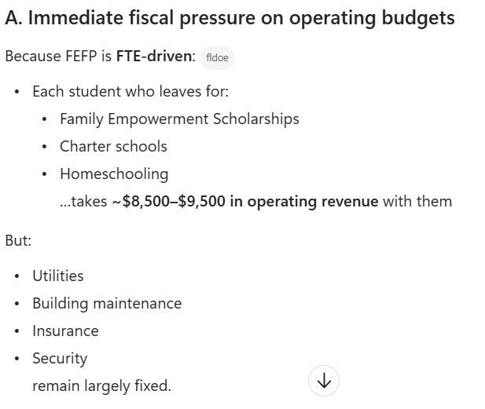
Florida K12 Problem Statement #2
Challenges if Student Population continues to decline:
Key Takeaway:
Revenue is tied to students, but cost is independent of student population.

Slide 16
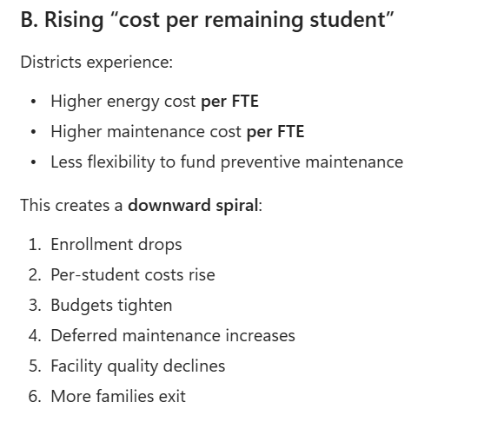
Florida K12 Problem Statement #2
Challenges if Student Population continues to decline:

Slide 17


Slide 18
Johnson Controls Florida K12 Strategy
Hypothesis:
Operational funding for Florida's public schools is on track for a structural breakdown, with consequences likely to include inferior classroom conditions, weaker student attendance and outcomes, and an outflow of both students and teachers from the public system.
Solution:
Florida school districts can break the cycle of rising facility costs and declining enrollment by using Energy Savings Performance Contracting (ESPC) to make budget-neutral investments in student achievement, teacher retention, health, comfort, and security.
New technology investments in lighting, HVAC, indoor air quality, and safety will modernize our schools and classrooms without new taxes or referendums—creating healthier, safer, and more productive spaces for students and teachers.
Bringing all schools up to the same standard of quality as newer campuses will advance social equity and make our public schools more competitive with charter and private alternatives.

Slide 19
Florida K12 Strategy
How will ESPC create healthier, safer, and more productive spaces for students and teachers?
Modern LED lighting in every school to improve alertness and learning, increase safety, enhance athletics, and reduce energy and operations costs
Reliable temperature control and healthier indoor air quality in every classroom to support focus, attendance, mental health and wellness, and student performance
Advanced security and safety technology for every student and teacher to strengthen protection from outside threats and bring peace of mind to families
Opportunity:
With ESPC, Florida public schools can lower costs and upgrade classrooms at the same time—improving the daily experience for students and teachers in a budget-neutral model with no new taxes or voter referendums

Slide 20
Florida K12 Strategy – Key Research Needed to Tell Story and “Bring Data”
Cost Drivers
  Energy Cost Trends
  Deferred Maintenance
  Shortage of Skilled Labor

Slide 21
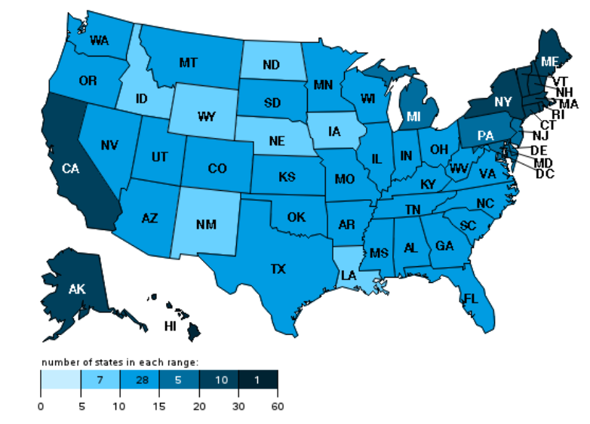
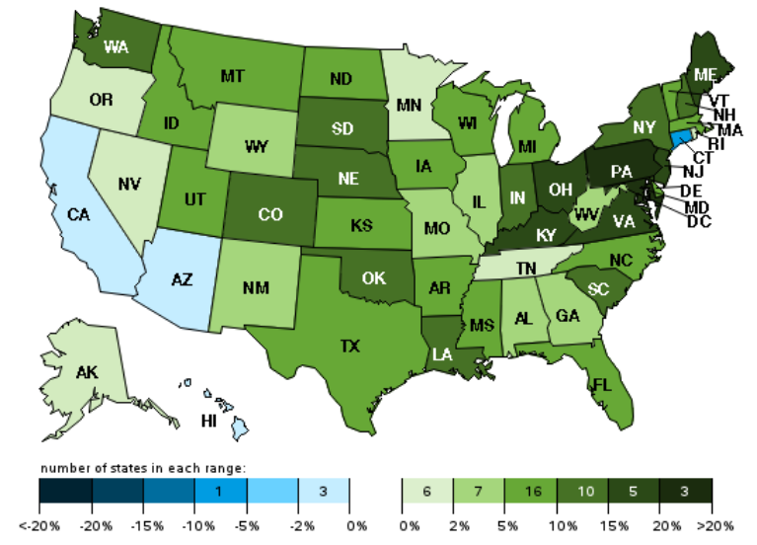
National Trends
Recent Electricity Price Increases
U.S electric industry average revenue per kWh
January 2026, cents per kilowatthour
U.S electric industry average revenue per kWh
January 2026 over January 2025, percent change
Source: EIA
Source: EIA
SI team has observed 50-100% supply price increases over the past two years
Prices are rapidly diverging in various geographic areas due to multiple drivers
  Regulated vertically-integrated and delivery only utilities price increases tend to be moderated by state PUCs
  Recent competitive supply price increases have been material in the Mid-Atlantic and Northeast

Slide 22
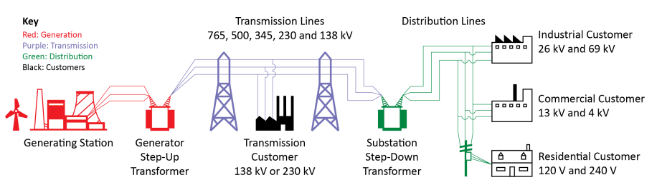
Primary Price Drivers
Source: NERC
Unprecedented Load Growth
Data Centers
Building Electrification
Transportation Electrification
Industrial Output
Increased Intermittent Generation
Shift from centralized to decentralized generation
Long interconnection queues delay capacity additions
Firming requirements (battery, CT, etc)
Aging Infrastructure
Increasing outages and maintenance
Retirement of inefficient plants
Tightening supply chain and increased costs (turbines, conductors, transformers)
State and Federal Policies
Grid hardening and storm recovery costs
Public benefits (energy efficiency, low income, etc)
Affordability and equity concerns
Rising Financing Costs
Wholesale market dynamics
Increasing interest rates
Stranded asset risk
ROI expectations

Slide 23
Mid and South Atlantic rate increases vary significantly across the 8 states
Geographies served by PJM are up significantly
Mid and South Atlantic
State | Rate Class | Q3 2020 Rate | Q3 2025 Rate | 5-Year % Change | 5-Year CAGR
Delaware | C | 8.57¢ | 12.57¢ | 46.7% | 8.0%
 | I | 7.02 | 9.66 | 37.6% | 6.6%
Florida | C | 8.83 | 11.49 | 30.1% | 5.4%
 | I | 7.31 | 8.99 | 23.0% | 4.2%
Georgia | C | 10.07 | 11.80 | 17.2% | 3.2%
 | I | 6.38 | 8.83 | 38.4% | 6.7%
Maryland | C | 9.38 | 15.13 | 61.3% | 10.0%
 | I | 7.81 | 12.52 | 60.3% | 9.9%
North Carolina | C | 8.87 | 10.01 | 12.9% | 2.4%
 | I | 6.81 | 7.76 | 14.0% | 2.6%
South Carolina | C | 10.37 | 10.90 | 5.1% | 1.0%
 | I | 6.35 | 7.33 | 15.4% | 2.9%
Virginia | C | 7.51 | 10.02 | 33.4% | 5.9%
 | I | 6.31 | 9.45 | 49.8% | 8.4%
West Virginia | C | 9.02 | 11.50 | 27.5% | 5.0%
 | I | 6.05 | 8.10 | 33.9% | 6.0%
Q3 2020
Q3 2021
Q3 2022
Q3 2023
Q3 2024
Q3 2025
Commercial
Industrial
Source: EIA
Rate Class: C – Commercial; I - Industrial
Notes:
📌Year 1 — Foundation & Diagnostics
Full Potential Plan: EQT works with management to define the company’s growth levers and operational roadmap.
Governance & KPIs: Standard EQT governance structures and reporting cadence are put in place.
Digital & ESG Baseline: Assess digital maturity and sustainability practices, set initial targets.
Quick Wins: Capture immediate efficiencies (procurement, overhead, working capital).
📌 Year 2 — Operational Excellence & Growth
Process Optimization: Improve supply chain, production, and customer delivery.
Digitalization Projects: Deploy ERP/CRM upgrades, analytics dashboards, automation.
Talent Development: Fill leadership gaps, recruit key roles.
Market Expansion: Begin entry into new geographies or customer segments.
📌 Year 3 — Scaling & Strategic Positioning
Growth Acceleration: Execute bolt‑on acquisitions or partnerships.
Innovation: Invest in product development and technology upgrades.
Sustainability Integration: Embed ESG targets into operations and reporting.
Brand Building: Position company as a leader in its sector.
📌 Year 4 — Consolidation & IPO Readiness
Operational Discipline: Standardize processes across the organization.
Financial Structuring: Optimize capital structure for IPO or sale.
Digital & ESG Embedding: Ensure transformation is fully integrated and measurable.
Board Preparation: Develop long‑term strategic plan for EQT board and potential investors.
📌 Year 5 — Exit Preparation
IPO or Sale Readiness: Finalize prospectus, investor roadshows, or buyer negotiations.
Performance Showcase: Highlight growth trajectory, digital maturity, and ESG achievements.
Succession Planning: Ensure leadership continuity post‑exit.
Value Realization: Position company for maximum valuation at IPO or sale.

Slide 24
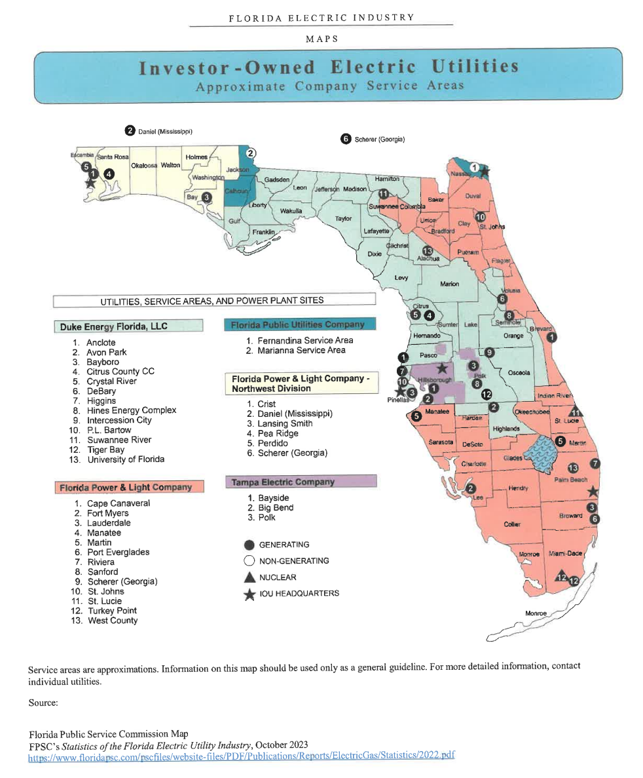
Florida Electric Utilities
Moderately fragmented market: 4 major Investor-Owned Electric Utilities ~ 50 Coops and Munis
Comments
Four investor-owned utilities
  Florida Power & Light and Florida Power & Light-Northwest (formerly Gulf Power) – owned by NextEra Energy
  Tampa Electric – owned by Emera in Nova Scotia
  Duke Energy – owned by Duke Energy in N.C.
  Florida Public Utilities Company – owned by Chesapeake Utilities Corporation
FPL – on Tuesday (April 7th), Florida utility regulators rejected a motion to reevaluate proposed $7 billion rake hike. Will now go to Florida Supreme Court.
Generation mix (state-wide)
  Natural Gas: ~70%
  Coal: ~3%
  Nuclear: ~10%
  Biomass: ~1%
  Solar: ~8%

Slide 25
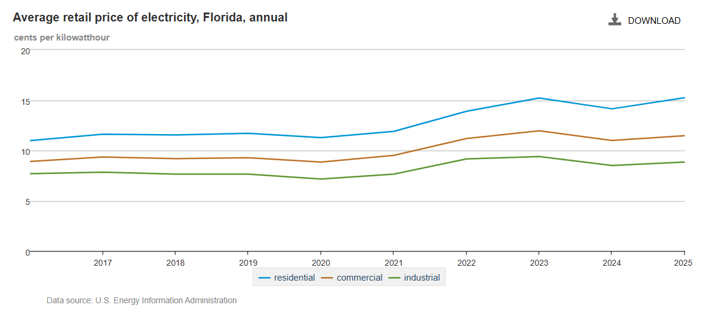
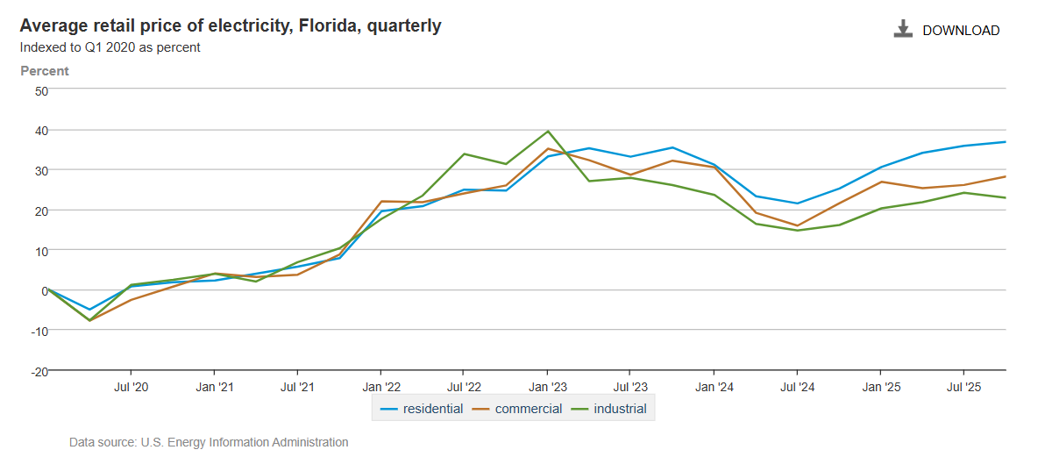
Florida Retail Prices
Observations
Residential customers are paying a materially higher price than C&I customers
Prices for all customer classes have increased 20-40% since 2020
2022-2023 price increases were primarily driven by:
  High natural gas prices, due to global market forces associated with Russia’s invasion of Ukraine
  Hurricane Ian and Hurricane Nicole restoration charges

Slide 26
Florida K12 Strategy – Key Research Needed to Tell Story and “Bring Data”
Cost Drivers (Partially Completed)
  Energy Cost Trends
  Deferred Maintenance
  Shortage of Skilled Labor
Enrollment Trends (In Progress - Digital Enablement)
  Population/Birth Rates
  Migration (Out of State, In-State Patterns)
  Transfers to Private/Charter/Home Schools
Student Achievement (Not Started – Informs Story)
  School Grades and Test Scores
  Teacher Retention
  Impact of Classroom Environment

Slide 27
Florida K12 Strategy – What Do We Hope to Learn?
Funding Crisis (Calculated from #1 and #2)
  Costs vs. Funding Divergence
  How Wide Does the Gap Get?
  When Does the System Break Down?
Are Schools That Invest Doing Better?
  How Many Districts Have Passed Sales Tax Referendum?
  How Much Invested in HVAC, Technology?
  What Are Cost Trends for these Districts? Are the Better?
  Hypothesis: Investments are not getting results and requires a different approach that focuses on outcomes, not just new equipment.

Slide 28
Florida K12 Problem Statement #3 (Enabling the Market, Solving the Problem)
Funding Reforms
  Changes to FEFP formula to account for facility condition
  Changes to FEFP and PECO restrictions on use
  Matching grants, revolving load fund for ESPC projects
  Incentives to leverage PECO funds with ESPC project (120% funding formula)
  Performance based bonuses/penalties
Changes to ESPC Legislation (F.S. 1013.23)
  Extend maximum contract term (25-30 years)
  Adjust payback requirements (cash positive every year)
  Require ESPC for underperforming school districts
Benefits to Legislators
  Job creation and economic development
  Increase student health and academic performance
  Promote long-term fiscal responsibility
  Strengthen ‘sFlorida economy and community resilience

Slide 29
Let’s Go and Create the Market!

