Slide 1
B.TECH CAPSTONE EVALUATION • DIGITAL ASSIGNMENT 1 (DA1)
VMotion AI
AI-Powered Live VM Migration Control Plane using Oracle VirtualBox Teleportation
Nithin Sarvesh M
B.Tech Computer Science and Engineering
School of Computer Science and Engineering (SCOPE)
Vellore Institute of Technology (VIT), Chennai, Tamil Nadu, India

Slide 2
PROBLEM OVERVIEW
Why Traditional VM Migration Needs an Intelligent Approach
1. Dynamic Workload Bursts
User traffic spikes unpredictably on cloud virtualization servers.
2. Resource Hotspots
One server hits 90%+ CPU while neighboring servers stay underutilized.
3. SLA Degradation
Customer applications experience latency spikes and slow responses.
4. Flapping & Thrashing
Static rules (e.g. CPU > 80%) trigger migrations back and forth repeatedly.
5. Operator Bottleneck
Manual intervention takes minutes; by then, performance has already dropped.
PROBLEM STATEMENT:
"How can we automatically rebalance running virtual machines across physical hosts using reinforcement learning, while guaranteeing deterministic safety and executing live memory teleportation between computers?"
Key Challenges We Address:
• Multi-metric trade-offs: balancing CPU, RAM, network, and migration cost simultaneously.
• Preventing AI mistakes: pure RL models can pick overloaded targets without deterministic gates.
• Migration cost awareness: each migration consumes network bandwidth and hypervisor CPU.
• Real live teleportation: streaming live VM RAM across physical LAN without disk copying delays.
THE CORE INFRASTRUCTURE DILEMMA
PROBLEM STATEMENT & CHALLENGE
VMotion AI | DA1 Evaluation | VIT Chennai

Slide 3
MOTIVATION
Why Intelligent Migration Matters in Cloud Infrastructure
Virtual machine loads fluctuate dynamically throughout the day. Static threshold rules cannot look ahead or account for how workloads interact on the same physical host.
Live migration allows moving a running VM with sub-second downtime. Doing this intelligently balances cluster load, improves fairness, and avoids server throttling.
1. DYNAMIC WORKLOAD DEMANDS
2. SMARTER RESOURCE BALANCING
Moving a VM is not free. It consumes interconnect bandwidth and hypervisor memory cycles. An intelligent agent learns to migrate only when the benefit outweighs the transient cost.
A reinforcement learning model is a statistical decision-maker. We should never let an AI directly run hypervisor commands without a deterministic safety gate verifying capacity first.
3. ACCOUNTING FOR MIGRATION COSTS
4. WHY A SAFETY LAYER IS NEEDED
VMotion AI | DA1 Evaluation | VIT Chennai

Slide 4
PROJECT SCOPE
What VMotion AI Was Built to Achieve
Collect host and VM metrics (CPU, RAM, Network, Disk) via native host agents and convert them into a normalized 103-dimensional state vector.
Deploy a frozen MaskablePPO agent on a Discrete(7) action space with cooldown action masking to identify optimal migration candidates.
1. REAL-TIME TELEMETRY & STATE ENCODING
2. REINFORCEMENT LEARNING WITH PPO
Build a fail-closed software layer with 16 strict checks and typed error codes (VBX_*) that independently verifies capacity, storage, and compatibility.
Orchestrate real live VM teleportation across physical computers running Oracle VirtualBox via native VBoxManage and shared storage.
3. DETERMINISTIC SAFETY GATE
4. REAL VIRTUALBOX LIVE TELEPORTATION
VMotion AI | DA1 Evaluation | VIT Chennai

Slide 5
COMPARISON
Existing Migration Approaches vs. VMotion AI
Evaluation Aspect | Traditional Threshold / Heuristic Approach | VMotion AI Approach
Decision Strategy | Static rule triggers (e.g., if CPU > 80% then migrate). Reactive only. | Reinforcement Learning (PPO) optimizes for overall cluster balance over time.
Cluster Awareness | Looks at single-server metrics; misses cluster-wide load skew. | 103-feature state vector tracks all nodes, VMs, and cluster fairness.
Flapping Prevention | Crude delays; VMs often migrate back and forth during load spikes. | 60-second cooldown dynamically enforced via invalid action masking.
Safety & Reliability | Rules execute directly on servers; no independent verification step. | Separate fail-closed safety gate (16 checks, VBX_* codes) verifies target first.
Live Demonstration | Abstract simulations or non-reproducible cloud scripts. | Real Oracle VirtualBox live teleportation between two physical computers.
VMotion AI | DA1 Evaluation | VIT Chennai

Slide 6
SYSTEM DESIGN
Decoupled Multi-Tier System Architecture
TIER 1: PHYSICAL HYPERVISOR & HOST AGENT LAYER
Oracle VirtualBox 7.x Hosts (Host A & Host B) + Standalone Host Agents (FastAPI + psutil)
Collects real hardware telemetry and drives VBoxManage live teleportation over LAN port 60050.
TIER 2: TELEMETRY & 103-FEATURE OBSERVATION ADAPTER
Feature Extractor, Rolling Telemetry Buffer, Jain's Fairness Calculator
Converts raw cluster metrics into a normalized 103-dimensional state vector every 2 seconds.
TIER 3: REINFORCEMENT LEARNING DECISION ENGINE
MaskablePPO Model (PPO V5 Frozen) + Action Masking + Destination Resolver
Evaluates cluster state, selects which VM to relocate, and resolves the best target node based on headroom.
TIER 4: SAFETY GATE, OPERATOR APPROVAL & TELEPORTATION FSM
Deterministic Safety Gate (16 checks, VBX_* codes), Operator Approval, FSM Orchestrator
Independently audits safety, requires operator signoff, pre-warms target teleporter, and verifies guest health.
VMotion AI | DA1 Evaluation | VIT Chennai

Slide 7
WORKFLOW
End-to-End Migration Lifecycle (Step by Step)
Step 1: Collect Host Telemetry
Query physical host agents every 2s for CPU, RAM, Disk, and running VM metrics.
Step 2: Build 103-Dim State
Normalize raw telemetry into a unified feature vector bounded between -1.0 and 1.0.
Step 3: Mask Invalid Actions
Disable any VM currently in a 60s cooldown or stopped from being selected.
Step 4: PPO Policy Evaluation
The frozen PPO V5 model evaluates the state vector and recommends the best VM to migrate.
Step 5: Pick Best Target Host
Headroom resolver identifies the host with the most available CPU/RAM capacity.
Step 6: Run Safety Gate Checks
Deterministic checks audit RAM margin, CPU ceiling, CPU compatibility, and storage.
Step 7: Operator Approval
Proposal appears on dashboard; human administrator approves or rejects the action.
Step 8: Teleport & Verify Health
Pre-warm target receiver, stream live RAM via VBoxManage, and verify target execution.
VMotion AI | DA1 Evaluation | VIT Chennai

Slide 8
IMPLEMENTATION MODULES
Core Software Components in the VMotion AI Repository
Polls host agents and extracts the 103-dimensional state vector with bounds checking [-1, 1].
Status: COMPLETE (100%)
Loads trained MaskablePPO weights, evaluates policy distributions, and provides heuristic fallback.
Status: COMPLETE (V5)
Independently enforces 16 fail-closed rules and typed VBX_* codes; prevents illegal dispatches.
Status: COMPLETE (100%)
TELEMETRY & ADAPTER
PPO DECISION ENGINE
DETERMINISTIC SAFETY GATE
Tracks each migration across FSM states, manages operator approval, and verifies post-placement state.
Status: COMPLETE (100%)
Wraps VBoxManage and psutil; handles target pre-warming and live memory streaming over LAN.
Status: COMPLETE & TESTED
React 19 control plane with dedicated Live Demo centerpiece, 3D spatial canvas, and audit logs.
Status: COMPLETE (100%)
MIGRATION FSM PLANNER
VIRTUALBOX PROVIDER & AGENT
CONTROL DASHBOARD (UI)
VMotion AI | DA1 Evaluation | VIT Chennai

Slide 9
REINFORCEMENT LEARNING
How the PPO Model Makes Migration Decisions
103-FEATURE OBSERVATION VECTOR:
• 24 Node Features (0..23): CPU util, RAM util, network RX/TX, disk util, and headroom for all 3 nodes.
• 60 VM Features (24..83): CPU util, RAM allocated, RAM used, network IO, SLA priority, cooldown timer, uptime, and host ID for 6 VMs.
• 19 Cluster Features (84..102): Jain's Fairness Index (CPU/RAM), standard deviation, power index, quorum, and storage health.
DISCRETE(7) ACTION SPACE:
• Action 0 = No-Op (Leave cluster as is; cluster in equilibrium).
• Actions 1..6 = Migrate VM 1 through 6.
• Destination Target = Chosen deterministically by finding the node with the highest unallocated capacity.
• Action Masking = Masks out VMs that migrated within the last 60 seconds or are currently stopped.
BALANCING GOALS & PENALTIES:
Reward = Balance + Stability - SLA Penalty - Overload Penalty - Migration Cost
+ Load Balance Dividend
Rewards uniform CPU spread across servers using Jain's Fairness Index (+2.5 * Jain).
+ Stability Bonus
+1.0 reward for choosing No-Op when cluster is already well balanced (prevents flapping).
- SLA Breach Penalty
-2.0 penalty whenever a workload exceeds its assigned SLA ceiling.
- Host Overload Penalty
-4.0 penalty if any server exceeds 85% CPU capacity (heavy penalty).
- Migration Overhead
-0.8 cost for each migration to account for network bandwidth and memory copying.
STATE & ACTION FORMULATION
MULTI-OBJECTIVE REWARD FUNCTION
VMotion AI | DA1 Evaluation | VIT Chennai

Slide 10
EXPERIMENTAL RESULTS
Comparing PPO V4 (Collapse) with PPO V5 (Balanced Training)
Overall Mean Reward
V4: -263.48
V5: +55.81
Change: +319.29 points
V5 actively balances cluster
Unseen Test Split
V4: -53.16
V5: +154.93
Change: +208.09 points
Strong generalization
Server Overload Steps
V4: 60.22
V5: 7.33
Change: -52.89 steps
-87.8% hotspot time
Jain's Fairness Index
V4: 0.7682
V5: 0.9288
Change: +0.1606
Significant balance gain
• Why V4 Failed: PPO V4 was trained on 100% normal, balanced data. Since normal states penalize migrations, the model learned that doing nothing (No-Op) was always best. When tested on severe hotspots, it refused to migrate (0.0 migrations).
• How V5 Succeeded: We introduced a balanced 4-scenario sampler (25% Normal, 25% CPU Hotspot, 25% RAM Hotspot, 25% Mixed Overload). By seeing hotspots during training, PPO V5 learned to take targeted action (averaging 2.07 migrations per episode), outperforming baseline heuristics on unseen test scenarios (+154.93).
KEY TAKEAWAY: FIXING TRAINING DISTRIBUTION COLLAPSE
VMotion AI | DA1 Evaluation | VIT Chennai

Slide 11
SAFETY LAYER
Deterministic Safety Gate: 8 Core Checks & 16 Strict Rules
1. VM Running State (VBX_VM_NOT_RUNNING)
Confirms the VM exists and is currently in an active hypervisor execution state.
5. Target RAM Headroom (VBX_RAM_INSUFFICIENT)
Target unallocated RAM must fit the VM plus a 20% safety margin buffer.
2. Distinct Target Host (VBX_SAME_HOST)
Ensures source and destination are two different physical servers (src != dest).
6. Target CPU Capacity (VBX_CPU_OVERLOAD)
Projected CPU utilization on the target after migration must remain below 85%.
3. Source Node Health (VBX_SOURCE_OFFLINE)
Checks that the source host agent is reachable with zero critical hardware alarms.
7. Storage & Port (VBX_STORAGE_MISSING)
Verifies shared storage accessibility and teleportation port 60050 availability.
4. Target Node Health (VBX_TARGET_UNREACHABLE)
Ensures the destination server is online and reachable over the LAN network.
8. 60-Second Cooldown (VBX_COOLDOWN_ACTIVE)
Prevents migrating a VM that was relocated less than 60 seconds ago.
FAIL-CLOSED PRINCIPLE: If any check fails, the migration is blocked immediately with a typed VBX_* error code, regardless of what the AI model recommended.
VMotion AI | DA1 Evaluation | VIT Chennai

Slide 12
HYPERVISOR INTEGRATION
Oracle VirtualBox Live Teleportation: 2-Host Physical Architecture
Target Pre-Warm Receiver
Target VM is placed in listening state: VBoxManage modifyvm <target> --teleporter on --teleporter-port 60050, followed by headless launch.
LAN Memory Streaming
Source VM streams active RAM and CPU registers over LAN port 60050 via VBoxManage controlvm <source> teleport --host <target> --port 60050.
Shared Network Storage (SMB/NFS)
VM disk images reside on shared network storage; zero multi-gigabyte disk copying is performed during live migration.
Post-Teleport Verification
Verifies source VM powers off, target VM resumes execution, and guest OS networking is actively responsive.
• VirtualBox Host Agent (FastAPI): [COMPLETE]
vmotion-agent/agent.py implements auth, telemetry, and VBoxManage
• VirtualBox Provider Driver: [COMPLETE]
backend/app/providers/virtualbox.py with compatibility matrix
• Live Teleport Execution Scripts: [COMPLETE]
7 automated PowerShell run scripts in scripts/ directory
• Unit & Integration Test Suite: [COMPLETE]
14 dedicated VirtualBox provider and agent unit tests pass 100%
• Control Plane 'Live Demo' Screen: [COMPLETE]
Dedicated UI screen with compatibility matrix & one-click trigger
• Physical 2-Host Lab Execution: [DEMO READY]
Ready to execute across two lab computers sharing LAN and storage
NATIVE VBOXMANAGE TELEPORTATION PROTOCOL
IMPLEMENTATION & DEMONSTRATION READINESS
VMotion AI | DA1 Evaluation | VIT Chennai

Slide 13
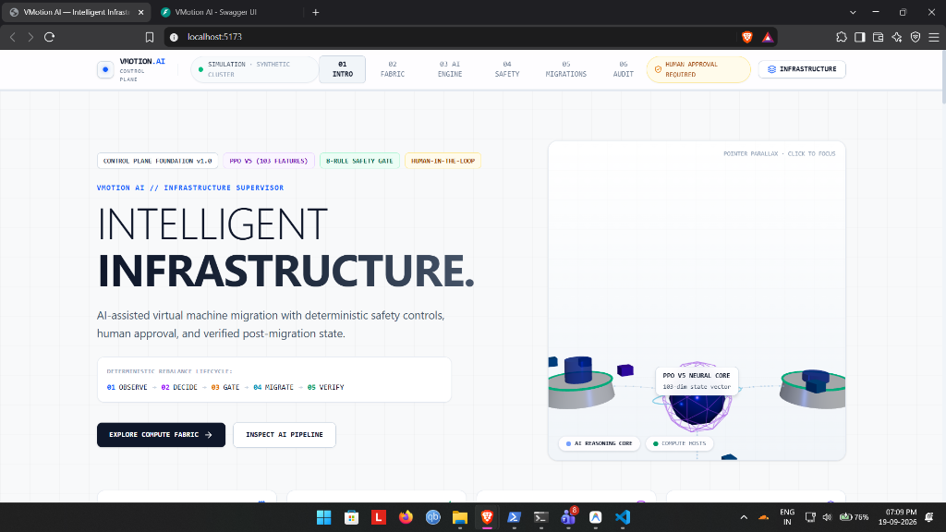
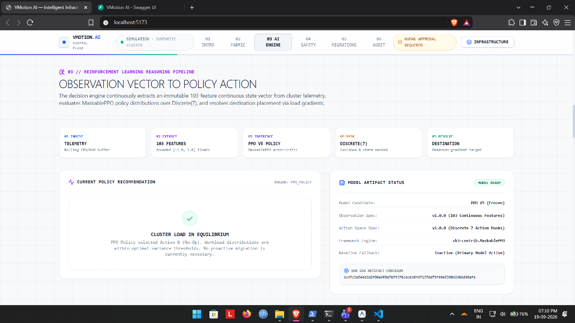
CONTROL PLANE UI
Real-Time 3D Cluster Monitoring & Live Demo Interface
Displays interactive Three.js 3D cluster with host pedestals proportional to CPU load, orbiting VMs with SLA priority rings, and cluster-wide telemetry figures.
Features dedicated '★ Live Demo' screen with pre-flight hardware compatibility matrix, one-click teleport dispatch, and live PPO policy evaluation breakdown.
3D CLUSTER OVERVIEW & SPATIAL TELEMETRY
AI DECISION ENGINE & LIVE DEMO CONTROL
VMotion AI | DA1 Evaluation | VIT Chennai

Slide 14
PROJECT COMPLETION
Implementation Progress & Defensible Completion Breakdown
SOFTWARE IMPLEMENTATION:
100%
All software components—FastAPI backend, 103-feature adapter, PPO V5 model, safety gate, VirtualBox provider, host agent, 3D frontend, and 110 automated tests—are fully written and verified.
PHYSICAL HARDWARE DEMONSTRATION:
DEMO READY
Oracle VirtualBox Teleportation scripts and agent services are completely built and verified on local VBoxManage; execution occurs when two physical computers are connected on LAN with shared storage.
Component | Weight | Status
Architecture & Interface Specs | 10% | 100% Complete
Backend & Control Plane | 15% | 100% Complete
Telemetry & 103-Dim Adapter | 10% | 100% Complete
PPO / Reinforcement Learning | 15% | 100% Complete (V5)
Safety Gate & Teleport FSM | 15% | 100% Complete
VirtualBox Provider & Agent | 10% | 100% Complete
Frontend Control Dashboard | 10% | 100% Complete
Automated Tests (110 Tests) | 10% | 100% (110 Tests Pass)
Demo Automation Scripts | 5% | 100% Complete
VERIFIED COMPLETION STATUS
VMotion AI | DA1 Evaluation | VIT Chennai

Slide 15
TESTING & VALIDATION
Automated Regression Test Suite & Build Results
110 Passed / 0 Failed
Runtime: 21.53s across 13 test modules
1,892 Modules Transformed
0 TypeScript errors • Clean bundle
600 Benchmark Episodes
Evaluated across 10 distinct cluster scenarios
BACKEND TESTS (PYTEST)
FRONTEND BUILD (VITE)
BENCHMARK HARNESS
• VirtualBox Provider Tests (8 tests): Verifies VBoxManage path discovery, showvminfo parser, compatibility matrix, pre-warming, and placement checks.
• VirtualBox Agent Tests (6 tests): Tests FastAPI host agent endpoints: health, inventory, psutil telemetry, teleporter pre-warm, and storage checks.
• Safety Gate Tests (12 tests): Verifies all 8 rules block on: identical hosts, offline servers, stopped VMs, high RAM, high CPU, and active cooldown.
• Observation Spec Tests (8 tests): Verifies exact 103 feature dimension, [-1.0, 1.0] mathematical bounds, and deterministic node/VM sorting order.
• Migration Lifecycle Tests (10 tests): Asserts valid FSM progression and verifies illegal transitions raise InvalidStateTransitionError.
AUTOMATED TEST COVERAGE BY SUBSYSTEM
VMotion AI | DA1 Evaluation | VIT Chennai

Slide 16
PROJECT ACHIEVEMENTS
What Has Been Accomplished in VMotion AI
Proved that reinforcement learning can be safely used for cluster rebalancing by placing a deterministic, fail-closed safety gate between the AI and hypervisors.
Diagnosed why single-scenario training caused the model to collapse to zero migrations, and resolved it with balanced multi-scenario sampling (+319.29 reward gain).
1. DECOUPLED AI & SAFETY ARCHITECTURE
2. OVERCOMING POLICY COLLAPSE (PPO V5)
Built a complete 2-host live migration control plane using native VBoxManage commands, standalone host agents, and shared network storage.
Developed an interactive React 19 control plane with Three.js 3D cluster visualization, dedicated Live Demo centerpiece, and append-only audit logging.
3. REAL ORACLE VIRTUALBOX TELEPORTATION
4. MODERN 3D WEB DASHBOARD & DEMO SCREEN
VMotion AI | DA1 Evaluation | VIT Chennai

Slide 17
CURRENT SCOPE & BOUNDARIES
Software Verified vs. Physical Laboratory Demonstration Status
✔ 103-Feature Telemetry Adapter: Continuous normalized vector extraction validated against mathematical bounds.
✔ PPO V5 Decision Model: Trained model evaluated across 600 benchmark episodes with verified SHA-256 hash.
✔ Deterministic Safety Gate: 16 fail-closed rules and typed error codes (VBX_*) independently verified.
✔ VirtualBox Control Plane & Agent: Fully verified through 14 unit and integration tests against local VBoxManage.
✔ React 19 & Three.js Web UI: Production frontend build passes with zero TypeScript or linting errors.
⚙ Two Physical Host Execution: Software is 100% complete; physical migration triggers when run on two lab PCs.
⚙ Shared Network Storage Mount: Requires mounting the central SMB/NFS storage share on both physical computers.
⚙ Firewall TCP Port 60050: Requires ensuring Windows Firewall allows TCP port 60050 on the destination PC.
⚙ Fixed Discrete Action Space: Currently dimensioned for 3 nodes and 6 VMs; larger clusters will use GNN policies.
⚙ Predictive Contention Detection: Designated for future work to trigger migrations 2 minutes before contention peaks.
VALIDATED IN SOFTWARE & TEST HARNESS
PHYSICAL LABORATORY DEMONSTRATION EXECUTION
VMotion AI | DA1 Evaluation | VIT Chennai

Slide 18
CONCLUSION
Summary of Work Done & Next Steps
WHAT VMOTION AI DOES:
"VMotion AI combines reinforcement learning (PPO), a deterministic safety gate, and native Oracle VirtualBox teleportation to achieve intelligent, safe live VM migrations between physical computers."
Key Verified Results:
• PPO V5 model achieved +154.93 on unseen test scenarios.
• Server overload time reduced by 87.8% compared to V4.
• Deterministic safety gate with 16 checks prevents illegal migrations.
• 110 automated backend tests passing with zero failures.
• 100% software implementation completion.
NEXT DEVELOPMENT STEPS:
1. Lab Two-Host Demonstration
Execute live teleportation between two physical computers in the VIT Chennai networking lab using run_live_migration_demo.ps1.
2. Multi-VM Teleportation Queue
Extend host agent to manage concurrent teleportation pipelines with dynamic port reservation.
3. GNN Policy Exploration
Investigate Graph Neural Networks to support clusters of arbitrary size (10+ physical nodes).
4. Predictive Contention Pre-empting
Use lightweight forecasting (e.g. ARIMA) to trigger migrations 2 minutes before contention peaks.
Thank You! Questions & Discussion Welcome.
PROJECT SUMMARY
NEXT MILESTONES
VMotion AI | DA1 Evaluation | VIT Chennai

