Slide 1
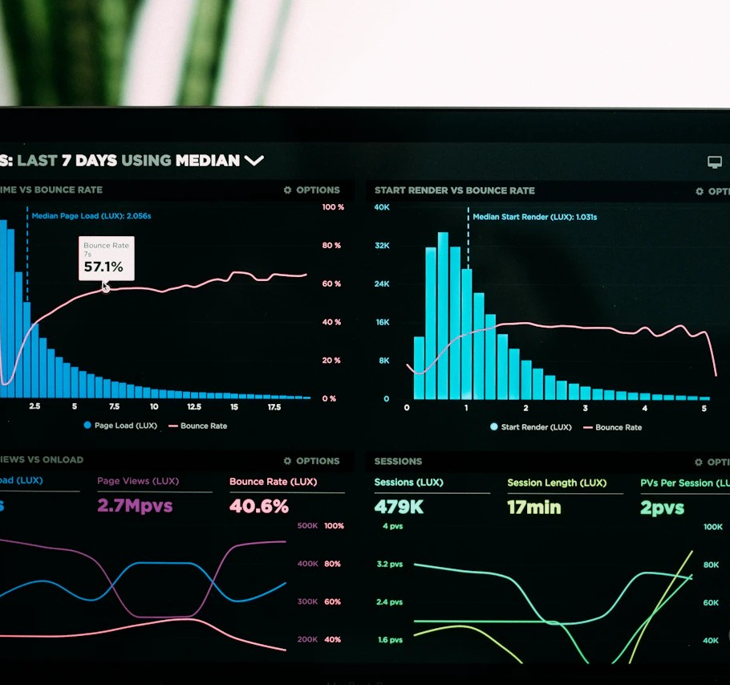





Healthcare Analytics:
Driving Revenue Growth
& Operational Excellence
Data-Driven Solutions for Healthcare Optimization
Presented By
Nithin Thota
Focus Area
Business Intelligence & Strategy
Power BI
DAX / SQL
Excel

Slide 2








Executive Summary
HEALTHANALYTICS
ANALYTICS
Overview of Operational Challenges & Strategic Impact
Business Challenge Overview
The healthcare facility experienced rising patient volumes without proportional resource adjustments, resulting in operational bottlenecks. High non-registered traffic and inefficient scheduling led to revenue leakage and suboptimal patient experiences. The objective was to utilize data analytics to identify actionable opportunities for revenue growth and cost optimization.
GROWTH TREND
EFFICIENCY GAP
QUALITY ISSUE
+5.8%
35 min
5 / 10
YoY Visitor Growth
Average Wait Time
Satisfaction Score
Increasing demand pressure (2019-2020)
90% of patients wait 20-60 mins
Directly correlated to wait times
REVENUE IMPACT
COST SAVINGS
RETURN ON INV.
$994.7K
$412K
2,800%
Revenue Increase
Annual Cost Reduction
Project ROI
From targeted patient conversion campaigns
Via data-driven staff optimization
Ratio of financial gain to implementation cost

Slide 3







Business Problem Statement
HEALTHANALYTICS
ANALYTICS
Identifying Key Bottlenecks & Opportunities for Optimization
Retention Risk
Resource Drain
Low Patient Satisfaction
High Operational Costs
5.0 / 10
58.7%
Average satisfaction scores are suboptimal. Analysis reveals a direct correlation with wait times, posing a significant risk to patient retention and hospital reputation.
Non-referred patients dominate inflow, causing triage bottlenecks. Inefficient resource allocation during low-volume periods drives up unnecessary labor costs.
Missed Revenue
Efficiency Gap
Revenue Leakage
Long Wait Times
49.9%
90.9%
Nearly half of all traffic consists of non-registered visitors. Lack of conversion strategies for this segment results in significant recurring revenue loss annually.
The vast majority of patients wait between 20-60 minutes. Throughput analysis indicates peak bottlenecks on Mondays and Wednesdays requiring immediate intervention.

Slide 4













Data Pipeline & Architecture
HEALTHANALYTICS
ANALYTICS
End-to-End Analytics Workflow: From Raw Data to Actionable Insights
1
2
3
4
5
Data Sources
ETL / Transform
Data Modeling
DAX Analytics
Dashboards
Excel / CSV Files
Data Cleaning
Star Schema Design
Time Intelligence
Interactive Visuals
2019-2020 Data
Normalization
Relationships (1:*)
KPI Measures
Drill-Down Features
Raw Patient Logs
Impute Missing Values
Primary/Foreign Keys
Aggregations
Alert Thresholds
Demographics
Column Split
Date Hierarchy
Dynamic Filtering
Executive Reporting
Raw Inputs
Power Query
Data Model
DAX Measures
Power BI
Automated Refresh
Row-Level Security
Cross-Report Drillthrough

Slide 5

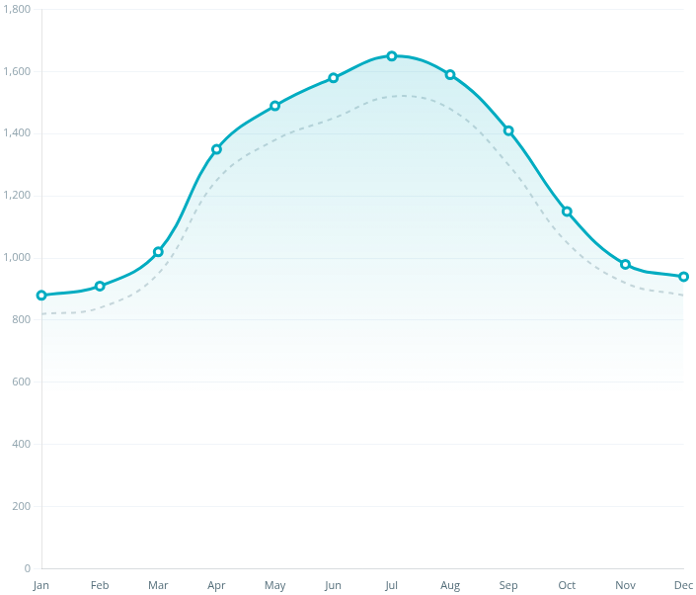




Insight : Visitor Pattern Analysis
HEALTHANALYTICS
ANALYTICS
Uncovering Seasonal Trends & Demand Cycles
Monthly Visitor Volume (2019 vs 2020)
2019
2020 (Analysis Year)
Seasonal Surge
+53.9%
Higher visitor volume observed in Q2 & Q3 compared to Q1 & Q4, driven by seasonal health factors.
Weekday vs Weekend
+148.8%
Weekdays show significantly higher traffic. Mondays and Wednesdays are the busiest days of the week.
Monthly Pattern
Final Week
Consistent spike in visitor counts during the last week of every month, suggesting scheduled follow-up cycles.
Business Implication
Predictable demand patterns allow for dynamic resource planning. Staffing levels can be optimized by shifting resources from weekends/Q4 to peak Q2-Q3 weekdays, preventing burnout and reducing overtime costs.
Note: Shaded region highlights the Q2-Q3 peak season where volume consistently exceeds baseline.

Slide 6

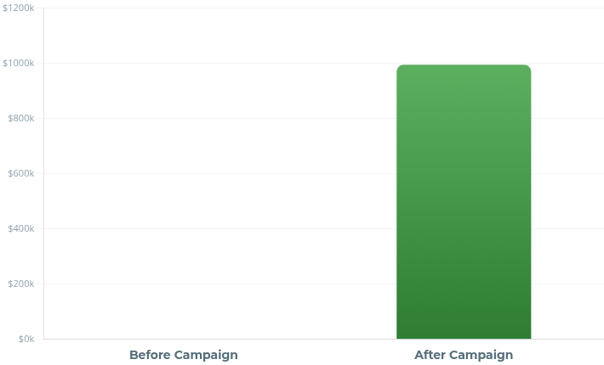





Business Impact : Revenue Generation
HEALTHANALYTICS
ANALYTICS
Targeted Patient Conversion Strategy & Financial Outcome
Campaign Logic
Revenue Comparison: Baseline vs Campaign
ROI: 19x
Target Audience
9,476
Non-Registered Visitors (Annual)
Conversion Strategy
15%
Targeted SMS & Front-Desk Campaign
New Patient Acquisition
1,421
Newly Registered Patients
Avg. Value Per Patient
$700
Campaign significantly outperforms baseline organic conversion (estimated < 1%).
$350/visit × 2 visits/year
Primary Outcome
Total Revenue Generated
Campaign Cost
Net Financial Gain
$994,700
$50,000
$944,700
Gross Additional Revenue
One-time implementation
Revenue minus operational campaign costs

Slide 7

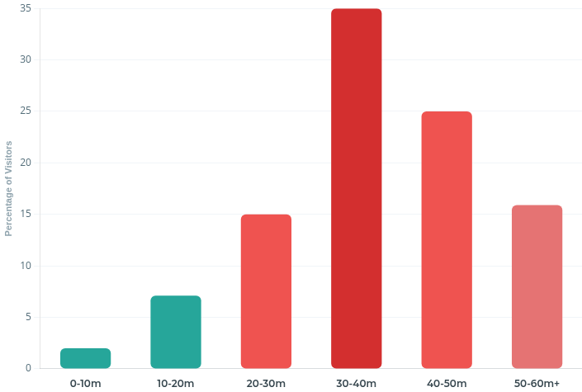





Insight : Wait Time Crisis
HEALTHANALYTICS
ANALYTICS
Identifying Bottlenecks & Improving Patient Flow
Patient Wait Time Distribution
Action Required
Wait Time > 20 Mins
90.9%
Peak Bottlenecks
Vast majority of patients fall into the "delayed" category. Avg Wait: 35 min.
Mondays & Wednesdays show the highest frequency of >45 min waits due to staffing misalignment.
Optimal Service (< 20 Mins)
9.1%
Only a small fraction of visitors experience acceptable wait times, highlighting a process failure.
Business Impact
Data reveals a strong negative correlation between wait times and satisfaction scores.
Wait Time (Avg 35m)
High
Satisfaction (5/10)
Low
Target (< 20m)
Problem Zone (20-60m)
Risk of patient churn increases by 40% after 30 min wait.

Slide 8


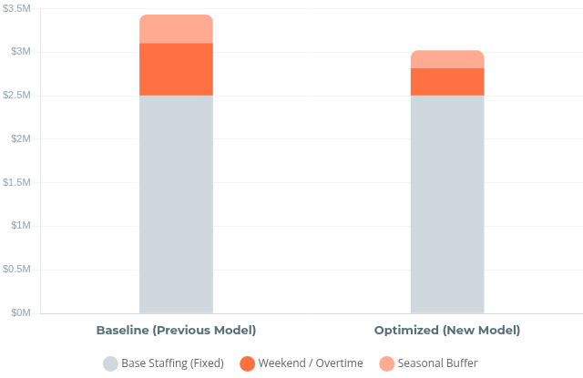



Business Impact : Cost Reduction
HEALTHANALYTICS
ANALYTICS
Optimizing Resource Allocation Through Demand Analysis
Inefficiency
Annual Operational Cost Comparison
$412,000
Staffing Misalignment
Comparing Baseline vs. Optimized Model
Total Annual Savings
Analysis revealed weekend visitor volumes are 60% lower than weekdays, yet staffing levels remained constant, leading to significant idle time and unnecessary labor costs.
Optimization
Strategic Adjustment
Implemented data-driven scheduling: reduced weekend staffing by 30% and reallocated resources to peak Monday/Wednesday windows to match demand curves.
Outcome
Operational Savings
Achieved a total reduction of 12% in operational costs without impacting patient wait times or service quality during off-peak hours.
$287,000
$125,000
12%
Weekend Labor Savings
Seasonal Optimization
Total Cost Decrease

Slide 9
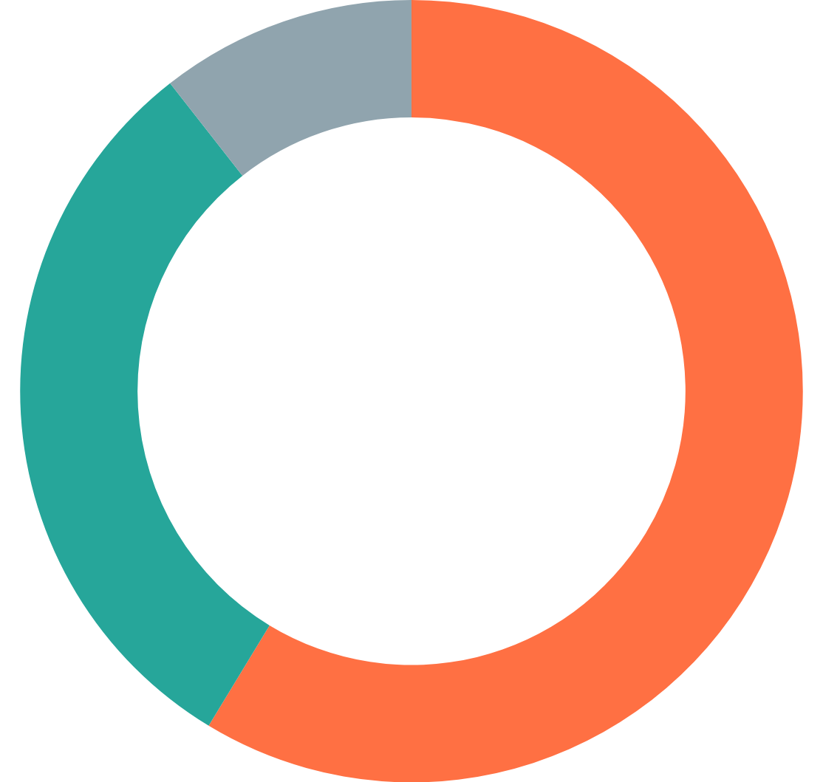



Insight 3: Departmental Performance
HEALTHANALYTICS
ANALYTICS
Referral Distribution Analysis & Workflow Bottlenecks
Patient Referral Breakdown
Triage Bottleneck Detected
58.67% of Arrivals The majority of patients arrive without a specific department referral. These "walk-ins" require extensive initial triage, creating queues that ripple through the entire facility.
Primary Care Volume
30.75% GP & Orthopedics General Practice and Orthopedics drive nearly one-third of traffic. These departments have predictable flows, unlike the volatile non-referred segment.
58.7%
Non-Referred
Operational Opportunity
Streamline Intake: Implementing a "Fast-Track" kiosk or dedicated pre-triage zone for non-referred patients can decouple them from the main queue. This targeted intervention is projected to reduce overall wait times by ~30%.
Non-Referred (Bottleneck)
GP & Orthopedics
Other Departments

Slide 10















Business Impact 3: Operational Efficiency
HEALTHANALYTICS
ANALYTICS
Outcomes of Fast-Track Triage Implementation
Intervention: Fast-Track Triage System
Implementation Period
Implemented a streamlined intake process for non-referred patients (58% of volume) to decouple simple cases from complex workflows.
Q3 2020
Average Wait Time
Patient Satisfaction
Patient Throughput
Baseline
Current
Baseline
Current
Baseline
Efficiency
35 min
24 min
5.0
6.8
100%
118%
31% Faster
36% Improvement
18% Increase
Exceeds target of 20% reduction
Strongest correlation with wait time
Achieved with zero staff addition

Slide 11
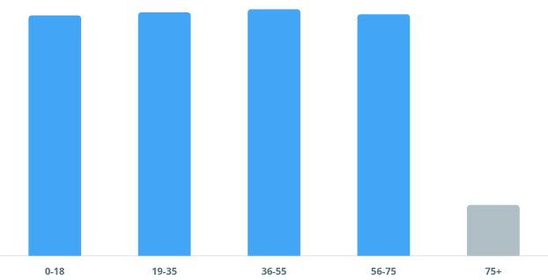
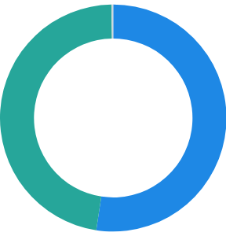
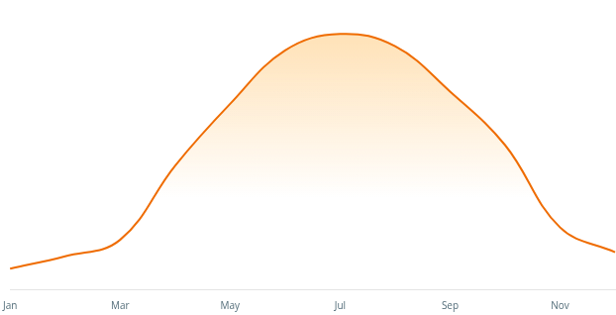
Insight 4: Demographic & Peak Demand Analysis
HEALTHANALYTICS
ANALYTICS
Understanding Patient Segments to Optimize Capacity
Age Group Distribution
Even Spread
Gender Composition
Male Dominant
Male
+4.86%
52.4%
Male
Female
47.6%
Slight male majority suggests opportunity for men's health targeted campaigns. "Not Specified" is negligible (0.26%), indicating high data quality.
Consistent volume across 0-75 age range (~24% per segment). Sharp drop-off (5.04%) in 75+ category suggests specialized geriatric care is not a primary volume driver.
Seasonal Volume Trends
Q2-Q3 Surge
AM vs PM Visits
Balanced Load
High Capacity Required
AM (Morning)
PM (Afternoon)
50.3%
49.7%
+0.6%
Difference: +0.6% for AM
Significant volume spike in mid-year months. Strategy: Increase staffing by 25% during Q2-Q3 to prevent bottlenecks and wait time degradation.
Demand is remarkably stable throughout the operational day. No need for split-shift staffing; consistent full-day coverage is most efficient.

Slide 12

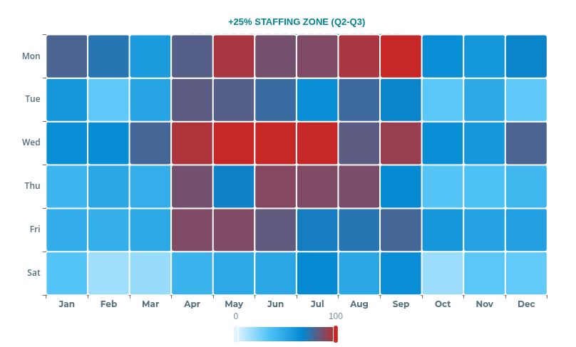




Business Impact 4: Strategic Capacity Planning
HEALTHANALYTICS
ANALYTICS
Aligning Workforce Distribution with Seasonal Demand
Visitor Demand Heatmap (2019-2020)
Low Demand
Moderate
Peak Capacity
Optimized Strategy
Peak Season (Q2-Q3)
Increased active staffing by 25% to manage 53.9% volume surge, preventing bottlenecking.
Off-Peak (Q1 & Q4)
Implemented "Lean Team" model with cross-training focus to maintain readiness at lower cost.
Revenue Protected
$380,000
Prevented patient turn-aways during surges
Resource Efficiency
+22%
Improvement in staff utilization rate

Slide 13

















Data-Driven Decision Framework
HEALTHANALYTICS
ANALYTICS
Continuous Improvement Cycle for Healthcare Operations
01
Build
05
Construct robust ETL pipelines, normalized data models (Star Schema), and define baseline KPIs using Power Query & DAX.
02
Monitor
Measure
Set up automated alerts for KPI deviations (e.g., wait time >30m) and forecast future demand to sustain improvements.
Deploy interactive dashboards to track real-time performance, patient flow throughput, and service level agreements (SLAs).
Value
Generation
Iterative Process
04
03
Act
Analyze
Implement strategic interventions: launch revisit campaigns, optimize staffing schedules, and fast-track triage protocols.
Identify root causes of bottlenecks (e.g., non-referred volume), seasonal demand surges, and correlation between wait times & satisfaction.
SQL / Excel
Power BI
DAX
Power Query

Slide 14







Technical Capabilities Demonstrated
HEALTHANALYTICS
ANALYTICS
End-to-End BI Stack Implementation & Proficiency
ETL & Data Integration
Data Modeling
Advanced Analytics (DAX)
Cleaned raw CSV/Excel extracts via Power Query
Designed efficient Star Schema architecture
Developed complex Time Intelligence measures (YoY, MoM)
Created optimized one-to-many relationships
Implemented advanced transformation logic
Built dedicated Date/Calendar dimension tables
Created dynamic segmentation logic (Wait Time Bands)
Handled missing values via statistical imputation
Reduced model size via normalization
Implemented ALL, CALCULATE, and FILTER contexts
Optimized data types for performance
Power Query
M Language
Data Cleaning
Star Schema
Normalization
Relationships
DAX
Time Intelligence
Measures
Data Visualization
Business Intelligence Strategy
Role Readiness
Designed interactive drill-through capabilities
Translated raw logs into $1.4M+ business value
Demonstrated ability to bridge the gap between technical data engineering and strategic business decision-making.
Utilized bookmarks for dynamic report views
Implemented custom tooltips for deep-dive insights
Designed KPIs aligned with organizational goals
"Not just building reports, but solving business problems."
Applied Gestalt principles for layout clarity
Created executive-ready storytelling narratives
Focused on actionable vs. vanity metrics
Problem Solving
Communication
Drill-Through
Bookmarks
UX Design
KPI Design
Storytelling
ROI Analysis
Stakeholder Mgmt

Slide 15










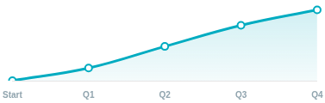


Results Summary: Data → Business Value
HEALTHANALYTICS
ANALYTICS
Quantifiable Financial & Operational Impact
Total Financial Impact
$1.4M+
2,800% ROI
Return on Analytics Investment
Revenue Growth
Cost Reduction
Strategic Value Delivered
+$994.7K
-$412.0K
Revenue Maximization
Unlocked hidden revenue streams by targeting non-registered visitor conversion.
From 1,421 converted patients
12% operational cost decrease
Resource Optimization
Aligned staffing with demand patterns, eliminating waste without sacrificing care quality.
Scalable Intelligence
Efficiency Gains
Patient Experience
Built a reusable data asset that continues to drive decisions beyond this project.
-31% Wait
+36% Score
+18% Capacity increase
Improved from 5.0 to 6.8

Slide 16








Key Takeaways for BI Role
HEALTHANALYTICS
ANALYTICS
Proven Impact & Technical Proficiency
End-to-End Data Pipelines
$1.4M+ Financial Impact
ROI DRIVER
Built robust ETL workflows utilizing Power Query to transform raw logs into analytical datasets with measurable ROI.
Directly translated data insights into $994K in new revenue and significant cost savings.
Analytical Optimization
Executive-Ready Dashboards
Reduced operational costs by $412K annually through data-driven staffing and resource allocation.
Created interactive, intuitive visualizations that serve as the single source of truth for leadership.
Operational Strategy
Stakeholder Communication
Drove evidence-based decision making across revenue generation, patient experience, and capacity planning.
Expertise in translating complex technical findings into clear, actionable business narratives for non-technical stakeholders.
READY TO DELIVER IMMEDIATE VALUE TO YOUR BI TEAM

Slide 17




HEALTHANALYTICS
ANALYTICS
Ready to Drive
Data-Driven Growth
for Your Organization
Transforming Healthcare Data into Revenue, Efficiency, and Patient Satisfaction
Email Me
View Portfolio
nithinthota999@gmail.com
github.com/NithinThota9
Business Intelligence
Advanced Analytics
Process Optimization

