Slide 1
Diabetes and Parkinson’s Prediction System Using Machine Learning
Team Members:
1. Nithin U
2. Rohan chakravarthi v
3. Sharan Shakthi G
4. Muhilan P
Guided By:
Mrs. V. Kalphana M.E,

Slide 2
Content
1. Objective
2. Problem Statement
3. Existing System
4. Literature Survey
5. Proposed System
6. Architecture

Slide 3
OBJECTIVE
In this project, diabetes and Parkinson's Leveraging extensive data and advanced feature engineering techniques to reduce consultant charge of patient.
Our models achieve high accuracy in disease diagnosis. Robust evaluation and validation methods ensure the reliability of predictions.
The user-friendly deployment of our system holds promise for early detection and personalized healthcare, contributing to improved patient outcomes and quality of life.
Deploy the prediction system in a user-friendly manner, making it accessible to healthcare professionals or individuals concerned about diabetes and Parkinson's disease.
Now Our Implementation is towards the side of Train the model using support vector Machine as our major phases of this project.

Slide 4
PROBLEM STATEMENT
Diabetes and Parkinson's diseases are significant global health challenges, affecting millions of individuals worldwide.
Early detection and accurate prediction of these diseases are critical for effective management and timely interventions.
However, traditional diagnostic methods often lack precision and efficiency. To address this issue, our project aims to develop a robust Machine Learning-based prediction system capable of accurately identifying the risk and progression of Diabetes and Parkinson's diseases.
This project addresses the pressing need for more accurate, accessible, and proactive healthcare solutions for these debilitating conditions.

Slide 5
EXISTING SYSTEM
Supervised Learning for Diabetes Prediction: In the existing system, supervised learning techniques are used to build predictive models for diabetes diagnosis.
Supervised Learning for Parkinson's Prediction: Similarly, supervised learning is employed for Parkinson's disease prediction.
Unsupervised Learning for Diabetes Risk Assessment: In addition to supervised learning, unsupervised learning methods are used in the existing system to identify hidden patterns and clusters within patient data.
Integration of Both Approaches: The existing system often integrates both supervised and unsupervised learning methods to provide a comprehensive assessment of patients.

Slide 6
"Machine Learning for Predictive Modeling of Diabetes: A Review"
Overview of Machine Learning in Diabetes Prediction: The paper provides a comprehensive overview of the various machine learning techniques used in the predictive modeling of diabetes.
Data Sources and Preprocessing: The authors delve into the sources of medical data used for diabetes prediction and the critical preprocessing steps required to prepare the data for machine learning analysis.
Authors: S. Kumar, R. S. Ravi, P. Krishna
Published in: Journal of Medical Systems, 2013

Slide 7
"A Comprehensive Survey on Machine Learning for Parkinson's Disease"
Survey of Machine Learning Techniques: The paper provides an extensive survey of machine learning techniques and methodologies employed in the context of Parkinson's disease research.
Data Sources and Preprocessing: The authors delve into the sources of medical data used for diabetes prediction and the critical preprocessing steps required to prepare the data for machine learning analysis.
Authors: A. Islam, N. S. Ahmad, Y. A. Wahab, S. M. M. Zain
Published in: Expert Systems with Applications, 2019

Slide 8
"Predicting the Onset of Parkinson’s Disease with Deep Learning"
Deep Learning for Parkinson's Disease Prediction: The paper focuses on the application of deep learning techniques, specifically deep neural networks, for predicting the onset of Parkinson's disease.
Model Evaluation and Performance: The paper presents the results of their deep learning-based prediction model for Parkinson's disease onset. It likely includes discussions on evaluation metrics, such as accuracy, sensitivity, specificity, and area under the curve (AUC), to assess the model's performance.
Authors: A. D. Caldas, S. C. Maia, M. J. Santos
Published in: IEEE/ACM Transactions on Computational Biology and Bioinformatics, 2019

Slide 9
"Machine Learning Models for Early Detection of Parkinson's Disease based on Resting-State Functional MRI Data"
Model Performance: Presentation of the results, including accuracy, sensitivity, specificity, and other relevant metrics, to demonstrate the effectiveness of the machine learning models.
Visualization: If applicable, the paper might include visualizations of brain regions or patterns that contribute to early Parkinson's disease detection.
Authors: L. Ma, X. Wang, J. Wu, et al.
Published in: NeuroImage: Clinical, 2019

Slide 10
"Predicting Type 2 Diabetes using Machine Learning Techniques"
Machine Learning Models for Diabetes Prediction: The paper likely discusses various machine learning techniques employed for predicting Type 2 Diabetes.
Data and Feature Selection: The paper is likely to describe the datasets used in the study, which may include clinical data, patient demographics, and biomarker measurements.
Authors: V. Nair, A. H. Hareendran
Published in: Informatics in Medicine Unlocked, 2018

Slide 11
Proposed System
Web-Based User Interface: The proposed system will feature a user-friendly web-based interface accessible through standard web browsers.
Integration with Anaconda: The system will be integrated with Anaconda, providing a comprehensive Python environment for data preprocessing, model development, and training.
Model Training in Jupyter Notebooks: Model development and training will be carried out in Jupyter Notebooks, which offer an interactive and visually appealing environment for machine learning experimentation.
User-Friendly Model Output: The web-based interface will seamlessly display the model predictions, making it easy for users to interpret and act upon the results.

Slide 12
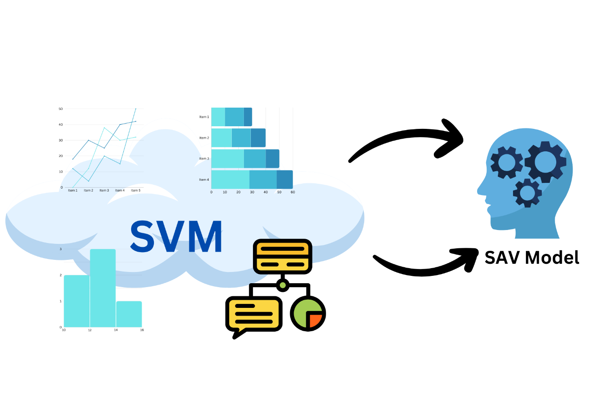
ARCHITECTURE

