Slide 1
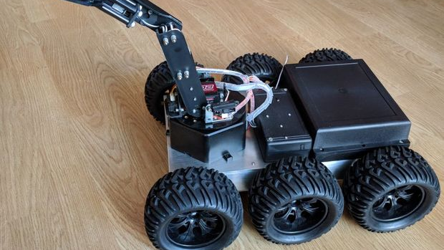
Arduino Rover
Presented By:
Nithin U 811720104071
Mohamed Jameer 811720104061
Saran Shakthi 811720104092

Slide 2

Synopsis
Introduction
Requirements
Analysis
Design
Coding
Operations
Outcome
Pros and Cons
Modules

Slide 3
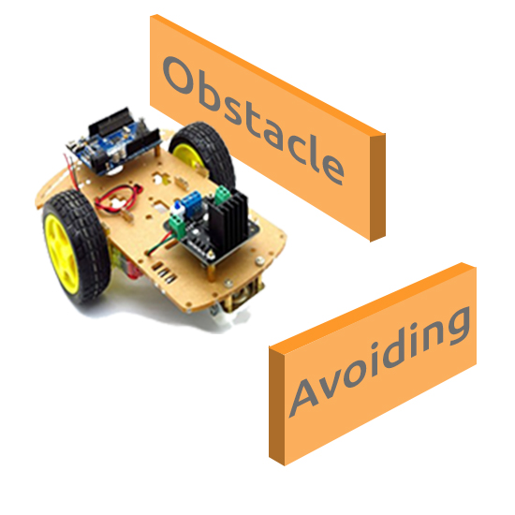
Introduction
Arduino Rover is an autonomous robot which will be able to avoid every obstacle in its path. It will use an ultrasonic distance sensor and a servo motor. The robot will check how far the nearest obstacle is (in every direction) and then decide upon the actions to be taken.

Slide 4
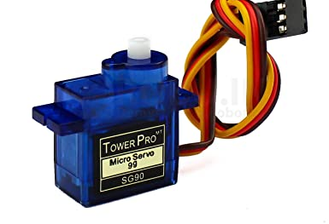
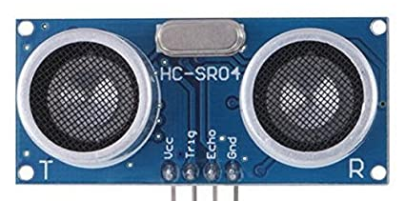
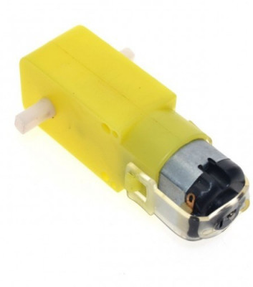
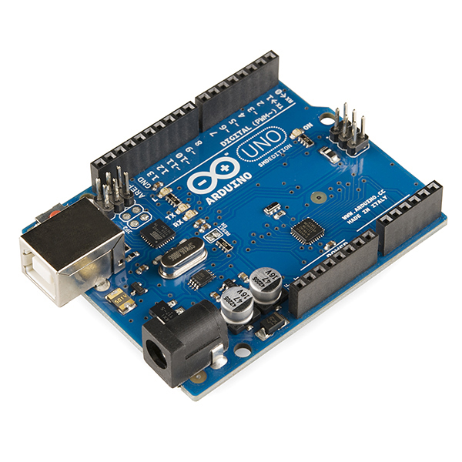
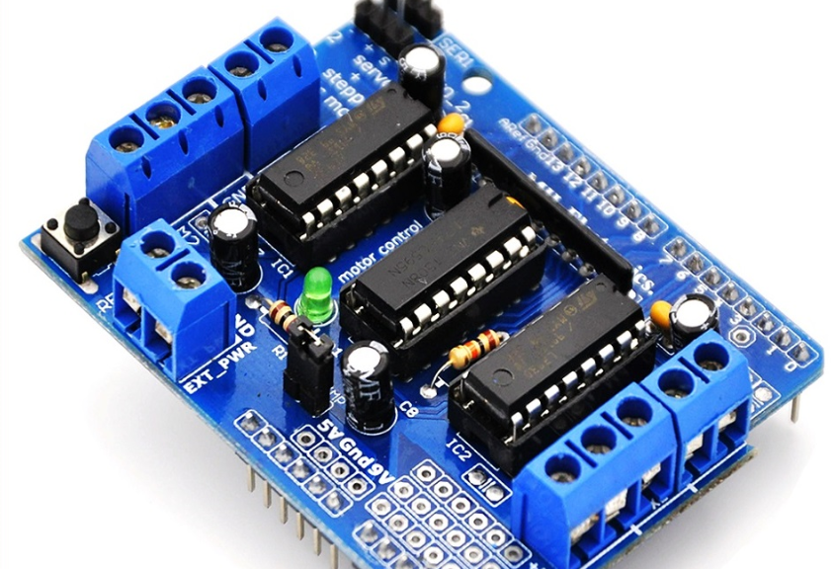
Requirements
Arduino Uno
L293D Motor Driver
Ultrasonic Sensor
HC05 Bluetooth Module
Stepper Motor
18650 Battery (3.7V Lithium Battery)
Servo Motor

Slide 5
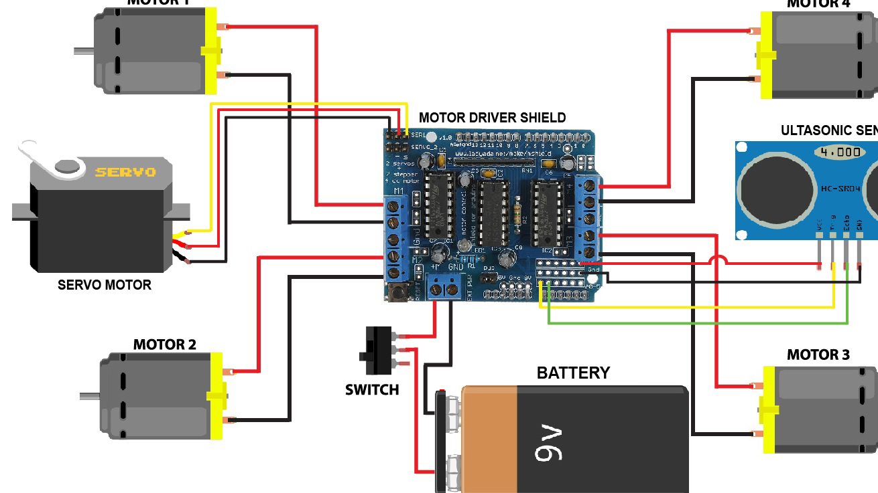
Analysis
The working principle of the robot is transmitting sensed signal to the microcontroller to control the DC motors for obstacle avoidance. The H-bridge L293D controls the direction of the motors to move either clockwise or anti-clockwise directions as provided by the microcontroller.

Slide 6
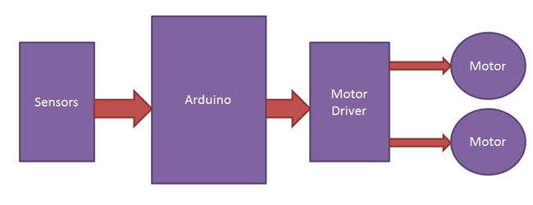
Design
An ultrasonic sensor is used to detect any obstacle ahead of it and sends a command to the micro-controller. Depending on the input signal received, the micro-controller redirects the robot to move in an alternate direction by actuating the motors which are interfaced to it through a motor driver.

Slide 7

Modules
Build Base and add Specifications
Assembling whole hardware Components
Make Rover to do some action
Add Code for Voice recognition and automatic sensing ability

Slide 8
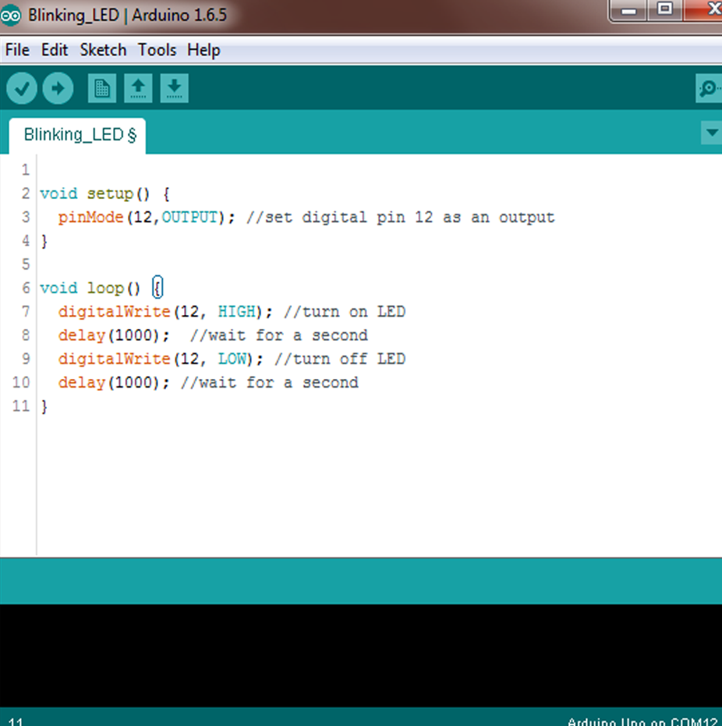
Coding
The coding screen is divided into two blocks. The setup is considered as the preparation block, while the loop is considered as the execution block.

Slide 9
Library Functions and Program:
Main library functions used in this project are
#include <AFMotor.h>
#include <Servo.h>
#include <ping.h>
Program:
Servo myservo;
const int MOTOR_1 = 1;
const int MOTOR_2 = 2;
const int MOTOR_3 = 3;
const int MOTOR_4 = 4;
// create motor object, 64KHz pwm
AF_DCMotor motor1(MOTOR_1, MOTOR12_64KHZ);
AF_DCMotor motor2(MOTOR_2, MOTOR12_64KHZ);
AF_DCMotor motor3(MOTOR_3, MOTOR12_64KHZ);
AF_DCMotor motor4(MOTOR_4, MOTOR12_64KHZ);

Slide 10

int distance_L, distance_F, distance_R;
long distance;
int set = 20;
int flag = 0;
void setup()
{
Serial.begin(9600); // Initialize serial port
Serial.println("Start");
myservo.attach(10);
myservo.write(90);
pinMode (trigpin, OUTPUT);
pinMode (echopin, INPUT );
motor1.setSpeed(180); // set the motor speed to 0-255
motor2.setSpeed(180);
motor3.setSpeed(180);
motor4.setSpeed(180);
}

Slide 11
void loop()
{
if (Serial.available()>0)
{
String S = Serial.readString();
if (S == "start")
{
flag = 1;
}
else if (S == "stop")
{
flag = 0;
}
}

Slide 12
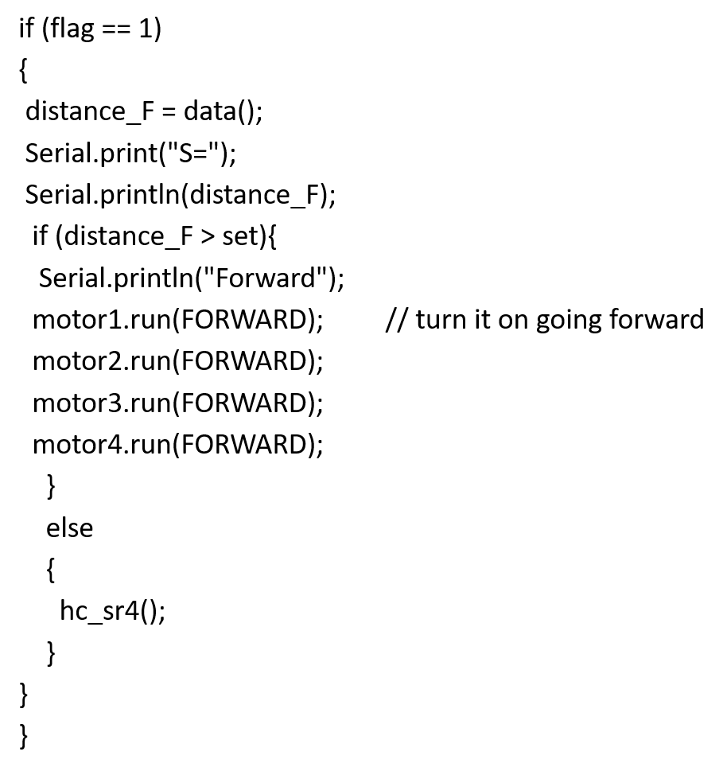
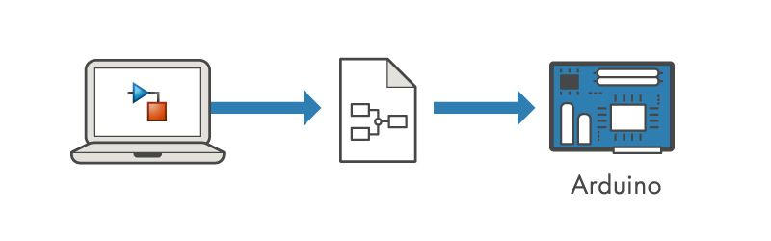

Slide 13
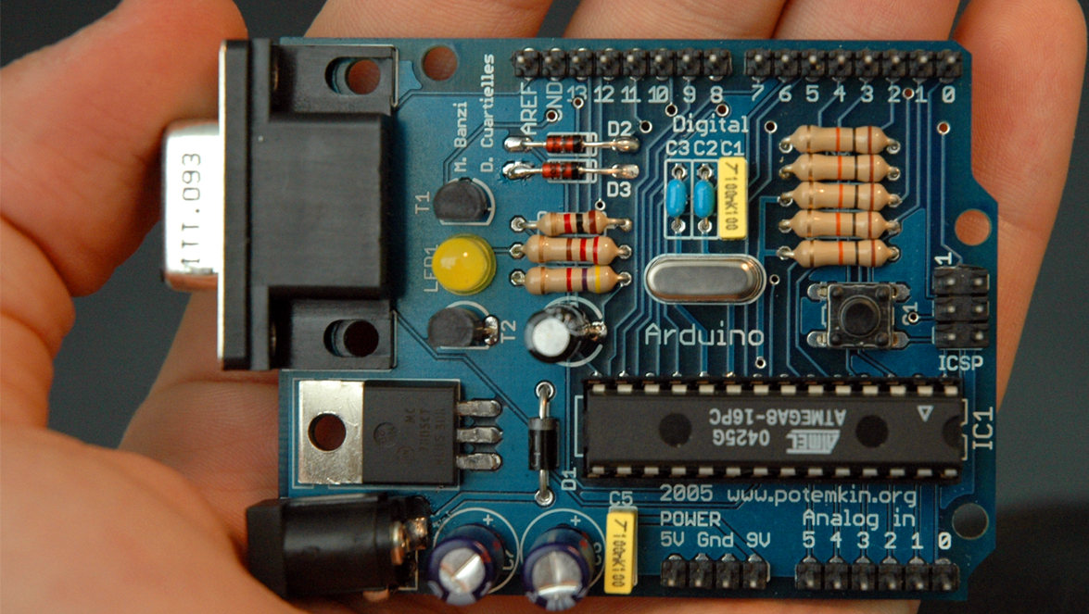
Operations
Arduino is an open-source electronics platform based on easy-to-use hardware and software. Arduino boards are able to read inputs - light on a sensor, a finger on a button, or a Twitter message - and turn it into an output - activating a motor, turning on an LED, publishing something online.
This Photo by Unknown author is licensed under CC BY-SA.

Slide 14
OUTCOME
•Understand the value and importance of learning a coding language with IOT Devices.
•Be able to write a simple program in C and C++ with GUN Compiler and execute in projects.
•Transform a physical input into a digital input and analyze it.
•Understand the function of electronic sensors and components

Slide 15

Pros And cons
• Ready to Use with few Lines Of Code.
• Simple and Easy learning of code to instruct a machine.
• Great Effort Makes New Projects Over It and products are Reusable.
• large user community, free and broad ranges of libraries of codes, relatively low cost components.
• Structure Of Arduino is the main disadvantage as it cannot stick for big PCB boards. Suitable for project as small size.
• Many people has hesitate to provide cost for this project by thinking as low cost to get creative outcome.

Slide 16


REPORT
₹ This project Takes 2,680 Rupees for requirements .
⌛ Need Time Duration of 4 Months

Slide 17
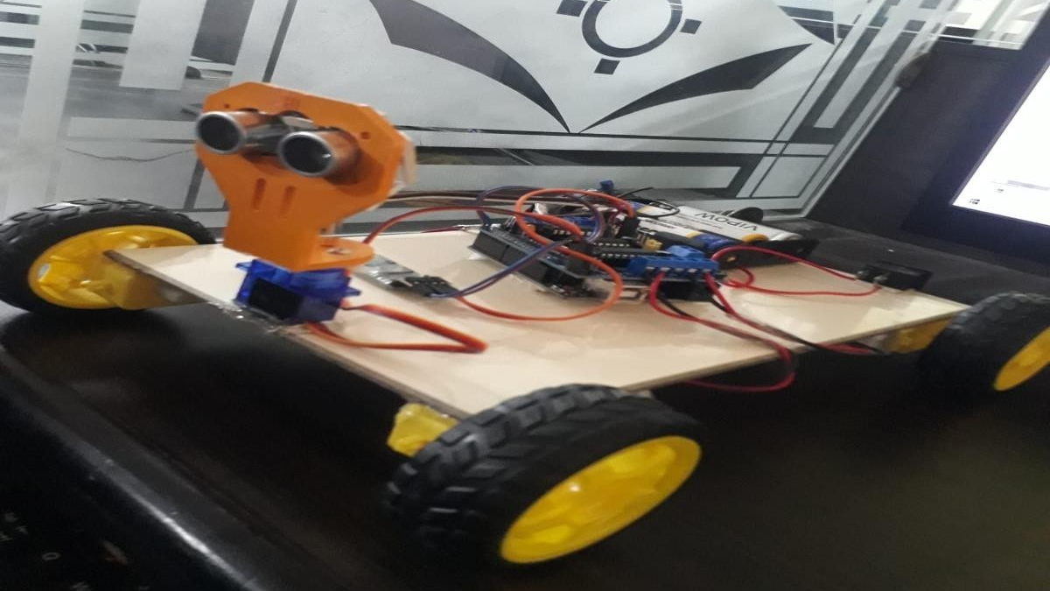
THANK YOU

