Slide 1

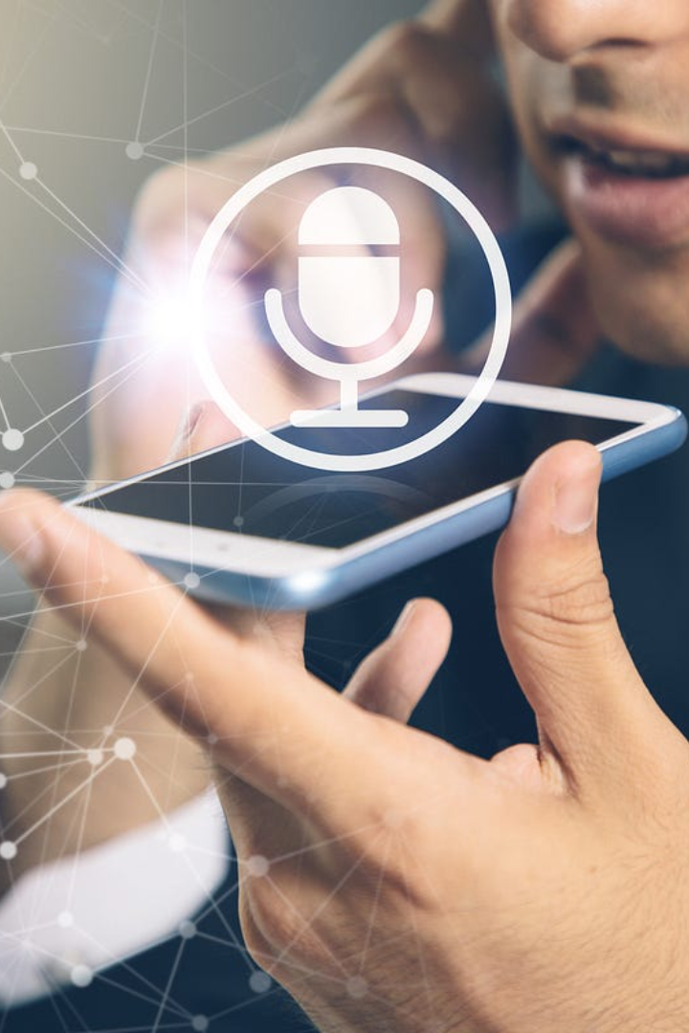

Speech Recognition and Multiple Speech Recognition
Discover the power of speech recognition technology and its applications across various industries. Learn how multiple speech recognition enhances user experience.
by Nithin kumar Biradhar

Slide 2

What is Speech Recognition?
Definition and Explanation
How it Works
Applications
Speech recognition systems utilize algorithms and artificial intelligence to process and analyze audio input, matching it to predefined patterns or models for accurate transcription or command execution.
Discover how speech recognition is transforming industries such as healthcare, customer service, automotive, and more, improving efficiency and user experience.
Speech recognition is a technology that converts spoken words into text or commands, enabling hands-free interaction with devices and applications.

Slide 3
Speech Recognition
1
Data Processing
Spectrogram Computation
Normalization
Character Mapping
DeepSpeech2 Architecture:
2
Convolutional Neural Networks (CNNs):
Conv2D, Batch Normalization, ReLu
Recurrent Neural Networks (RNNs): Bidirectional Gated Recurrent Units (GRUs)
3
Data Collection
We use the LJSpeech Dataset The dataset contains 13,100 audio files.
Word Error Rate(WER) computed using ‘Jiwer’ library

Slide 4
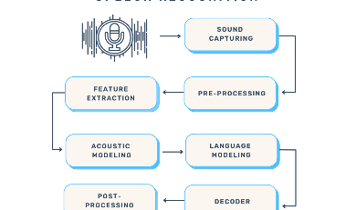
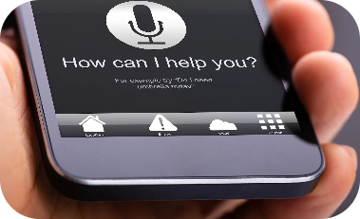

The Power of Multiple Speech Recognition
Enhanced User Experience
Voice Assistants and Smart Devices
Advantages and Challenges
Improve user experience by enabling simultaneous and independent speech recognition from multiple sources, allowing hands-free collaboration and seamless interaction.
Discover how multiple speech recognition revolutionizes voice assistants and smart devices, enabling personalized experiences and efficient control in multi-user environments.
Explore the benefits and considerations of implementing multiple speech recognition in applications like conference calls and team meetings for improved communication.

Slide 5

Multiple Person Speech Recognition
1
Architecture
2
Data Preprocessing:
Whisper ASR: Used for automatic speech recognition.
SpeechBrain Pretrained Model: Utilized for extracting speaker embeddings.
Agglomerative Clustering: Applied to cluster speaker embeddings and perform speaker diarization.
PyAnnote: Used for handling audio segments, speaker diarization, and writing the transcript.
ASR Transcription
Audio Segments
Speaker Diarization
Text formatting

Slide 6

Conclusion
Speech recognition technology revolutionizes human-computer interaction, offering hands-free and convenient experiences across industries. The future holds exciting possibilities for further advancements.

Slide 7
THANK YOU

