Slide 1
project2 IPL DATA ANALYSIS
Using NUMPY, MATPLOTLIB LIBRARIES

Slide 2
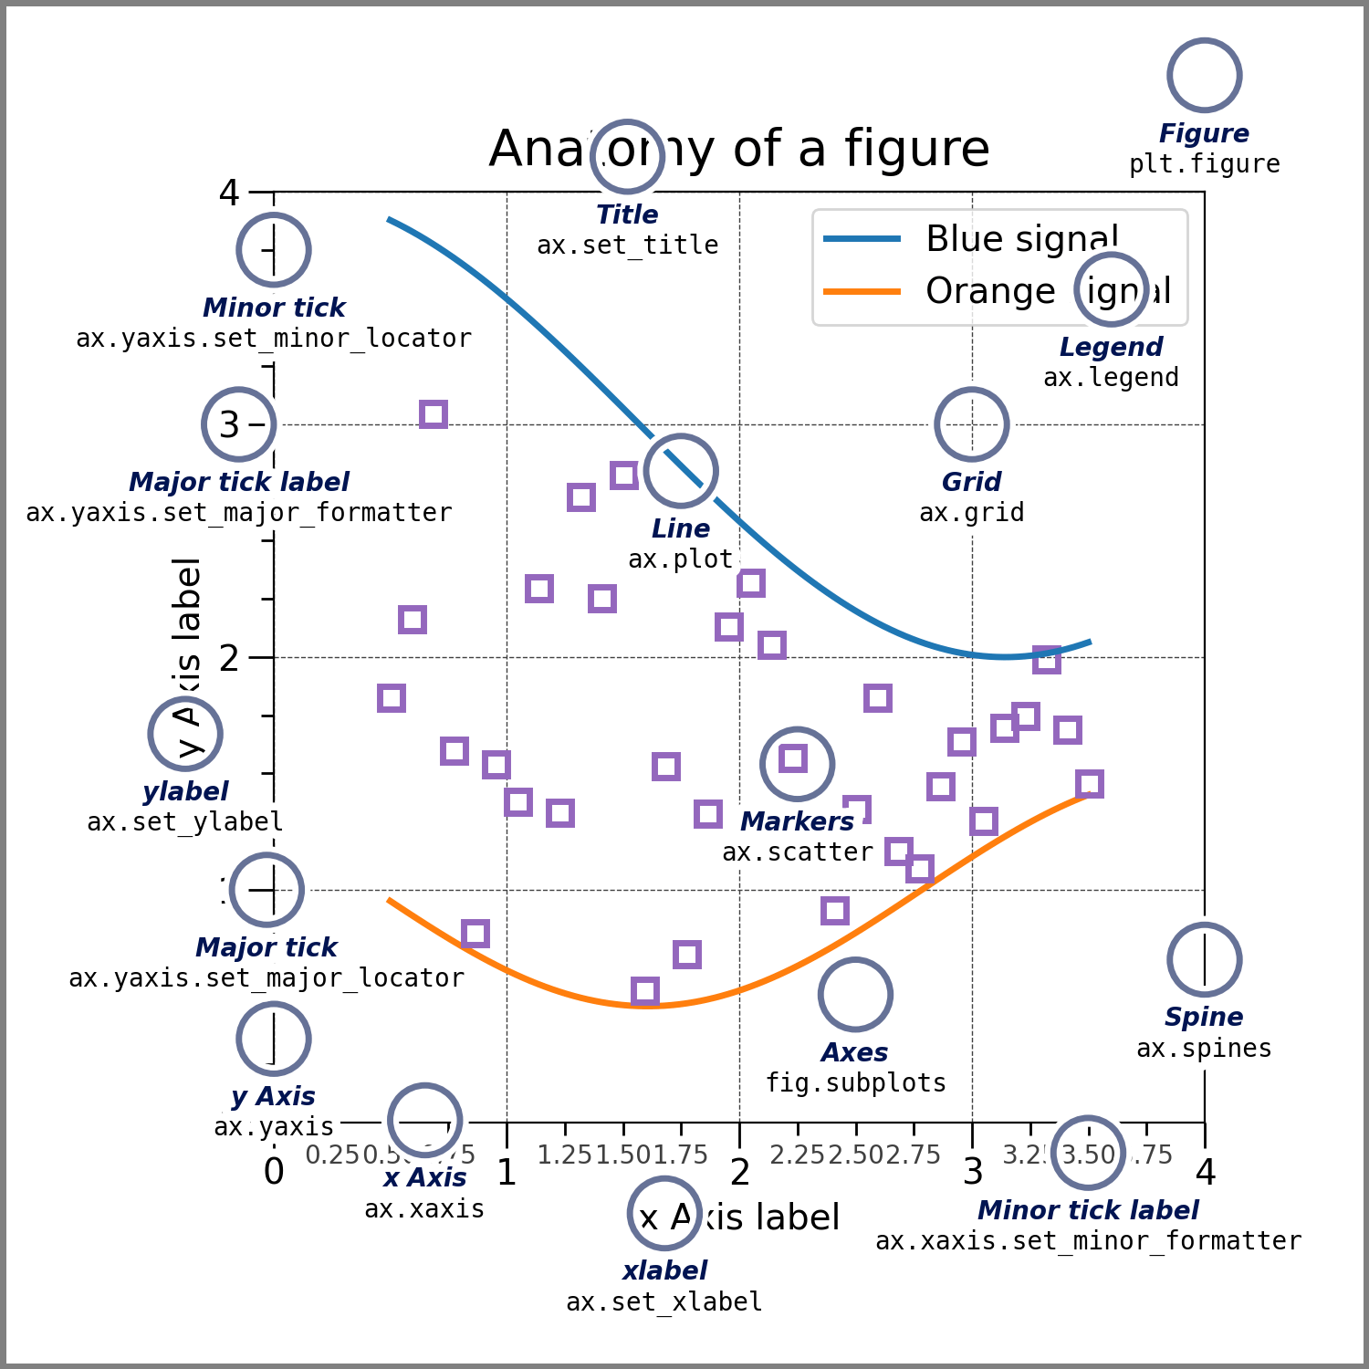
introduction
Matplotlib: Visualization with Python
Matplotlib is a comprehensive library for creating static, animated, and interactive visualizations in Python. Matplotlib makes easy things easy and hard things possible.
Create publication quality plots.
Make interactive figures that can zoom, pan, update.
Customize visual style and layout.
Export to many file formats.
Embed in JupyterLab and Graphical User Interfaces.
Use a rich array of third-party packages built on Matplotlib.
Try Matplotlib (on Binder)

Slide 3

Dataset & libraries
Form Seasons and Players lists, create Season dictionary & Player dictionary.
Create Salary, Games, Points matrices to store three dimensional data (salary, season,player)
Libraries: numpy, matplotlib, warnings.

Slide 4
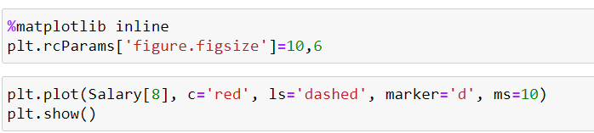
Method
To access a player’s salary we use Salary[8] as Pdict[‘kohli’] =8 , in this way we get salary of kohli in all seasons.
We have to plot this data in a graphical way to understand player’s performances and insights in data analysis for audience.
In Data visualization, the most important matter of concern is to reach the end user, make him/her understand the trends, predictions regarding games & players performances.
There are many attributes to plot function, like color, linestyle, label, marker, markersize, etc
With RcParams, size of the plotting graph can be modified.

Slide 5
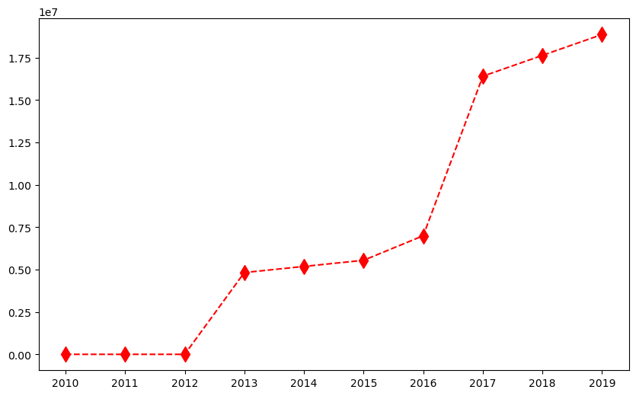
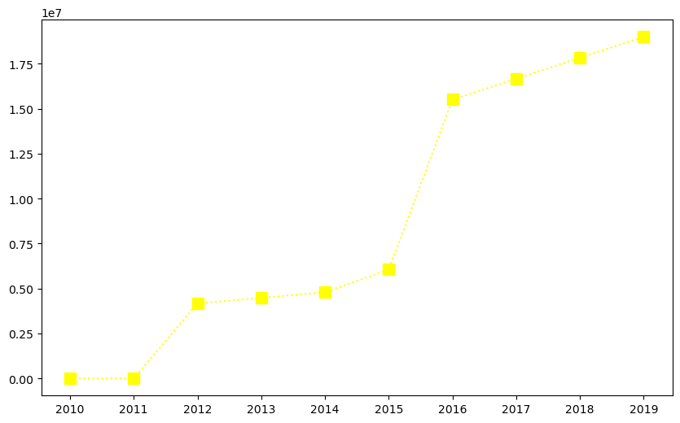
Plot Comparison
Players[8] : kohli
Players[7] : Dhoni

Slide 6
Insights of comparison
Players[8]
Kohli’s salary has not grown fast as he has many lean patches through seasons.
But in recent seasons, he is vastly experienced and consistent and gets high salary
There is a jump in kohli’s salary from 2016-2017, bcoz of his success in that season as he is highest run-getter of 2016.
Players[7]
Dhoni’s salary growth has been very similar to kohli.
There is a jump in his salary from 2015 -2016, bcoz of his success as captain contributed to surge.

Slide 7
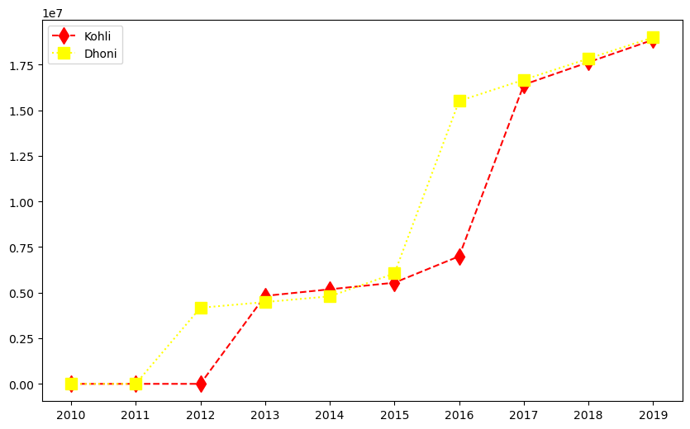

Slide 8
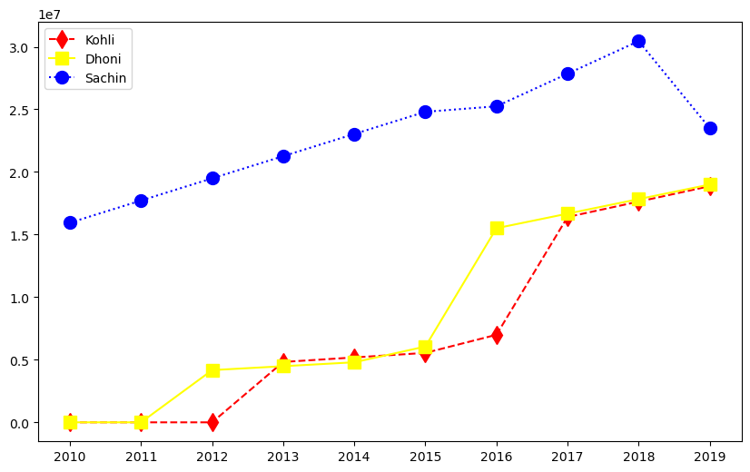

Slide 9
Analysis
Sachin being an experienced player, is more consistent across all seasons as shown in above graph comparison
His performance decreased in after 2018, as a result salary also decreased.
visualization of kohli, dhoni, sachin's salaries earned across seasons
performances of kohli, dhoni got increased; on the other hand sachin's salary decreased.
but sachin is more consistent across seasons than kohli, dhoni.

Slide 10
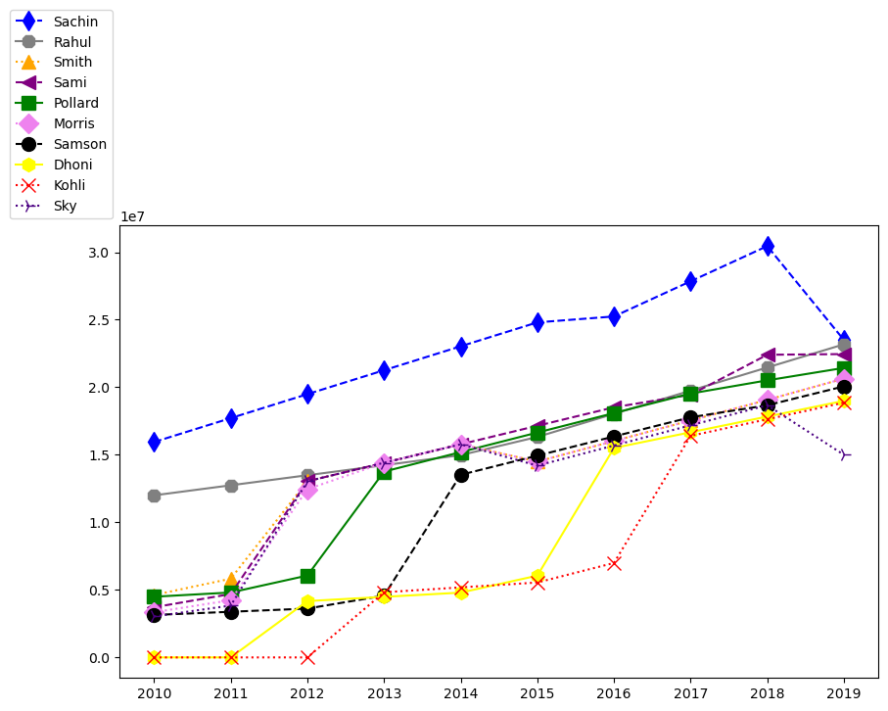
Salaries of all players across seasons
This plot shows all players in all seasons earnings
Out of all all players sachin more consistent and samson is inconsistent
Kohli’s lean patch during 2013 to 2016 shows his under performance
Dhoni’s surge in salary from 2015 bcoz his success as a captain and brand value he brings to his ipl team.

Slide 11
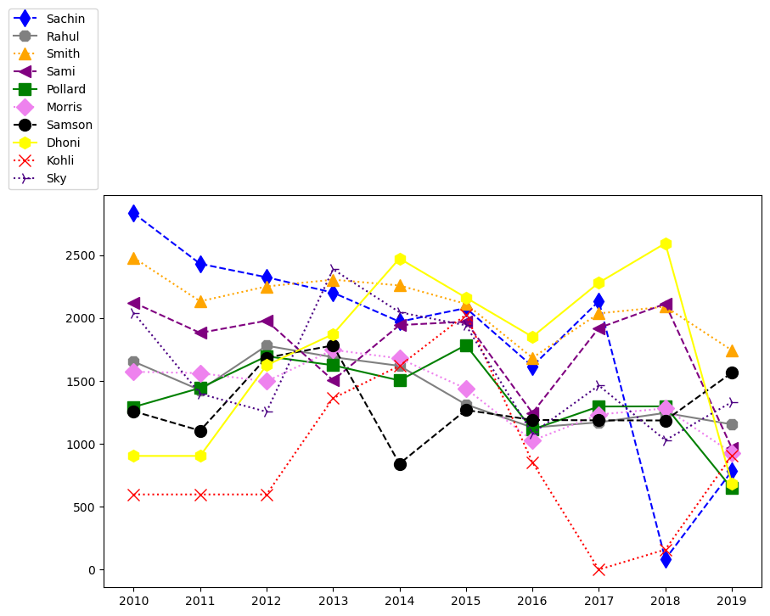
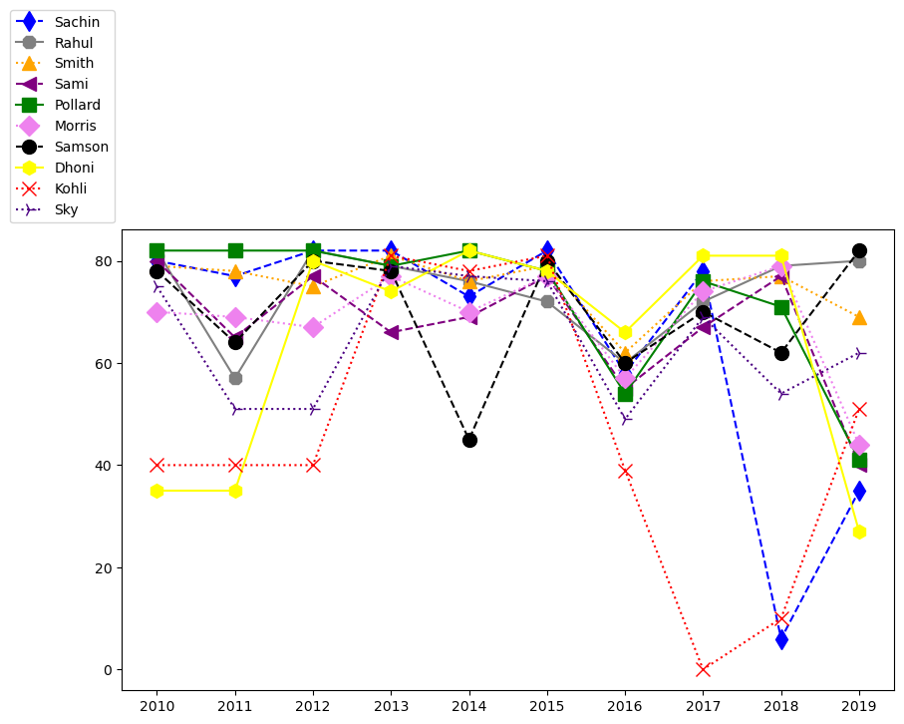
Parameter comparison
Points scored by all players across seasons
Games Played across seasons by players

Slide 12
summary
My final presentation of the project is we can draw analysis from players salaries to relate to their consistency and performance.
Games played shows their fitness , Points scored implies their match winning ability
AUTHOR : R. NITHIN KUMAR
nithinraineni466@gmail.com
https://github.com/Nithinkumar55

Slide 13
THANK YOU

