Slide 1
NUMPY
R. NITHIN KUMAR

Slide 2


Agenda
A
Introduction
NumPy Creating Arrays
NumPy Random
Case Studies
NumPy Functionalities
Areas of focus
Summary

Slide 3
Introduction
In Python, we use lists in place of arrays, but they are slow to process. NumPy aims to an array object that is upto 50x faster than traditional python lists. NumPy provides an array object called ndarray, which provides a lot of supporting tools, which makes working with ndarray easy.
Arrays are used in data science, where speed and resources are very important.

Slide 4
NumPy Creating Arrays
Create a Numpy ndarray object

Slide 5
NumPy Arrays
import numpy as np
Or
from numpy import *
arr = np.array([1,2,3,4,5])
Print(arr)
type(arr) = numpy.ndarray
NumPy arrays are n dimensional arrays, which are used in data science, Opencv.

Slide 6
The core functionality of NumPy is its "ndarray", for n-dimensional array, data structure. These arrays are strided views on memory.^{[11]} In contrast to Python's built-in list data structure, these arrays are homogeneously typed: all elements of a single array must be of the same type.
Such arrays can also be views into memory buffers allocated by C/C++, Python, and Fortran extensions to the CPython interpreter without the need to copy data around, giving a degree of compatibility with existing numerical libraries. This functionality is exploited by the SciPy package, which wraps a number of such libraries (notably BLAS and LAPACK). NumPy has built-in support for memory-mapped ndarrays.

Slide 7
NumPy Random Random number does NOT mean a different number every time. Random means something that can not be predicted logically. from numpy import random x = random.randint(100) print(x)
“
”

Slide 8
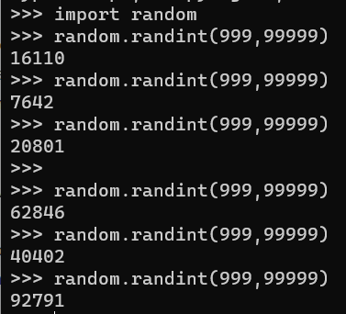
NumPy Random
NumPy offers random module to deal with random values.
Random module is very helpful in python programming language applications.
It used in generating otp in mobile , to generate random numbers between a range for security purposes.

Slide 9

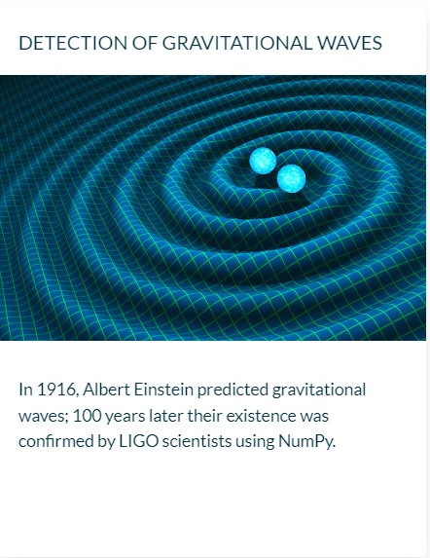

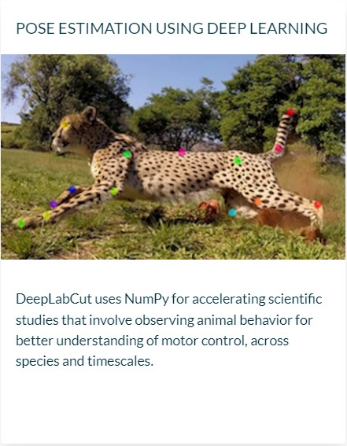
Case Studies

Slide 10
NumPy Functionalities
Any()
Reshape()
Append()
All()
Allclose()
Absolute()
Conjugate()
Delete()
Diag()
Eye()
Insert()
Mean()
Median()
Max()
Min()
Logical_and()
Logical_or()
Matrix()
Item()
Randint()
Reduce()
Sort()
Split()
Unique()
Trim_zeros()
Squeeze()
Seed()
Take()
Transpose()
Zeros()
Zeros_like()
Permutation()
Hsplit()
Histogram()
Floor()

Slide 11
Areas of focus
F
Data Science
Develop strategies, patterns to keep ahead of the competition
Store, use and analyze data for deriving information from it.
Visualize customer directed convergence
Business Analysis
Find trends from historical data
Establish stratergies for new new business models.

Slide 12
Summary
NumPy is python library adding support for large multi dimensional arrays and matrices , along with high level mathematical functions used on arrays. Data science is about to store , run and analyse data from structured and unstructed data like weblog, speech, html, csv etc. To any analyse the multidimensional dat we use numpy. Numpy is the foundation of python applications.

Slide 13
Thank you
Raineni Nithin Kumar
nithinraineni466@gmail.com
https://github.com/Nithinkumar55

