Slide 1
NithinSrivatsan S
Final Project

Slide 2
PROJECT TITLE
DeepSight: Detecting Malaria with Convolutional Neural Networks

Slide 3
AGENDA
The agenda for the Malaria Detection project entails several key stages. Firstly, it involves an introduction to the project, providing context on the global impact of malaria and outlining the specific problem statement. Following this, the methodology section will detail the approach of utilizing Convolutional Neural Networks (CNNs) for automated malaria detection, including preprocessing steps, model architecture, and training procedures. Subsequently, the dataset used for training and testing the CNN model will be presented, highlighting its size, composition, and any preprocessing applied. Evaluation metrics and results will then be discussed, assessing the performance and effectiveness of the CNN-based detection system. Finally, the agenda will conclude with reflections on the project's outcomes, potential implications, and avenues for future research and development.

Slide 4
PROBLEM STATEMENT
Despite significant advancements in medical science, malaria remains a significant global health threat, particularly in regions with limited resources. Conventional diagnostic methods often require skilled personnel and can be time-consuming and expensive. Therefore, there is a critical need for automated, accurate, and cost-effective solutions for malaria detection. My project aims to address this challenge by leveraging Convolutional Neural Networks (CNNs) to develop a robust and efficient system for the automated detection of malaria parasites in blood smear images.

Slide 5
PROJECT OVERVIEW
My project aims to develop an automated malaria detection system using Convolutional Neural Networks (CNNs). With malaria's persistent global health impact and limitations in current diagnostic methods, our objective is to create an accurate and cost-effective solution. By preprocessing blood smear images and training the CNN model on datasets sourced from repositories like the National Institutes of Health (NIH), I seek to improve efficiency and accuracy. Through this endeavor, we hope to contribute to better healthcare outcomes, particularly in resource-limited regions, by providing a scalable and reliable tool for malaria diagnosis

Slide 6
END USERS OF MY PROJECT
Healthcare Professionals
Medical Facilities
Research Institutions
Public Health Organizations
Mobile Health (mHealth) Applications
Common People

Slide 7
MY SOLUTION AND ITS VALUE PROPOSITION
Developing an automated malaria detection system using Convolutional Neural Networks (CNNs)
Value Proposition:
Accuracy: Offers a highly accurate detection method, reducing the risk of misdiagnosis and ensuring timely treatment for patients.
Efficiency: Streamlines the diagnostic process, saving time for healthcare professionals and enabling quicker decision-making in patient care.
Cost-effectiveness: Provides a cost-effective alternative to traditional diagnostic methods, particularly beneficial for healthcare facilities in resource-limited regions.
Scalability: Can be easily scaled and deployed in various healthcare settings, from small clinics to large hospitals, improving access to reliable malaria diagnosis.
Public Health Impact: Contributes to malaria surveillance efforts, aiding in disease monitoring, control, and prevention initiatives, ultimately reducing the burden of malaria on affected communities

Slide 8
THE WOW IN MY SOLUTION
Immediate Results: Providing instantaneous detection of malaria parasites in blood smear images, offering healthcare professionals swift diagnostic insights.
Enhanced Accessibility: Empowering remote healthcare facilities with state-of-the-art technology, bridging healthcare access gaps and elevating patient outcomes worldwide.
Life-saving Impact: Ensuring prompt and precise diagnosis leads to timely treatment, potentially saving numerous lives and alleviating the global burden of malaria-related morbidity and mortality.
Innovative Approach: Leveraging advanced AI technology signifies a pioneering advancement in combating malaria, establishing new benchmarks for diagnostic efficiency and efficacy.

Slide 9
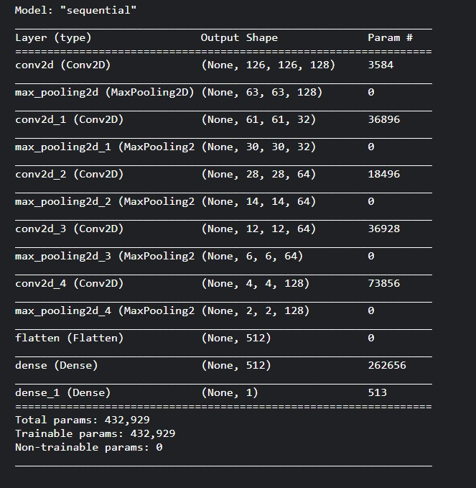
MODELLING

Slide 10
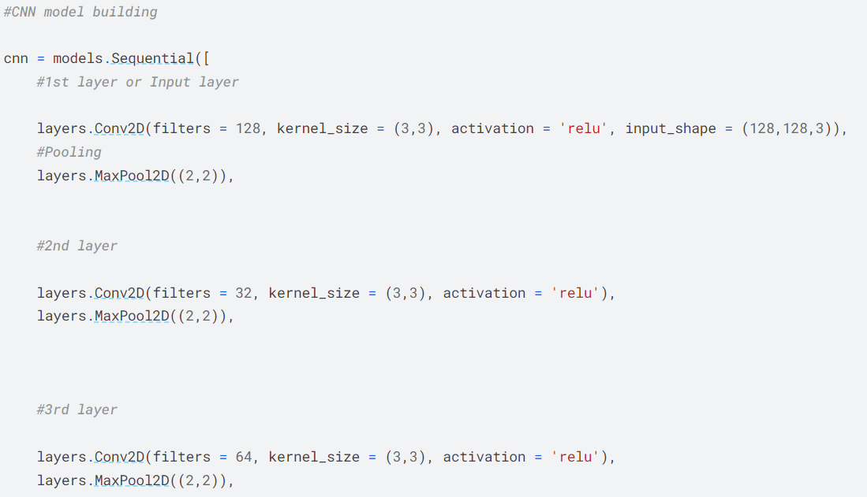
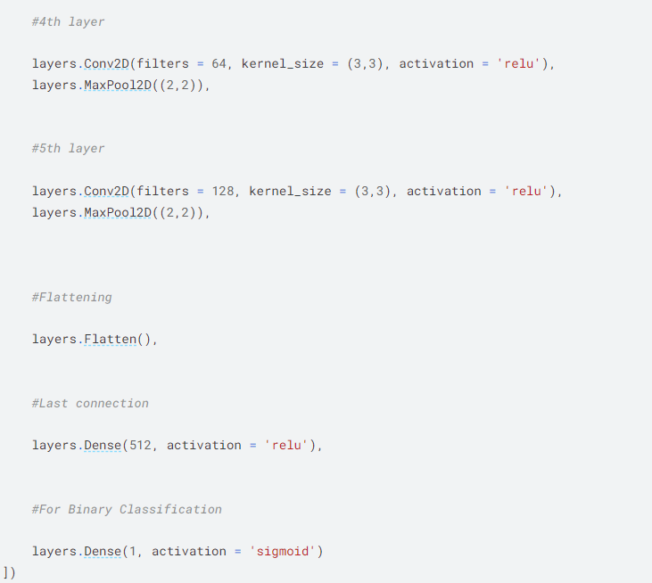
MODELLING

Slide 11
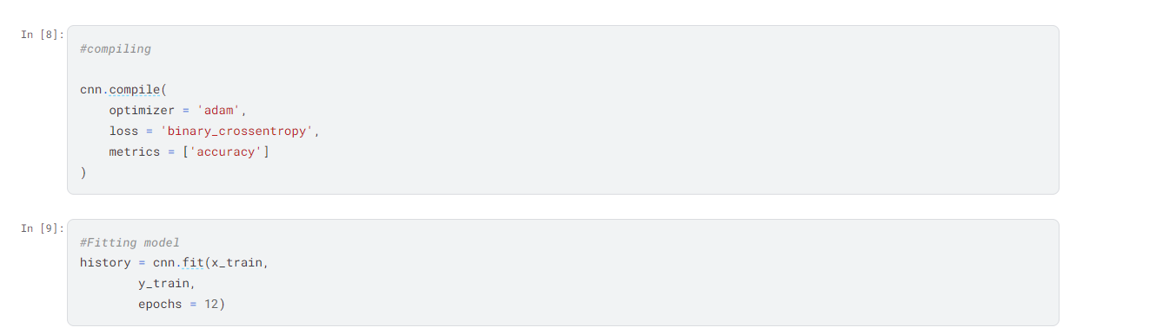
MODELLING

Slide 12
RESULT
The result of the Malaria Detection project would be a fully functional automated system capable of accurately identifying malaria parasites in blood smear images. This system would have undergone rigorous testing and validation to ensure its reliability and effectiveness in real-world scenarios. Additionally, the project would likely yield insights into the performance of Convolutional Neural Networks (CNNs) for malaria detection and provide valuable data for further research and development in the field of medical image analysis. Ultimately, the tangible result of the project would be a tool that can significantly improve malaria diagnosis, leading to earlier treatment and better patient outcomes
Project LINK :
https://github.com/Nithinsrini2003/Malaria_detection--Nithin-MIT-2021506058-

Slide 13
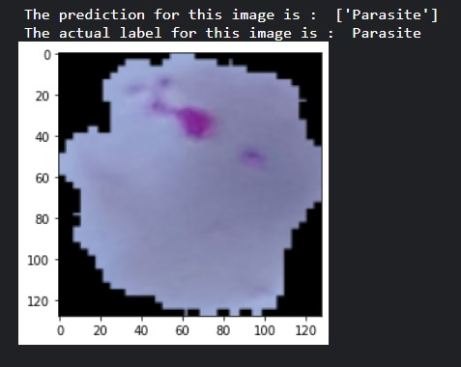
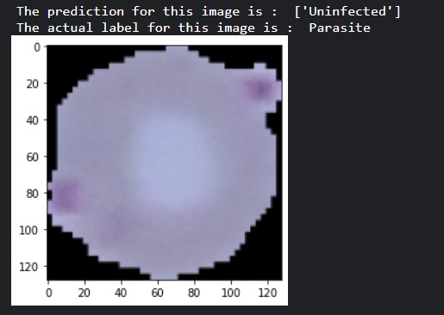
Output Images
Image showing the correct detection of disease
Image showing the incorrect detection of disease

